Slide 1
Grace Bible Church Glorifying God by Making Disciples of Jesus Christ

Slide 2
A reminder to consider others Please:
Turn off your cell phone or set to vibrate only
Turn off sound to all electronic devices
Use the nursery or cry room if your child is fussy
Get up during the preaching only if absolutely necessary (please sit in back if you must leave early)
Notes:
2

Slide 3
How to Make Disciples: Baptism Selected Scriptures
The Great Commission can be fulfilled because Jesus has all authority - He is able to enable the available
Command to make disciples fulfilled by:
1) Going into all the world.
2) Baptizing those who believe.
3) Teaching them to obey Jesus

Slide 4
How to Make Disciples: Baptism Selected Scriptures
Evangelism is going into all the world to faithfully proclaim the good news of Jesus Christ to sinners
Be bold in your witness of Christ, yet sensitive to speak the truth in love

Slide 5
How to Make Disciples: Baptism Selected Scriptures
Jesus caught people’s interest and invited them to learn more - we are to do the same
Do not fall into the trap of skewing the gospel (marketing it) in order to get people to respond positively

Slide 6
How to Make Disciples: Baptism Selected Scriptures
Evangelism is the faithful explanation and application of the gospel message of Jesus Christ to sinful men in order that through the power of the Holy Spirit they may come to put their trust in God through Him, to accept Him as their savior, and serve Him as their King in the fellowship of His Church." J. I. Packer

Slide 7
How to Make Disciples: Baptism Selected Scriptures
There will be varied responses to the gospel - the Parable of the Sower, Matthew 13:3-23
After hearing the gospel, some reject Christ immediately - snatched away by the devil

Slide 8
How to Make Disciples: Baptism Selected Scriptures
Some initially respond, then turn away when they are rejected or persecution arises. They want an easy life.
Some initially respond, then eventually give up because they are more concerned about worldly things

Slide 9
How to Make Disciples: Baptism Selected Scriptures
Some respond and becoming spiritually alive and true disciples of Jesus who bear fruit

Slide 10
Baptizing Them Matthew 28:19
Name is singular, for it is one God existing in three distinct persons: Father, Son, Holy Spirit - the Trinity
God’s attributes are beyond human full comprehension - eternal, omniscient, omnipotent, immutable, etc.

Slide 11
Baptizing Them Matthew 28:19
God presents Himself as triune - a god you can comprehend is not God
God is not like us and the trinitarian formula for baptism points this out

Slide 12
Baptismal Precedents
Christian baptism is an adaptation of Jewish practices tracing back to Levitical ceremonial washings

Slide 13
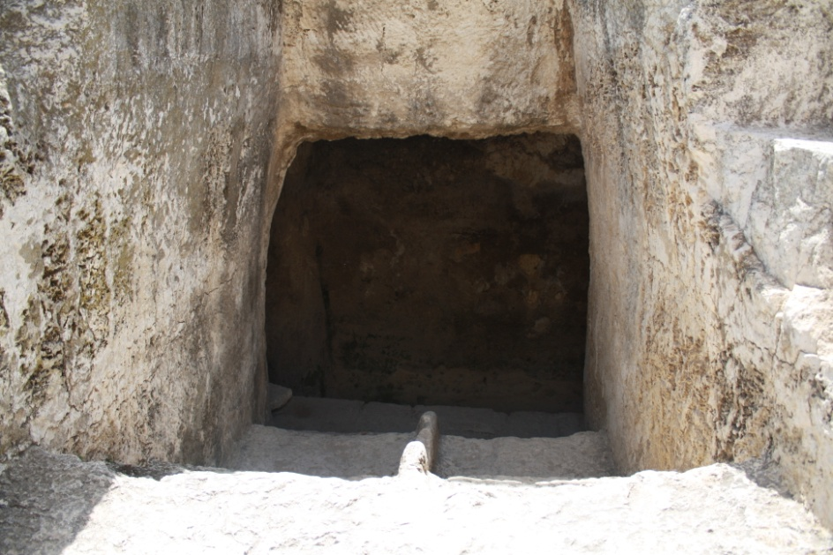
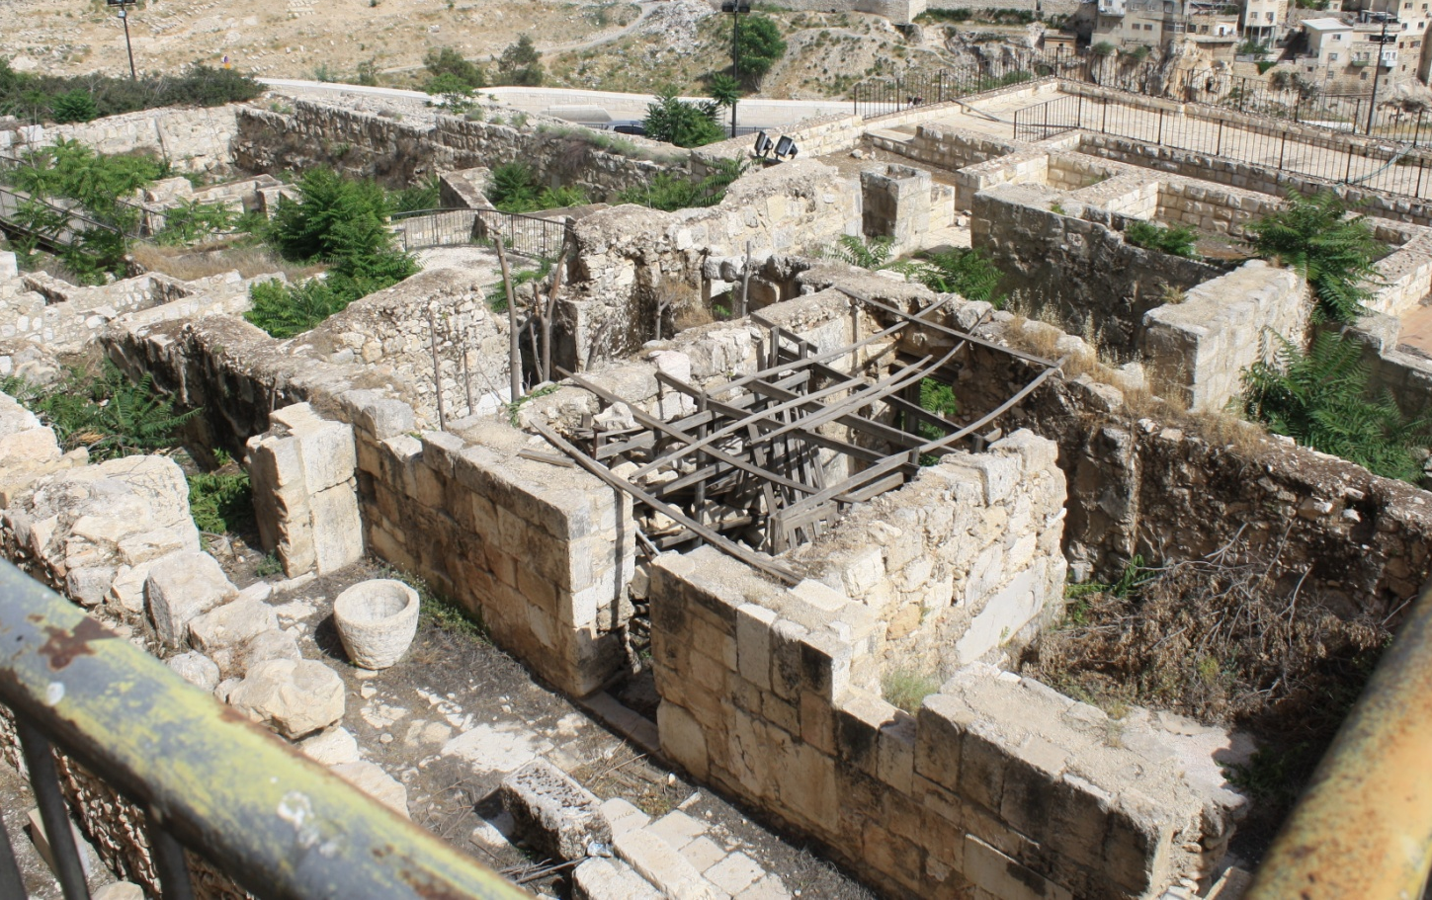
Baptismal Precedents
Ritual baths - mikvehs at Temple Mount entrance

Slide 14
Baptismal Precedents
John’s baptism symbolized cleansing from sin by repentance and confession - 1 John 1:9
Christian baptism has an element of repentance for that was the message - Luke 24:46-48; Acts 2:28

Slide 15
Baptismal Precedents
Titus 3:5-7 - baptism symbolizes the washing of regeneration and renewing by the Holy Spirit

Slide 16
Christian Baptism Acts 19:2-5
John’s baptism was in preparation for the Messiah while Christian baptism looks back at Messiah’s work

Slide 17
Identification with Christ Romans 6:1-11
In Baptism, you identify with Jesus’ death, burial & resurrection - die to sin and raised to new life in Christ
Baptism was only by immersion (the meaning of baptivzw / baptizo) until the middle ages

Slide 18
Identification with Christ Romans 6:1-11
“In immersion the setting forth of the burial of Christ is more plainly expressed, in which this manner of baptizing is more commendable.” Thomas Aquinas (1225-1274)

Slide 19
Identification with Christ Romans 6:1-11
“Christian baptism is like a soldier who puts on his uniform, not to become a soldier, but because he is a soldier and wants to publicly identify himself as a soldier. In Christian Baptism the believer publicly identifies himself with Christ and His people.” Professor Henry Holomon

Slide 20
Timing of Baptism
Matthew 28:19 “baptizing” occurs after “make disciples of all the nations”
In Acts, people are baptized after expressing repentance or faith or receiving the Holy Spirit
Water baptism is a reflection of spiritual baptism (1 Cor. 12:13) since cloth is dyed by baptizing

Slide 21
Believer’s Baptism
A person who is baptized before salvation becomes just a wet sinner
Baptism is not an equivalent of circumcision - it neither saves, removes original sin nor is a covenant sign

Slide 22
Believer’s Baptism
Infants should not be baptized, but even a very young child can turn from sin to believe in Jesus - Mt. 18:6
Genuine belief in Christ must precede Christian baptism if it is to be scriptural and meaningful

Slide 23
Counting the Costs
Shortly after Pentecost, Jewish religious leaders began persecuting Christians - Acts 4,5,6,7,8
Baptism can result in similar physical persecution and martyrdom in many parts of the world today

Slide 24
Counting the Costs
Persecution in the United States is rarely as severe, but rejection and its consequences are common
Even “Christian” families that practice baptism can react strongly against a believer’s baptism

Slide 25
Motivations
Those who love Jesus & want to obey as His disciple will step out in faith to identify with Him by baptism
Do not get baptized to get saved or stay saved for baptism can do neither
Do not get baptized to imitate or please others, gain a position or social standing - those are fraudulent

Slide 26
Baptism is NOT required for Salvation
Acts 2:38 – can / should be translated as repent, be baptized “because of / on the occasion of forgiveness of sins.”
Forgiveness of sin is linked with repentance independent of baptism
It is baptism of the Holy Spirit that places you in the body of Christ & seals you (1 Cor. 12:13; Eph. 1:13)

Slide 27
Baptism is NOT required for Salvation
Baptism is not mentioned in many of gospel presentations in epistles or at all in 1 John
Paul could not say “Christ did not send me to baptize” if it was a condition of salvation (1 Cor. 1:17)
Those who heard Peter’s sermon would connect it to the Baptism of John

Slide 28
Motivations
Genuine professions of faith will result in being baptized because the repentant believer wants to obey Jesus
A profession of faith with a refusal to be baptized calls into serious question the nature of the belief

Slide 29
Grace Bible Church Glorifying God by Making Disciples of Jesus Christ

