Slide 1
Grace Bible Church
Glorifying God by Making Disciples of Jesus Christ

Slide 2
A reminder to consider others Please:
Silence your cell phone & all electronic devices
Use the nursery or cry room if your child is fussy
Get up during the preaching only if absolutely necessary (please sit in back if you must leave early)
Refrain from eating & drinking during worship service (except medical needs)
Notes:
2

Slide 3
Third view of the New Jerusalem & An Imminent Return
Revelation 22:1-7, 12, 20
Its good to be home
It was a good conference
It was good to see family & friends
The CCF Conference went well – pray for our young adults

Slide 4
Third view of the New Jerusalem & An Imminent Return
Revelation 22:1-7, 12, 20
Thank you to Ed & Sam
We will examine John’s third view of the new Jerusalem and Jesus’ statements about His imminent return

Slide 5
First View of the New Heaven, Earth
& Jerusalem
Revelation 21:1-8
Revelation 20 briefly covers the Millennium & the judgment at the Great White Throne that follows it
Rev. 21:1-2
This is not the Millennium. It is a new heaven, a new earth & a new Jerusalem

Slide 6
First View of the New Heaven, Earth
& Jerusalem
Revelation 21:1-8
Rev. 21:3-4 - God dwells with redeemed humanity & comforts them - no more death, mourning, crying, pain
Rev. 21:4-8 - The angel & Christ both attest to these truths. No who is unrighteous will be there

Slide 7
Second View of the New Jerusalem
Revelation 21:9-27
From a new vantage point, John sees the new Jerusalem come down from heaven. It is glorious
Rev. 21:12-20. The wall surrounding the city, its foundation stones and its gates are all described in detail

Slide 8
Second View of the New Jerusalem
Revelation 21:9-27
The city itself is “pure gold, like clear glass” (vs. 18, 21) - which does not fit within current physics
It is huge - a cube between 1,288 & 1,465 miles on each side

Slide 9
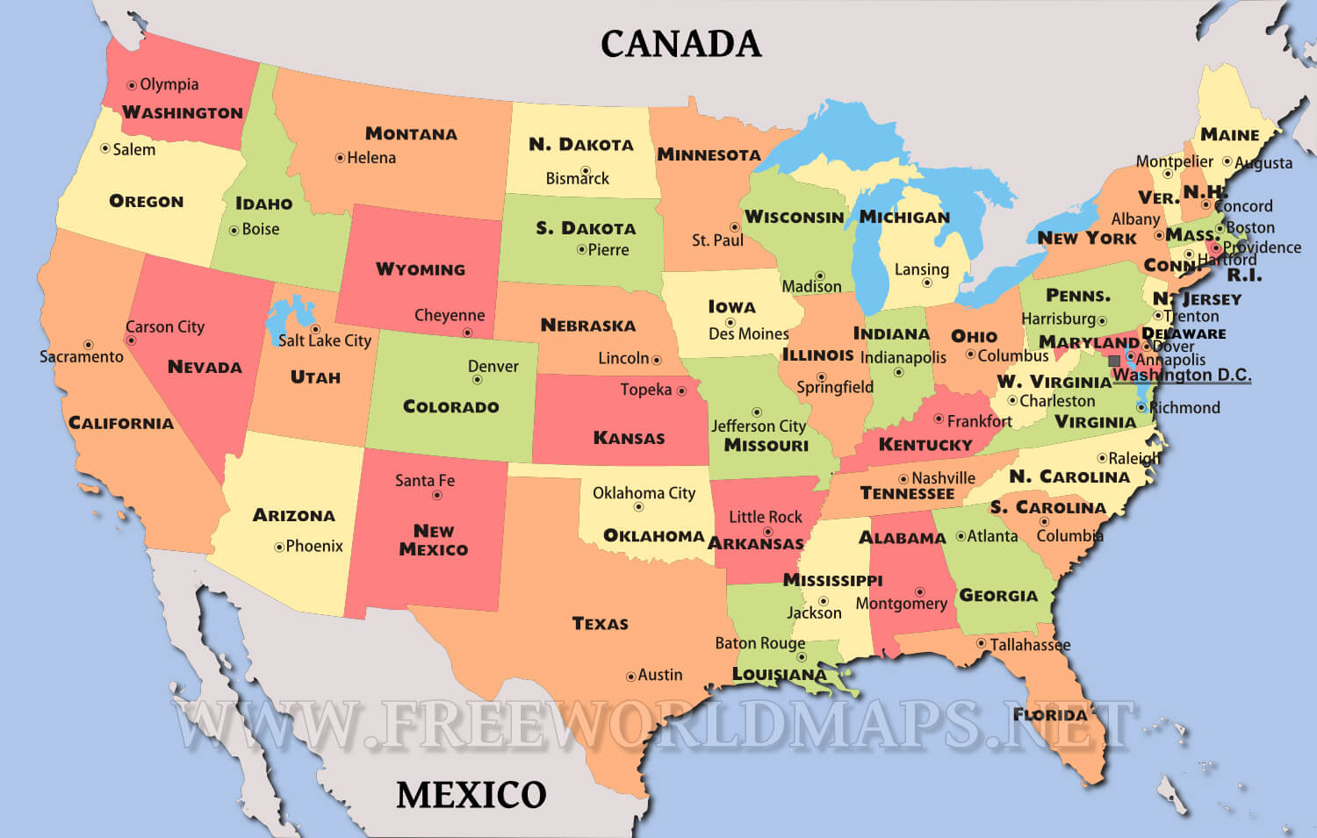
The Physical Description: Its Size
Revelation 21:16

Slide 10
Second View of the New Jerusalem
Revelation 21:9-27
There is no temple because the Lord God, the Almighty & the Lamb dwell in it - their glory illuminates it
It will be fully accessible & safe for only the redeemed will be there
Again, this is not the millennium for the world it will exist in will be destroyed - this is all new

Slide 11
Third View of the New Jerusalem
Revelation 22:1-5
This is a third view of the new Jerusalem shown to John by the same angel that showed him the second view

Slide 12
The River of the Water of Life
Revelation 22:1-2
In a dry climate, water is extremely important & valuable
Water stored in cisterns becomes stale - rivers, springs & deep wells are “living water”
Water and its source are often used as analogies to spiritual truth (John 4; Jeremiah 2)

Slide 13
The River of the Water of Life
Revelation 22:1-2
Those in the 7 churches in Asia would have delighted in the river’s description & recognized it significance
It is a river, not a cistern, so it is flowing water, not stagnant. It is “bright as crystal,” so it is pure & clean

Slide 14
The River of the Water of Life
Revelation 22:1-2
Its origin from the throne of God points to a continual, eternal flow
Flowing down the middle of the street gives easy access to all
Life in the new Jerusalem will be abundant, refreshing, clean, continual and available

Slide 15
The River of the Water of Life
Revelation 22:1-2
The Father & the Son (the Lamb) sit on the same throne, for they are two persons, but one entity
This is not the river of the millennium described in Zechariah 14 or Ezekiel 47

Slide 16
The Tree of Life
Revelation 22:2
It encompasses both sides of the river, but the exact description is unclear
The emphasis is on the relationship between the tree & the river and its size being adequate for its purpose
This is not the tree of life that was in the garden of Eden for that tree was destroyed

Slide 17
The Tree of Life
Revelation 22:2
Adam’s sin excluded him from the tree of life - all in the new Jerusalem will have access to the new one
The tree of life will produce 12 fruits, each in its month - but moon phases will no longer determine a month

Slide 18
The Tree of Life
Revelation 22:2
Its leaves are for “healing” - does not indicate disease for there is no curse & humans have glorified bodies
The word for healing here points to “health-giving” - good for promoting general health

Slide 19
No Curse
Revelation 22:3
The curse was the consequence of Adam’s sin which every human inherited
Salvation from sin & its curse comes only by God’s grace through faith in Jesus & His atonement

Slide 20
No Curse
Revelation 22:3
The only humans in the new Jerusalem will be the redeemed who will be glorified & sinless

Slide 21
The Throne of God & the Lamb
Revelation 22:3
Removal of the curse enables man to dwell with God

Slide 22
God’s Slaves
Revelation 22:3, 4, 5
As God’s slaves, we will serve Him in eternity however He desires
Slaves serve their master joyfully without question - servants retrain a pride that hinders perfect obedience

Slide 23
God’s Slaves
Revelation 22:3, 4, 5
We will see God’s face because we will be sinless - even Moses could not do that (Exodus 33:23).
We will be identified as belonging to God by having His name on our foreheads & we will reign with Him

Slide 24
It’s Illumination
Revelation 22:5
The glory of God illumines them and the city

Slide 25
Testimony of the Angel
Revelation 22:6
The same angel declares the whole prophecy to be faithful and true
The origin of the word of the prophecy is from God just as with all other true prophecy

Slide 26
Testimony of the Angel
Revelation 22:6
It is communication from God to the angel to John to the 7 churches to the world - it is all true
Revelation should be interpreted like other prophecies instead of substituting the musings of men

Slide 27
Testimony of Christ’s Return
Revelation 22:7, 12, 20
The angel declared the things declared in Revelation “must soon take place” - a relatively brief interval
Jesus’ multiple declarations of “I am coming quickly” - backs up the doctrine of imminency

Slide 28
Testimony of Christ’s Return
Revelation 22:7, 12, 20
Christians are to eagerly wait for Jesus return - many things could, but nothing must happen before then
John & Paul both expressed expectation Jesus could return in their lifetimes (1 John 2:28; 1 Thess. 4:17)

Slide 29
Testimony of Christ’s Return
Revelation 22:7, 12, 20
Paul and James both declared “the Lord is near” meaning ready to return - Phil. 4:5; James 5:7-9
Christians are to wait for Jesus’ return with eager anticipation - Rom. 8:19, 23; 1 Cor. 1:7; Phil. 3:20

Slide 30
Testimony of Christ’s Return
Revelation 22:7, 12, 20
Christians are to look for Jesus’ return with a sense of longing, an anxious waiting - Titus 2:13; Jude 21
Christians are to anticipate Jesus’ return as if it could be at anytime - 1 Thess. 1:10

Slide 31
Conclusions
The millennium will be wonderful, the new Jerusalem will be better
Be sure that you will be there!

Slide 32
Grace Bible Church
Glorifying God by Making Disciples of Jesus Christ

