Slide 1
Grace Bible Church
Glorifying God by Making Disciples of Jesus Christ

Slide 2
A reminder to consider others Please:
Silence your cell phone & all electronic devices
Use the nursery or cry room if your child is fussy
Get up during the preaching only if absolutely necessary (please sit in back if you must leave early)
Refrain from eating & drinking during worship service (except medical needs)
Notes:
2

Slide 3
The Second View of the New Jerusalem
Revelation 21:9-27
Eternity will be wonderful from what is revealed, but there are many questions about it left unanswered

Slide 4
The New Heaven and New Earth
Revelation 21:1
The old heaven and earth are destroyed and new one created.
The new earth will not have a sea

Slide 5
First View of the New Jerusalem
Revelation 21:2-8
Its origin is in heaven - it is not constructed by man (vs. 2)
God will dwell in it with His people (vs. 3)
God’s comfort will be complete & permanent - no more mourning, crying or pain (vs. 4)

Slide 6
First View of the New Jerusalem
Revelation 21:2-8
There will be no more death (vs. 4)
All things become new (vs. 5)
No one who is wicked will be there (vs. 8). The wicked will be in the eternal lake of fire & brimstone

Slide 7
Second View of the New Jerusalem
Revelation 21:9-27
Origin & General Description: 9-11
Physical Description: 12-24
Access: 25-27

Slide 8
Its Origin & General Description
Revelation 21:9-11
There is some contrasting parallelism with the new Jerusalem and the great harlot Babylon in Rev. 17
The bride metaphor introduced in vs. 2 is identified as “the wife of the Lamb” in vs. 9

Slide 9
Its Origin & General Description
Revelation 21:9-11
The angel takes John to a new vantage point on a great & high mountain
In a repeat of vs. 2, John sees the new Jerusalem coming down out of heaven from God
The general beauty of it is brilliant like crystal clear jasper - probably a diamond or something similar

Slide 10
The Physical Description
Revelation 21:12-23

Slide 11
The Physical Description: Its Size
Revelation 21:16
Immense - 12,000 stadia cubed
~1,288 - 1,465 miles.
Here west to Omaha, Nebraska & south to San Salvador, Caribbean

Slide 12
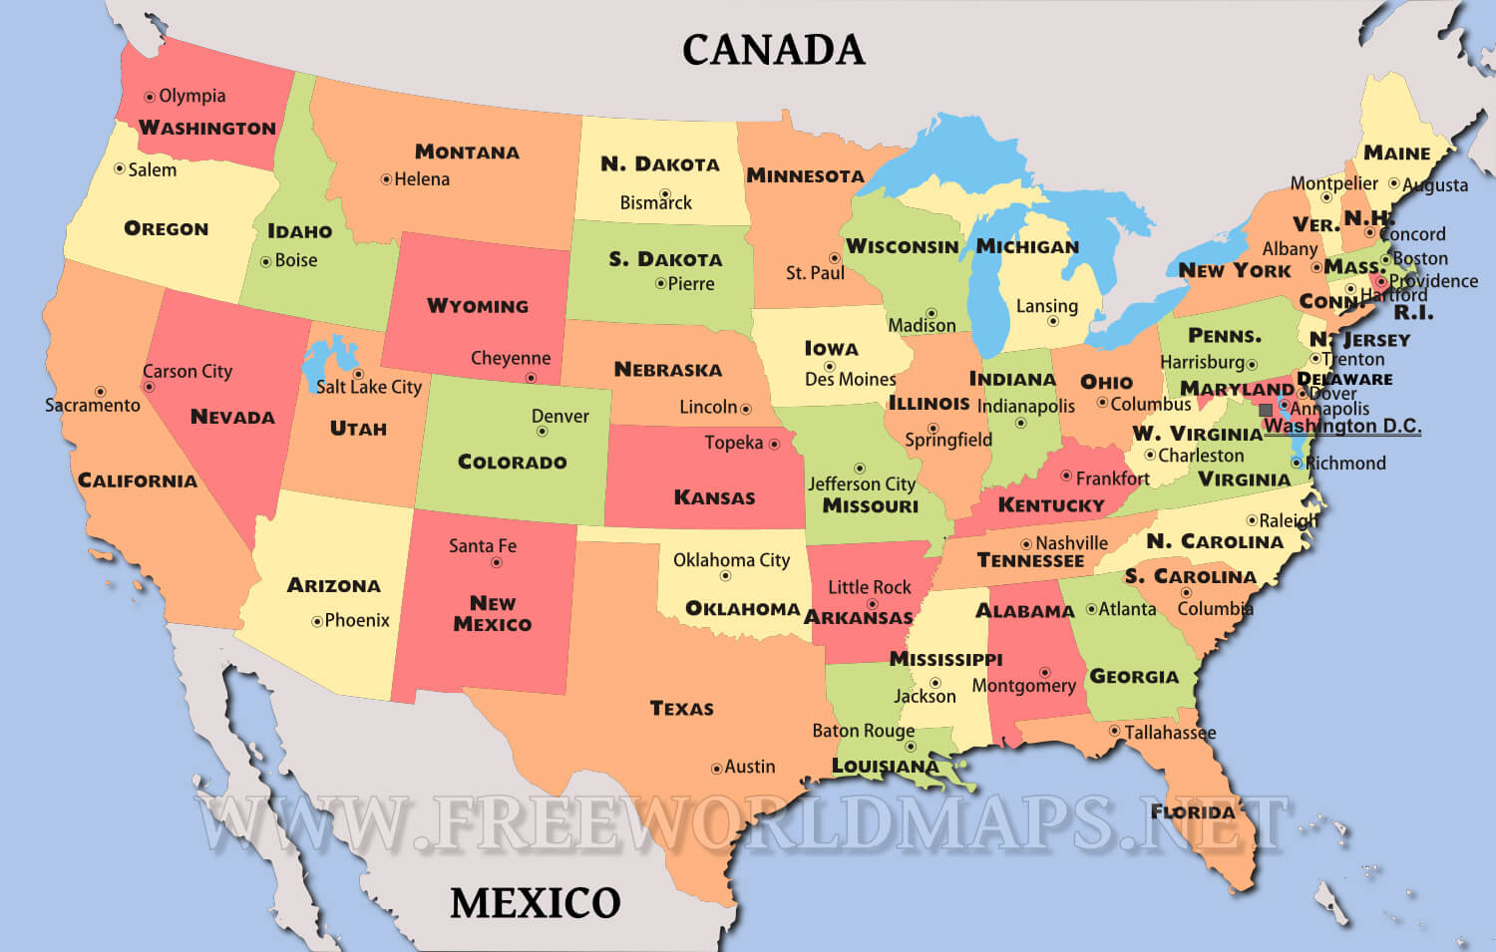
The Physical Description: Its Size
Revelation 21:16

Slide 13
The Physical Description: Its Size
Revelation 21:16
Height reaches to low earth orbit satellites.
Volume of 21.4 - 31.4 million cubic miles

Slide 14
The Physical Description: Its Wall
Revelation 21:12, 17-18
The wall is high & beautiful.
144 cubits (@17.5") ~ 210 feet.
The height of Solomon’s porch was ~175 ft
Walls of ancient cities were to protect. This wall was meant to beautify, for there will be no enemies there

Slide 15
The Physical Description: Its Wall
Revelation 21:12, 17-18
The material of the wall is jasper - diamond?
Perhaps embedded into the wall

Slide 16
The Physical Description: The City
Revelation 21:18
The City and its streets, are “pure gold, like pure glass.”
Gold is transparent at 100 nm or less.
Gold is very malleable and cannot be used as a structural building material even if thick

Slide 17
The Physical Description: The City
Revelation 21:18
John is describing a new world that is very different from what exists today. This is not a renovated earth

Slide 18
The Physical Description: Foundation Stones – Revelation 21:19-20
The foundation stones are beautiful & they extend high enough John can see them, but arrangement is uncertain
The stones could alternate with the gates or be layered - they are meant to beautify, not to be structural

Slide 19
The Physical Description: Foundation Stones – Revelation 21:19-20
If the stones are meant to be symbolic, that is not explained, & all attempts have been unsatisfactory
Each foundation stone has the name of one of the twelve apostles of the Lamb - which signifies the church

Slide 20
The Physical Description: Foundation Stones – Revelation 21:19-20
Each of the 12 gates will have the name of a tribe of Israel on it - the church does not replace Israel
The stones are beautiful.
Jasper is clear & brilliant (diamond?);
Sapphire is blue.
Chalcedon is greenish

Slide 21
The Physical Description: Foundation Stones – Revelation 21:19-20
Emerald is green.
Sardoyx is white with layers of red or brown.
Sardius is red.
Chrysolite is golden yellow
Beryl is green to bluish green.

Slide 22
The Physical Description: Foundation Stones – Revelation 21:19-20
Topaz is yellow-greenish.
Chrysoprase is translucent golden-green
Jacinth is blue-violet.
Amethyst is violet to purple.
The overall appearance will be stunning

Slide 23
The Physical Description: Its Gates
Revelation 21:12-13, 21
Twelve large gates each inscribed with the name of a tribe of Israel
There are three gates on each of the four sides of the city - following the pattern in Ezekiel 48:30-34

Slide 24
The Physical Description: Its Gates
Revelation 21:12-13, 21
The millennial Jerusalem will be tiny (1.25 miles each side) compared to the new one (1,288 - 1,465 miles)
Each large gate is made from one pearl. The largest pearly on record is only 75 lbs, 26.37 inches

Slide 25
The Physical Description: Sanctuary
Revelation 21:22
In the Millennium, the Temple will be a central feature of Jerusalem
There is no sanctuary in the new Jerusalem
  for the Lord God the Almighty & the Lamb are the sanctuary in the new Jerusalem - God dwells among His people

Slide 26
The Physical Description: Source of Light
Revelation 21:23
The source of light for the new Jerusalem & beyond is the Shekinah glory of God
What John describes will be incredibly beautiful with the glory of God radiating out from it

Slide 27
The Physical Description: Source of Light
Revelation 21:23
Light from God’s glory extends beyond the new Jerusalem to illuminate the nations outside it

Slide 28
Physical Description: Those Outside
Revelation 21:24, 26
It is speculation to identify the nations & kings of the earth in vs. 24 for they are not clearly revealed
Could they be the saved who lived through the Millennium that did join Satan and so are transformed?
Could it be a reference to equality of all people regardless of ethnicity or class?

Slide 29
Accessibility
Revelation 21:25-27
The gates do not close because there is no night there
vs. 26 - Those outside the city bring their glory and honor into it
vs. 27 - Nothing defiled and no one practicing abomination and lying can enter it

Slide 30
Accessibility
Revelation 21:25-27
Vs. 27 is a warning to those reading the Apocalypse they need to be an overcomer to enter the new Jerusalem

Slide 31
Conclusions
If you are not a true Christian, you will not see the new Jerusalem unless you get right with God
If you are a true Christian, you will see and dwell with God in the new Jerusalem in eternity

Slide 32
Grace Bible Church
Glorifying God by Making Disciples of Jesus Christ

