Slide 1
Grace Bible Church Glorifying God by Making Disciples of Jesus Christ

Slide 2
A reminder to consider others Please:
Silence your cell phone & all electronic devices
Use the nursery or cry room if your child is fussy
Get up during the preaching only if absolutely necessary (please sit in back if you must leave early)
Refrain from eating & drinking during worship service (except medical needs)
Notes:
2

Slide 3
The Seventh Bowl Plagues; The Judgment of Religious Babylon Revelation 16:17 - 17:18
The 7th bowl of wrath brings the last plagues, and brings the wrath of God to its finish (Rev. 15:1)
Rev. 15 picks back up the sequential narrative from Rev. 11:19 (Rev. 12-14 is parenthetical)

Slide 4
The First Six Bowls of Wrath Revelation 16:1-16
The 7 bowls of wrath are poured out sequentially near the end of the 7 year tribulation period
These plagues occur in a different sequence & are far worse that previous ones & there are new ones

Slide 5
The First Six Bowls of Wrath Revelation 16:1-16
The 7th seal comprises the trumpet judgments, & the 7th trumpet comprises the bowls of wrath

Slide 6
The First Six Bowls of Wrath Revelation 16:1-16
1st Bowl: Horrible, unavoidable, incurable, ulcerative, painful sores on those with the mark of the beast
2nd Bowl: The sea becomes blood & all living things in it die
3rd Bowl: Rivers & streams become Blood - An angel proclaims the righteousness of God’s judgment on

Slide 7
The First Six Bowls of Wrath Revelation 16:1-16
4th Bowl: Sun becomes scorching and scorches the men who then blaspheme God instead of repenting
5th Bowl: The Kingdom of the beast is supernaturally darkened, and the darkness causes severe pain
6th Bowl: The way is prepared and armies of world gather for Armageddon

Slide 8
The 7th Bowl: “It is Done” & Cataclysms Revelation 16:17-21
The plagues that come with the 7th bowl of wrath far exceed anything similar that has occurred previously

Slide 9
The Proclamation Revelation 16:17 - 18a
This bowl is poured out upon the air, and the atmosphere will be the first place effected by it
The first response is a loud voice from the sanctuary, that of God, that proclaims, “It is done”

Slide 10
The Proclamation Revelation 16:17 - 18a
This is anticipatory of this declaration being made again in Rev. 21:6 as a statement of finality
The immediate reaction is a storm theophany - lightning & thunder - as in Rev. 4:5; 8: 4 & 11:19

Slide 11
The Earthquake Revelation 16:18b – 20
Verse 18 is not hyperbole as evidence by the description in verses 19-20 of what this earthquake does
The 6.1 Sylmar quake (2/9/1971) “was nothing” compared to the 6.7 Northridge quake (1/17/1994)

Slide 12
The Earthquake Revelation 16:18b – 20
The 12/16/1811 New Madrid quake is estimated to have been 7.5 - 7.7 - with three severe aftershocks from 7.0 - 7.7

Slide 13
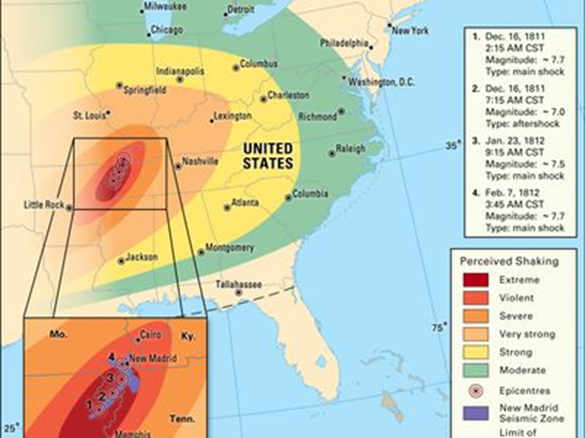
The Earthquake Revelation 16:18b – 20
Damage over area of 232,000 square miles, felt over area of 2 million sq. miles

Slide 14
The Earthquake Revelation 16:18b – 20
George Conclin’s experience:
The New Madrid quake “is nothing” compared to the earthquake described in Revelation 16:19-20

Slide 15
The Earthquake Revelation 16:18b – 20
The “great city,” Jerusalem is split into three sections, and the cities of the nations fall
Verse 20 - the focus is then on Babylon the great which God remembers to give her the wrath of His rage

Slide 16
The Earthquake Revelation 16:18b – 20
The physical mountains shatter (Hab. 3:6) & gravity pulls them down to rubble
Islands, mountains in the sea, collapse and are washed away by tsunamis and waves

Slide 17
The Hailstones Revelation 16:21a
The hailstones that weigh one talent, about 100 pounds
“The hail falls when the thunderstorm's updraft can no longer support the weight of the hailstone” (NOAA National Severe Storms Laboratory)

Slide 18
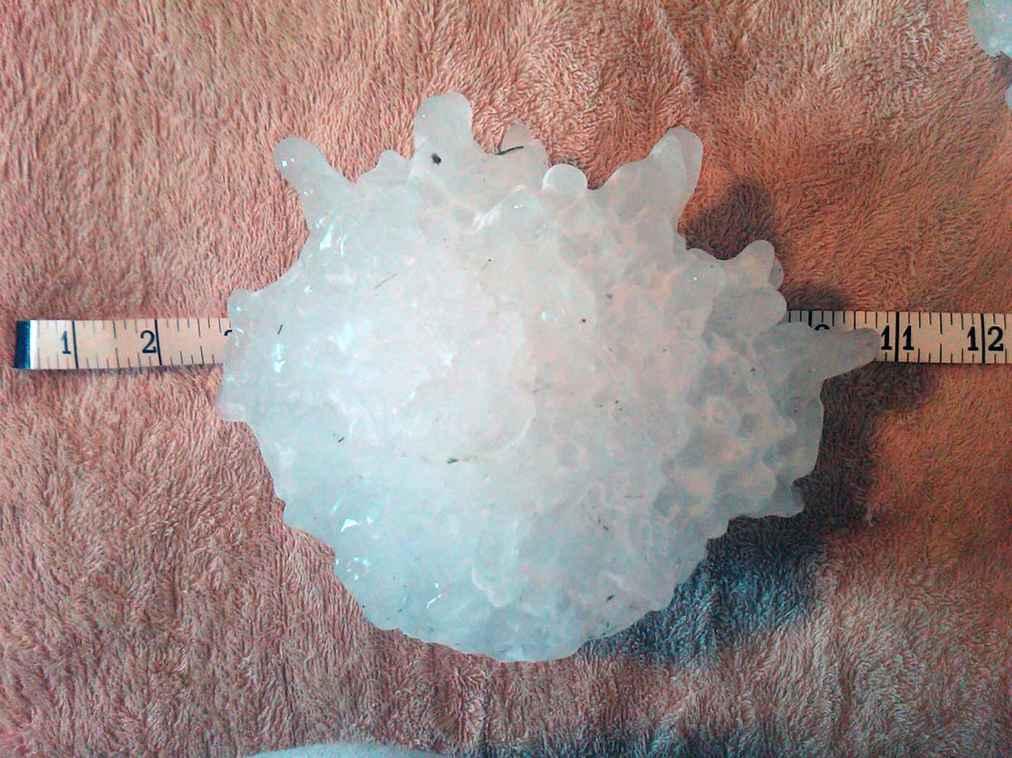
The Hailstones Revelation 16:21a
The largest hailstone in the U.S. was 8" diameter, about the size of a volleyball, and weighed about 2 lbs

Slide 19
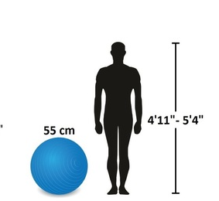
The Hailstones Revelation 16:21a
A 100 lb hailstone would be over 25" - a little bigger than a medium exercise ball

Slide 20
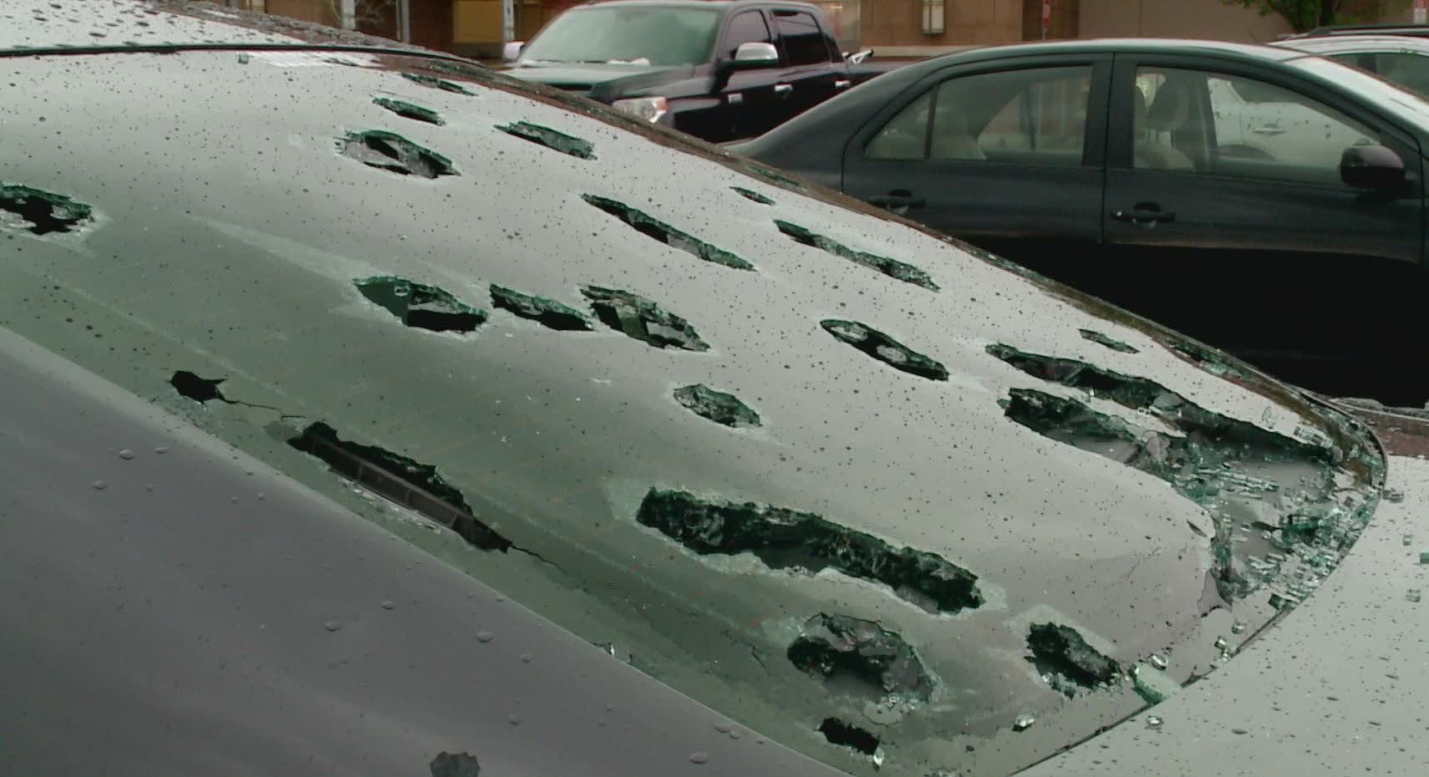
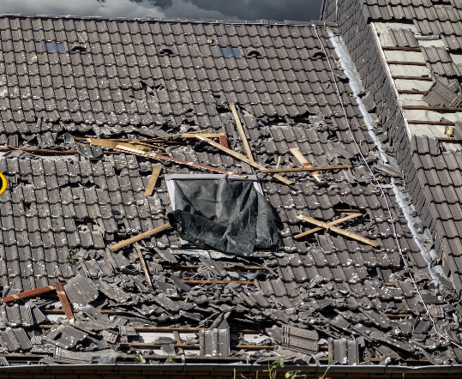
The Hailstones Revelation 16:21a
Baseball size hail punches through windshields.
Grapefruit size hail destroys shingle roofs & can kill people

Slide 21
The Hailstones Revelation 16:21a
100 lb hail? At minimum destroys wooden and light metal structures, severely injure or kill people
Updraft wind speeds in a supercell thunderstorm can reach 160 mph - how fast needed to create 100 lb hail?

Slide 22
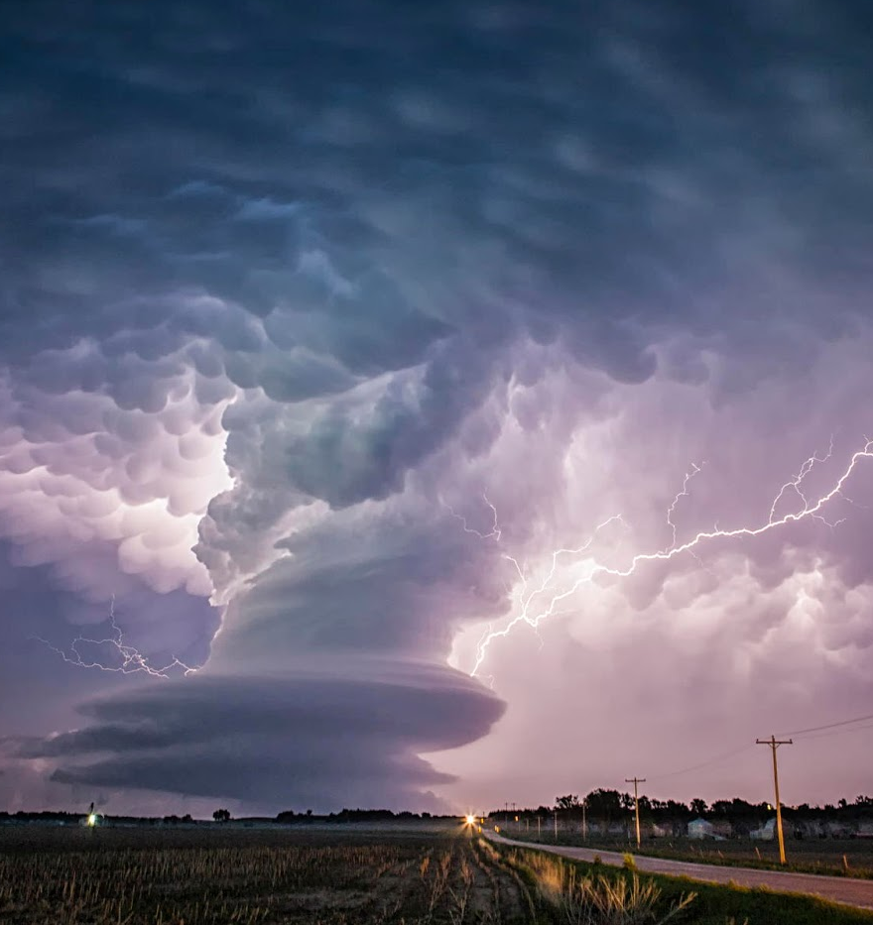
The Hailstones Revelation 16:21a
The strongest supercell thunderstorm cannot create conditions to form 100 lb hail. These are supernatural

Slide 23
The Reaction Revelation 16:21b
Instead of repenting, they blaspheme God because the hail was extremely severe

Slide 24
Revelation 17 – Judgement on Religious Babylon
Rev. 17 & 18 are explanatory interjections
The narrative sequence will pick up again in Rev. 19:11.
Rev. 17 focuses on Babylon as a religious entity. Rev. 18 focuses on Babylon as an economic entity

Slide 25
Revelation 17 – Judgement on Religious Babylon
Rev. 17 & 18 can be very confusing due to its symbolism
Allegorical interpretation just makes that worse
The symbolism used is defined within the text or in other places in the book

Slide 26
Identification of the Actors Revelation 17
The Angel (17:1-2, 3, 7-14; 15-18) is one of the angels that had a bowl of wrath (vs. 1)
The Great Harlot (17:1, 3-6, 18) is the system of false religions which reach their apex in the tribulation

Slide 27
Identification of the Actors Revelation 17
The Waters (17:1,15) on which the great harlot sits “are peoples and crowds and nations and tongues”
The Scarlet Beast (17:3, 8, 11) is the same as in 13:1 - the beast from the Sea, the antichrist

Slide 28
Identification of the Actors Revelation 17
The seven heads of the beast (17:3, 9-10) are 7 mountains & 7 kingdoms - 5 historical 1 present, 1 future
The Ten Horns (17:3, 12-14; 16) are 10 kings allied with the beast & wage war against the Lamb
The Lamb is the Jesus Christ, “Lord of lords and King of kings.”

Slide 29
Summary of Revelation 17
Ancient Babylon generated false religions around the world; An ecumenical form reaches its apex in the tribulation
The great harlot, false religion, is allied with the beast, the antichrist, until he becomes the world dictator

Slide 30
Summary of Revelation 17
The antichrist then destroys the false religion replacing it with worship of himself.
The antichrist and his allies age war against the Lamb, Jesus Christ, and are utterly destroyed

Slide 31
Summary of Revelation 17
We take heart - though tribulation is coming, Jesus wins!
Rejoice Christian!
Switch sides non-Christian!

Slide 32
Grace Bible Church Glorifying God by Making Disciples of Jesus Christ

