Slide 1
Grace Bible Church Glorifying God by Making Disciples of Jesus Christ

Slide 2
A reminder to consider others Please:
Silence your cell phone & all electronic devices
Use the nursery or cry room if your child is fussy
Get up during the preaching only if absolutely necessary (please sit in back if you must leave early)
Refrain from eating & drinking during worship service (except medical needs)
Notes:
2

Slide 3
The Seven Bowls of God’s Wrath Revelation 16:1-21
A general literary pattern in the Apocalypse is summary sequential narrative with parenthetical detail
Rev. 4-6 gives the origin of the seven sealed scroll & the breaking of the first six seals

Slide 4
The Seven Bowls of God’s Wrath Revelation 16:1-21
Rev. 7 is an insertion explaining details of the 144,000 Jewish slaves of God & the innumerable martyrs
Rev. 8-9 is a sequential narrative of the first 6 trumpet judgments followed in 10-11 with explanatory detail

Slide 5
The Seven Bowls of God’s Wrath Revelation 16:1-21
Rev. 11:15-19 is the blowing of the 7th trumpet and description of the scene & proclamations in heaven
Rev. 12-14 is a parenthetical explanation of the background, characters & plot of what will come

Slide 6
The Seven Bowls of God’s Wrath Revelation 16:1-21
Rev. 15 picks up the sequential narrative again describing the origin of the 7 angels & 7 bowls of wrath
Rev. 16 is the sequential narrative of the 7 bowls of wrath & 17-19 give details of events within the narrative

Slide 7
The Seven Bowls of God’s Wrath Revelation 16:1-21
The 7 bowls are the last plagues & bring God’s wrath to its finish. They do not retell earlier plagues
These are still future events and not events fulfilled in history - allegorical interpretation not withstanding

Slide 8
The Command Revelation 16:1
The narrative continues with the command to “Go & pour out on the earth the 7 bowls of the wrath of God.”
The great / loud voice from the sanctuary would be that of God, & there is urgency in the command given

Slide 9
The First Bowl: Malignant Sores Revelation 16:2
The first angel goes & pours out his bowl with the remaining six following in sequence & ready to act
The contents flow to every place on earth people would be & affects only those with the mark of the beast

Slide 10
The First Bowl: Malignant Sores Revelation 16:2
The plague: ulcerative sores that are bad, injurious, painful & unhealing - Luke 16:20-21; Ex. 9; Deut. 28:27
Like the plague on the Egyptians, men cannot prevent or heal them, & only effect worshipers of the beast

Slide 11
The Second Bowl: Sea becomes Blood Revelation 16:3
John’s observation point is heaven - this affects the whole sea and kills all life in it
The water turns to blood like that of a dead man - thick, viscous, decaying

Slide 12
The Third Bowl: Rivers & Streams become Blood - Revelation 16:4-7
Similar to the 2nd bowl in turning water into blood, & 2nd plague on Egypt in affecting fresh water sources
Angel of the waters is similar to other angels having authority over elements (Wind, Fire - Rev. 7:1; 14:18)

Slide 13
The Third Bowl: Rivers & Streams become Blood - Revelation 16:4-7
The angel proclaims the righteousness of God in this judgment which is affirmed by a voice from the altar
God is the Holy One, and righteousness - conformity to God’s law - is a quality that extends from holiness

Slide 14
The Third Bowl: Rivers & Streams become Blood - Revelation 16:4-7
The righteous judgment is based on lex talionis, the punishment is equal to the crime committed
The altar speaks - it not unknown for inanimate objects to speak - Gen. 4:10, Luke 19:40; Isa 55:12

Slide 15
The Fourth Bowl: Sun Becomes Scorching - Revelation 16:8-9
Unlike earlier judgments which darkened the Sun (which would cause cooling), this intensifies Sun’s heat
Being burned with a great burning, their misery made worse by difficulty in getting water

Slide 16
The Fourth Bowl: Sun Becomes Scorching - Revelation 16:8-9
The article is used - the men - indicating the scorching is limited to those with the mark of the beast
The sun is given this ability - it is beyond its natural actions - it comes from God, but men will not repent

Slide 17
The Fourth Bowl: Sun Becomes Scorching - Revelation 16:8-9
Suffering the consequences of sins committed is justice - blaming God only adds greater condemnation

Slide 18
The Fifth Bowl: Beast’s Kingdom Darkened - Revelation 16:10-11
Like the 9th plague on Egypt, this darkness is more than the absence of light, it can be felt - it causes pain
It is poured out on the throne of the beast - his seat of power / location from which he rules. He can’t stop it

Slide 19
The Fifth Bowl: Beast’s Kingdom Darkened - Revelation 16:10-11
It darkens the beast’s kingdom - a limiting factor.
There will be a distinction between those in it or out of it
Unlike those in Rev. 11:13 that responded in giving glory to the God of heaven, there is no repentance here

Slide 20
The Fifth Bowl: Beast’s Kingdom Darkened - Revelation 16:10-11
They blaspheme God because of their pains & sores (both plural). Their suffering increases with each plague

Slide 21
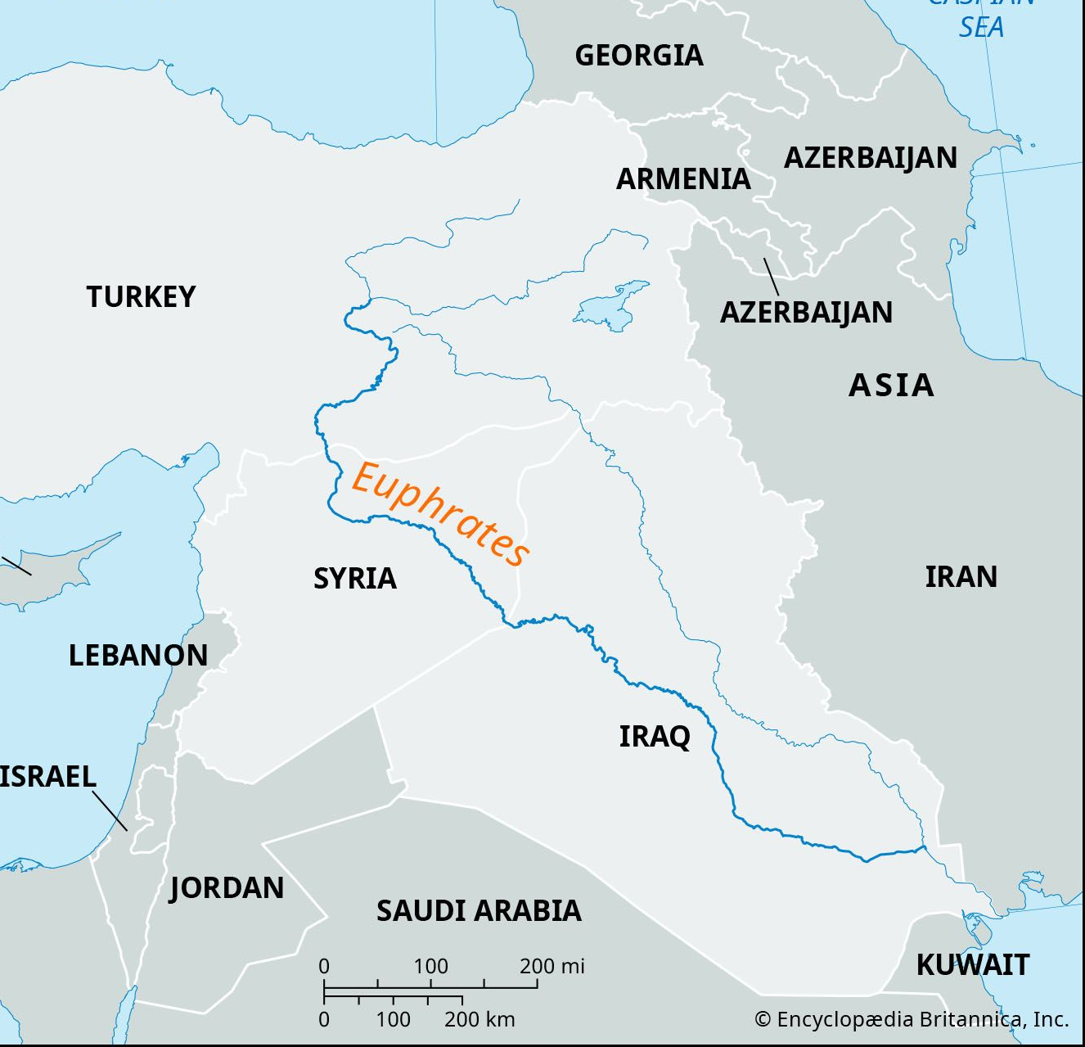
The Sixth Bowl: Preparation for Armageddon - Revelation 16:12-16
The First consequence is the drying up of the Euphrates river, a natural barrier, to make way for kings of east

Slide 22
The Sixth Bowl: Preparation for Armageddon - Revelation 16:12-16
The antichrist will be the dictator of an empire - he will have vassal kings over nations he has conquered

Slide 23
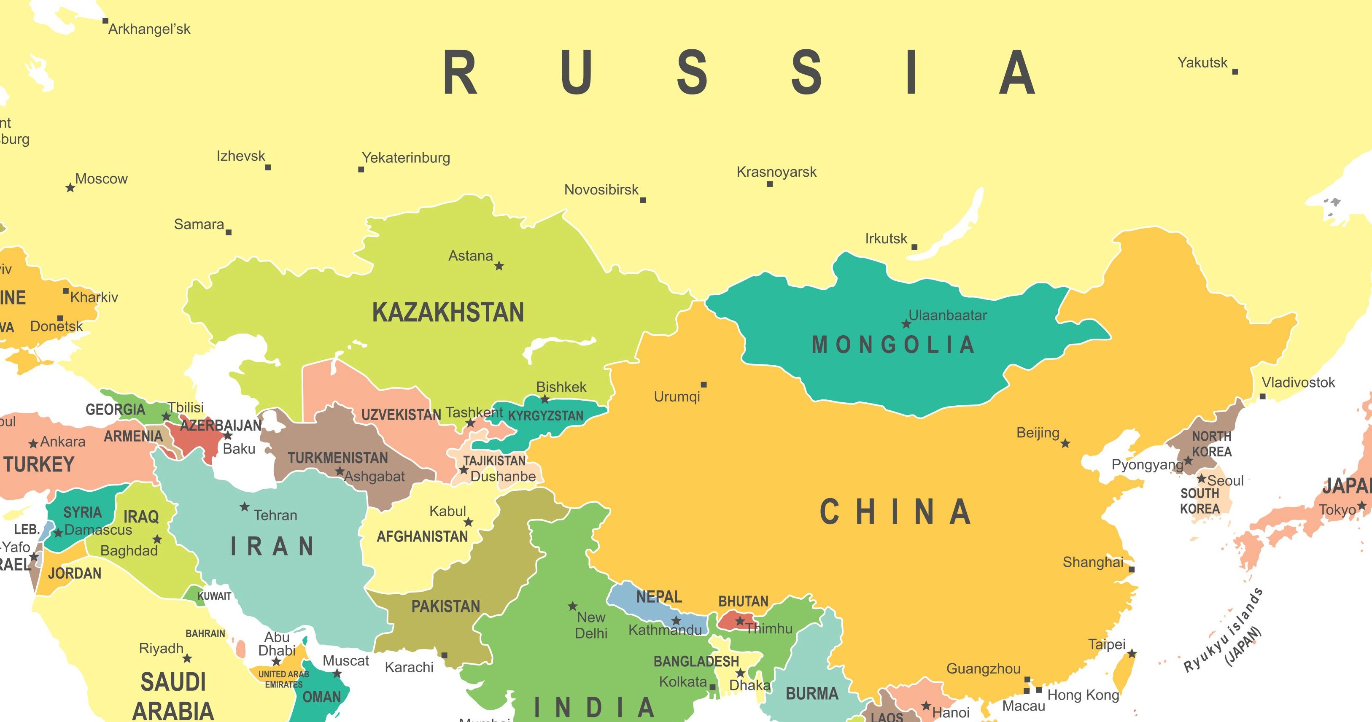
The Sixth Bowl: Preparation for Armageddon - Revelation 16:12-16
Kings from the east - all armies that would have to cross the Euphrates to get to Israel

Slide 24
The Sixth Bowl: Preparation for Armageddon - Revelation 16:12-16
The first reason given for armies to cross the Euphrates to gather in Israel for war is demonic influence
The 3 unclean spirts appear as frogs because frogs are unclean & detestable animals (Lev. 11:10-11)

Slide 25
The Sixth Bowl: Preparation for Armageddon - Revelation 16:12-16
The 3 demons use signs to deceive kings of the whole world to gather for war
Satan loses the war in heaven (Rev. 12), this war will be against the remnant & Christ (Rev. 17 & 19)

Slide 26
The Sixth Bowl: Preparation for Armageddon - Revelation 16:12-16
Satan foments this war, but it is God controlling it for it will be “the war of the great day of God,” not Satan
This day will fulfill multiple prophecies - Joel 3:2; Zechariah 14:2-3; Psalm 2:1-3, etc.

Slide 27
The Sixth Bowl: Preparation for Armageddon - Revelation 16:12-16
This war culminates in the fulfillment of Christ’s promise & warning that He is coming like a thief

Slide 28
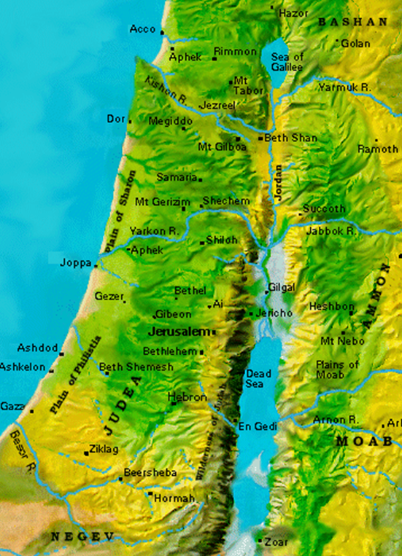
The Sixth Bowl: Preparation for Armageddon - Revelation 16:12-16
The location this armies will gather is Har-Magedon (Armageddon) - the plain of Jezreel in northern Israel

Slide 29
The Sixth Bowl: Preparation for Armageddon - Revelation 16:12-16
The plain is not large enough to hold all the armies, it will be a wide ranging war throughout Israel

Slide 30
The Seventh Bowl: “It is Done” & Cataclysms - Revelation 16:17-21
It brings the finality of God’s wrath.
The tribulation of that time will beyond anything prior or after (Mt. 24)

Slide 31
Conclusions
God is sovereign in all things - using even Satan’s schemes to fulfill His own plans (6th Bowl)
Those blind to the cause of their own troubles will remain unrepentant (4th & 5th bowl)

Slide 32
Conclusions
God’s longsuffering mercy will come to an end followed by just & righteous judgment (3rd bowl)
God is not bound by the laws of physics or nature (2nd bowl)
God hates idolatry and will severely punish those that worship false gods (1st bowl)

Slide 33
Conclusions
Rejoice Christian – you are not subject to any of these things
Repent non-Christian - God’s wrath abides on you, but He offers forgiveness of sin through faith in the Lord Jesus Christ

Slide 34
Grace Bible Church Glorifying God by Making Disciples of Jesus Christ

Slide 35


