Slide 1
Grace Bible Church Glorifying God by Making Disciples of Jesus Christ

Slide 2
A reminder to consider others Please:
Silence your cell phone & all electronic devices
Use the nursery or cry room if your child is fussy
Get up during the preaching only if absolutely necessary (please sit in back if you must leave early)
Refrain from eating & drinking during worship service (except medical needs)
Notes:
2

Slide 3
The 5th & 6th Trumpets Revelation 9:1-21
True success in life begins with a proper fear of your Creator - Proverbs 1:7, 9:10
God’s longsuffering patience as part of His kindness and goodness should lead to repentance (Rom. 2:3-4)

Slide 4
The 5th & 6th Trumpets Revelation 9:1-21
God often brings about punishment / chastening to instill fear that will bring about repentance
It gets much worse as the Tribulation period progresses from the seal judgments to the trumpet judgments

Slide 5
The 5th & 6th Trumpets Revelation 9:1-21
The 7th seal breaks upon the 7 trumpet judgments, the first of which bring destruction on nature by thirds
The 5th, 6th and 7th trumpet bring a series of three woes worse than what preceded them

Slide 6
5th Trumpet: The Abyss is Opened Revelation 9:1-2
This “star” is not a celestial object, it is a person, a “him” who is given the key to the abyss
The abyss: demons detained there (Luke 8:31), related to death (Rom. 10:7), & contains evil beings (Rev.)

Slide 7
5th Trumpet: The Abyss is Opened Revelation 9:1-2
When the abyss is unlocked & opened, smoke rises like from a furnace and darkens the Sun
The abyss is a different place than Hell which is better equated with the lake of fire - Rev. 20.

Slide 8
The “Locusts” & Their Authority Revelation 9:3-6
Strange, locust like creatures come out of the smoke from the abyss & disperse over the earth
They are given power, the ability to perform the actions assigned to them, as scorpions have power

Slide 9
The “Locusts” & Their Authority Revelation 9:3-6
These “locusts” with scorpion tails may not harm the grass, trees or anything green, opposite of insects
They may only harm (as with a scorpion sting) only humans without the seal of God on their forehead

Slide 10
The “Locusts” & Their Authority Revelation 9:3-6
They torment with stings for five months causing people to seek death, but death actively runs away
Death can end the pains of life on this earth, but it only begins the pain of eternal punishment for unbelievers

Slide 11
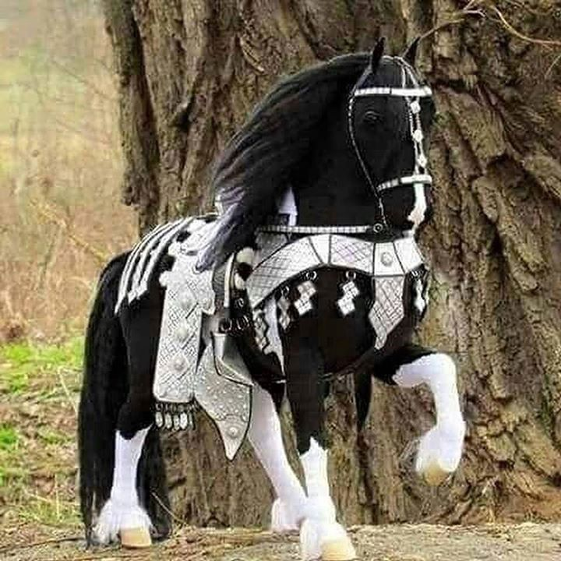
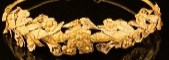
The Characteristics of the “Locusts” Revelation 9:7-11
These are not insects, they are compared to horses prepared for battle & victors’ crowns on their heads

Slide 12
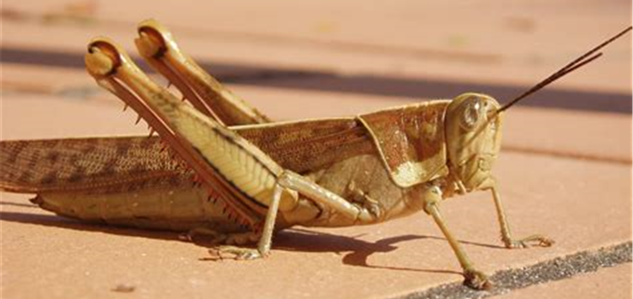
The Characteristics of the “Locusts” Revelation 9:7-11
They have faces like a man (bearded?), hair like a woman and teeth like a lion

Slide 13
The Characteristics of the “Locusts” Revelation 9:7-11
Their breastplates are like those of iron and their wings sound like chariots, of horses running to battle

Slide 14
The Characteristics of the “Locusts” Revelation 9:7-11
Their tails are like scorpions and they can sting like them causing harm

Slide 15
The Characteristics of the “Locusts” Revelation 9:7-11
Their king is the angel of the abyss named Abaddon / Apollyon - destroyer
The angel of the abyss is not Satan, but may be a demon since the abyss is associated with themly

Slide 16
The Characteristics of the “Locusts” Revelation 9:7-11
John is describing real things he is seeing,
Creatures can look very bizarre,
Demons can manifest physically

Slide 17
The 6th Trumpet: The Four Angels Revelation 9:13-15
The 6th trumpet sounded & a voice from the golden altar (probably the 8th angel) gives a command
The 6th angel the four angels who have been bound at the great river Euphrates - the region of the river

Slide 18
The 6th Trumpet: The Four Angels Revelation 9:13-15
These angels have been ready and waiting to take action at the specific hour, day, month, year set by God
They kill 1/3 of mankind –
added together, more than ½ of humanity has died since the tribulation began

Slide 19
The Horsemen, Horses, & Death of a 1/3 Rev. 9:16-19
The relationship of the four angels and this huge cavalry is not specifically stated
This is a specific number: Two myriads of myriads: 20,000 X 10,000 = 200,000,000.
John is emphatic. He heard the number

Slide 20
The Horsemen, Horses, & Death of a 1/3 Rev. 9:16-19
Nothing today matches since ½ the population will die by then, & logistics prevents such a large army
The breastplates of the riders are colored fiery red, smoky blue and sulphurous yellow

Slide 21
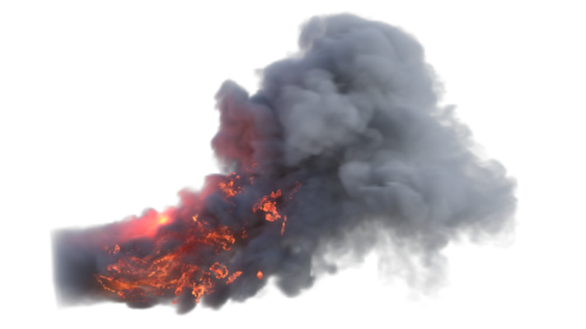
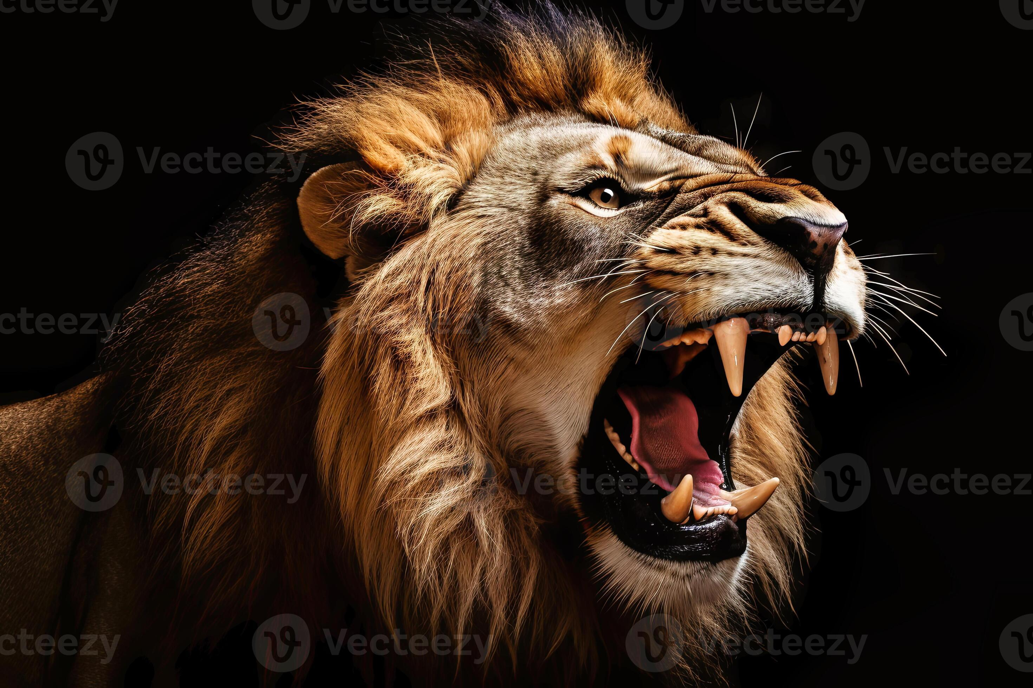
The Horsemen, Horses, & Death of a 1/3 Rev. 9:16-19
Bizarre horse like creatures - heads like lions; fire, smoke & brimstone from mouths, tails like serpents

Slide 22
The Horsemen, Horses, & Death of a 1/3 Rev. 9:16-19
Some elements could describe a tank - (fire, smoke, brimstone; snake like tail) but not other parts: lion head
Serpent like tails only harm, not kill
Why describe them like a horse when a wagon would better fit a tank?

Slide 23
The Horsemen, Horses, & Death of a 1/3 Rev. 9:16-19
Severe logistics problem in trying to supporting 200 million self-propelled military weapons
These are probably supernatural demonic creatures equipped to kill - the logistics problem is eliminated

Slide 24
The Horsemen, Horses, & Death of a 1/3 Rev. 9:16-19
The supernatural aspects of these judgments should compel men to beg God for mercy

Slide 25
The Unrepentant Survivors Revelation 9:20-21
The people that survive will not cease from their Idolatry / worship of demons
They will refuse to repent from their murders, sorceries, sexual immorality & thefts
The evil nature of man expressed in Romans 3:10-18 will continue into the future

Slide 26
Conclusions
The fear of the Lord is the beginning of knowledge & wisdom - without it man is ignorant & foolish
Don’t presume & put off getting right with God
Rejoice in the fear of the Lord and the knowledge and wisdom that comes from that

Slide 27
Grace Bible Church Glorifying God by Making Disciples of Jesus Christ

