Slide 1
Grace Bible Church Glorifying God by Making Disciples of Jesus Christ

Slide 2
A reminder to consider others Please:
Silence your cell phone & all electronic devices
Use the nursery or cry room if your child is fussy
Get up during the preaching only if absolutely necessary (please sit in back if you must leave early)
Refrain from eating & drinking during worship service (except medical needs)
Notes:
2

Slide 3
The Throne Room of God, Part 2 Revelation 5:1-14
The mind of a man plans his way, but Yahweh directs his steps - Proverbs 16:9
Chapter 4 begins the 3rd section of Revelation concerning future events
Rev. 4 is John’s vision of the throne room of God - majestic, frightening, a scene of judgment & wrath

Slide 4
The Throne Room of God, Part 2 Revelation 5:1-14
The doxologies in verses 8 & 11 focus on God’s holiness, omnipotence, eternal nature & the Creator
Rev. 5 continues John’s description of the scene in heaven, but now focuses on Christ the redeemer

Slide 5
The Throne Room of God, Part 2 Revelation 5:1-14

Slide 6
The Scroll Revelation 5:1
John sees God on His throne with a scroll in His right hand which has writing on its inside & outside

Slide 7
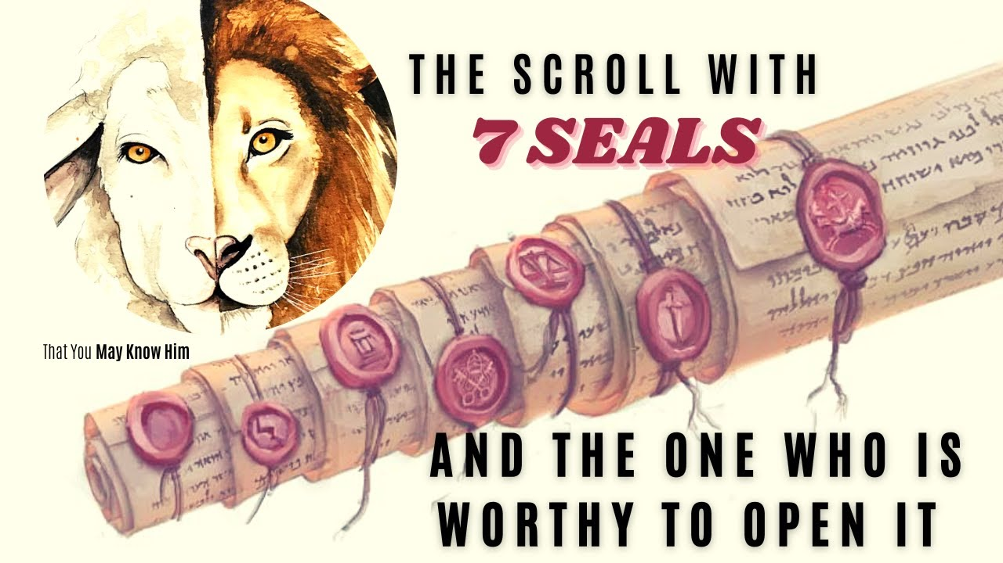
The scroll has seven seals on one of its side ends which have to be broken in succession to read each section

Slide 8
The Scroll Revelation 5:1
The contents of the scroll are the prophecies revealed & then fulfilled throughout the rest of Revelation
Only someone qualified could open the scroll and break the seals

Slide 9
No One Able Revelation 5:2-4
The identity of the strong angel is not given for a reason, so best to leave it that way
Worthy, a[xioV / axios, a weight to bring a scale into equilibrium - having sufficient merit, being worthy

Slide 10
No One Able Revelation 5:2-4
An exhaustive search yields no one who is worthy - John reacts emotionally with great weeping / crying

Slide 11
He Who Has Overcome Revelation 5:5-7
An elder commands John to cease crying for, behold, there is someone who is worthy.
The Lion that is from the tribe of Judah is Messianic arising from Jacob’s prophecy in Genesis 49:9-10

Slide 12
He Who Has Overcome Revelation 5:5-7
The root of David - a descendant of David (Isaiah 11:1,10), fulfills the Davidic Covenant (2 Sam. 7:8-16)
Overcome, nikavw/ nikaō, is to win a victory, to conquer. John’s sorrow is turned to joy

Slide 13
He Who Has Overcome Revelation 5:5-7
The Lamb “in the midst of the throne” (ejn mevsw / en mesō) - on the throne with the Father - Rev. 3:21
Lamb is an ajrnivon / arnion. The Passover lamb (Exod. 12:5-6), the lamb led to slaughter (Isa. 53:7)

Slide 14
He Who Has Overcome Revelation 5:5-7
Standing, but as if slain - Jesus continued to have the marks of crucifixion after His resurrection
A lion is a contrast to a lamb, but Jesus is both - the lamb takes away the sin of the world. The lion conquers

Slide 15
He Who Has Overcome Revelation 5:5-7
Having seven horns & seven eyes - horns symbolize strength - Num. 23:22; Psalm 132:17; Zech. 1:18-21
Eyes represent sight, intelligence and wisdom (Zech. 4:10). These are the 7 spirits of God - the Holy Spirit

Slide 16
He Who Has Overcome Revelation 5:5-7
The Lamb is worthy to open the scroll & break its seals so He takes possession of it

Slide 17
The Response Revelation 5:8
The 4 living beings & the 24 elders worship God - the 24 elders now also have harps & bowls full of incense
The harp is a traditional musical instrument used in worship and associated with the prophets

Slide 18
The Response Revelation 5:8
Incense is part of worship in the tabernacle & temple - a priestly function - represents prayers of the saints
These are the future saints of the tribulation period

Slide 19
The New Song Revelation 5:9-10
“They” refers to the subject of the verb in the first part of compound sentence: The living beings & elders
The anthem declares why Messiah is worthy - His blood atonement for humans to purchase them for God

Slide 20
The New Song Revelation 5:9-10
Some from each of 4 groups of humanity, but not all humanity
The purpose of the redemption was to create a kingdom & priests to our God who will reign upon the earth

Slide 21
The Second Anthem Revelation 5:11-12
An innumerable number of angels join with loud voice in giving praise to the Lamb
Jesus is worthy to receive all the accolades given: power, riches, wisdom, might, honor, glory & blessing

Slide 22
The Second Anthem Revelation 5:11-12
All of these belong to Jesus:
Power - Matthew 28:18; John 3:35;
Wisdom & Power - 1 Corinthians 1:24;
Strength - Ephesians 6:10;
Glory & Honor - Hebrews 2:9;
Blessed - Romans 9:5

Slide 23
The Third Anthem Revelation 5:13-14
All of creation joins in this chorus of praise with the angels, twenty-four elders and four living beings
Probably living beings, but inanimate objects give praise to God too - Psalm 19:1; Isa. 55:12

Slide 24
The Third Anthem Revelation 5:13-14
In the future, every knee will bow before Christ and confess that He is Lord - Phil. 2:10-11
The doxology is given to both “Him who sits on the throne, & to the Lamb”

Slide 25
The Third Anthem Revelation 5:13-14
Dominion, the power to rule, is added to the praise, & that belongs to Jesus forever (1 Peter 4:11).
The four living beings respond with “amen” - a strong affirmation that what has been declared is true
The 24 elders fall in worship

Slide 26
Conclusions
The activity in the throne room of God is praise & glorification of Him and the Lamb
Our own praise & glorification of the triune God must be genuine which is demonstrated by how you live

Slide 27
Conclusions
Do all for the glory of God - even the mundane things (1 Corinthians 10:31)
Jesus Christ is worthy of it all - all power and riches and wisdom and might and honor and glory and blessing . . . and dominion . . . and your life!

Slide 28
Grace Bible Church Glorifying God by Making Disciples of Jesus Christ

