Slide 1
Grace Bible Church
Glorifying God by Making Disciples of Jesus Christ

Slide 2
A reminder to consider others Please:
Silence your cell phone & all electronic devices
Use the nursery or cry room if your child is fussy
Get up during the preaching only if absolutely necessary (please sit in back if you must leave early)
Refrain from eating & drinking during worship service (except medical needs)
Notes:
2

Slide 3
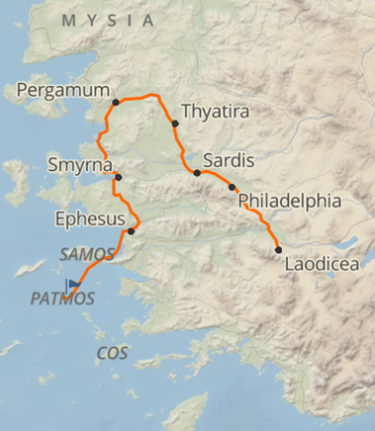
Philadelphia: The Faithful Church
Revelation 3:7-13
Particular letters to particular churches at a particular time but with principles that transcend place & time

Slide 4
Review
Ephesus: Revelation 2:1-7
Commended for deeds, toil, perseverance & strong moral & doctrinal integrity
But having left their first love Jesus commands them to remember, repent and redo

Slide 5
Review
Smyrna: Revelation 2:8-11
Severely persecuted & impoverished, but rich in the things of God - Encouraged to remain faithful

Slide 6
Review
Pergamum: Revelation 2:12-17
Commended for their perseverance & witness in a very dangerous place
Condemned for those within it that compromised doctrinally with syncretism - called to repent

Slide 7
Review
Thyatira: Revelation 2:18-29
Commended for deeds of love, faith, service & perseverance that had increased
Condemned for prevalent tolerance of heretics & syncretism - called to repent

Slide 8
Review
Sardis: Revelation 3:1-6
The “zombie” church that was still moving but was spiritually dead
The little life remaining commanded to be alert, strengthen what remained, remember, keep it, repent

Slide 9
The Letter to the Church at Philadelphia
Revelation 3:7-13

Slide 10
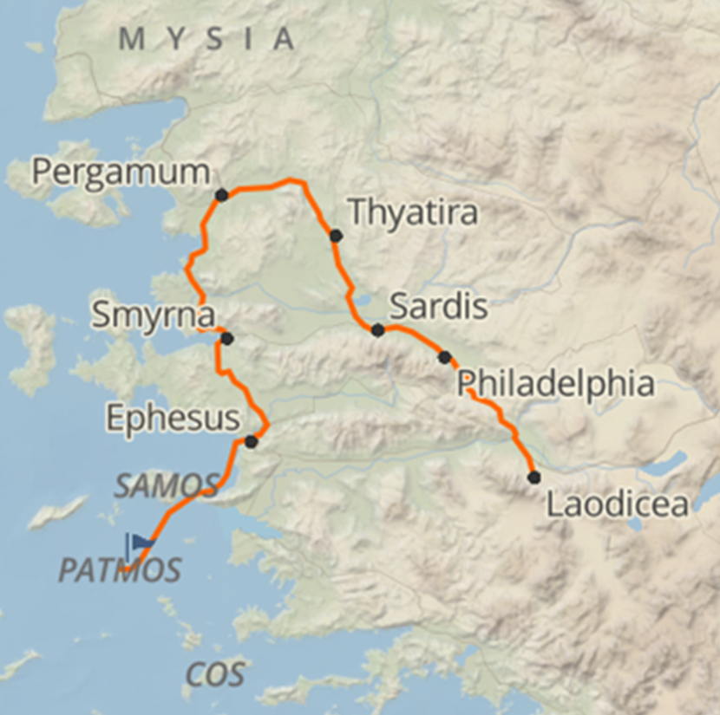
The Recipient of the Letter
Revelation 3:7a
The angel - human messenger - of the church in Philadelphia

Slide 11
The City of Philadelphia
Named after Attalus II Philadelphius, founded after 189 b.c.

Slide 12
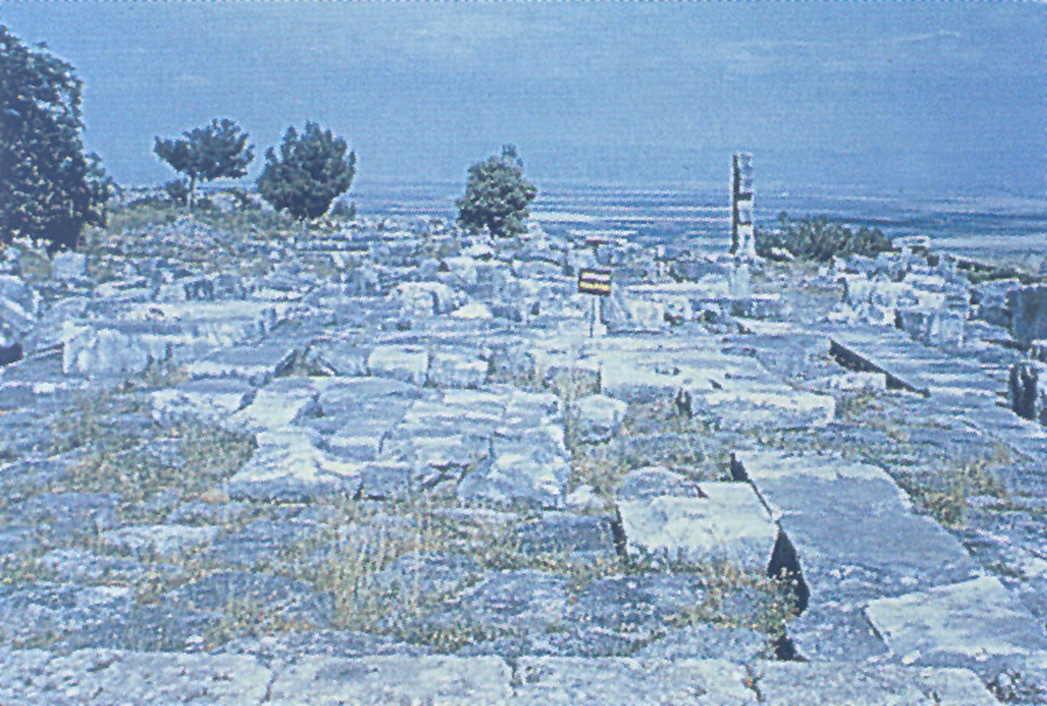
The City of Philadelphia
Located in Cogamis River valley along trade road from Smyrna to the central plateau

Slide 13
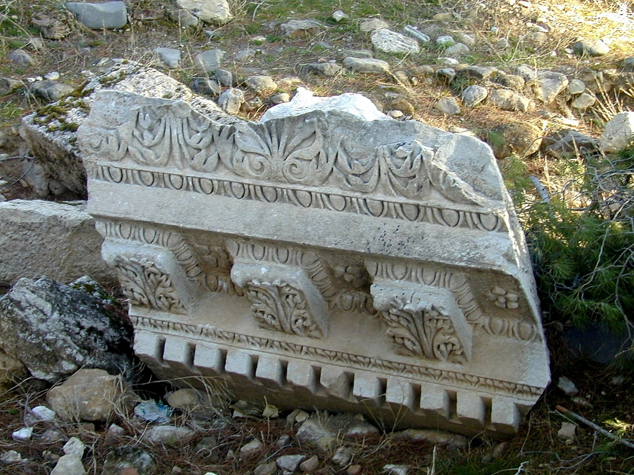
The City of Philadelphia
An outpost of Graeco-Asiatic culture including language and religion

Slide 14
The City of Philadelphia
Subject to earthquakes, destroyed in A.D. 17 & helped by Tiberius to rebuild - a monument erected to him

Slide 15
The City of Philadelphia
Primary god was Dionysius, the god of wine, but emperor cult, paganism & Judaism also there

Slide 16
The Author
Revelation 3:7b
Jesus is the holy one, oJ a’gioV / ho hagios - title for God the Father, the God of Israel and Messiah
Holiness includes sinless purity, which Jesus was, but focus is on being set apart in reverence

Slide 17
The Author
Revelation 3:7b
Jesus is the true one, oJ alhqinovV / ho alātheinos. He is the genuine Messiah who keeps all of His promises
Jesus has the key of David who opens & shuts and no one can change that. See Isaiah 22:20-22

Slide 18
The Author
Revelation 3:7b
Jesus has complete authority over who enters His kingdom and who is kept out

Slide 19
First Assessment & Promises
Jesus’ Knowledge – Revelation 3:8
Jesus knows all of their works of past & present & will continue to know in future

Slide 20
First Promise – An Open Door
Revelation 3:8
Past action continuing to present and future
Not a specific promise of expanded missionary opportunities - missions expand wherever Christians go

Slide 21
First Promise – An Open Door
Revelation 3:8
This is the entrance to Christ’s kingdom - and no one can shut the door He opens. See Romans 8:38-39

Slide 22
Their Little Power
Revelation 3:8
Apparently a small church that was faithful but remained small

Slide 23
Their Faithfulness
Revelation 3:8
They had not wavered in the midst of persecution

Slide 24
Not Denied His Name
Revelation 3:8
indicates strong pressure to deny Jesus, and they had not compromised

Slide 25
Second Promise: Humbling of Jews
Revelation 3:9
Synagogue of Satan - Jewish unbelievers following Satan’s lies instead of God’s truth
Physical descendants of Abraham/Israel, but not spiritual descendants - see John 8:39-47; Rom. 2:28-29; 9:6

Slide 26
Second Promise: Humbling of Jews
Revelation 3:9
A reference to Isaiah 60 being fulfilled in Messiah’s kingdom which includes the church reigning with Him
Unbelieving Jews are given to be humbled before the church - the 1/3 left saved to enter Christ’s kingdom

Slide 27
Second Assessment & Promises
Their Steadfastness – Revelation 3:10
They followed Jesus’ example to persevere in persecution - See Hebrews 12:1-3

Slide 28
Second Assessment & Promises
Jesus’ Protection – Revelation 3:10
Understandable when interpreted according to normal meaning in context
The testing soon to come is for those “who dwell on the earth” - the objects of God’s wrath in Revelation

Slide 29
Second Assessment & Promises
Jesus’ Protection – Revelation 3:10
The test encompasses the whole earth causing either repentance or punishment on those not repenting
The hour is the specific time period “after these things” (1:19) detailed in Revelation 4-19

Slide 30
Second Assessment & Promises
Jesus’ Protection – Revelation 3:10
1) The promise is for more than those in Philadelphia.
2) The testing is of the unrighteous, not the righteous
3) Jesus keeps / preserves / protects / guards them from the testing - ejk / ek = out from.

Slide 31
Second Assessment & Promises
Jesus’ Protection – Revelation 3:10
If the protection was within the testing it would be e[n / en and if through the testing it would be diav / dia
If the promise included going through the Tribulation, the reward for faithfulness would be more persecution

Slide 32
The Charge
Revelation 3:11
Jesus would not be coming quickly if this referred to the second advent at the end of the Tribulation period
As a reference to the rapture (1 Thess. 4:15-17), Jesus’ coming is imminent

Slide 33
The Charge
Revelation 3:11
Hold fast;
  Don’t become weary and let go;
  Don’t let anyone take the crown of victory from you

Slide 34
Promises to the Overcomer
Revelation 3:12
The overcomer, the true saint perseveres and is assured of belonging to God in heaven for eternity
Temple pillars are strong and remain in the place of the worship of God
Having a name written on you is a sign of ownership and belonging

Slide 35
The Call to All
Revelation 3:13
The principles in the letter apply to all Christians / churches throughout time

Slide 36
Conclusions
Follow the example of the believers in Philadelphia to remain faithful to Christ in all circumstances
Rejoice in Jesus’ promises. Assurance of salvation, corrected to be holy, protection from the Tribulation

Slide 37
Grace Bible Church
Glorifying God by Making Disciples of Jesus Christ

