Slide 1
Grace Bible Church Glorifying God by Making Disciples of Jesus Christ

Slide 2
A reminder to consider others Please:
Silence your cell phone & all electronic devices
Use the nursery or cry room if your child is fussy
Get up during the preaching only if absolutely necessary (please sit in back if you must leave early)
Refrain from eating & drinking during worship service (except medical needs)
Notes:
2

Slide 3
Sardis: The Zombie Church Revelation 3:1-6
A zombie - a sci-fi creature that moves as if alive but it is actually dead
Specific letters & content to specific churches in specific locations & time, but principles are universal

Slide 4
Review
Ephesus – 35 miles N to Smyrna – 65 miles N to Pergamum – 40 SE to Thyatira – 40 miles SE to Sardis

Slide 5
Review Persecution & Perseverance
First four churches commended for their faith & perseverance in tribulation

Slide 6
Review Ephesus – Revelation 1:1-7
Commended for deeds, toil, perseverance and their moral & doctrinal integrity
They left their first love resulting in a cold orthodoxy without the warmth of Christian charity

Slide 7
Review Ephesus – Revelation 1:1-7
Commanded to remember, repent & redo –
A charge to all Christians & churches of similar nature

Slide 8
Review Smyrna – Revelation 1:8-11
Endured much tribulation from pagan society & unbelieving Jews
Encouraged to continue to remain faithful despite circumstances
Those with faith in Jesus have life, not death
An encouragement to all in similar situations

Slide 9
Review Pergamum: Revelation 2:12-17
Commended for remaining faithful in a difficult place
Condemned for tolerating those who followed the syncretism of false teachers (Balaam & Nicolaitans)

Slide 10
Review Pergamum: Revelation 2:12-17
Do not fall for false teaching that distorts the gospel by excusing worldliness & sin in the Christian life

Slide 11
Review Thyatira: Revelation 2:18-29
Commended for increasing deeds of love, faith, service & perseverance
Condemned for tolerating false teacher & teaching that merged paganism into the Christian life

Slide 12
Review Thyatira: Revelation 2:18-29
False teachers can make the pursuit of what is worldly seem like a pursuit of godliness. Don’t Fall for It!

Slide 13
The Letter to Sardis Revelation 3:1-6

Slide 14
The Address The Recipient - Revelation 3:1
A human messenger representing Sardis and delivering the letter to that church

Slide 15
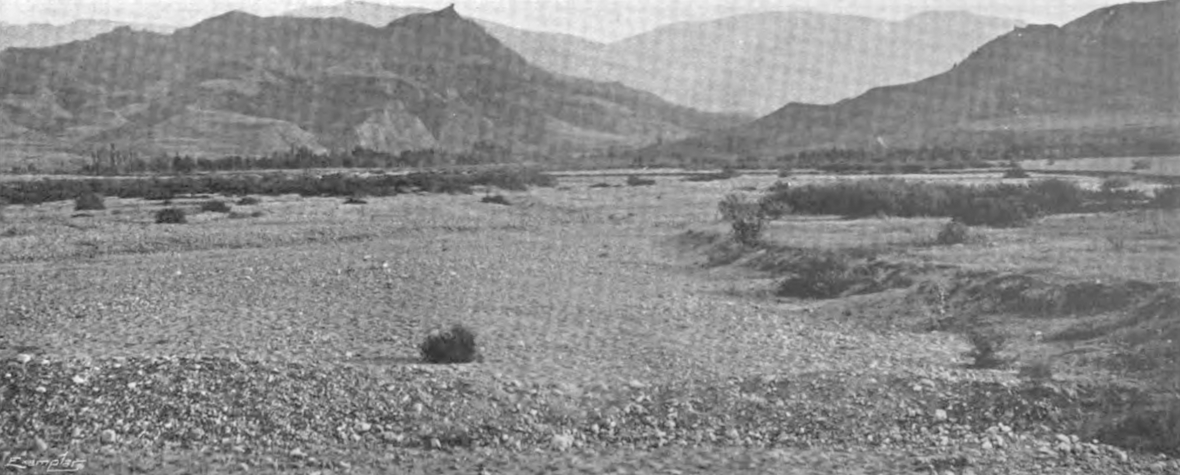
The City of Sardis
33 miles southwest of Thyatira on a plateau 1,500 ft above Hermus valley on King’s highway
←Mt Tmolus
Hill of acropolis of Sardis
Hermus Valley

Slide 16
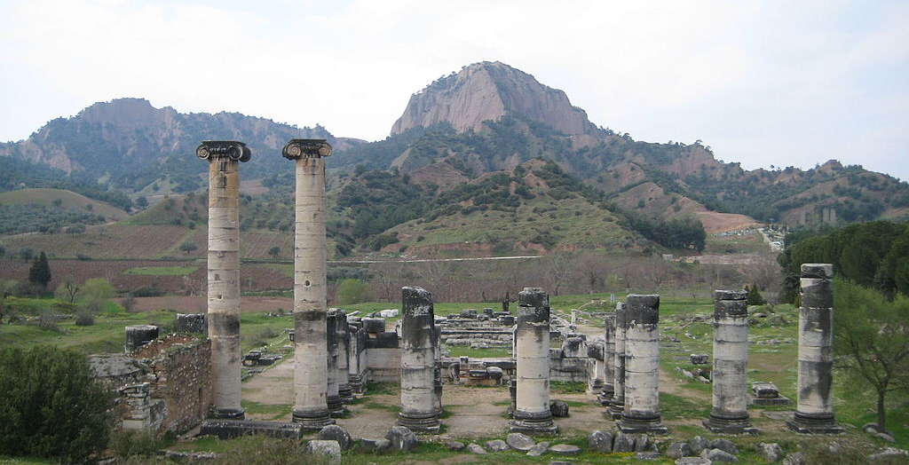
The City of Sardis
With only one approach it was a natural impregnable fortress - It became the capital of Lydian kingdom
User:Quintucket, CC BY-SA 4.0 <https://creativecommons.org/licenses/by-sa/4.0>, via Wikimedia Commons

Slide 17
The City of Sardis
In 549 B.C. Croesus did not guard the cliffs so Cyrus had them scaled & captured Sardis shocking all
User:Quintucket, CC BY-SA 4.0 <https://creativecommons.org/licenses/by-sa/4.0>, via Wikimedia Commons

Slide 18
The City of Sardis
After an earthquake in 17 A.D. Tiberius rebuilt city and emperor cult developed there
Sardis was wealthy due to trade, agriculture, commerce, jewelry and woolen textiles & fabric dyeing

Slide 19
The City of Sardis
Patron goddess was Cybele (Artemis) with much pagan worship of the force of nature
It had a wealthy & influential Jewish community - church likely planted by converts from Ephesus

Slide 20
The Author Revelation 3:1b
Seven Spirits of God (see 1:4) = Holy Spirit (See Isaiah 11:2-5 - Spirit of Yahweh, wisdom, understanding, counsel, strength, knowledge and fear of Yahweh).
Seven stars = seven churches (Rev. 1:16; 2:1)

Slide 21
The Author Revelation 3:1b
City preoccupied with death & restoration of life.
Jesus gives life through Holy Spirit (John 6:33; Rom. 8:11; Eph. 2:5)

Slide 22
The Assessment Revelation 3:1c
Jesus is omniscient & knows their past & present condition.
Their reputation was being spiritually alive. but they were spiritually dead
The evidence of their dead condition is that there is no opposition to them by pagans, Jews or false teachers

Slide 23
The Commands Wake up! – Revelation 3:2
It would seem futile to command the dead to wake up, but Jesus can wake the dead - John 11
The phrase is better translated as “you be watching” - an emphasis on what you do after you are awake

Slide 24
The Commands Wake up! – Revelation 3:2
Given the city’s history, it may be a tacit reference to being watchful lest an enemy surprises & destroys you

Slide 25
The Commands Strengthen! – Revelation 3:2
Something did remain, so there were a few cells in the corpse barely hanging on to life
Without proper motivation & faith, even many actions & words are worthless exercises before God

Slide 26
The Commands Strengthen! – Revelation 3:2
Their works were deficient, so God calls them to strengthen them to be firm in a proper attitude & belief

Slide 27
The Commands Remember! – Revelation 3:3
A call to look back at what they had been given & told in the past

Slide 28
The Commands Keep it! – Revelation 3:3
Continue with present actions while going back to do again what you were doing in the past

Slide 29
The Commands Repent! – Revelation 3:3
Change your mind about you are doing that is wrong & proceed in a new direction of what is right

Slide 30
The Warning Revelation 3:3b
If the commands are not heeded, Jesus will return without warning in judgment

Slide 31
The Faithful Few Revelation 3:4
There were a few that were still alive and had not soiled their garments - a life polluted with sin
Their reward was a promise of purity walking in close fellowship with Christ

Slide 32
Promises to the Overcomers Revelation 3:5
The overcomer - all true Christians - receive the same promise of being clothed with purity
The true Christian cannot lose salvation for it comes from God & is kept by Christ - John 6:37-40; 10:27-30

Slide 33
Promises to the Overcomers Revelation 3:5
A litotes? The affirmative expressed by the negative of the contrary statement? ∴ A promise of security
The book of life: Phil. 4:3; Rev. 13:8, 17:8, 20:12,15; 21:27
& Psalm 69:28 is a prayer to blot out unrighteous

Slide 34
Promises to the Overcomers Revelation 3:5
A theological antinomy - two truths in apparent contradiction resolved in the mind of God
A roll of all humanity in which those that do not receive Christ as Savior have their names blotted out?

Slide 35
Promises to the Overcomers Revelation 3:5
Don’t worry if you do not understand - Deut. 29:29; Rom. 11:33-34.
The true Christian is assured salvation

Slide 36
The Call to All Revelation 3:6
The principles in the letter apply to all Christians & churches in all places & times

Slide 37
Conclusions
Zombie Christians & churches due to
Resting on laurels?
Dead liturgy?
Being worldly?
True Christians are called to remain faithful, keep their garments unsoiled, & be Christ’s light shining in the dark

Slide 38
Grace Bible Church Glorifying God by Making Disciples of Jesus Christ

