Slide 1
Grace Bible Church
Glorifying God by Making Disciples of Jesus Christ

Slide 2
A reminder to consider others Please:
Silence your cell phone & all electronic devices
Use the nursery or cry room if your child is fussy
Get up during the preaching only if absolutely necessary (please sit in back if you must leave early)
Refrain from eating & drinking during worship service (except medical needs)
Notes:
2

Slide 3
Pergamum: The Compromised Church
Revelation 2:12-17
If you missed the introductory sermons or those on Chapter 1, please review them on the website
7 specific letters with specific messages to 7 specific churches in 7 specific places at a specific time period

Slide 4
Review - Letter to Ephesus
Revelation 2:1-7
Commended for their toil & enduring hardship for the Lord’s sake
Commended for their strong moral & doctrinal integrity
Rebuked for leaving their first love

Slide 5
Review - Letter to Ephesus
Revelation 2:1-7
Commanded to Remember, Repent & Re-do their first works
Promised access to the tree of life in the garden of God

Slide 6
Review - Letter to Smyrna
Revelation 2:8-11
Commended and comforted in the midst of their current suffering and what was about to happen
Though impoverished and slandered, they remained faithful
Their suffering would be of limited duration and they were promised the crown of life

Slide 7
The Letter to Pergamum
Revelation 2:12–17

Slide 8
The Author
Revelation 2:12
The one who has the sharp two-edged sword - an instrument of aggressive attack, used to destroy & conquer
Pergamum was the capital of the province and had the “right of the sword” - freedom to execute

Slide 9
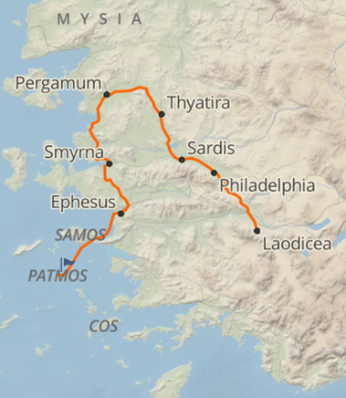
The City of Pergamum
Revelation 2:13
~65 miles north of Smyrna, 6 miles from Aegean sea in Caicus river valley with an acropolis rising 1,000 feet

Slide 10
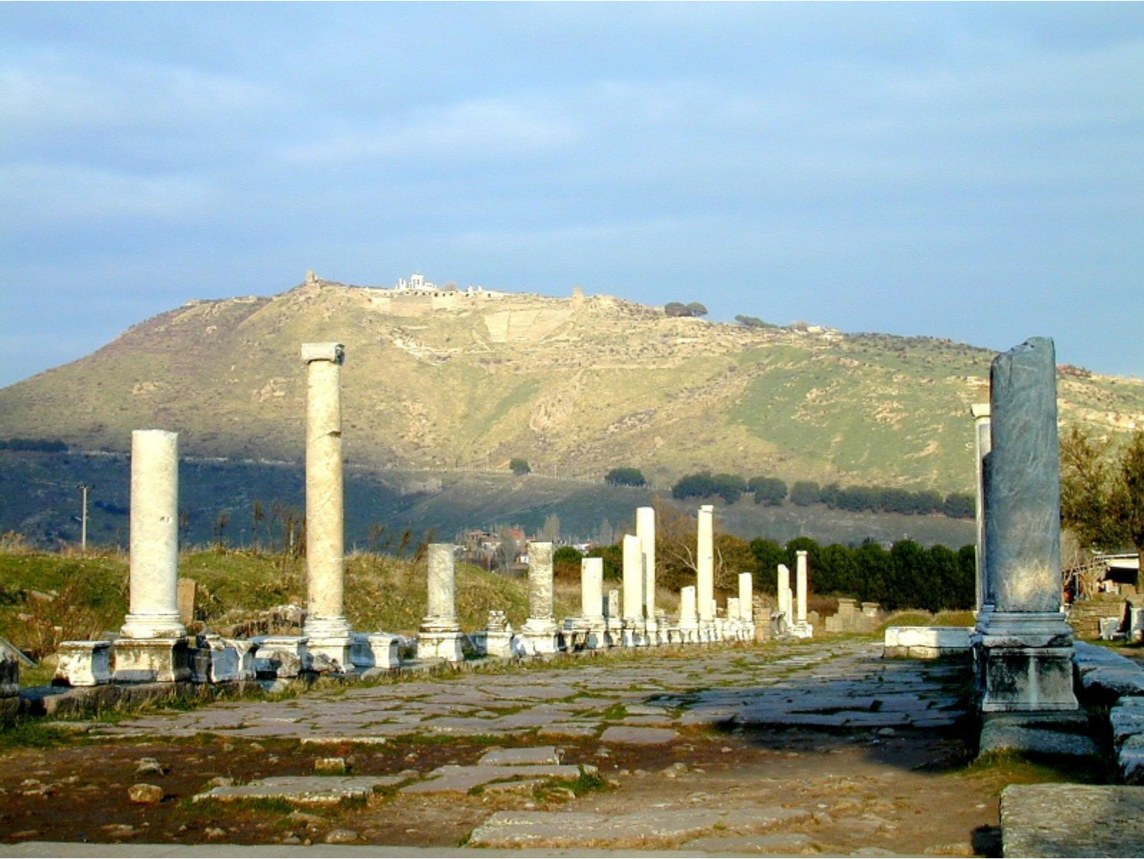
Pergamum: Capital of an independent kingdom in 281 B.C. and developed strong ties to Rome

Slide 11
Its golden age included a school of sculpture, a library of 200,000+ volumes, manufacture of parchment

Slide 12
It became capital of Roman province of Asia in 133 B.C. It had many pagan temples and altars

Slide 13
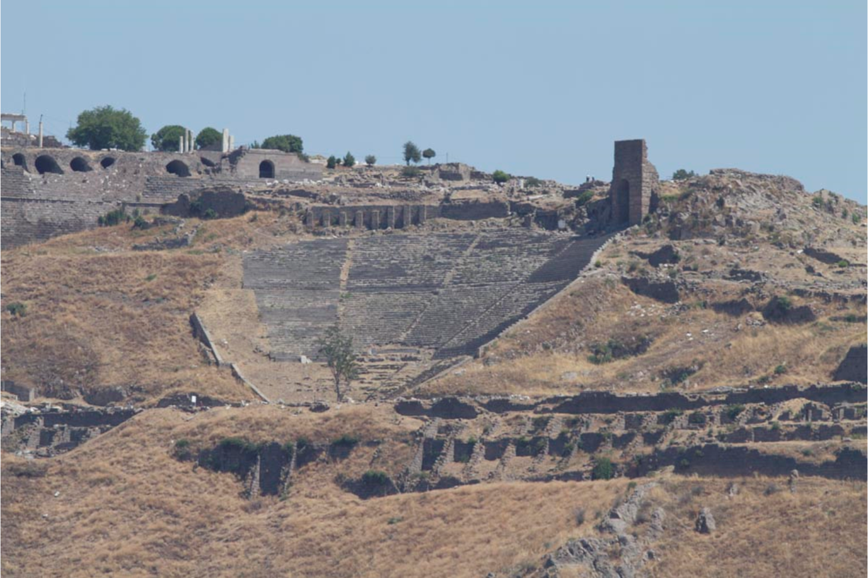
It was center and leader in Asia of the emperor cult with the first temple built to it in A.D. 29

Slide 14
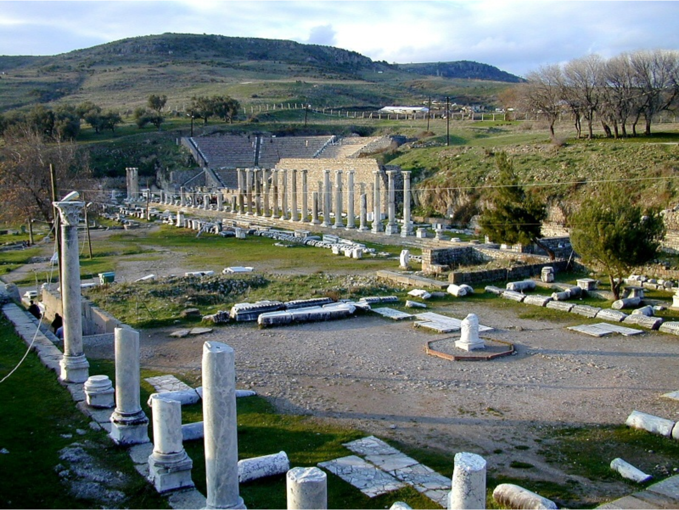
It was “Satan’s throne” due to having state authority to execute those not yielding to the emperor worship

Slide 15
The Commendation
Revelation 2:13
They continued to dwell there instead of fleeing the city in which Satan dwells and has his throne
Persecution is a legitimate reason to leave a place (Acts 8), but those who stay are to be commended

Slide 16
The Commendation
Revelation 2:13
They held fast to Jesus’ name and did not deny the faith though Antipas was executed
Many Christians continue to show the same example of faithfulness in the midst of severe persecution

Slide 17
The Condemnation
Revelation 2:14-15
Balaam’s actions in Numbers 22-24 appear to be proper commitment to declare what God said
God knows the heart, which explains God’s anger in Numbers 22:22 and the incident of the talking donkey

Slide 18
The Condemnation
Revelation 2:14-15
King Balak tries multiple times to get Balaam to curse Israel, but each time he blessed Israel instead
The first clue to the teaching / error (Jude 11) of Balaam is that he is killed with the kings of Midian

Slide 19
The Condemnation
Revelation 2:14-15
Numbers 31:16 explains Balaam counseled them on how to get the Israelites to trespass against the Lord
Numbers 25 - the daughters of Moab played the harlot with the Israelites & involved them in their sacrifices

Slide 20
The Condemnation
Revelation 2:14-15
Deut. 23:5; Josh. 24:10 - Yahweh was not willing to listen to Balaam and turned the curses into blessings
2 Peter 2:14-16 - Balaam loved the wages of unrighteousness - he was greedy & wanted the riches of Balak

Slide 21
The Condemnation
Revelation 2:14-15
Rebuked for tolerating those teaching participation in paganism & sexual immorality were acceptable
It would have been difficult to avoid food sacrificed to idols there, but Christians should have done that

Slide 22
The Condemnation
Revelation 2:14-15
Sexual immorality was also rampant in Greek culture, but Christians were to avoid that too
Christians must be careful to avoid both worship of false caricatures of God and false practices of worship

Slide 23
The Condemnation
Revelation 2:14-15
Christians must also avoid being involved in the rampant sexual immorality of our society
The Nicolaitans taught a syncretism between the Christian life and the surrounding culture

Slide 24
The Condemnation
Revelation 2:14-15
The same ideas exist today in those proclaiming liberty in Christ in order to pursue their worldly desires

Slide 25
The Correction
Revelation 2:16
The command is to change your mind & direction or destruction is at hand

Slide 26
The Call & Promise
Revelation 2:17
The hidden manna brings to mind God’s provision in the wilderness - a contrast to food sacrificed to idols
A white stone with a new name - related to reward given to winning athletes which also admitted to a feast l)

Slide 27
The Call & Promise
Revelation 2:17
Both appear to be related to the promise of the marriage supper of the Lamb in Revelation 19
A new personal name qualitatively different upon receiving a new status (Example Jacob is renamed Israel)

Slide 28
Conclusions
Hold fast to faith in Christ in all circumstances & do not make any compromise with worldliness

Slide 29
Grace Bible Church
Glorifying God by Making Disciples of Jesus Christ

