Slide 1
Grace Bible Church Glorifying God by Making Disciples of Jesus Christ

Slide 2
A reminder to consider others Please:
Silence your cell phone & all electronic devices
Use the nursery or cry room if your child is fussy
Get up during the preaching only if absolutely necessary (please sit in back if you must leave early)
Refrain from eating & drinking during worship service (except medical needs)
Notes:
2

Slide 3
Smyrna: The Persecuted Church Revelation 2:8-11
While exiled to the island of Patmos, John writes down what has been revealed to him by an angel & Jesus
Jesus has John write 7 distinct letters to 7 churches in Asia from which all the writings would be spread

Slide 4
Smyrna: The Persecuted Church Revelation 2:8-11
The glorified Christ commissions John to write what is revealed to him about things past, present & future
“The things that are” concern the specific condition at that time of each of the 7 churches addressed ( Ch. 2-3)

Slide 5
Smyrna: The Persecuted Church Revelation 2:8-11
Each letter must be understood in its historical context before its principles can be applied to other churches

Slide 6
The Letter to Ephesus Revelation 2:1-7
This church was highly commended for their work, toil, perseverance & high doctrinal & moral integrity
However, they had left their first love resulting in a cold orthodoxy without Christian warmth & charity.

Slide 7
The Letter to Ephesus Revelation 2:1-7
The cure for a diminished love is to Remember, Repent and Re-do
The overcomer, all true Christians, will have access to the tree of life (Rev. 22)

Slide 8
The Letter to the Church at Smyrna Revelation 2:8-10

Slide 9
The Recipient of the Letter Revelation 2:8
The angel is a respected human messenger that is the representative of the whole church at Smyrna

Slide 10
The City of Smyrna Background
~35 miles north of Ephesus, at the end of an inlet with deep harbor, Road from the Hermus valley

Slide 11
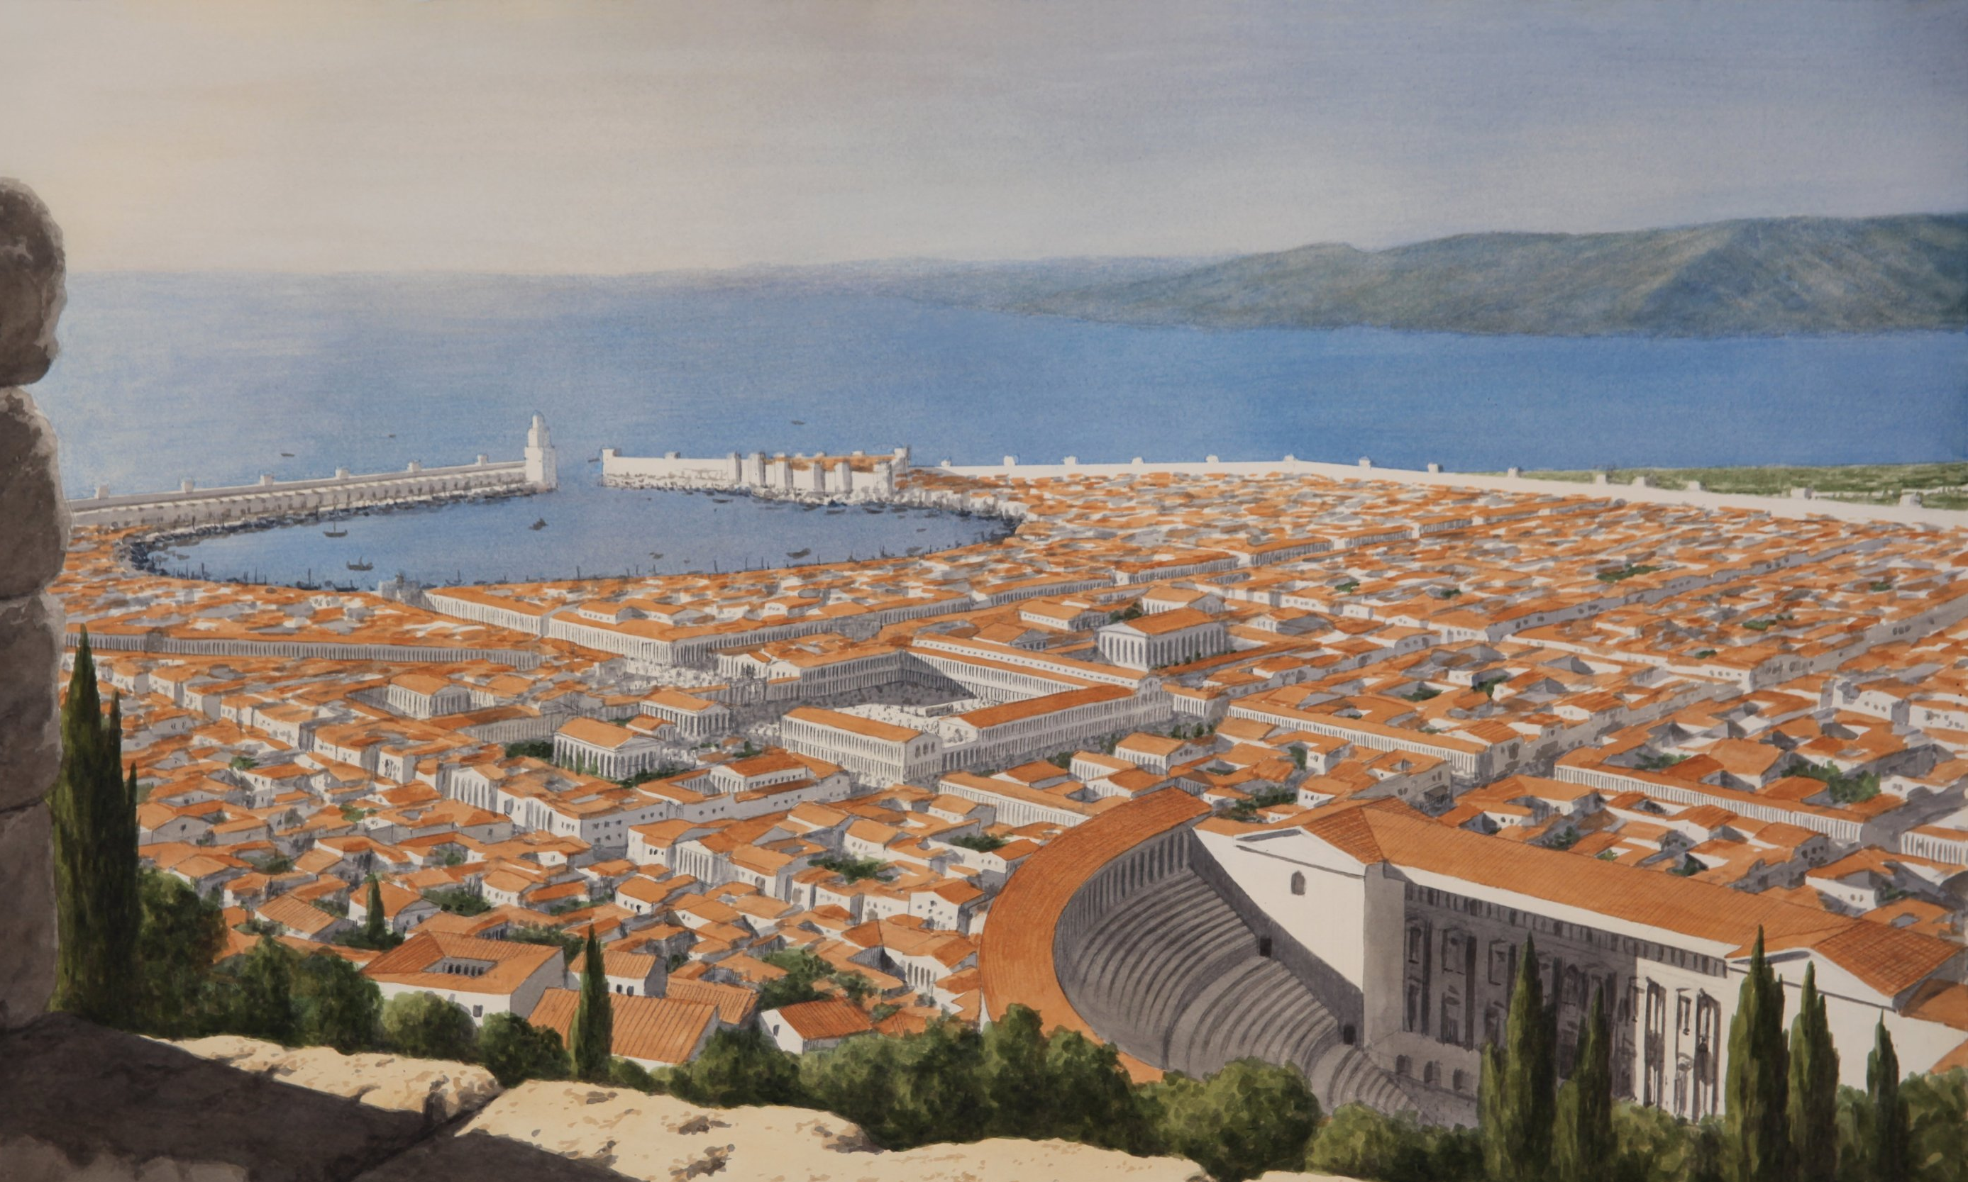
The City of Smyrna
A wealthy trade city picturesque for location, layout, landscaping & buildings - esp. many temples on its hill
Drivethruhistory.com

Slide 12
The City of Smyrna Background
Founded as a Greek colony, then destroyed, then re-established in 290 B.C.
It developed a strong alliance with Rome building a temple to it in 190 B.C. & one to Tiberius in A.D. 26

Slide 13
The City of Smyrna Background
Cultic emperor worship became very strong
A center for education and renowned in the areas of science & medicine. Temple of Asklepios located there

Slide 14
The City of Smyrna Background
“Smyrna” means “bitter.” It translates the Hebrew word for myrrh - bitter, aromatic gum used in medicine
The church most likely planted after church in Ephesus established which evangelized the area (Acts 19)

Slide 15
The Author Revelation 2:8
Only Jesus Christ matches this description which is a variation of what He proclaimed about Himself in 1:16
“The first and the last” refers to His eternal nature - existing outside the boundaries of time

Slide 16
The Author Revelation 2:8
“Who was dead” is Jesus’ physical death at a point in time
“And has come to life” - physical resurrection at a point in time and remaining alive

Slide 17
The Situation at Smyrna Revelation 2:9
Jesus has full knowledge of their current condition and will continue to have full knowledge in the future
Their tribulation - afflicted, oppressed, harassed - included destitute poverty & blasphemous slander

Slide 18
The Situation at Smyrna Revelation 2:9
Though destitute in material goods, they were rich by God’s standards - and He provided for their needs
There could have been several contributing factors, but context ties this to their faithfulness to Christ

Slide 19
The Situation at Smyrna Revelation 2:9
Those who would not comply with the required emperor worship were subject to ostracization & even death
The blasphemy - lies & slander done to harm another - by ethnic, but ungodly Jews, aggravated the situation

Slide 20
The Situation at Smyrna Revelation 2:9
Physical descent cannot save you. Each individual must have personal faith in Jesus Christ
Synagogue of Satan = An assembly of Jews promoting Satan’s slander against God & His people (Jn 8:44)

Slide 21
The Command Revelation 2:10
A command to cease from their current state of fear of future suffering - to counteract the normal response
Emotions arise from thoughts & beliefs and so are changed when thoughts & beliefs are changed

Slide 22
The Command Revelation 2:10
Actions can reinforce emotions - or can be the first step in the process of changing them
The word for fear here has a root meaning of “to flee,” “to run from” the natural response to what is feared

Slide 23
The Command Revelation 2:10
Some of them would be cast into prison by the devil (those doing his bidding) to be tested (tempted to yield)
Their faith would be tested with the temptation to get out of prison by an act of worship of Caesar

Slide 24
The Command Revelation 2:10
A true Christian cannot deny Christ by worship of another.
Polycarp was martyred for refusing to deny Christ & call Caesar Lord
Those not imprisoned would suffer some additional tribulation or intensification of what they already had

Slide 25
The Promise Revelation 2:10
The command to “stop fearing” was given a basis to be encouragement by the limitation of the tribulation
The tribulation was imminent, but it was limited to 10 days - no other interpretation is honest with the text

Slide 26
The Promise Revelation 2:10
They could even face martyrdom, but additional encouragement is given in the promise of crown of life
Receiving the crown of life does not require death as a martyr, only faithfulness in life (Matt. 10:32-33)

Slide 27
The Promise Revelation 2:10
The imagery of the crown probably comes from the victor’s wreath given in athletic contests
The juxtaposition here is between death & life which brings you back to Jesus’ victory over death (vs. 8)

Slide 28
The Call & Promise Revelation 2:11
The message is given universal application for it is from the Spirit to the churches & all who will hear
Jesus knows the suffering of His sheep. He does not allow them to be tempted beyond ability (1 Cor. 10:13) 1:8)

Slide 29
The Call & Promise Revelation 2:11
He who overcomes applies to all true Christians. Adam’s sin condemns to death. Faith in Christ grants life
The second death is only for those judged whose name is not in the book of life (Rev. 20:6, 11-15; 21:8)

Slide 30
Conclusions
We trust God to keep His promises therefore we can be at peace even in the midst of extreme tribulation
Jesus never leaves, never forsakes and is always with His true disciples

Slide 31
Grace Bible Church Glorifying God by Making Disciples of Jesus Christ

