Slide 1
Grace Bible Church Glorifying God by Making Disciples of Jesus Christ

Slide 2
A reminder to consider others Please:
Silence your cell phone & all electronic devices
Use the nursery or cry room if your child is fussy
Get up during the preaching only if absolutely necessary (please sit in back if you must leave early)
Refrain from eating & drinking during worship service (except medical needs)
Notes:
2

Slide 3
The Glorified Christ Revelation 1:12-20
Preface: Revelation 1:1-3.
A revelation from God the Father ➔ Jesus Christ ➔ angel ➔ John ➔ God’s slaves

Slide 4
The Glorified Christ Revelation 1:12-20
Salutation: Revelation 1:4-5a.
John writes to 7 churches in Asia wishing them grace & peace from the Triune God

Slide 5
The Glorified Christ Revelation 1:12-20
Doxology: Revelation 1:5-6
Glory given to Christ for what He has done
Attestation: Revelation 1:7-8
God the Father attests to the truth of the declaration that Jesus is coming back

Slide 6
The Glorified Christ Revelation 1:12-20
Commission: Revelation 1:9-11

Slide 7
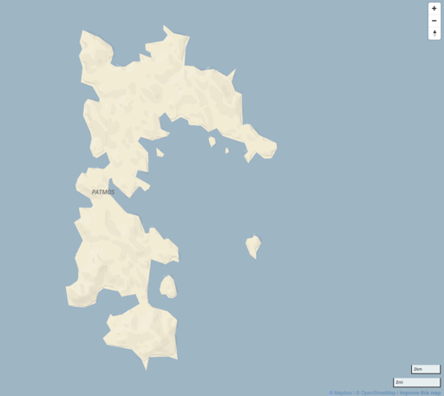
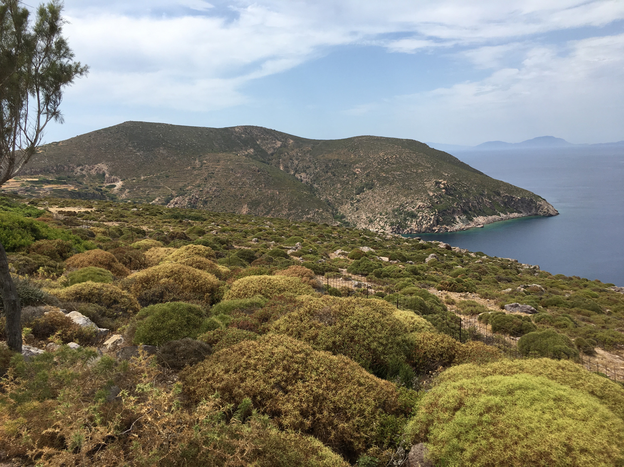
John the Apostle was exiled to Patmos, a small, barren volcanic island off the coast of modern Turkey, about AD 95

Slide 8
John’s Commission Revelation 1:9-11
John is to write to 7 cities in Asia located on a road making a loop tying together this area - each is a mail hub

Slide 9
Glorious Appearance of the Son of Man Revelation 1:12-18
Revelation 1:12–16. What John sees.
John turns & first sees seven golden lampstands upon which an oil lamp would be placed

Slide 10
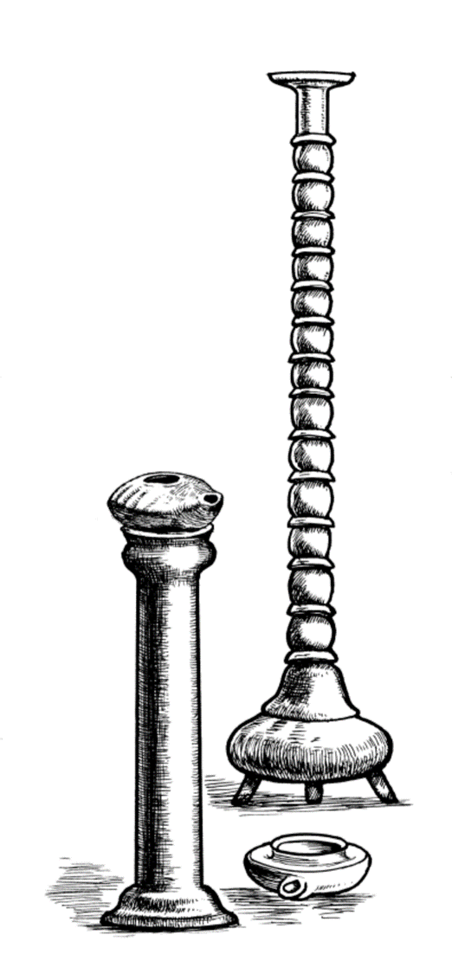
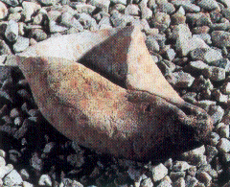
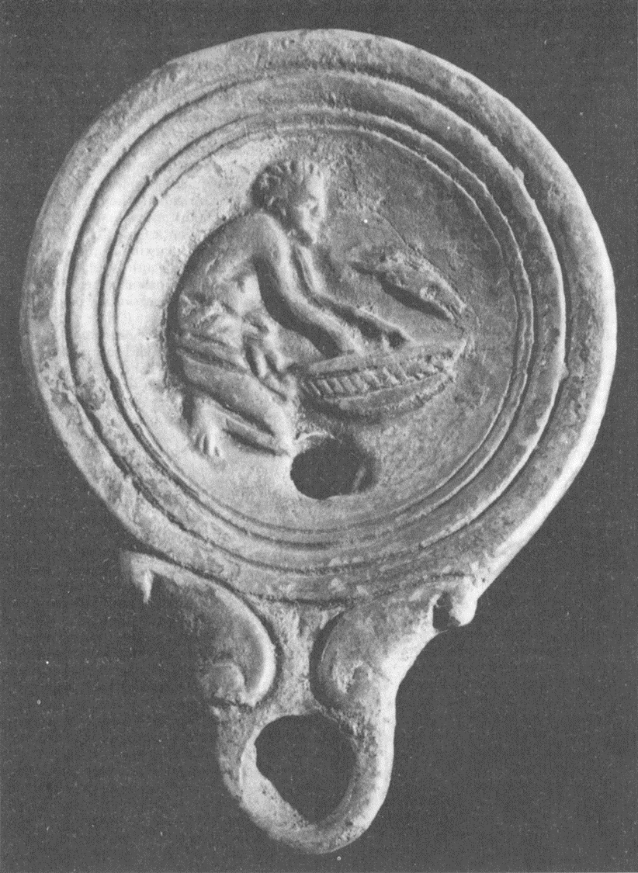
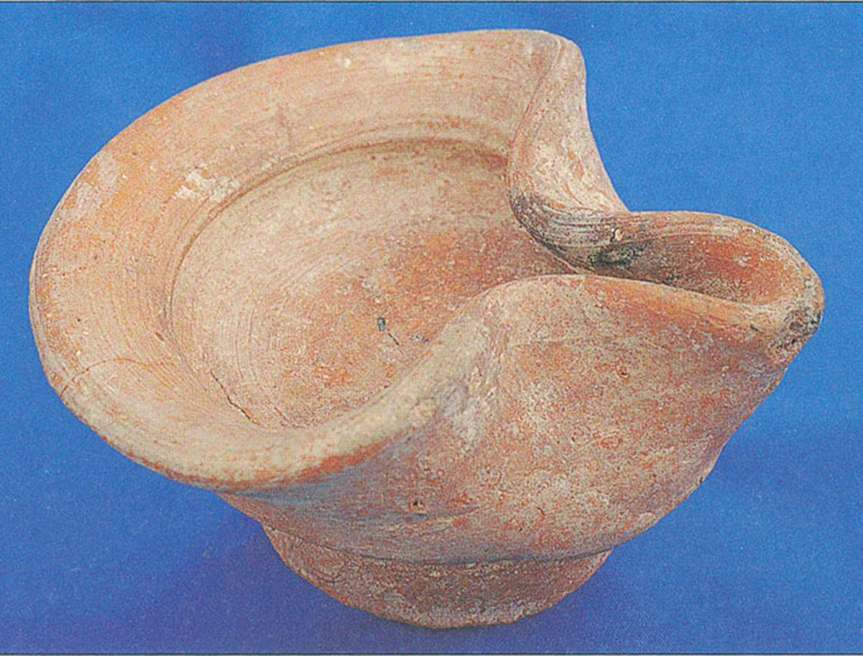
Lampstand Lamps
Gold demonstrates value & importance

Slide 11
Glorious Appearance of the Son of Man Revelation 1:12-18
One like a son of man - a human form is in the midst / among the lampstands
“Son of man” could be a human (Job, Psalms, Ezekiel, etc) or a Messianic title (Daniel; Gospels)
His clothing was of great dignity

Slide 12
Glorious Appearance of the Son of Man Revelation 1:12-18
Head and hair white like wool, like snow matches description of the Ancient of Days - Daniel 7:9
His eyes were like a flame of fire - also in Rev. 2:18 & 19:12, same as angel in Daniel 10:6

Slide 13
Glorious Appearance of the Son of Man Revelation 1:12-18
His feet were like burnished bronze - also in Rev. 3:18. Similar to angel in Daniel 10:6; God’s glory - Ezk 1
His voice was like the sound of many waters - used in Ezek. 43:2 for the glory of the God of Israel

Slide 14
Glorious Appearance of the Son of Man Revelation 1:12-18
The descriptions so far are simile & metaphor - not allegory or even presented as symbolic

Slide 15
Glorious Appearance of the Son of Man Revelation 1:12-18
Having in His right hand seven stars - that is the hand of strength, will be explained in vs. 20
Sharp two-edged sword from out of His mouth - large, broad war sword used to kill - Rev. 19:15, 21

Slide 16
Glorious Appearance of the Son of Man Revelation 1:12-18
Rev. 2:16 is a warning of war on the unrepentant - this is more than a figure of speech for a sharp tongue
His face was like the sun shining in its power - angel in Daniel 10:6; the Transfiguration - Matthew 17:1-7

Slide 17
Glorious Appearance of the Son of Man Revelation 1:12-18
John fell at His feet - humans encountering a glorious heavenly being are frightened, undone, humbled
Just as at the Transfiguration, Jesus intervenes to remove John’s fear

Slide 18
Glorious Appearance of the Son of Man Revelation 1:12-18
I am the first and the last - statement of being the eternal one - Isaiah 41:4; 43:10-11; 44:6; 48:10
I am the living one - statement of true deity as the self-existent one, a contrast to dead idols - Jer. 10:6-16

Slide 19
Glorious Appearance of the Son of Man Revelation 1:12-18
I was dead, & behold, I am alive forevermore - resurrection to eternal life, Jesus is the first fruit - 1 Cor 15
I have the keys of death & of Hades - Keys = authority. Jesus has authority over death & place of the dead

Slide 20
Glorious Appearance of the Son of Man Revelation 1:12-18
Jesus can give eternal life (John 10:27-30)
Or condemn to eternal punishment (Matt. 25:31-46)

Slide 21
Glorified Christ’s Instructions to John Revelation 1:19-20
John is commanded to write things you have seen, things that are, things which will take place after
Vs. 20 - Jesus reveals a mystery, something previously hidden is uncovered and explained

Slide 22
Glorified Christ’s Instructions to John Revelation 1:19-20
Seven stars in right hand are a[ggeloV / angelos - angels or messengers of the seven churches
These stars receive commendation and rebuke - that does not fit angels - messengers from God

Slide 23
Glorified Christ’s Instructions to John Revelation 1:19-20
Stars can represent a teacher, good or bad (Dan. 12:3; Jude 13), these are human messengers
It is someone respected in that church who will carry the message of the Revelation back to that church

Slide 24
Glorified Christ’s Instructions to John Revelation 1:19-20
The lampstands represent the 7 churches, and Jesus is in the midst of them ready to give each a message

Slide 25
Conclusions
People are comfortable with Jesus if He does not pose a threat (a baby or a good teacher meek & mild)
Jesus is glorious & exalted beyond the description of any mere human. He is God incarnate

Slide 26
Conclusions
Jesus is the Savior giving eternal life all who repent and believe - Love Him!
Jesus is the just judge who condemns eternally the unrighteous who do not repentant - Fear Him!

Slide 27
Grace Bible Church Glorifying God by Making Disciples of Jesus Christ

