Slide 1
Grace Bible Church Glorifying God by Making Disciples of Jesus Christ

Slide 2
A reminder to consider others Please:
Silence your cell phone & all electronic devices
Use the nursery or cry room if your child is fussy
Get up during the preaching only if absolutely necessary (please sit in back if you must leave early)
Refrain from eating & drinking during worship service (except medical needs)
Notes:
2

Slide 3
John’s Salutation & Commission Revelation 1:4-11
The actual author of Revelation is God the Father ➔ Jesus Christ ➔ Angel ➔ John
Literal interpretation prevailed until Augustine in 5th century. It revived due to the Reformation

Slide 4
John’s Salutation & Commission Revelation 1:4-11
Scripture is God’s revelation to man to be understood as He intended - that requires a literal hermeneutic
Revelation is a prophecy that will bring a blessing to those that read and heed it
These “things must soon take place” & “the time is near” refer to imminency & increases urgency to heed

Slide 5
John’s Salutation Revelation 1:4-5
John gives a common greeting among Christians wishing God’s grace and peace to the recipients
“From Him who is and who was and who is to come” is God the Father
“The seven Spirits who are before His throne” is God the Spirit (cf. Rev. 3:1; 4:5; 5:6; Zech. 4:1-10)

Slide 6
John’s Salutation Revelation 1:4-5
“Jesus Christ” is God the Son. The three additional titles arise from Psalm 89
The faithful witness - Ps 89:36-37. Jesus was a faithful witness to what the Father said (Jn 8:31; 12:49-50)

Slide 7
John’s Salutation Revelation 1:4-5
The firstborn of the dead - Ps. 89:27. Jesus is preeminent of those resurrected (Col. 1:18; 1 Cor. 15:23)
The ruler of the kings of the earth - Ps. 89:27. Jesus returns as “King of kings, and Lord of lords” (Rev. 19)

Slide 8
John’s Doxology Revelation 1:5-6
Jesus paid the price of redemption from our sins with His own precious blood (1 Peter 1:18-19)
God’s love is not just in the past, it is in the present too and remains current and active

Slide 9
John’s Doxology Revelation 1:5-6
Christians as priests (1 Peter 2:9-10) lead in worship and mediate between God & man
Glory refers to honor, reverence, exultation that belong to God. Dominion = power to rule / control

Slide 10
John’s Doxology Revelation 1:5-6
Forever & ever (age to age) = continuing in the future for perpetuity. Amen = pronouncement it is all true

Slide 11
The Theme of the Book Revelation 1:7-8
The promised return of Jesus underlies all the Apocalypse: What happens before, during & after His return
Jesus returns with the clouds: Daniel 7:13; Matthew 24:30; 26:64; Acts 1:9-11
His coming is imminent - present tense “is coming” instead of future tense “will come”

Slide 12
The Theme of the Book Revelation 1:7-8
Nothing hidden / secretive about Jesus’ return - every eye will see Him
“Those who pierced Him” - cf. Zech. 12:10 & Isaiah 53:5. Those who would have agreed to Jesus’ death

Slide 13
The Theme of the Book Revelation 1:7-8
Not the mourning of repentance, but of wailing, violent outcries alternating with laments - Zech. 12:10
John gives an emphatic “Yes! Amen” - This absolutely certain. The speaker of vs. 8 also verifies it.

Slide 14
The Theme of the Book Revelation 1:7-8
God the Father & God the Son are co-equal in all attributes - Jesus’ manifests the Father (Col. 2:9; Heb. 1:3)
Jesus uses the covenant name of God, “I am,” (Exod 3:14) of Himself in John 8:58

Slide 15
The Theme of the Book Revelation 1:7-8
Alpha & Omega / first & last / beginning & end are used of Jesus (Rev. 22:13) and the Father (Isa. 41:3; etc)
The Almighty is used of the Lord God distinguished from the lamb (Rev. 21:22) & of the Lamb (Rev. 15:3

Slide 16
The Theme of the Book Revelation 1:7-8
“Who is & who was & who is to come” is used for the Father (Rev. 1:4; 4:8), but Jesus is also eternal (Jn 1:1
Jesus is the subject of vs. 7, but in vs. 8 it is the Lord God that attests to the truth of vs. 7

Slide 17
The Theme of the Book Revelation 1:7-8
No passage definitively uses “Lord God” for the Son; The Father attests to the Son (Mt. 3:16-17; 17:2-5)
OT law requires witness to be borne by someone other than self (John 5). The Father assures truth of vs. 7

Slide 18
John’s Commission Revelation 1:9-11
John humbly identifies himself as “brother” & “fellow partaker” with those also suffering for Jesus
Suffering is normal for the disciples of Christ (Acts 3, 5, etc.) in the “fellowship of suffering” (Phil. 3:10)

Slide 19
John’s Commission Revelation 1:9-11
Emperor Domitian became an ego-maniac & caused a lot of people to suffering including faithful Christians

Slide 20
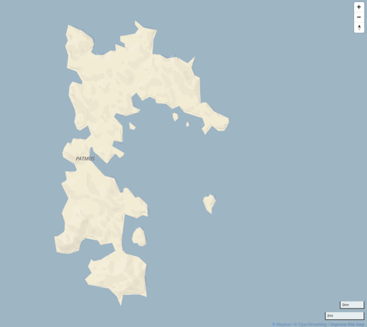
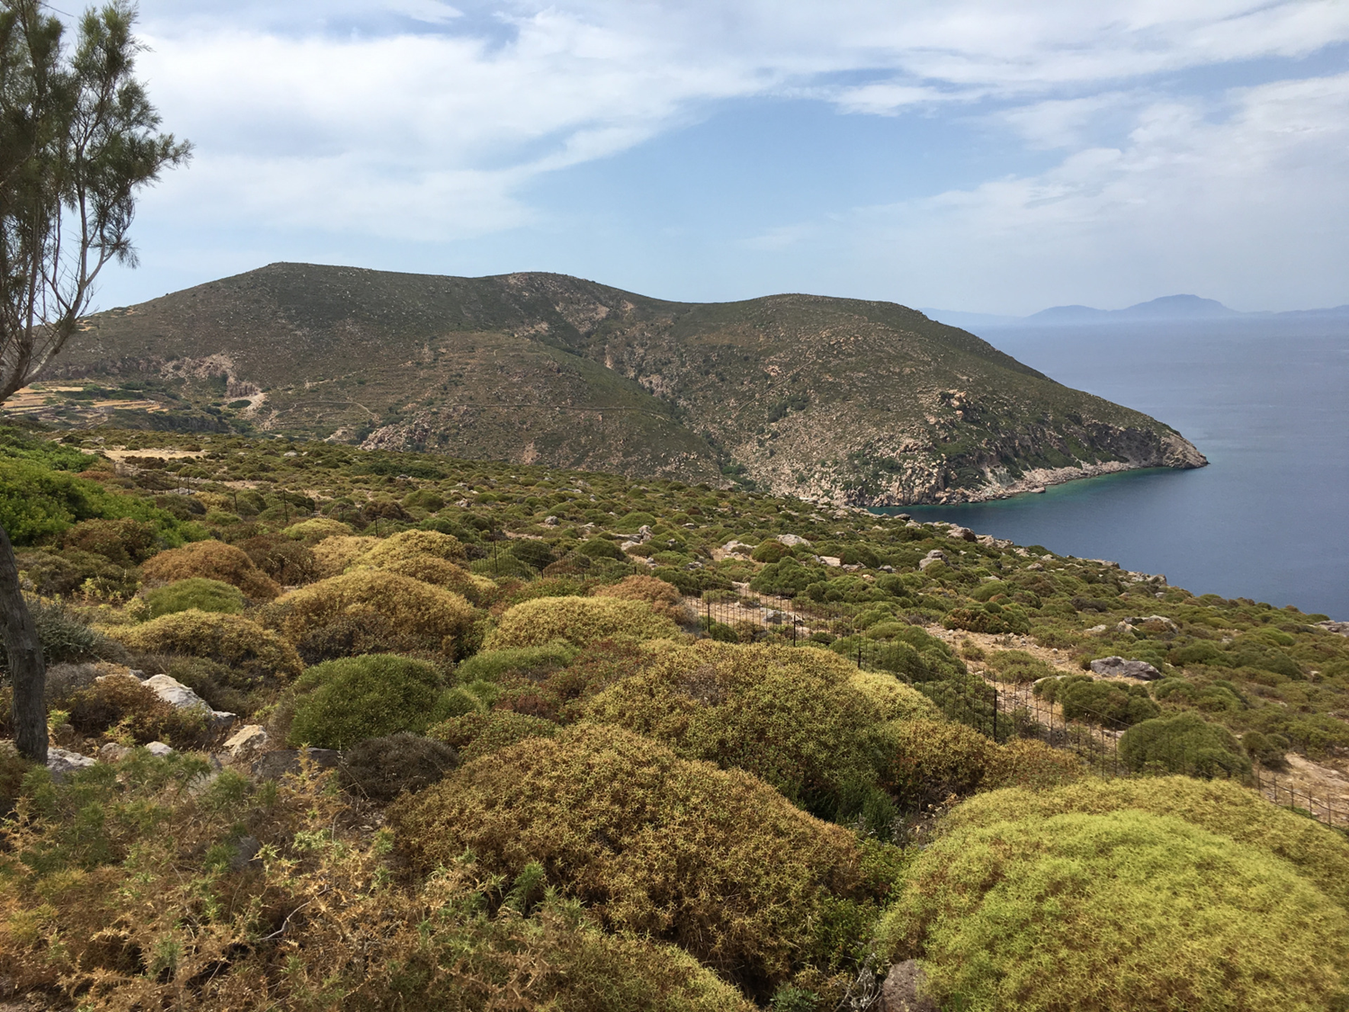
John was exiled to Patmos, a small, barren volcanic island off the coast of modern Turkey, about ad 95

Slide 21
John’s Commission Revelation 1:9-11
John was “in the Spirit” - an ecstatic state which would have been similar to Ezekiel (2:2; 3:12, 14, 24)
This occurred on “the Lord’s Day” - not the “Day of the Lord” - which would not fit this context

Slide 22
John’s Commission Revelation 1:9-11
“The Lord’s Day” was used at that time & area to refer to the first day of the week, our Sunday
Acts 20:7; 1 Cor. 16:2 - the practice of some churches meeting on the first day of the week began early

Slide 23
John’s Commission Revelation 1:9-11
Rom. 14:5-6; Gal. 4:10; Col. 2:16-17 - meeting for worship is according to preference - it varies worldwide

Slide 24
John’s Commission Revelation 1:9-11
John hears a loud voice like a trumpet - he will hear after this many loud voices from different beings
This is the voice of Jesus - who is described in verses 12-20
John is told to write a book and send it to seven particular churches located in the Roman province of Asia

Slide 25
John’s Commission Revelation 1:9-11
These cities are located on the road that makes a loop that ties together this area of Asia - each is a mail hub

Slide 26
John’s Commission Revelation 1:9-11
The specific letter to each church would be shared with all - indicating application to similar churches

Slide 27
John’s Commission Revelation 1:9-11
Allegorical interpretation of these churches representing time periods of any kinds is foreign to the text
Everything is particular: person, place, time, reason, state of being, day, command, book, churches

Slide 28
Conclusions
John is not writing mystical allegory - he writes to bless those who read & heed this prophecy

Slide 29
Grace Bible Church Glorifying God by Making Disciples of Jesus Christ

