Slide 1
Grace Bible Church
Glorifying God by Making Disciples of Jesus Christ

Slide 2
A reminder to consider others Please:
Turn off your cell phone or set to vibrate only
Turn off sound to all electronic devices
Use the nursery or cry room if your child is fussy
Get up during the preaching only if absolutely necessary (please sit in back if you must leave early)
Notes:
2

Slide 3
Tis’ No Myth
Selected Scriptures
What makes Grace Bible Church different?
We believe the Bible to be God’s word & true, not a myth
We live by its teachings – 2 Peter 1:2-4
Those denying the miracles of the Bible also deny its promises

Slide 4
Tis’ No Myth
Selected Scriptures
Christmas season mythologies endanger the true story of Christmas as recorded in the Scriptures

Slide 5
Christmas Myths and Traditions
There are many fine and wonderful Christmas traditions that would be good to adopt.
Even traditions originating in pagan practices can / have been changed to symbolize the truth

Slide 6
Christmas Myths and Traditions
The Christmas tree –
  Evergreen = eternal life.
  Decorations vary.
    Popcorn
    Candy / cookies
    Lights
  Jesus died on a tree giving us hope

Slide 7
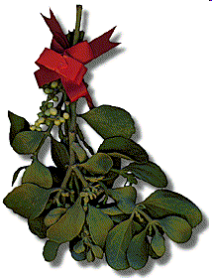
Christmas Myths and Traditions
Mistletoe –
A Roman & Scandinavian symbol of peace - Enemies dropped their weapons and kissed in peace under it.

Slide 8
Christmas Myths and Traditions
Holly – an evergreen
The thorns symbolized Jesus’ crown of thorns;
The red berries His blood.

Slide 9
Christmas Myths and Traditions
Romans 14:23 - if you do not have faith to participate, it is sin to you and you must refrain
God redeems even symbols to make them reflective of Himself

Slide 10
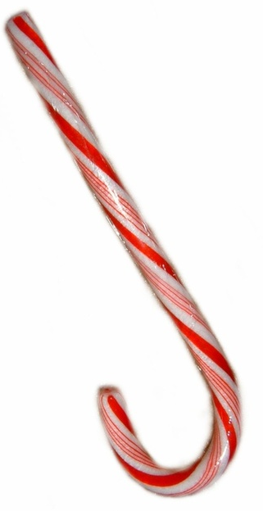
Christmas Myths and Traditions
The Candy Cane
Created by an Indiana candy make to reflect Jesus’ life, nature and death

Slide 11
Christmas Myths and Traditions
Gifts are given as a reflection of God’s gift to us - Jesus
Christmas cards are sent as joyous greetings and wish well to others

Slide 12
Concerns about Christmas
Traditions and Myths
Commercialization removes the joy by making gifts obligatory and happiness dependent on materialism
Even evangelical churches have cancelled their worship services so people could celebrate “Christmas”

Slide 13
Concerns about Christmas
Traditions and Myths
Runaway myths tend to cover up the meaning of Christmas
Santa Claus was first patterned after Nicholas, Bishop of Lycia, in Asia Minor (4th century)

Slide 14
Concerns about Christmas
Traditions and Myths
The tradition of the Dutch “Sinterklaas” was brought to America and modified in the 1800's
  Washington Irving - 1809 (book)
  Clement Moore - 1822 (poem)
  Thomas Nast - 1860's (illustrations)

Slide 15
Concerns about Christmas
Traditions and Myths
Qualification - Santa as a myth can be enjoyed without harm
Danger 1 - Bribing a child to be good.
  God loved us while we were yet sinners (Romans 5:8)
Danger 2 - Damaging your children’s ability to trust you to tell the truth

Slide 16
Concerns about Christmas
Traditions and Myths
Danger 3 - Confusing truth and myth leading to doubt about the truth of the story of Jesus
Keep the proper emphasis on Jesus, but you can enjoy Christmas myths - as long as they are presented as fiction

Slide 17
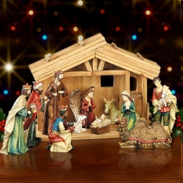
The Scene at the Manger
Luke 2
The manger scene has been romanticized into a wonderful place to be – and unthreatening.

Slide 18
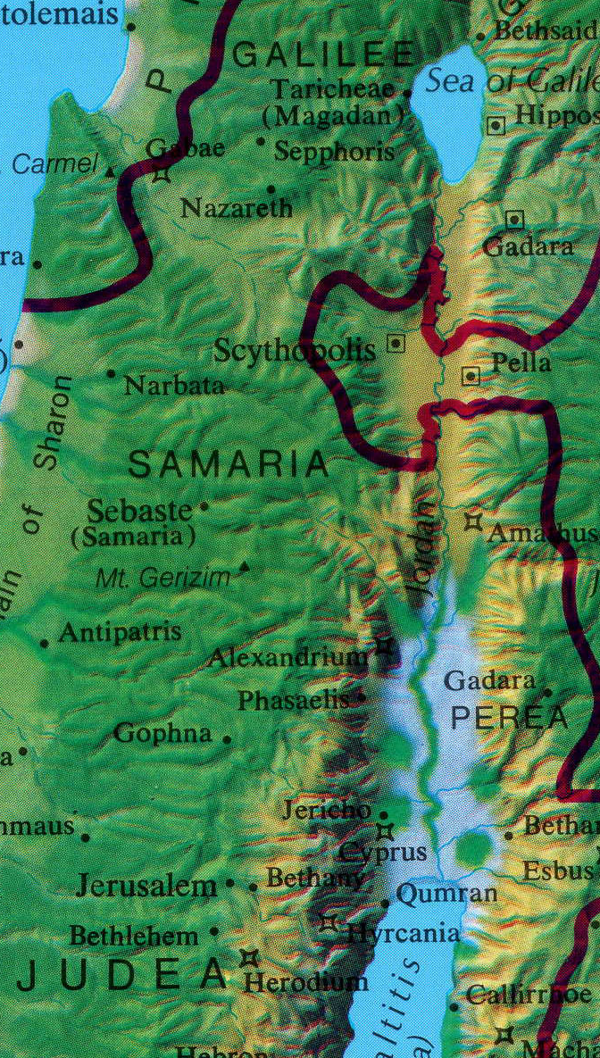
The Scene at the Manger
Luke 2
Nazareth *
Luke 2 - Joseph & Mary have traveled 70 miles from Nazareth to Bethlehem
Jerusalem *
Bethlehem *

Slide 19
The Scene at the Manger
Luke 2
The only place they can find to stay is a stable, and Mary is near her time to give birth
The newborn Jesus is wrapped in cloths and laid in a feeding trough filled with hay
Philippians 2:6-8 - The reality of the scene is fitting with Jesus’ humility

Slide 20
The Scene at the Manger
Luke 2
Luke 2:10-14 - The angels announce the birth to shepherds, who go to see the Lord
Luke 2:21-38 - Jesus is circumcised, then presented at the Temple where Simeon & Anna see Him

Slide 21
The Events that Followed
Matthew 2
An unknown number of Magi from the East arrive in Jerusalem bringing three gifts
They find Jesus in a house (Mt. 2:11), arriving up to two years after His birth (Mt. 2:16).
A Christmas creche symbolizes the broader story, not an actual event itself

Slide 22
The Consequences of the Story
If the Christmas story were simply a myth, men could romanticize it as they liked and not fear God

Slide 23
The Consequences of the Story
Jesus’ birth fulfills at least 11 Hebrew prophecies including:
  His lineage (Gen 12:3; 49:10; Isa. 9:7)
  Being born of a virgin - “seed of a woman” (Isaiah 7:14; Gen. 3:15)
  Place of birth (Micah 5:2)
  Time of birth (Daniel 9:25)

Slide 24
The Consequences of the Story
God became a man and intervened into the affairs of men - there is hope of salvation from sin
Jesus did not stay a baby - He grew up, lived a sinless life, died as sin sacrifice, & rose from the dead
His return is a certainty - are you ready for it?

Slide 25
Conclusions
Do not let cultural myths and customs crowd out Jesus
Tis’ no myth - it’s the truth.
Let's proclaim it, celebrate it, and live according to it.

Slide 26
Grace Bible Church
Glorifying God by Making Disciples of Jesus Christ

