Slide 1
Grace Bible Church Glorifying God by Making Disciples of Jesus Christ

Slide 2
A reminder to consider others Please:
Turn off your cell phone or set to vibrate only
Turn off sound to all electronic devices
Use the nursery or cry room if your child is fussy
Get up during the preaching only if absolutely necessary (please sit in back if you must leave early)
Notes:
2

Slide 3
The Beginnings of the Future Tribulation Matthew 24:1-14; Mark 13:1-13; Luke 21:5-19
The Great War
Armistice Day
Tragedies of WW I
Mankind can expect to have continual war until the Lord returns and sets up His kingdom

Slide 4
The Setting Matthew 24:1-2, Mark 13:1-2, Luke 21:5-6
Jesus began ministry with “Repent, for the kingdom of heaven is at hand,” but the kingdom was now distant
Jesus had entered the Temple on Monday to the cries of the people proclaiming Him to be the Messiah

Slide 5
The Setting Matthew 24:1-2, Mark 13:1-2, Luke 21:5-6
Jesus spent Wednesday answering various religious leaders and concluded with warnings and woes
Jesus’ lamented their unwillingness to receive Him, their house was left to them desolate

Slide 6
The Setting Matthew 24:1-2, Mark 13:1-2, Luke 21:5-6
Jesus left the Temple, went up the Mount of Olives and the disciples remark on the Temple’s beauty

Slide 7
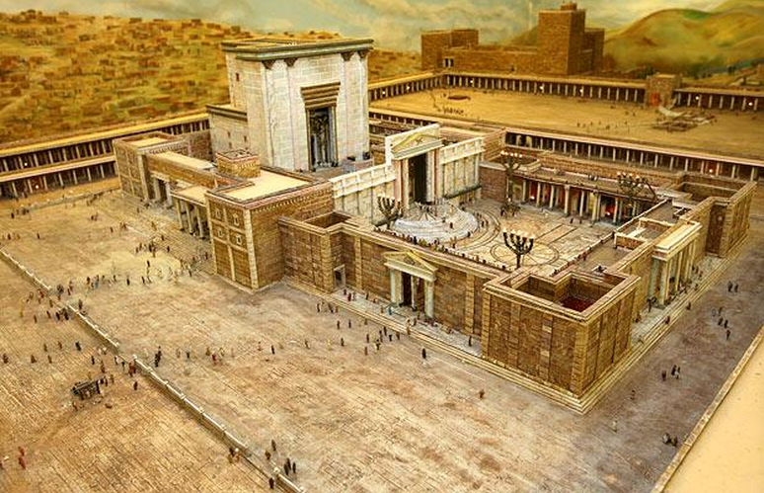
The Setting Matthew 24:1-2, Mark 13:1-2, Luke 21:5-6

Slide 8
The Setting Matthew 24:1-2, Mark 13:1-2, Luke 21:5-6
Jesus responds that the Temple would be completely torn down - and it was in 70 AD

Slide 9
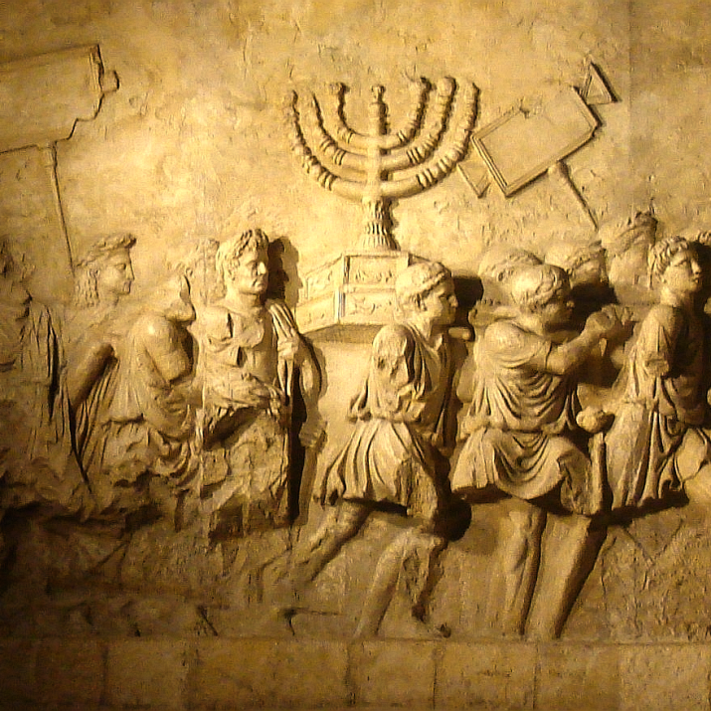
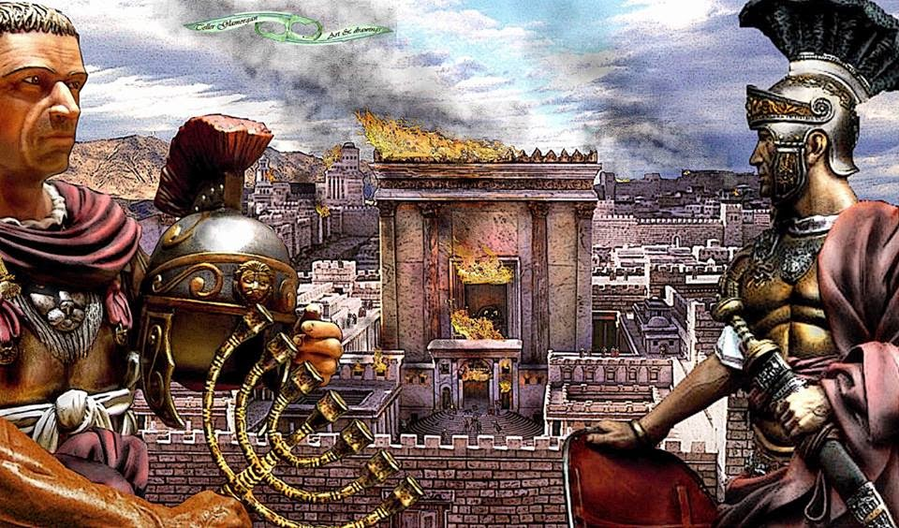
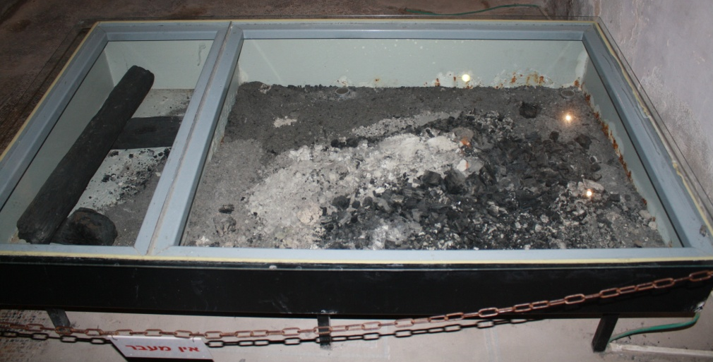
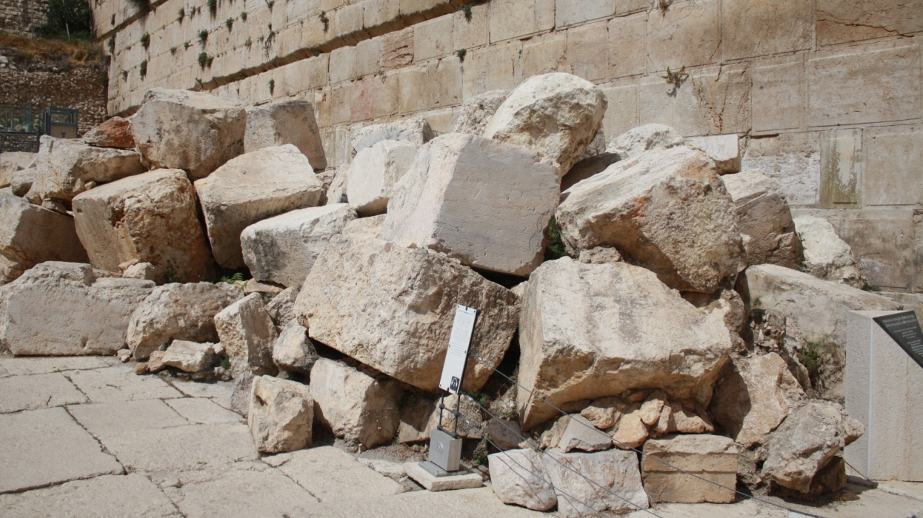
Destruction of the Temple – 70 AD

Slide 10
The Questions Matthew 24:3; Mark 13:3-4; Luke 21:7
The questions must be understood as coming from Jewish men with expectations of the Messiah
There would be tribulation before His return (Zechariah 14, etc.).
There would be an Elijah forerunner first - Jesus said it was John the Baptist

Slide 11
The Questions Matthew 24:3; Mark 13:3-4; Luke 21:7
The Messiah would appear and fulfill the Hebrew prophecies restoring the Jewish kingdom
They want to know when Messiah would establish His kingdom
They want to know the signs that Messiah would take His place as King

Slide 12
The Questions Matthew 24:3; Mark 13:3-4; Luke 21:7
They wanted to know the signs of the end of the current age and beginning of the Messianic age
After Jesus resurrection they were still looking the kingdom to be restored - Acts 1:6

Slide 13
The Scope of Jesus’ Answer
Jesus addresses them, but is speaking prophetically as did the prophets - example: Zechariah 9:9

Slide 14
The Scope of Jesus’ Answer
Evidence: Matthew 24 details many things that did not happen in their lifetimes, & still have not happened
Gospel preached to all the world
Abomination of desolation
Unparalleled Tribulation
Signs in the heavens

Slide 15
The Scope of Jesus’ Answer
Jesus’ answer is for those alive at the beginning of the events of Revelation: Matt. 24 parallels Rev. 6
The church will suffer persecution, but not God’s wrath (1 Thess. 1:10; 5:9, Rev. 3:10)

Slide 16
The Scope of Jesus’ Answer
The church will be caught up (raptured) prior to the Tribulation period due to the Scriptures indicating it
Rapture a comfort to believers
Church exempt from God’s wrath
Church not in Revelation 6-18
Allows for non-glorified human population during Millennium

Slide 17
The Early Signs of End of the Age Matthew 24:4-14; Mark 13:5-13; Luke 21:8-19
1) False Christs – vs. 4-5, Luke 21:8
Many have made this claim in the past & present, and more to come in the future
2) Wars & Rumors of War – vs. 6-7
Corresponds to 1st & 2nd Seal, Rev. 6:1-4, the first two horsemen

Slide 18
The Early Signs of End of the Age Matthew 24:4-14; Mark 13:5-13; Luke 21:8-19
3) & 4) Famine, Plagues & Earthquakes – vs. 7 & Luke 21:11
Correspond to 3rd, 4th & 6th Seals, Revelation 6:5-8, 12
These are only the beginning of birth pangs - they become more severe and frequent

Slide 19
The Early Signs of End of the Age Matthew 24:4-14; Mark 13:5-13; Luke 21:8-19
5) Persecution of Believers – vs. 9
Corresponds to 5th Seal, Revelation 6:9-11
Mark 13:10-11; Luke 21:12-14 - This gives opportunity to witness to governors and kings - and the Holy Spirit will direct the defense

Slide 20
The Early Signs of End of the Age Matthew 24:4-14; Mark 13:5-13; Luke 21:8-19
6) Apostasy, Betrayal & Hatred – vs 10-13
Hatred is bad, but betrayal by family & friends is worse
Apostasy due to fear (avoid suffering or being an outcast) and being lead astray by false teachers

Slide 21
The Early Signs of End of the Age Matthew 24:4-14; Mark 13:5-13; Luke 21:8-19
Lawlessness increases:
Selfishness,
Enticements to sin,
Love that grows cold and can become hatred
God preserves a remnant that will resist temptation and hold fast to their faith

Slide 22
The Early Signs of End of the Age Matthew 24:4-14; Mark 13:5-13; Luke 21:8-19
7) Terrors & Great Signs from Heaven Luke 21:11
Corresponds to the 6th Seal, Revelation 6:12-13
Sun darkened, moon becomes like blood, stars fall, sky split apart as a scroll

Slide 23
The Early Signs of End of the Age Matthew 24:4-14; Mark 13:5-13; Luke 21:8-19
8) Global Gospel Proclamation – vs. 14
Supernaturally empowered witnesses - Revelation 7, 11, 14
These are the preliminary signs after which the end will come

Slide 24
God has revealed aspects of a future already determined - how will you respond to that knowledge?
That will depend on these 3 factors:
Your understanding of them
Your trust in God to keep His word
Your own relationship with Jesus

Slide 25
Grace Bible Church Glorifying God by Making Disciples of Jesus Christ

