Slide 1
Grace Bible Church Glorifying God by Making Disciples of Jesus Christ

Slide 2
A reminder to consider others Please:
Silence your cell phone & all electronic devices
Use the nursery or cry room if your child is fussy
Get up during the preaching only if absolutely necessary (please sit in back if you must leave early)
Refrain from eating & drinking during worship service (except medical needs)
Notes:
2

Slide 3
The Creation of Man Genesis 1
Biblical understanding of marriage is critical in a society in which the family is under constant attack
While there will be a focus on marriage, the principles and skills apply to all human relationships

Slide 4
The Days of Creation Genesis 1
The primary problem in all of life is forgetting your origin & therefore your purpose in life (Ps 100:3)
1 Cor. 11:8-12 - woman originates from Adam & man’s birth is through the woman. All originates in God

Slide 5
The Days of Creation Genesis 1
Evolutionary philosophy rejects God (atheism) or questions Him (agnosticism) or He is uninvolved (deism)

Slide 6
Genesis 1 Overview
Day Vs. Action
1 1-5 Heavens & Earth; Light; Divided light & Darkness
2 6-8 Expanse between waters
3 9-13 Seas; Dry land; Vegetation, seed plants, fruit trees
4 14-19 Sun, Moon & stars, ordered movement

Slide 7
Genesis 1 Overview
Day Vs. Action
5 20-23 Water creatures; Birds
6 24-31 Land creatures: cattle, beasts, creeping things; Man made in God’s image & given rule over living things & Earth; Plants given as food for man & animals
7 2:1-3 God rested

Slide 8
Order of Creation vs. Evolution
is contradictory
Evolution | Creation
Matter is eternal | God is eternal (1)
Sun & stars before Earth | Earth before Sun & stars (1, 14)
Sun: Earth’s 1st light | Light before Sun (3,16)
Sun before plants | Plants before Sun (11,16)
Land before seas | Seas before land (3,10)

Slide 9
Evolution | Creation
Contiguous Atmosphere & hydrosphere | Atmosphere between two hydrospheres (6,8)
First Life: Marine cells | First life: Land plants
Fish before trees | Trees before fish (11, 20)
Insects & Reptiles before birds | Birds before Insects and Reptiles (20,24)
Woman before man | Man before woman
Rain before man | Man before rain

Slide 10
Day One – Verses 1-5
In the beginning:
Denies the eternity of time
In the beginning God:
Denies atheism and polytheism
In the beginning God created:
Denies fatalism / chance
Denies progressive / infinite becoming

Slide 11
Day One – Verses 1-5
In the beginning God created the heavens and the earth:
Denies pantheism
Denies eternal materialism (basis of evolution)

Slide 12
The earth was formless and void, and darkness was over the surface of the deep; and the Spirit of God was moving over the surface of the waters Genesis 1:2

Slide 13
No time gap suggested in verse 2,
conjunction (waw) connects it to vs. 1
No Biblical or theological reason for an extended period of time for Satan’s fall
“ruined & desolate” is a mistranslation
Reconstruction / Re-creation fails:
Contrary to the text
Have death prior to sin (cf. Rom. 5:12)
No evidence of previous world if recreated or reconstructed

Slide 14
God created light. He saw the light was good. He separated light from darkness. Genesis 1:3-4

Slide 15
He called the light day, He called the darkness night Evening & Morning, one day Genesis 1:5

Slide 16
Yom = Day. Context determines whether figurative or literal and length of time.
Yom – used figuratively – 65 times . - used literally – 1200 + 700 times
Genesis 1:5
Yom / day = period of light
Yom / day = sequence of evening & morning. (Cf. Vs 5, 8, 13, 19, 23 & 31)

Slide 17
Day 1 Genesis 1:1-5
Nothing in Genesis 1 or any Biblical reference to it suggests any figurative meaning for day. All claims of a figurative meaning are without Biblical support

Slide 18
Day 2 God makes an expanse in the midst of the waters. He separates the waters above and below the expanse He calls the expanse heaven. Genesis 1:6-8

Slide 19
Day 2 Genesis 1:6-8
The expanse (firmament) is stretched out (Isa. 40:22) - which gives possible explanation of starlight & time
Water molecules in space could be physical evidence of water being above as well as below the expanse

Slide 20
Day Three - Genesis 1:9-13
Then God said, “Let the waters below the heavens be gathered into one place, and let the dry land appear”

Slide 21
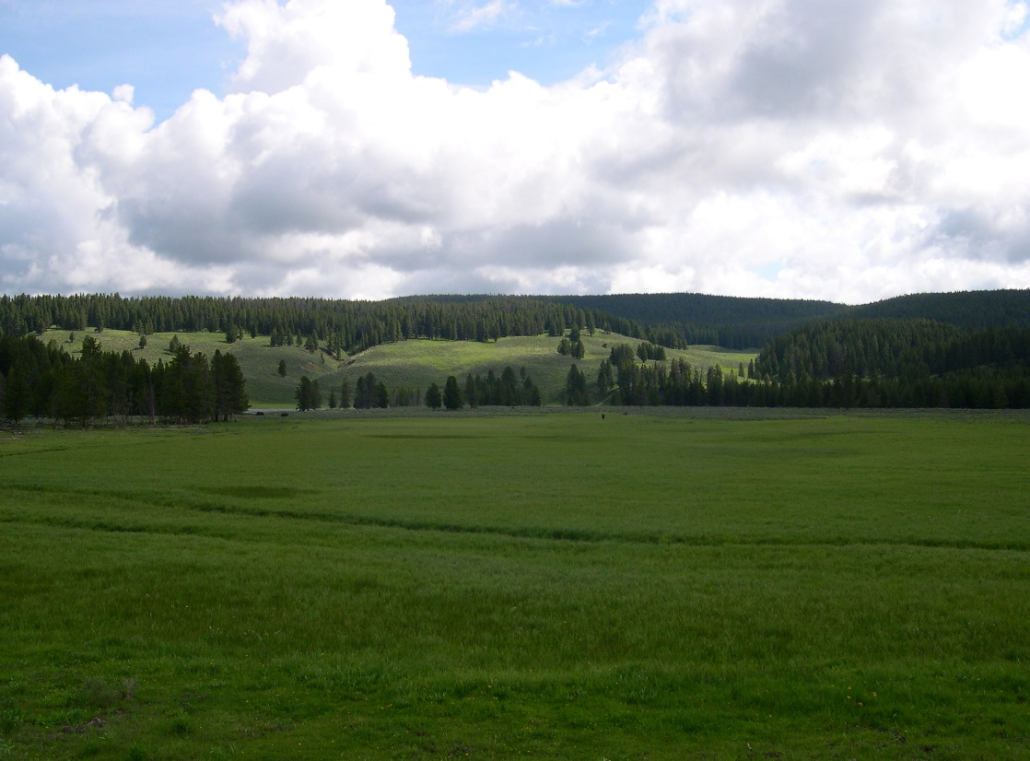
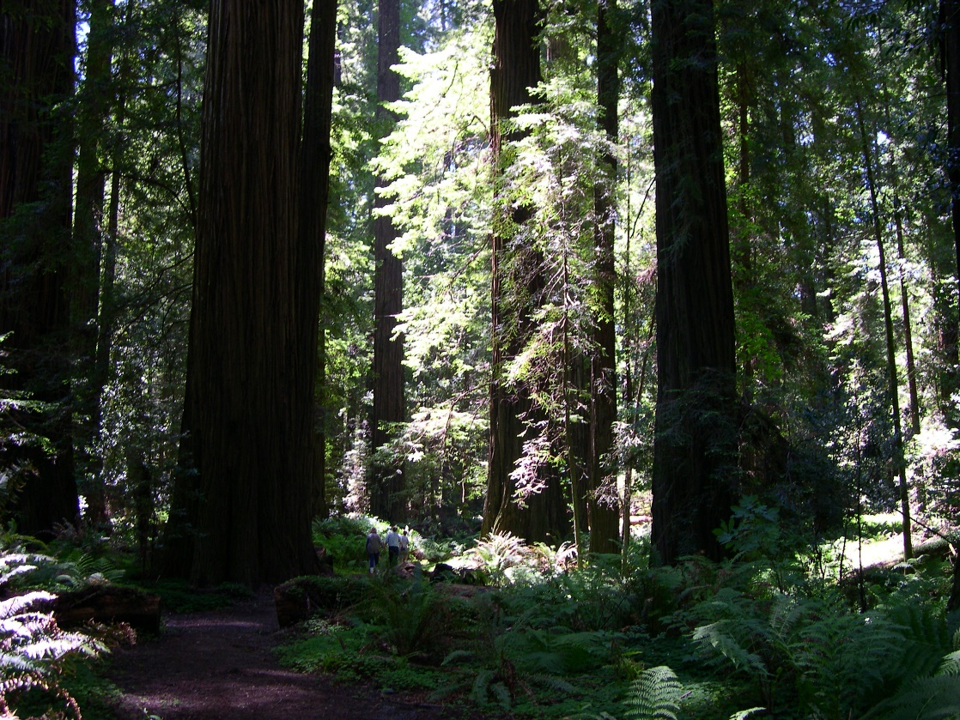
Day Three - Genesis 1:9-13
Then God said, “Let the earth sprout vegetation, plants yielding seeds, and fruit trees bearing fruit after their kind . .

Slide 22
Day Three - Genesis 1:9-13
Summary: God gathers the seas, dry land appears & plants are created

Slide 23
Day 3 Genesis 1:9-13
The length of the cycle for a day - darkness then light - cannot be long because plants need light to live

Slide 24
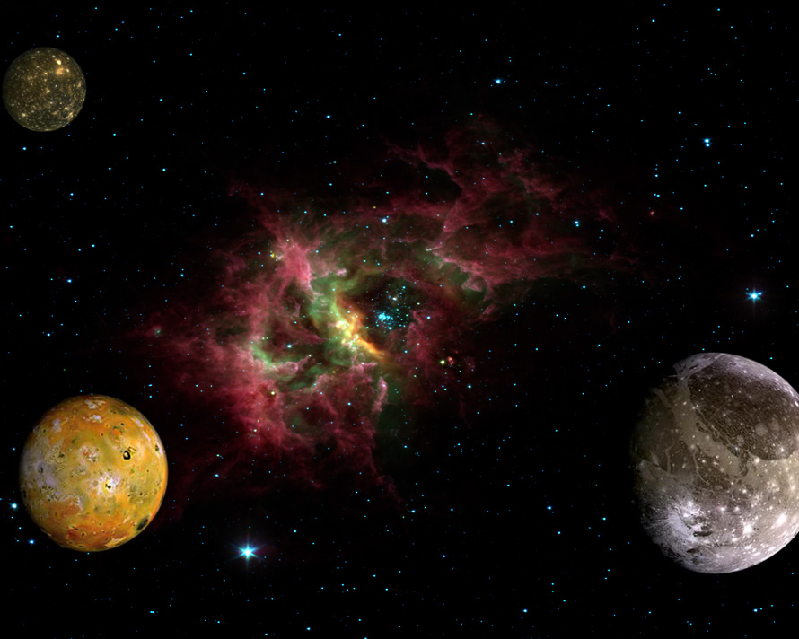
Day 4 God makes the sun for the day and the moon for the night. He also makes the stars in the sky. Genesis 1:14-19

Slide 25
Day 4 Genesis 1:14-19
The period of a day is governed by the rotational speed of earth relative to its light source - now the Sun
Whether rotational speed of earth was slightly faster or slower, each day of creation was about 24 hours

Slide 26
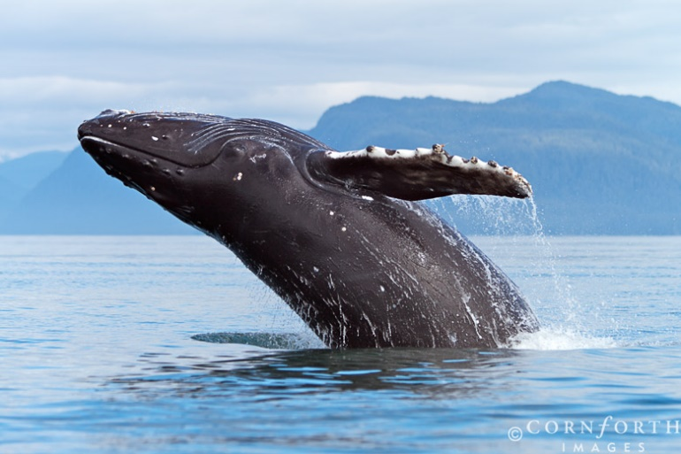
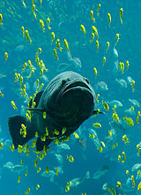
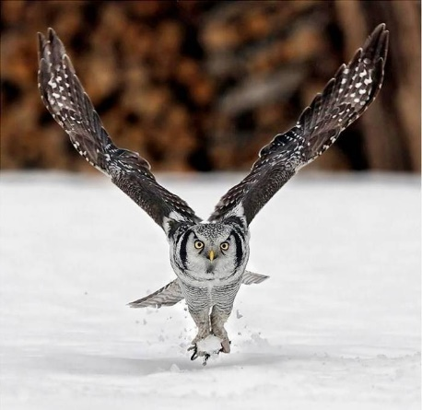
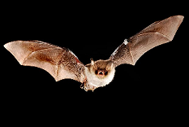
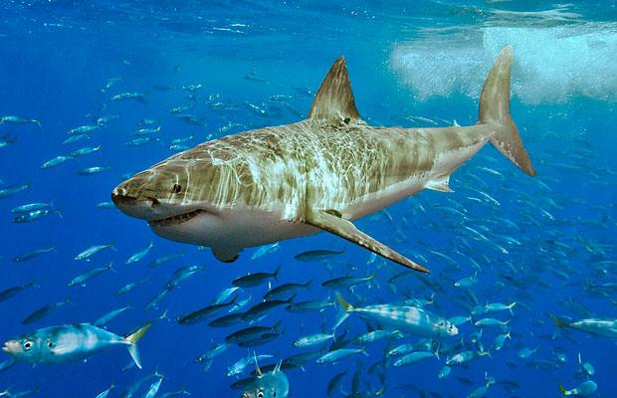
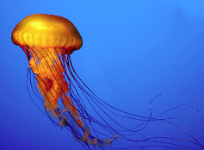
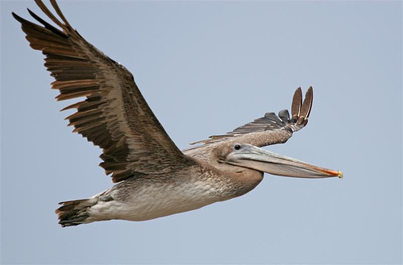
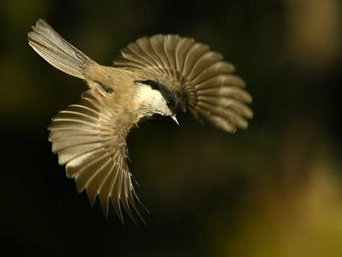
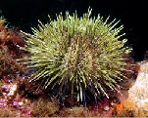
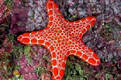
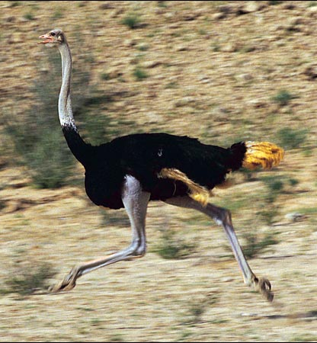
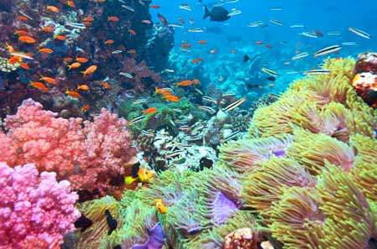
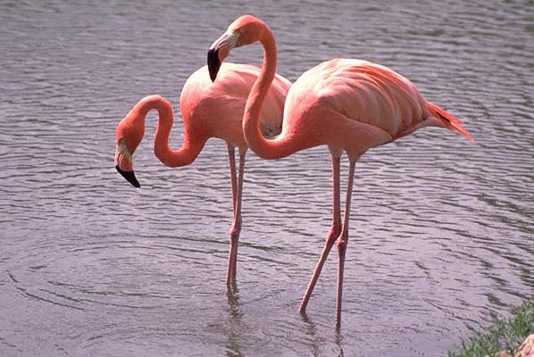
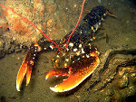
Day 5 – Genesis 1:20-23
God creates all the living creatures of
the sea
God creates all
the flying creatures
of the air

Slide 27
Day 5 Genesis 1:20-23
“Kind” defined as those animals that can reproduce viable offspring - which limits speciation
Evolution requires a gain of beneficial genetic information by random mutation contrary to law of entropy

Slide 28
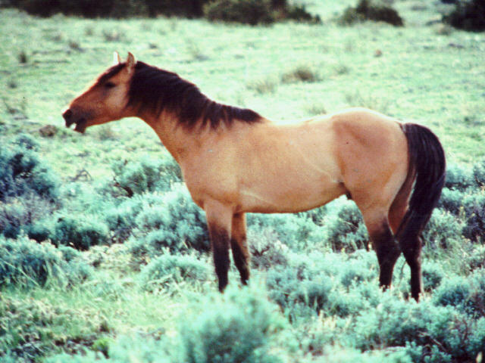
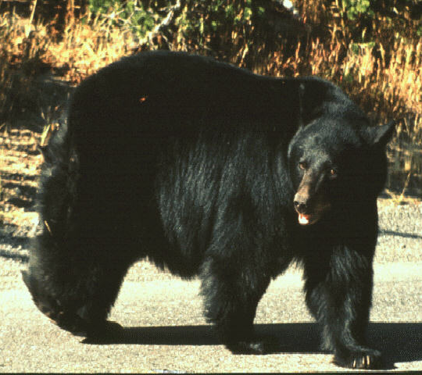
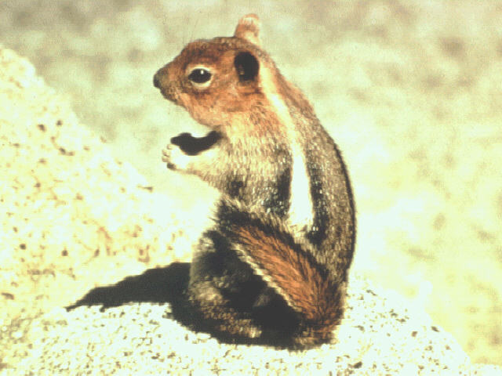
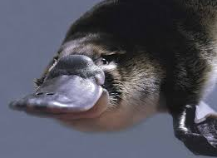
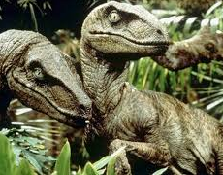
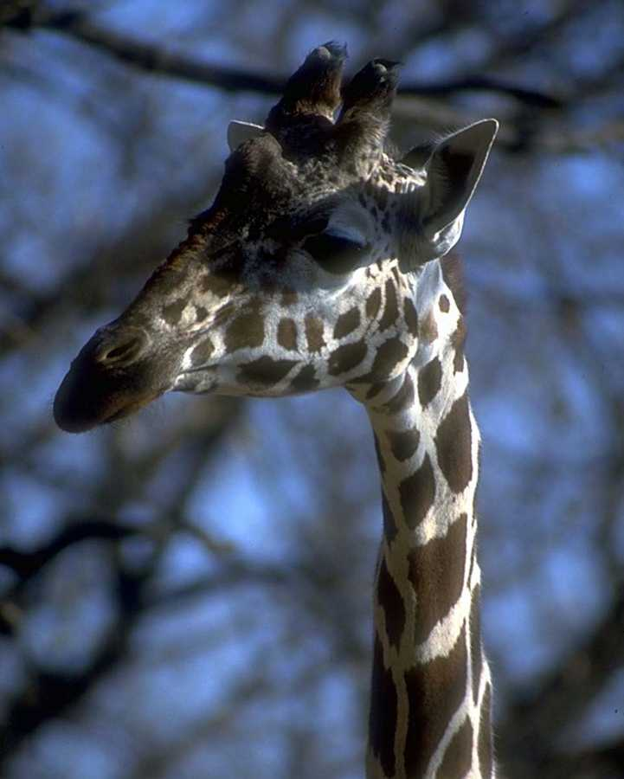
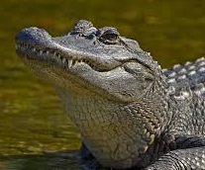
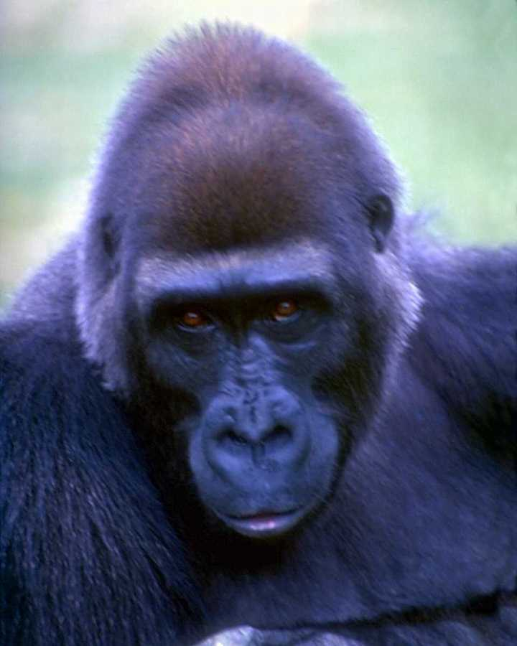
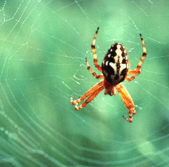
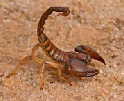
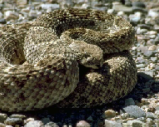
Day 6 – Genesis 1:24-31
God creates all the land animals & man

Slide 29
Day 7 God rests from all His work. He blesses the seventh day and makes it holy. Genesis 2:1–3

Slide 30
The week of creation set the pattern for mankind to follow - a 7 day work week that includes a day of rest

Slide 31
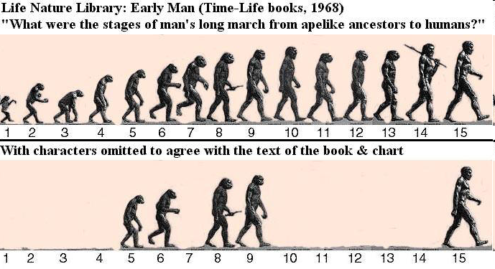
The Creation & Purpose of Man Genesis 1:26-31
1.The origin of man is God - vs 26-27

Slide 32
The Creation & Purpose of Man Genesis 1:26-31
1.The origin of man is God - vs 26-27
2. Unlike the animals, man is made in the likeness and image of God
Man reflects God in having an eternal immaterial aspect - a soul
Man reflects God in being a person - rational, emotional, volitional

Slide 33
The Creation & Purpose of Man Genesis 1:26-31
3. God created mankind with two and only two non-transmutable sexes - male & female (vs 27)
4. The plants and their fruit were given to man and animals for food (vs 29-30)

Slide 34
The Creation & Purpose of Man Genesis 1:26-31
5. Man was given three related responsibilities (vs 26-28).
Be fruitful & multiply & fill the earth
Bring the earth into subjection - bring under control so that man might gain its benefits)

Slide 35
The Creation & Purpose of Man Genesis 1:26-31
5. Man was given three related responsibilities (vs 26-28).
Rule (have dominion) over all the animals - organize, direct, protect, provide (as a king over a kingdom)

Slide 36
Conclusions
Understanding the purpose of your existence requires remembering you are a creature made by & for God

Slide 37
Conclusions
You can either accept or reject God’s revelation in Genesis 1
If you reject it:
You favor the thoughts of the fools described in Romans 1:18-23
You accept the mocking of the ungodly – 2 Peter 3:3-7
Your god is small and impotent

Slide 38
Conclusions
Every person in all actions, attitudes and roles should live according to God’s commands & will
May each of us learn and grow to know and follow the will of our merciful and gracious Creator

Slide 39
Grace Bible Church Glorifying God by Making Disciples of Jesus Christ

