Slide 1
Grace Bible Church Glorifying God by Making Disciples of Jesus Christ

Slide 2
A reminder to consider others Please:
Silence your cell phone & all electronic devices
Use the nursery or cry room if your child is fussy
Get up during the preaching only if absolutely necessary (please sit in back if you must leave early)
Refrain from eating & drinking during worship service (except medical needs)
Notes:
2

Slide 3
An Oracle of Judgment & Salvation Zechariah 9 & 10
An oracle (“burden”) is a message which has a burdensome element
The first oracle, ch. 9-11, is undated, but would have been given later in Zechariah’s ministry

Slide 4
Oracle Concerning Israel’s Enemies - Zechariah 9:1-7
Verses 1-6 fits exactly the conquest middle east by Alexander the Great in 333-32 BC
Hadrach is in western Syria ~ 28 miles sw of Aleppo. Hamath is between it and Damascus
*
*

Slide 5
Costal cities Tyre & Sidon are described as “very wise” due to trade and alliances
Tyre was extremely wealthy – silver like dust, gold like street mire
*

Slide 6
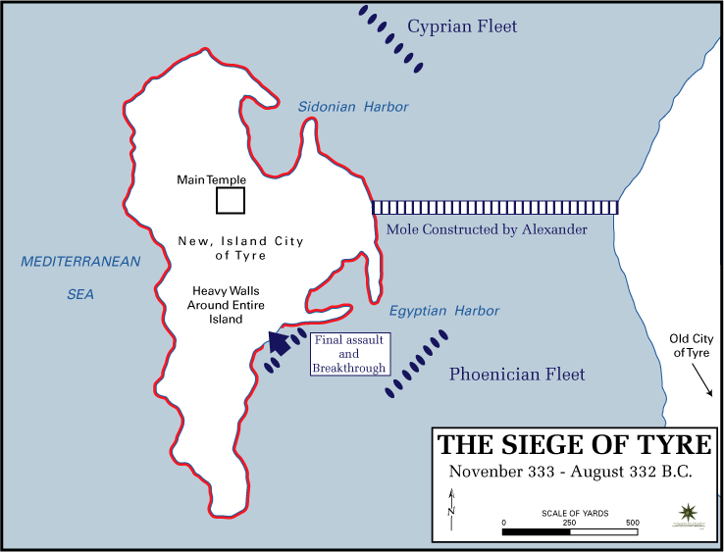
Tyre was on an island fortress – unconquered by Assyrians & Babylon.
Alexander conquered it in 7 months. He built a mole to it, set it on fire & razed it
The fall of Tyre caused fear in Philistine cities - Ekron’s alliance was now worthless

Slide 7
Gaza held out for five months, in retribution, Alexander dragged its king to death
The people of Ashkelon were killed or deported, and Ashdod was overrun by foreigners.

Slide 8
Oracle Concerning Israel’s Enemies Zechariah 9:1-7
Vs. 7 - the remnant of Philistines would end their paganism and be assimilated into national Israel

Slide 9
Yahweh’s Protection of Israel Zechariah 9:8
Josephus records Jaddua the high priest’s dream & action of opening Jerusalem & going to meet Alexander
Alexander saluted Jaddua & adored the name of God on the priest’s breastplate according to his own dream

Slide 10
Yahweh’s Protection of Israel Zechariah 9:8
God delivered Jerusalem as He said. The verse continues to foretell of the safety of the Messianic kingdom

Slide 11
The Arrival of Messiah Zechariah 9:9
Cited in Matt. 21:4-5 & John 12:14-15 as fulfilled by Jesus and described in Mark 11:6-10 & Luke 19:29-38
The characteristics described belong to Jesus - righteous, endowed with salvation, humble

Slide 12
Messiah’s Future Reign Zechariah 9:10
It shifts to the first person in verse 1 - Yahweh takes action to remove the implements of war
Messiah’s kingdom will have a reign of peace with a world-wide extent

Slide 13
Promises to the Remnant Zechariah 9:11-12
The blood of your covenant refers to God’s covenants in Genesis 15 & Exodus 24 sealed with blood
The Jews remain God’s chosen people, and the Deut. 30 promise of restoration will be kept

Slide 14
Promises to the Remnant Zechariah 9:11-12
A promise to give double encouraged their return - a blessing in a return of both land & Joy (Isa 61:7)

Slide 15
Prophecies Near and Far Zechariah 9:13-17
The mention of Greece shows this was fulled at the time of the Maccabees (164 -142 B.C.)
Verse 14 jumps to the distant future when Yahweh Himself will intervene, take action & defend them

Slide 16
Prophecies Near and Far Zechariah 9:13-17
The bowl & altar describe a bloody slaughter such as that prophesied in Revelation 14:20

Slide 17
Yahweh, The Provider Zechariah 10:1
Storm gods such as Baal were very important in paganism - that was the contest on Mt. Carmel - 1 Kg 18
Yahweh answered the prayers of Elijah - for drought for 3 years, to burn up the sacrifice, to bring rain

Slide 18
Yahweh, The Provider Zechariah 10:1
Yahweh makes the storm clouds & provides rain at the proper time for the crops. He just has to be asked

Slide 19
Warnings Against Idols & False Shepherds - Zechariah 10:2-3a
Teraphim are household idols used for divination & false worship - part of Israel’s disobedience to God
The false shepherd used them to lead people astray, so Yahweh will punish their corrupt leaders (male goats)

Slide 20
Yahweh Makes Future Israel Mighty Zechariah 10:3b-7
This describes a future time when Israel will be blessed, mighty & glorious
It is Yahweh with them that defeats their enemies and reunites the nation
Messiah arises out of Judah & is the bow of battle at His second coming (Psalm 110:5-7; Rev. 19:11-16)

Slide 21
Yahweh Makes Future Israel Mighty Zechariah 10:3b-7
Messiah is the cornerstone (Isa. 8:14-15; 28:16; Matt. 21:44; 1 Pt. 2:1-8)
Messiah is the Peg (Ezek. 15:3; Isa. 22:23-25 as a type) that does not fail

Slide 22
Yahweh Re-gathers His People Zechariah 10:8-12
Just as Yahweh had whistled for the armies that deported Israel, so He will whistle to bring Israel back
They were sown to prosper and increase to return “as numerous as they were before” the deportation

Slide 23
Yahweh Re-gathers His People Zechariah 10:8-12
Yahweh redeems (vs. 8) and they remember Him (vs. 9) to turn back - describes the future salvation of Jews
The future restoration described in Deut 30 which includes circumcised hearts will be fulfilled

Slide 24
Yahweh Re-gathers His People Zechariah 10:8-12
The restoration will be massive with Israel’s northern & eastern borders becoming full (Lebanon & Gilead)
There will be a compulsion to this return - Egypt & Assyria are representative for bondage & deportation

Slide 25
Yahweh Re-gathers His People Zechariah 10:8-12
The return will not be easy - passing through a sea of distress - but the Lord enables them to pass through
Drying up the Nile - remember the Red Sea crossing - enabled to overcome physical barriers by Yahweh

Slide 26
Yahweh Re-gathers His People Zechariah 10:8-12
Assyria brought down - mighty nations fall (Dan. 2 & 7) - Yahweh prevent being stopped by military power
Scepter of Egypt removed - Yahweh prevents any political intrigue / authority from stopping them
Yahweh’s intervention ensures all of His promises will be perfectly fulfilled

Slide 27
Conclusions
Fulfilled prophecy gives assurance prophecies still future will also be fulfilled
We are not surprised by the decline in the world for it fits with what is coming in the prophetic future

Slide 28
Conclusions
We are to actively serve God, preach the gospel, teach His word, destroy speculations, capture minds
We know the end – GOD WINS!

Slide 29
Grace Bible Church Glorifying God by Making Disciples of Jesus Christ

