Slide 1
Grace Bible Church Glorifying God by Making Disciples of Jesus Christ

Slide 2
A reminder to consider others Please:
Silence your cell phone & all electronic devices
Use the nursery or cry room if your child is fussy
Get up during the preaching only if absolutely necessary (please sit in back if you must leave early)
Refrain from eating & drinking during worship service (except medical needs)
Notes:
2

Slide 3
The Practical Importance of Eschatology 2 Peter 3
A proper understanding of Biblical prophecy should result in wisdom by setting proper priorities

Slide 4
The Need for Reminders 2 Peter 3:1-2
Peter’s letter is an encouragement to maturity in order to combat false teachers current and future
Chapter 1 is a call to maturity & holiness by explaining their ground of belief & how to grow in Christ

Slide 5
The Need for Reminders 2 Peter 3:1-2
Chapter 2 is an exposure of the dangers of false teachers and how to recognize them
Chapter 3 warns of mockery in the last days, the coming Day of the Lord & a call to mature, godly living

Slide 6
The Need for Reminders 2 Peter 3:1-2
A Biblical church teaches people of what has already been taught in the Scriptures - not new doctrine

Slide 7
Foolish Mockers 2 Peter 3:3-7
Foolish mockers reject both God’s revelation and the physical evidence before their eyes
Their philosophy of consistency from Creation is the same as Evolution’s “the present is the key to the past”

Slide 8
Foolish Mockers 2 Peter 3:3-7
Mockers are forgetful - “willingly ignorant” - of the destruction of the world by the flood of Noah’s time
Scripture is clear the flood was worldwide and it is cited as an historical event by Isaiah, Peter & Jesus

Slide 9
Foolish Mockers 2 Peter 3:3-7
Geologic evidence for the flood abounds - fossil graveyards, cross strata fossils, misplaced features, plateaus

Slide 10
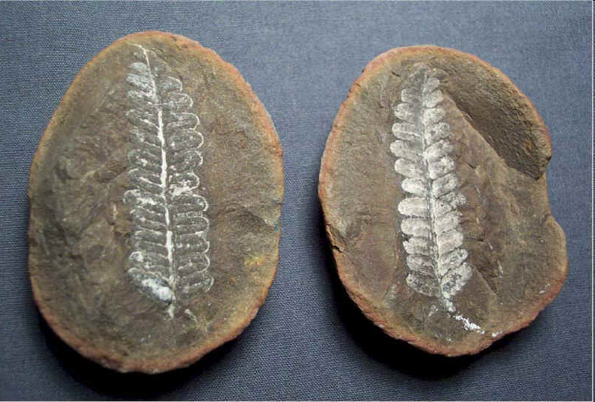
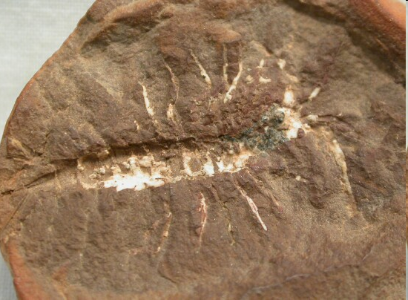
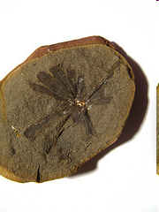
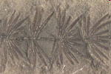
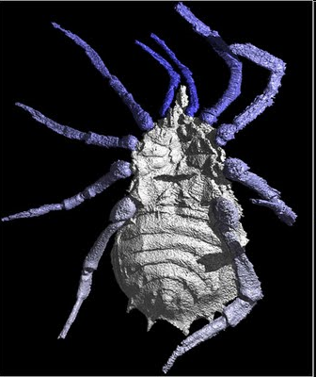
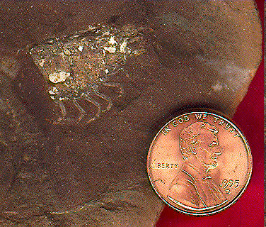
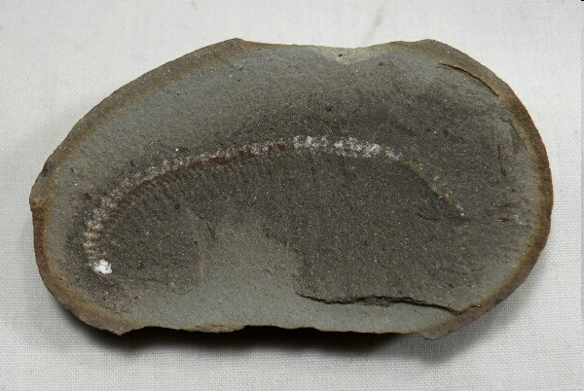
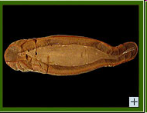
Mazon Creek shale layer, near Chicago: 100,000+ specimens, 400+ species including ferns, insects, scorpions, tetrapods, jellyfish, mollusks, crustaceans, & fish

Slide 11
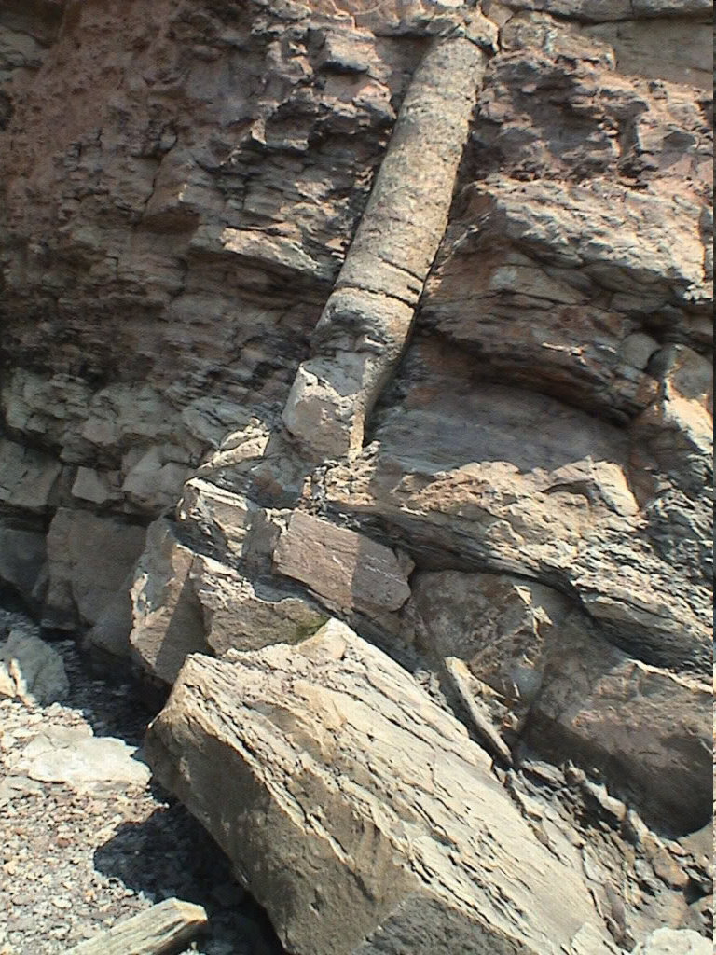
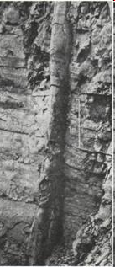

Slide 12
The Mauve - Redwall Limestone interfaces - intertongued & gradational

Slide 13
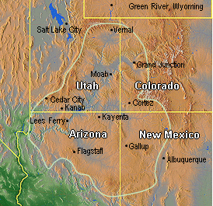
1. Regional Sedimentary Deposition
Colorado Plateau ~ 250,000 square miles

Slide 14
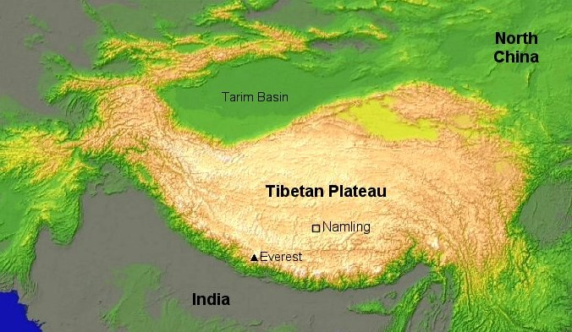
1. Regional Sedimentary Deposition
Tibetan Plateau ~ 750,000 square miles

Slide 15
Foolish Mockers 2 Peter 3:3-7
They ignore the evidence of God’s past judgment in order to ignore the warning of God’s future judgment

Slide 16
God’s Patience 2 Peter 3:8-10
Even Christians can wonder why God has delayed Jesus’ promised return for so long
A) The Lord views time differently for He transcends the time-space continuum in which we are trapped
God will keep His promises in His timing and not that of men

Slide 17
God’s Patience 2 Peter 3:8-10
B) God is extremely patient and longsuffering allowing ample time for people to repent
The Lord’s desire is for people to repent from their wickedness instead of dying in their sin (Ezekiel 33:11)

Slide 18
God’s Patience 2 Peter 3:8-10
God has given man volition, and man in his corrupted nature chooses sin & selfishness and rejects God
The path to Heaven requires repentance in order to believe Christ
God’s love for sinful man gives us hope (John 3:16; Rom. 5:8), & His patience arises from that love

Slide 19
The Day of the Lord 2 Peter 3:10-13
The foolish scoff & sneer at the warnings of the coming Day of the Lord, but they do so at their own peril
There is an emphasis on the suddenness of the coming of Day of the Lord - “like a thief”

Slide 20
The Day of the Lord 2 Peter 3:10-13
Scripture teaches the imminent return of Christ - He could return any day at any time. He is “at the door”
Peter jumps from the start of the Day of the Lord to its culmination in preparation for new heavens & earth

Slide 21
The Day of the Lord 2 Peter 3:10-13
The present heavens & earth will be destroyed by fire: 2 Peter 3:10,12, Matthew 24:34, Revelation 21:1
The present earth will be consumed by fire with the very elements melting - 2 Peter 3:10, 12

Slide 22
The Day of the Lord 2 Peter 3:10-13
The Day of the Lord will be a time of God’s judgment - so heed Peter’s warning & be prepared!

Slide 23
Living in Light of the Day of the Lord 2 Peter 3:11-18
If the things of this world are going to burn, what effect should that have on the way you live your life?
A. How important is the pursuit of material possessions?
B. What eternal benefit is gained from a position of power or prestige?
C. Is striving for fame worth the effort?

Slide 24
Living in Light of the Day of the Lord 2 Peter 3:11-18
The Day of the Lord culminates in new heavens & a new earth in which righteousness dwells (2 Peter 3:13)
Peter’s call to godly maturity is pragmatic for this earth is temporary & will burn, so prepare for the new one

Slide 25
Living in Light of the Day of the Lord 2 Peter 3:11-18
Prepare for eternity by developing a godly character of being in peace, spotless & blameless in the present
Christian maturity requires understanding of truth including the Lord’s longsuffering patience with sinners

Slide 26
Living in Light of the Day of the Lord 2 Peter 3:11-18
Peter affirms that Paul’s writings are also Scripture - though hard to understand at times (but not impossible)
Christian maturity also requires understanding the Scriptures in order to be on guard against false teachers

Slide 27
Living in Light of the Day of the Lord 2 Peter 3:11-18
The foundation of all Christian maturity is understanding Jesus - grow in the grace & knowledge of Christ

Slide 28
Grace Bible Church Glorifying God by Making Disciples of Jesus Christ

