Slide 1
Grace Bible Church Glorifying God by Making Disciples of Jesus Christ

Slide 2
A reminder to consider others Please:
Silence your cell phone & all electronic devices
Use the nursery or cry room if your child is fussy
Get up during the preaching only if absolutely necessary (please sit in back if you must leave early)
Refrain from eating & drinking during worship service (except medical needs)
Notes:
2

Slide 3
History Foretold Daniel 11:1-35
Only God can know accurately what will occur in the future –
Isaiah 46:9-10;
Isaiah 44:6-8;
Isaiah 41:21-24
A prophet had to be 100% accurate or he was to be stoned - Deuteronomy 18:19-22

Slide 4
History Foretold Daniel 11:1-35
Daniel 11 is the most extensive section of detailed & fulfilled prophecy in the Bible
The more detailed a prophecy, the more assurance there can be about its accuracy
The god of the liberals is not capable of revealing the future, but the true God of the Bible has done so

Slide 5
The Coming of the Prophecy Daniel 10
It is a comfort to know that God sends angels to give personal ministry to us.
Angels, good & bad, are organized and have a hierarchy - some of them have national influence.
The angel is revealing to Daniel “what is inscribed in the writing of truth.”

Slide 6
The Coming of the Prophecy Daniel 10
The future is unknown to us, yet is already written down to some degree
We can endure the present because God’s sovereignty assures us He can fulfill His promises for the future

Slide 7
Angelic Action Daniel 11:1
The angel began encouragement & protection of Darius the Mede in his first year
The angelic battle for influence of Darius can be seen in Daniel 6
Angels and demons can influence, but they cannot force a human to do something against their will

Slide 8
Angelic Action Daniel 11:1
Angels can interact in the physical dimensions and provided physical protection for Daniel
Angelic warfare is beyond us, so submit to God and resist the devil which causing him to flee (James 4:7)

Slide 9
The Persian Empire Daniel 11:2
529 - Cambyses, (Ahasuerus in Ezra)
522 - Pseudo-Smerdis, (Artaxerxes in Ezra)
521 – Darius I Hystaspes (Ezra 4:24)
486 - Xerxes (Ahasuerus in Esther) was very wealthy and stirred up Greece by invading in 480 B.C.

Slide 10
The Rise of the Greek Empire Daniel 11:3-4
Verse 3 describes the nature and power of Alexander the Great
Verse 4 succinctly describes the break up of Alexander’s kingdom

Slide 11
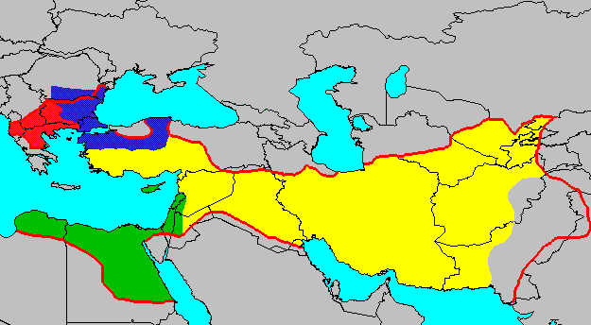
Daniel 11:4
Divisions of Alexander’s Empire
Lysimachus
↑
Cassander
Seleucus
Ptolemy

Slide 12
The Kings of the North & South Daniel 11:5-20
These are the Ptolemaic dynasty based in Egypt and the Seleucid dynasty based in Syria
Israel is the ultimate focus of the prophecy, so what is mentioned is what has bearing on that nation

Slide 13
Ptolemy I Soter & Seleucus Nictor Daniel 11:5
Ptolemy I (Soter) protected Seleucus from Antiogus (301 B.C.), but Seleucus’ dominion became greater

Slide 14
Ptolemy II and Antiochus II Daniel 11:6
Ptolemy II (Philadelphius) (285-246 B.C.) forces Antiochus II (261-246 B.C) to marry his daughter, Berenice (252 B.C.)
After Ptolemy II dies (246 B.C.), Antiochus II removed Berenice and brings back Laodice – but she poisons them all

Slide 15
Ptolemy III Euegetes (246-221 B.C.) Daniel 11:7-8
He conquers most of Syrian empire and brings back great booty
He outlives Seleucus Callinicus (246-226 B.C.) by four years

Slide 16
Seleucus II Callinicus (246-226 B.C.) Daniel 11:9
Seleucus II tries to invaded Egypt c. 240-235 B.C. , but a storm wrecks his fleet, he is defeated and returns home

Slide 17
Seleucus III & Antiochus III Daniel 11:10
Seleucus III Ceranus (226-223 B.C.) raises an army, but dies.
His brother, Antiochus III the Great (223-187 B.C.) conquers through Israel to the border of Egypt

Slide 18
Ptolemy IV Philopater & Antiochus III Daniel 11:11-13
Verse 11f - Ptolemy IV Philopater (221-203 B.C.) soundly defeat Antiochus III at Raphia (217 B.C.) -
He does not solidify gains and makes peace with Antiochus.
He profanes the Temple in Jerusalem and persecutes the Jews

Slide 19
Ptolemy IV Philopater & Antiochus III Daniel 11:11-13
Verse 13 - Ptolemy IV & his wife mysteriously die 14 years (203 B.C.) later and Antiochus III the Great returns with a larger army

Slide 20
Antiochus III the Great Daniel 11:14
An insurrection of Jews seeking a fulfillment of the vision (Daniel 8 & 9?) is defeated
A coalition joins Antiochus III seeking Egypt’s downfall

Slide 21
Antiochus III the Great Daniel 11:15-16
Antiochus III defeated Ptolemy’s armies (198 B.C.) and occupied Israel – the “Beautiful Land” - and slew many Jews

Slide 22
Antiochus III the Great Daniel 11:17
Antiochus III has his daughter, Cleopatra, marry Ptolemy V (Epiphanes) in 193 B.C., but she sides with her husband

Slide 23
Antiochus III the Great Daniel 11:18
Antiochus III captures Aegean Islands & parts of Greece and scorns the Romans
Scipio Asiaticus drives him out of Greece (191 B.C.) and soundly defeats him (189 B.C) returning the scorn

Slide 24
Antiochus III the Great Daniel 11:19
Antiochus III returns to his own land defeated, and then is killed while robbing a temple

Slide 25
Seleucus IV Philopator Daniel 11:20
Seleucus IV sends Heliodorus to collect heavy taxes from the Jews – the “Jewel of the kingdom”
He is killed by poisoning – “neither in anger or in battle”

Slide 26
Conclusions
The fulfillment of such detailed prophecy is confirmation of the nature and power of God
Our hope in God’s promises are dependent on His ability to control the future – and He does!

Slide 27
Grace Bible Church Glorifying God by Making Disciples of Jesus Christ

