Slide 1
Grace Bible Church Glorifying God by Making Disciples of Jesus Christ

Slide 2
A reminder to consider others Please:
Silence your cell phone & all electronic devices
Use the nursery or cry room if your child is fussy
Get up during the preaching only if absolutely necessary (please sit in back if you must leave early)
Refrain from eating & drinking during worship service (except medical needs)
Notes:
2

Slide 3
The Vision of the Ram & the Goat Daniel 8:1-27
This vision occurs in 551 B.C. - two years after the previous vision and 12 years before Daniel 5
Daniel 7 - An overview of the time of the Gentiles from Babylon to eternity

Slide 4
The Vision of the Ram & the Goat Daniel 8:1-27
Daniel 8 - Only two kingdoms following Babylon - Medo-Persia and Greece
Fulfillment of detailed prophecy is positive proof of God’s hand at work.

Slide 5
The Vision Daniel 8:2-14
Daniel sees himself in his vision as being at the citadel of Susa by the Ulai canal

Slide 6
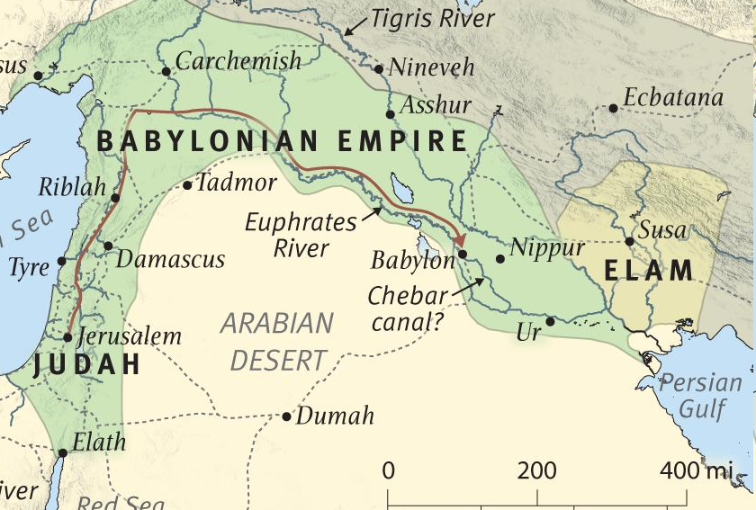
Susa was the provincial capital of Elam - 230 miles east of Babylon, 120 miles north of the Persian Gulf
SUSA

Slide 7
Daniel 8:3-14 - The Vision Described
SUSA

Slide 8
The Vision Daniel 8:3-14
The Bible is the best interpreter of the Bible and any passage must be interpreted in its context

Slide 9
Daniel & Gabriel Daniel 8:15-19
Daniel again sees himself in his vision and this time he hears Gabriel being directed to explain the vision
Gabriel (man or warrior of God) is an angelic messenger – Daniel 9:21, Luke 1:19
Daniel passes out for fear is a common reaction of humans when they meet angelic beings

Slide 10
Daniel & Gabriel Daniel 8:15-19
The first indignation probably refers to the Assyrian & Babylonian captivities - Isaiah 10:5, 25, Jeremiah
The latter indignation probably refers to the time from the return from exile until Messiah’s return

Slide 11
The Ram Daniel 8:3-4, 20
The Medo-Persian Empire - the ram was a symbol used by that empire
Two horns are the two kingdoms that made up the empire - Media and Persia which later became dominate

Slide 12
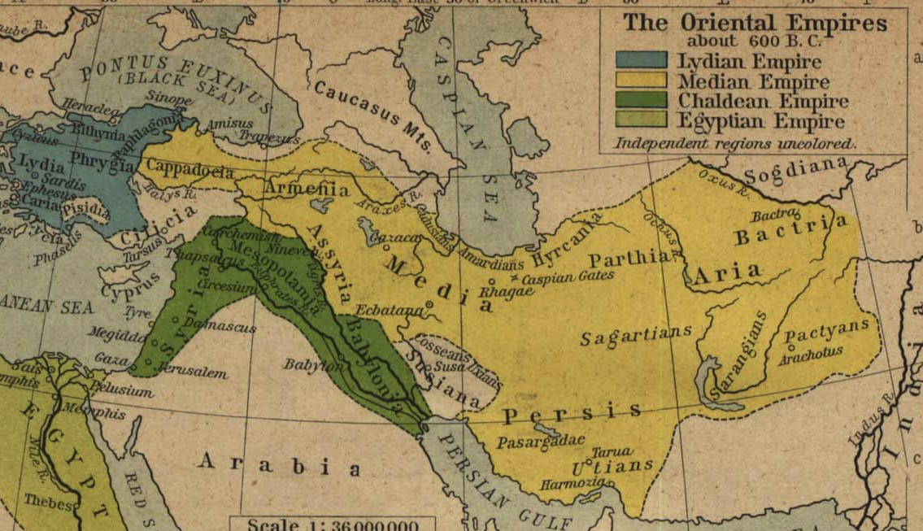
The Medo-Persian Empire before Cyrus

Slide 13
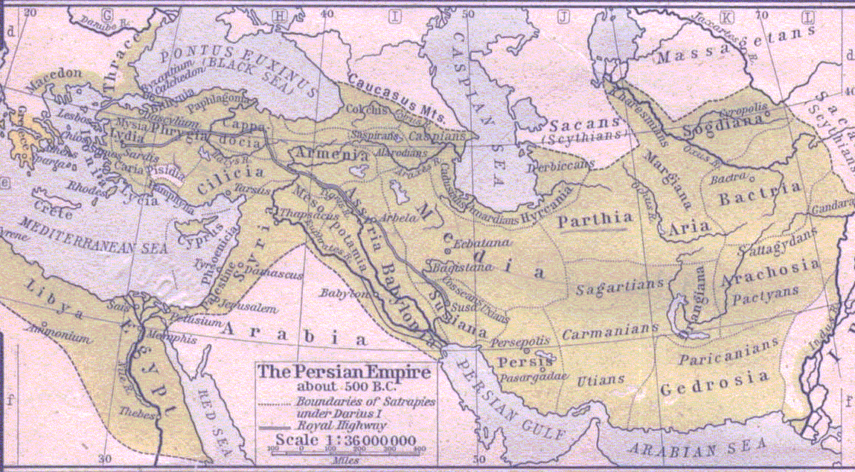
The ram butted westward - Cyrus conquered Babylon, Syria, Assyria and the land of Israel
Points – Random bars horizontal

Slide 14
The ram butted northward - He conquered areas of the Armenians and Scythians

Slide 15
The ram butted southward - Cambyses conquered Egypt

Slide 16
The Medo-Persian Empire about 500 B.C.

Slide 17
The Goat Daniel 8:5-14, 21-26
The goat heading East very quickly that tramples the ram is Greece under Alexander the Great
Alexander become king in 336 B.C. at age 20.

Slide 18
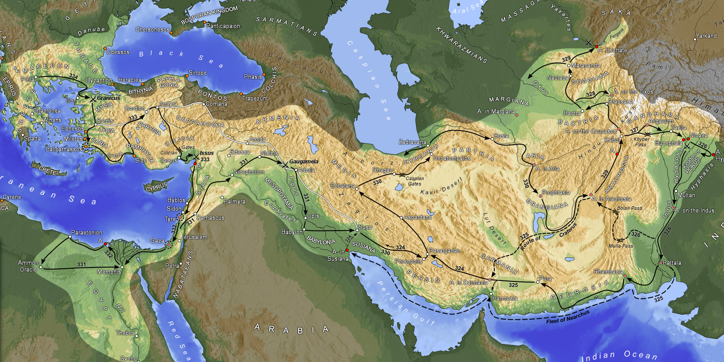
Alexander the Great 334 BC Asia Minor invaded – Victory at Granicus
Granicus
334 BC

Slide 19
Alexander the Great 333 BC – Victory at Issus – Asia Minor Conquered
333 BC
Issus

Slide 20
Alexander the Great 332 BC – Victory at Tyre – Syria Conquered
Tyre 332 BC

Slide 21
Alexander the Great 331 BC – Egypt annexed, Alexandria founded
331 BC
Alexandria

Slide 22
Alexander the Great 331 BC – Victory at Gaugamela - Persia Defeated
331 BC
Gaugamela

Slide 23
Alexander the Great 330 BC – Persepolis Destroyed
330 BC
Persepolis

Slide 24
Alexander the Great 329 BC – Bacrtria & Beyond
329 BC
Bactria

Slide 25
Alexander the Great 327 BC – Into India
327 BC
India

Slide 26
Alexander the Great 325 BC – At Indian Ocean and heading back
325 BC
Heading back

Slide 27
Alexander the Great Territory Conquered 334-325 B.C.

Slide 28
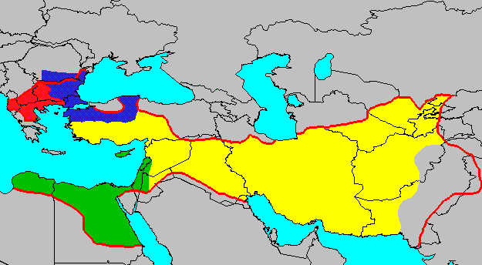
Daniel 8:22
Divisions of Alexander’s Empire
Lysimachus
↑
Cassander
Seleucus
Ptolemy

Slide 29
The Small Horn Daniel 8:9-14, 23-26
The small horn of Daniel 8 arising out of Greece is not the little horn of Daniel 7 arising out of Rome
The small horn is Antiochus IV “Epiphanes” 175-164 B.C.
Antiochus invaded Egypt to the south, Babylon to the east and Israel - the “beautiful land” - see vs. 9

Slide 30
The Small Horn Daniel 8:9-14, 23-26
Antiochus & Jewish apostate “transgressors” persecuted faithful Jews including murder - see vs. 10, 24
Antiochus was known for his deceit which included slaughtering those who trusted him - see vs. 23, 25
He magnified himself, stopped the sacrifices, installed an idol of Zeus and sacrificed pigs - see vs. 11-14

Slide 31
The Small Horn Daniel 8:9-14, 23-26
The holy place was properly restored by the Maccabees - Dec. 25, 165 B.C. - celebration of Hanukkah
Antiochus took the title Theos Epiphanes -the Visible God. His enemies called him Epimanes - madman
Daniel “shut up” “sealed” the vision - he preserved it to be available for the future

Slide 32
Daniel’s Response Daniel 8:27
Daniel was overwhelmed and became sick. He remained astounded by the vision

Slide 33
Our hope for the future is in God who:
Holds the future in His hands
Fulfills all His promises
Has a proven love for us
Will never leave or forsake us
Who will take us to be with Him in heaven forever

Slide 34
Until then – Walk with the Lord faithfully, serving Him however He directs for the sake of His glory

Slide 35
Grace Bible Church Glorifying God by Making Disciples of Jesus Christ

