Slide 1
Grace Bible Church Glorifying God by Making Disciples of Jesus Christ

Slide 2
A reminder to consider others Please:
Silence your cell phone & all electronic devices
Use the nursery or cry room if your child is fussy
Get up during the preaching only if absolutely necessary (please sit in back if you must leave early)
Refrain from eating & drinking during worship service (except medical needs)
Notes:
2

Slide 3
The Vision of the Four Beasts Daniel 7:1-28
What will happen in the future?
Weather
Business
Politics
Risk management
Man is not and cannot be in control of the future – Luke 12; James 4:13-15

Slide 4
The Vision of the Four Beasts Daniel 7:1-28
Only God controls the future which is why prophecy is such a strong proof of God’s hand
Humans have a natural interest in the near future, but the wise pay more attention to the distant future

Slide 5
Daniel Receives a Dream Daniel 7:1
The first year of Belshazzar is 553 B.C. - This is 14 years before the events in Daniel 5
Daniel received a dream with visions in his head which he then summarized and wrote down

Slide 6
Daniel’s Dream & Response Daniel 7:2-18
Daniel is distressed and seeks an interpretation in vs. 15-18
The four great beasts represent four kingdoms that would arise
Daniel does not show interest in the first three beasts, only the fourth and the one that follows it

Slide 7
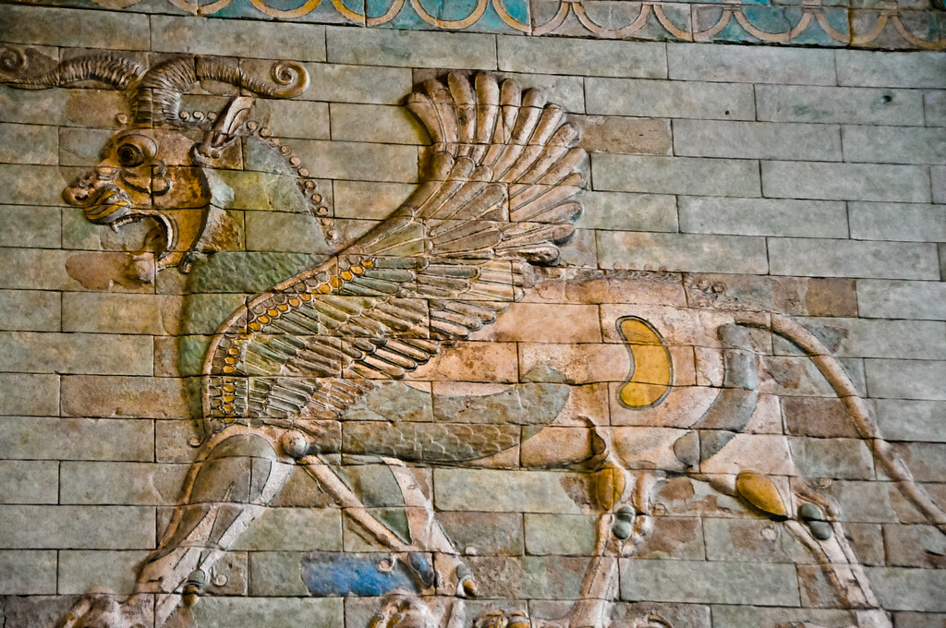
Daniel’s Dream & Response Daniel 7:2-14
The lion with the wings of an eagle represents the Babylonian empire

Slide 8
Daniel’s Dream & Response Daniel 7:2-14
The second beast resembling a bear represents the Medo-Persian empire
The leopard with four wings and four heads is the Grecian empire
The fourth beast is not a particular animal but is described as dreadful, terrifying and extremely strong

Slide 9
The Fourth Beast Daniel 7:19-26
Daniel’s Desire - vs. 19-22
Daniel’s mind is preoccupied by the fourth beast and desires further understanding

Slide 10
The Angel’s Explanation Daniel 7:23-26
The fourth beast is Rome - which was different from the other ancient empires
Once Rome began its expansion it became relentless in its quest to conquer

Slide 11
Roman Conquests
275 B.C. - Italy.
241 B.C. - Sicily.
202 B.C. - Spain.
189 B.C. - Antiochus III defeated - Asia Minor
149 B.C. - Greece.
146 B.C. - Macedonia.
146 B.C. - Carthage destroyed.

Slide 12
Roman Conquests
128 B.C. - Southern France
69 B.C. - Armenia.
64 B.C. - Syria.
63 B.C. - Jerusalem.
57 B.C. - France.
47 B.C. - Egypt

Slide 13
The Angel’s Explanation Daniel 7:23-26
In the next century Rome would control southern Britain, Belgium, Switzerland and Germany west of the Rhine river
Rome was not content to defeat an enemy, it crushed it with slaughter and selling captives into slavery
Rome reached its zenith in A.D. 117 followed by a slow decline with its last emperor killed in A.D. 1453

Slide 14
The Ten Horns & What Follows Daniel 7:8-14, 20-22 and 24-27
1) Daniel was wrong - No.
Daniel’s prophecies concerning the earlier kingdom have already been fulfilled accurately.

Slide 15
The Ten Horns & What Follows Daniel 7:8-14, 20-22 and 24-27
2) The prophecies are symbolically fulfilled in church history - No.
All efforts to explain the 10 horns and little horn in church history remain wildly speculative
Nothing comparative to the final kingdom has yet occurred.

Slide 16
The Ten Horns & What Follows Daniel 7:8-14, 20-22 and 24-27
O.T. prophecies give little indication of the church age - compare Isaiah 61:1-2 with Luke 4:18-22

Slide 17
The Ten Horns & What Follows Daniel 7:8-14, 20-22 and 24-27
3) The prophecies are to be fulfilled in the future in a revived Roman empire
Only a future king will be able to fulfill the acts and great evil done by the “little horn”
Only a future evil king will be given such power for 3 ½ years & then destroyed by God

Slide 18
The Final Kingdom Daniel 7:27
This corresponds to Nebuchadnezzar’s vision of the stone that smashes the idol and fills the earth
God’s people will be established as the final kingdom under the rule of the Son of Man.

Slide 19
The Final Kingdom Daniel 7:27
This final kingdom is universal with an everlasting dominion which will not pass away or be destroyed

Slide 20
Responses Daniel 7:28
The visions are grand in scale, troubling in detail and so very alarming
The near future can be frightening, but this is to be tempered by knowing the eventual conclusion
Keep your focus on the eternal perspective.

Slide 21
Our Response
Until the Lord’s return:
Proclaim the gospel
Walk by faith in godliness
Do not be dismayed
Keep your hope fixed on the Lord’s return
Remain steadfast - 1 Cor. 15:58

Slide 22
Grace Bible Church Glorifying God by Making Disciples of Jesus Christ

