Slide 1
Grace Bible Church Glorifying God by Making Disciples of Jesus Christ

Slide 2
A reminder to consider others Please:
Silence your cell phone & all electronic devices
Use the nursery or cry room if your child is fussy
Get up during the preaching only if absolutely necessary (please sit in back if you must leave early)
Refrain from eating & drinking during worship service (except medical needs)
Notes:
2

Slide 3
God’s Judgment of the Proud Daniel 5:1-31
God opposed Nebuchadnezzar because of his pride, yet He also was patient and merciful to him
Daniel 5 is important
Historically
Theologically
Practically

Slide 4
Belshazzar’s Feast Daniel 5:1-4
66 years since Daniel was taken into captivity
23 years since Nebuchadnezzars’ death
The succession of kings: Nebuchadnezzar
Evil-Merodach (562 B.C.)
Nerigal-Sharezar (560 B.C.)
Labushi-Marduk (556 B.C.)
Nabonidus (556 B.C.)
Belshazzar co-regent (553 B.C.)

Slide 5
Belshazzar’s Feast Daniel 5:1-4
Nabonidus fled to Borsippa after being defeated by the Medo-Persians who then laid siege to Babylon
Babylon was built and supplied to be able to withstand a siege for many years
Belshazzar gives a great feast though Babylon was under siege

Slide 6
Belshazzar’s Feast Daniel 5:1-4
The vessels from the Lord’s temple were used for drinking in praise of their gods
The sacrilege was to increase their courage as they remembered past victories over foreign nations / gods
Babylon was under siege, but instead of being humble, they were arrogantly having a festival

Slide 7
The Hand Writing on the Wall Daniel 5:5-9
Belshazzar was completely unnerved by this supernatural scene
He offered great honor and position to the wise man that could interpret the writing,
but none of them could do so

Slide 8
The Queen’s Advice Daniel 5:10-12
The queen mother was likely a widow or daughter of Nebuchadnezzar that had married Nabonidus
She recounts Daniel’s multiple qualifications and abilities including explaining enigmas
Daniel was at least 80 years old and so was not with the other wise men and had to be summoned

Slide 9
The King’s Response Daniel 5:13-16
The king explains the problem to Daniel and offers him the same reward

Slide 10
Daniel’s Rebuke of the King Daniel 5:17-24
Daniel rejects the king’s offer - his interpretation would not be prejudiced by them
Daniel censures the King for his failure to learn from Nebuchadnezzar’s example and his blasphemy

Slide 11
Daniel’s Interpretation Daniel 5:25-28
MENE, MENE, TEKEL, UPHARSIN = numbered, numbered, weighed and divided

Slide 12
The King’s Response Daniel 5:29
Belshazzar does for Daniel what he promised, but there is no indication of repentance
He had dishonored the God of Israel, but his last official act is to honor a Jew that served that God

Slide 13
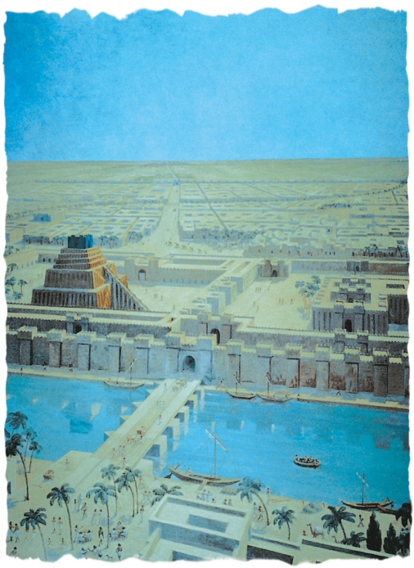

Slide 14
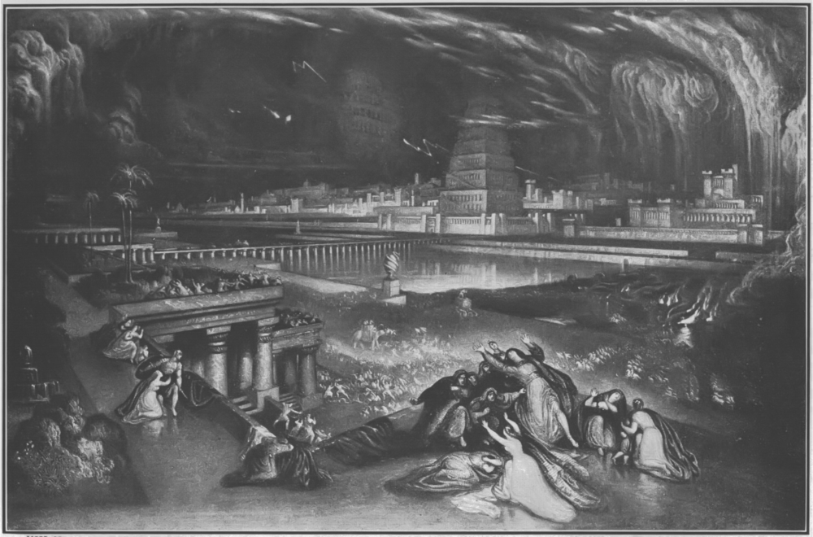
The Fulfillment of the Prophecy Daniel 5:30-31
Isaiah 13:17-22; 21:1-10; Jeremiah 51:33-58 - prophecy that Babylon would fall on such a night

Slide 15
The Fulfillment of the Prophecy Daniel 5:30-31
Daniel 5 concludes with the end of the Babylonian kingdom and the triumph of the Medo-Persian empire

Slide 16
Conclusions
God keeps His promises
Don’t presume on God’s patience
Follow the example of Daniel

Slide 17
Grace Bible Church Glorifying God by Making Disciples of Jesus Christ

