Slide 1
Grace Bible Church Glorifying God by Making Disciples of Jesus Christ

Slide 2
A reminder to consider others Please:
Turn off your cell phone or set to vibrate only
Turn off sound to all electronic devices
Use the nursery or cry room if your child is fussy
Get up during the preaching only if absolutely necessary (please sit in back if you must leave early)
Notes:
2

Slide 3
The Failure of Human Wisdom Judges 17-21
1 & 2 Thessalonians point to a model church that thrived in the midst of persecution
Habakkuk shows God’s actions in chastening Israel but also giving hope in a promised restoration

Slide 4
The Failure of Human Wisdom Judges 17-21
Knowing God according to His word & walking with Him increase trust and brings peace
Israel’s history illustrates God’s blessings upon the obedient and curses on the unfaithful

Slide 5
The Failure of Human Wisdom Judges 17-21
American history shows God’s blessings on a nation & society that feared & honored Him
Recent history shows a nation descending into greater sin and God’s judgment

Slide 6
The Failure of Human Wisdom Judges 17-21
Pursuing righteousness reaps God’s favor while the opposite reaps God’s wrath

Slide 7
Review
God chose a people for Himself - Abraham, Isaac, Jacob and his descendants (Genesis)
God prepared a people for Himself with the Mosaic Covenant & purging the unfaithful (Exodus - Numbers)

Slide 8
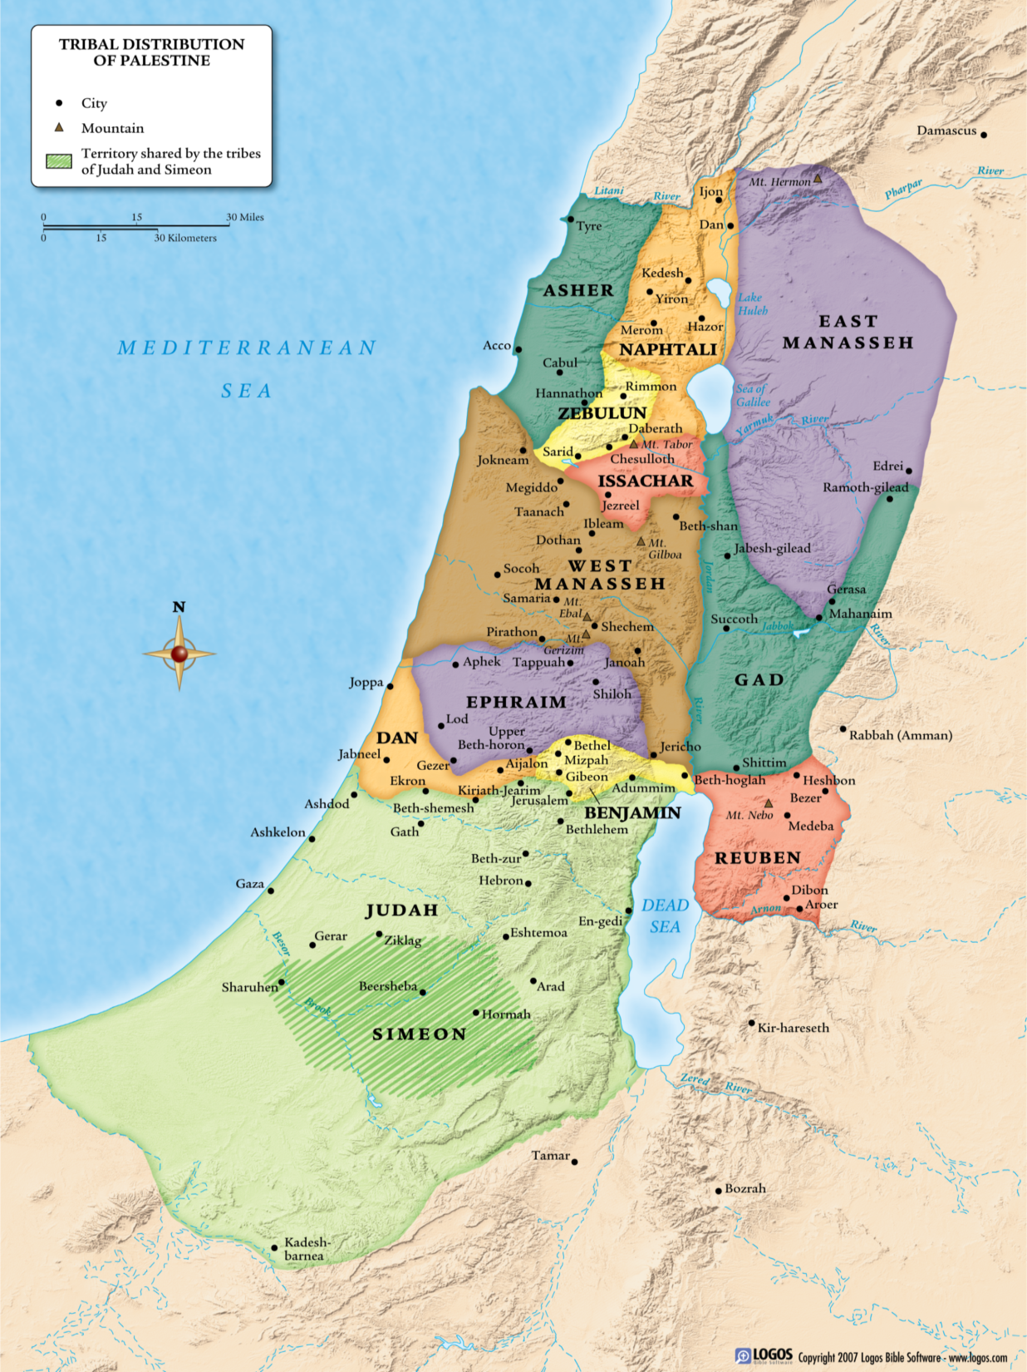
The second generation was faithful and so conquered the land and set up the theocracy
●
Hebron

Slide 9
Review
The theocracy failed because of:
Incomplete obedience
Failure to diligently teach children (Deut. 6)
Idolatry / Syncretism
Intermarriage

Slide 10
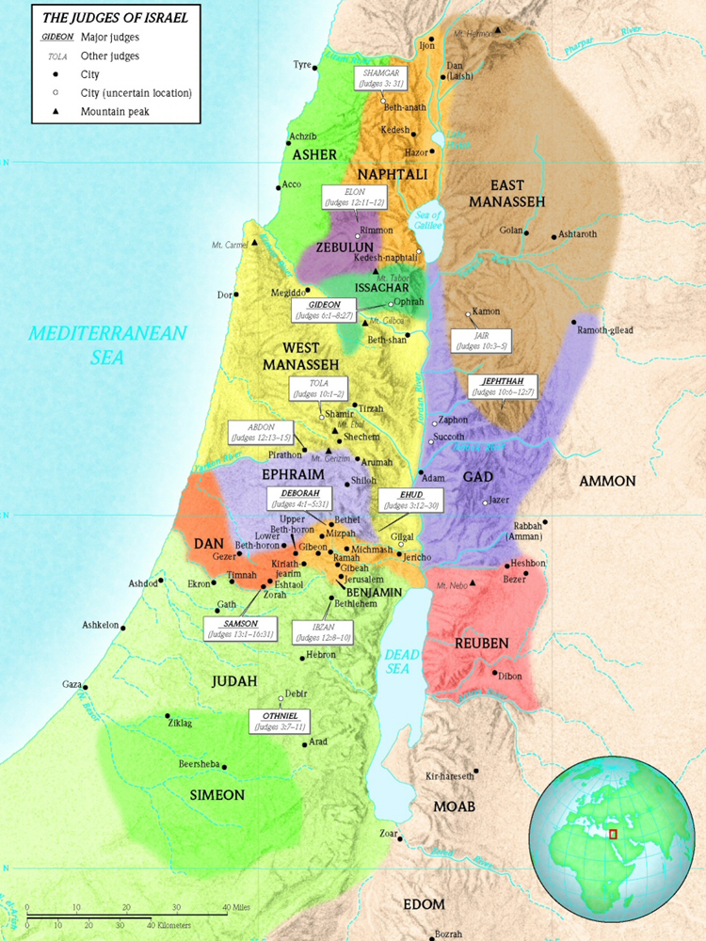
Review
The cycle of the judges: disobedience - idolatry - oppression - repentance - God’s pity - deliverance by a judge

Slide 11
Review
The shocking concluding historical stories illustrate a people that did “what was right in their own eyes”

Slide 12
Micah and the Danites Judges 17-18
Micah is a thief, and he and his mother are syncretic idolaters
A Levite agrees to become the priest for Micah’s family - and he joins in with their syncretic idolatry
This Levite, Jonathan, is a descendant of Moses and this occurs within two generations following Joshua

Slide 13
Micah and the Danites Judges 17-18
Dan did not obey Yahweh and drive out the Amorites, and instead looked for an easier land to conquer

Slide 14
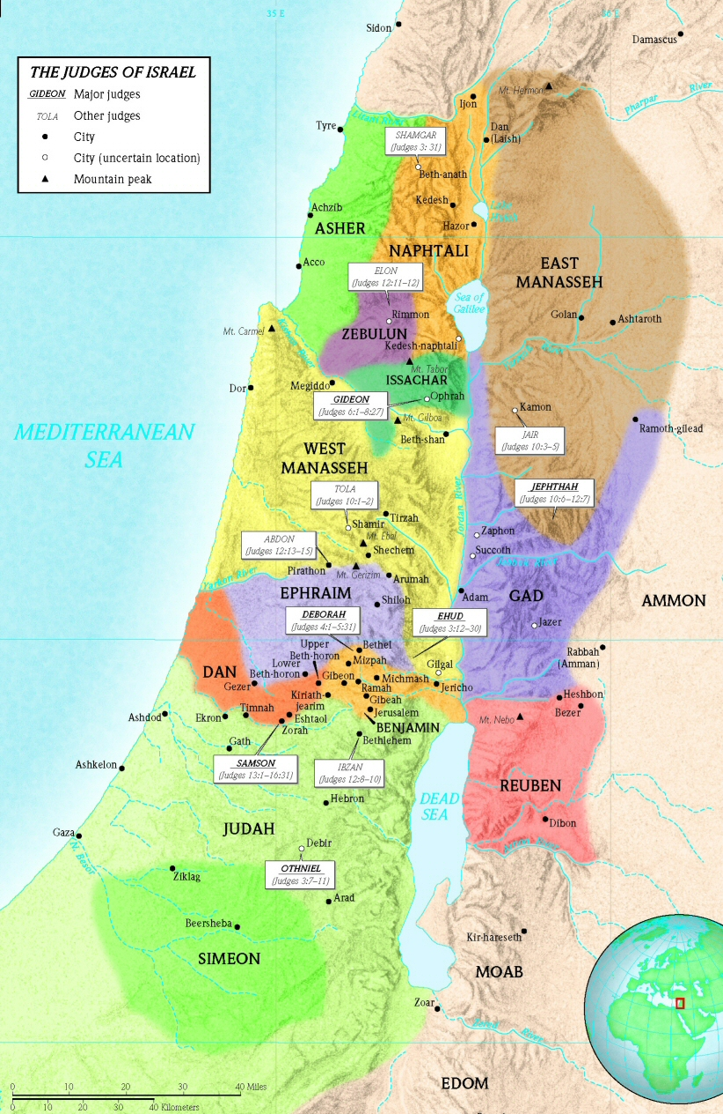
The Danite war party stole Micah’s graven image, idols & ephod - & convinced Jonathan to be their priest

Slide 15
The Danites conquered Laish, and with Jonathan & his descendants as their priest, followed syncretic idolatry

Slide 16
Micah and the Danites Judges 17-18
Syncretism mixes false religious & secular ideas & practices with those of Christianity
The prevention & cure for syncretism is to know & love God and walk with Him

Slide 17
Gibeah & the Benjamite Civil War Judges 19-21
This occurs early in the period of the judges for Phinehas, grandson of Aaron, is High Priest
A Levite travels from Ephraim to Bethlehem to speak tenderly to his concubine in order to bring her back

Slide 18
Gibeah & the Benjamite Civil War Judges 19-21
He is welcomed by his father in law - and detained there four days eating, drinking & making merry

Slide 19
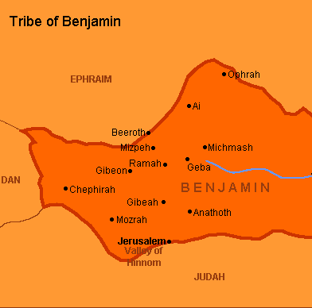
Gross Immorality - Gibeah Judges 19
He leaves late on the fifth day and arrives in Gibeah in Benjamin just after sundown
An old man from Ephriam that lives there takes them in for the night
*Bethlehem

Slide 20
Gibeah & the Benjamite Civil War Judges 19-21
Sons of Belilal want to sodomize the Levite, but the old man gives them the concubine whom they gang rape
In the morning, the Levite finds his concubine dead at the door.
He takes her body home, cuts it into 12 pieces, and sends them to each territory of Israel

Slide 21
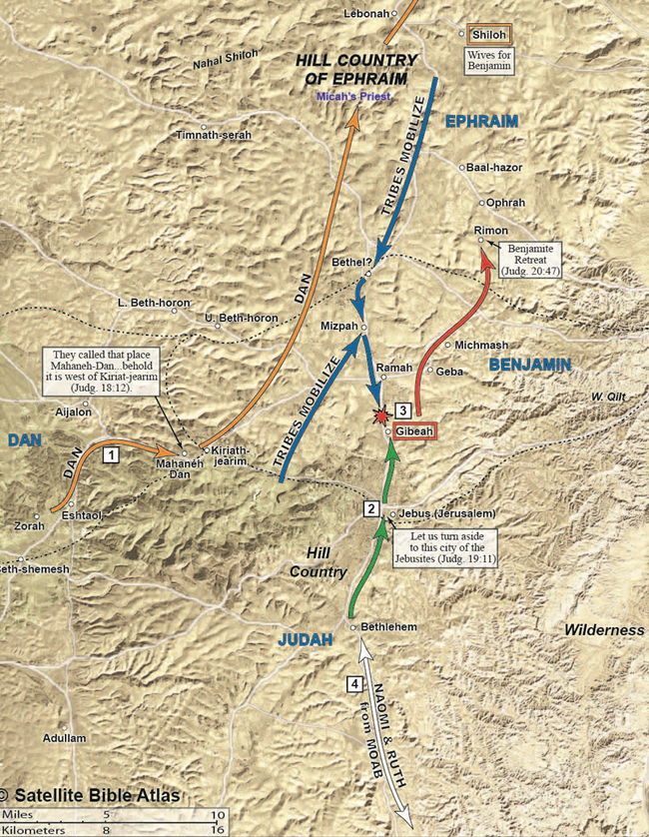
Gibeah & the Benjamite Civil War Judges 19-21
The sons of Israel muster from around that nation gathering at Mizpah with an army of 400,000

Slide 22
Gibeah & the Benjamite Civil War Judges 19-21
Messengers are sent throughout Benjamin asking them to deliver up the guilty

Slide 23
Gibeah & the Benjamite Civil War Judges 19-21
Benjamin instead musters an army of 26,000 swordsmen and 700 stone slingers to defend the Gibeonites

Slide 24
Gibeah & the Benjamite Civil War Judges 19-21
Defending immorality and protecting the guilty is injustice and leads to greater tragedy
In two days of war, 40,000 sons of Israel are killed by the Benjaminites (10% of the army)

Slide 25
Gibeah & the Benjamite Civil War Judges 19-21
After fasting and making sacrifices, Yahweh tells them to fight again the next day and they would win

Slide 26
Gibeah & the Benjamite Civil War Judges 19-21
An ambush is set up & by the time it is over, all of Benjamin is destroyed except 600 men

Slide 27
Gibeah & the Benjamite Civil War Judges 19-21
Only 600 men of Benjamin were left & the Israelites vowed not to give them their daughters in marriage

Slide 28
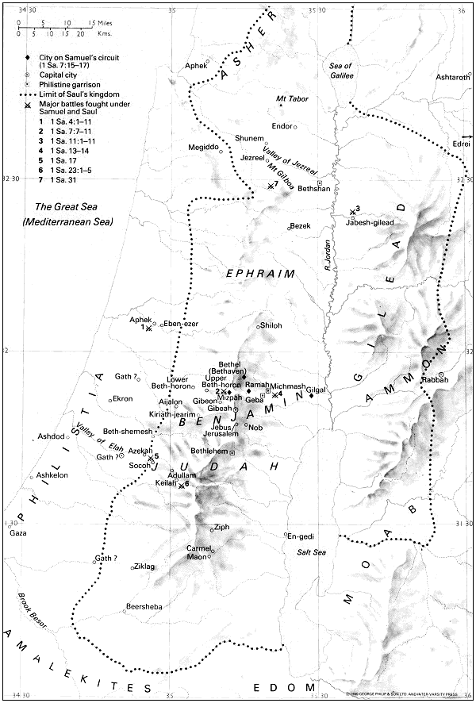
Jabesh-Gilead was attacked and destroyed for not joining them & to take 400 young virgins for Benjamin
Rimon

Slide 29
200 more young virgins were kidnaped from Shiloh to give to the men of Benjamin
Rimon

Slide 30
Gibeah & the Benjamite Civil War Judges 19-21
This story is filled with violations of the Mosaic law from beginning to end
The concluding stories illustrate the depth of sin that result when people do what is right in their own eyes

Slide 31
Conclusions
No nation is exempt from God’s truths - righteousness exalts, sin is a reproach bringing God’s judgment
The period of the judges could be bad, the story of Ruth shows there is always a remnant of godly people

Slide 32
Conclusions
Commit yourself to seek & follow God and you will be a blessing to others.
Diligently teach your children so that they will be like the generation that conquered the Joshua

Slide 33
Grace Bible Church Glorifying God by Making Disciples of Jesus Christ

