Slide 1
Grace Bible Church Glorifying God by Making Disciples of Jesus Christ

Slide 2
A reminder to consider others Please:
Turn off your cell phone or set to vibrate only
Turn off sound to all electronic devices
Use the nursery or cry room if your child is fussy
Get up during the preaching only if absolutely necessary (please sit in back if you must leave early)
Notes:
2

Slide 3
To the Chosen 1 Peter 1:1-2
The author is Peter, an apostle of Jesus Christ, and he is a worthy role model
His purpose was to give hope & encourage Christians to stand firm in the grace of God in the midst of suffering

Slide 4
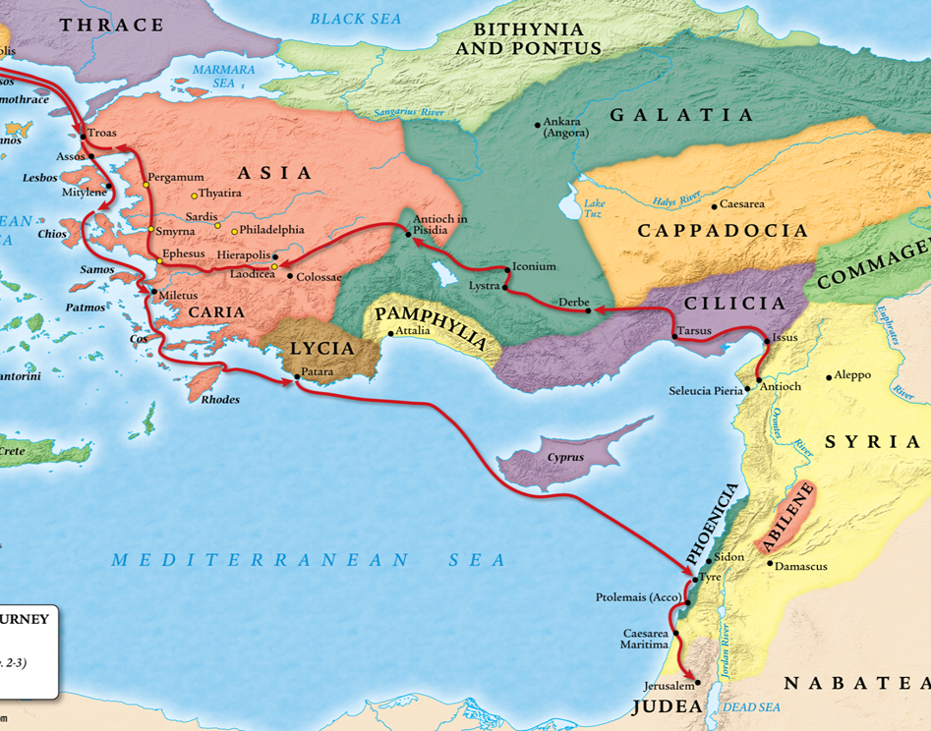
Introduction
Pontus, Galatia, Cappadocia, Asia, & Bithynia are the major Roman provinces of Asia Minor

Slide 5
The Heading 1 Peter 1:1-2
There is a lot of variation in translations as they try to convey the meaning of the Greek into English
It is written to “the choice sojourners of the dispersion of . . .” the various Roman provinces (Young’s Literal)

Slide 6
(From:) Peter, an apostle of Jesus Christ
(To:) Elect, sojourners, of (the) diaspora in Pontus, Galatia, Cappadocia, Asia, and Bithynia, according to (the) foreknowledge of God (the) Father, by sanctification of (the) Spirit, for the purpose of obedience and sprinkling of (the) blood of Jesus Christ.

Slide 7
Elect, Sojourners of (the) Diaspora 1 Peter 1:1
Picked out, chosen, elect - ejklektovV / eklektos. Context reveals God the Father chose them
Alien, stranger, temporary resident, pilgrim - para (beside) + epi (upon) + dhmoV (people) / parepidāmos

Slide 8
Elect, Sojourners of (the) Diaspora 1 Peter 1:1
1 Peter 2:10-11; Phil. 3:20-21. A Christian’s citizenship is heaven, so we are temporary alien residents of Earth
diasporav / diaspora - a region in which people have been scattered. The dispersed Jews in John 7:35; James 1:1
The elect sojourners scattered in particular Roman provinces

Slide 9
The Foreknowledge of God 1 Peter 1:2
Foreknowledge of God is confusing because we are creatures limited in time & space and God is infinite
God is beyond the time-space box being eternal, omniscient and omnipresent

Slide 10
The Foreknowledge of God 1 Peter 1:2
God declares the end from the beginning (Isa. 46:10). The test of a prophet from God is 100% accuracy (Deut.18)
Foreknowledge is prov / pro (before) + gnw:siV /gnosis (experiential knowledge) / proginosis

Slide 11
The Foreknowledge of God 1 Peter 1:2
Knowing someone you have met (gnw:siV /gnosis) is different from knowing about someone by hearing (oi[da / oida
God chose us in Him before the foundation of the world (Eph. 1:4), so He knew me experientially before time

Slide 12
The Foreknowledge of God 1 Peter 1:2
Foresight is not foreknowledge - God did not “look down the corridor of time” to chose those who chose Him
God is the initiator of salvation, not a responder. Man will not seek God on his own (Psalm 14:1-3; Romans 3:10-18)

Slide 13
The Foreknowledge of God 1 Peter 1:2
Natural man is a child of wrath with a blinded mind unaccepting of the things of God (Eph 2:3; 2 Cor 4:4; 1 Cor 2:14
God makes a genuine offer of salvation, but unless God intervenes (John 1:12-13; 6:44), man will not accept it

Slide 14
The Foreknowledge of God 1 Peter 1:2
Substituting foresight for foreknowledge easily leads to a works based salvation & is a basis for open theism heresy

Slide 15
The Foreknowledge of God 1 Peter 1:2
Romans 8:29-30. God’s foreknowledge is directly linked to predestination, calling, justification and glorification
Theological tension between God’s sovereignty in salvation and man’s volition must remain this side of heaven

Slide 16
The Foreknowledge of God 1 Peter 1:2
Divine foreknowledge, predestination & election must not be confused or mixed with determinism or fatalism
Be humble and content to rest in God’s character for what you do not understand - Isaiah 55:8-9

Slide 17
The Sanctification of the Spirit 1 Peter 1:2
Sanctification, aJgiasmovV / hagiosmos, has the same root as the word for holy, and is setting apart a person to God
John 16:8-11 - Sanctification by the Spirit begins with His convicting work regarding sin, righteousness & judgment

Slide 18
The Sanctification of the Spirit 1 Peter 1:2
Proclaiming the gospel / pointing out sin can result in either godly or worldly sorrow (2 Cor. 7:10; Acts 26:15-18)
The Spirit enlightens the mind and regenerates the soul of those with godly sorrow (Eph. 2; John 3; Titus 3:5-7)

Slide 19
The Sanctification of the Spirit 1 Peter 1:2
The Spirit washes, sanctifies and justifies those who are called through the gospel (1 Cor. 6:11; 2 Thess 2:13-14)
The Spirit baptizes the believer into Christ’s body (1 Cor. 12:13) indwelt & sealed by Him (Rom. 8:9-11; Eph. 1:13)

Slide 20
The Sanctification of the Spirit 1 Peter 1:2
After salvation the Holy Spirit continues His ministry to the believer:
1) He is the helper / advocate (Jn 14:116-17).
2) He is the Spirit of truth that teaches us & bears witness of Christ (Jn 15:26; 1 Jn 2:27).

Slide 21
The Sanctification of the Spirit 1 Peter 1:2
3) He testifies to our spirit we are children of God (Rm 8:16)
4) He intercedes with the Father in prayer (Rm. 8:26-27)
5) He enables us to give proper worship to God (Phil 3:3; Jn 4:24).

Slide 22
The Sanctification of the Spirit 1 Peter 1:2
6) Walking in Him blocks the deeds of the flesh and bears His fruit in our lives (Gal. 5:16-17; 22-23).
7) He continues His work of conviction (Jn 16:8-11).
8) He gives us our gifts by which we serve God (1 Cor. 12)

Slide 23
The Sanctification of the Spirit 1 Peter 1:2
9) He leads us in truth (Rm 8:14; Jn 16:13).
10) He fills the believer and empowers him for ministry and holy living (Rm 15:13; Eph. 5:18).

Slide 24
Obedience & Sprinkling by the Blood 1 Peter 1:2
This is a reference to Moses confirming the covenant in Exodus 24. They committed themselves to obey
Obedience here (uJpakohv / hupakoā) refers to the initial obedience of faith that brings salvation ( Rom 1:5; 16:26)

Slide 25
Obedience & Sprinkling by the Blood 1 Peter 1:2
Moses sprinkled them with blood to cleanse from sin - shedding of blood is required for forgiveness (Heb. 9:19-22)
Jesus’ shed blood is applied to the believer to cleanse from sin - Hebrews 10:22; 12:24; 13:12; 1 Pet 1:18-19

Slide 26
Salutation 1 Peter 1:2
Grace refers to undeserved blessing granted by God and includes mercy, love and forgiveness of sin.
Peace is a state of tranquility that exists when there is harmony in relationships - Peter wishes for that to be multiplied

Slide 27
Summary & Conclusions
Peter identifies them in this specific way to give hope and encouragement to those already suffering. God is in control

Slide 28
To you, who according to the foreknowledge of God the Father & the sanctification of the Holy Spirit & the cleansing by the blood of Christ, are the elect of God living at the present time scattered throughout the areas of the Hudson Valley & beyond, Grace to you & may God’s peace be multiplied to you.

Slide 29
Grace Bible Church Glorifying God by Making Disciples of Jesus Christ

