Slide 1
Grace Bible Church Glorifying God by Making Disciples of Jesus Christ

Slide 2
A reminder to consider others Please:
Turn off your cell phone or set to vibrate only
Turn off sound to all electronic devices
Use the nursery or cry room if your child is fussy
Get up during the preaching only if absolutely necessary (please sit in back if you must leave early)
Notes:
2

Slide 3
An Introduction to 1 Peter 1 Peter 1:1

Slide 4
Author - 1 Peter 1:1
Peter, an apostle of Jesus Christ
Peter’s authorship was universally accepted until the rise of academic following the ideas of Higher

Slide 5
Author - 1 Peter 1:1
Claim: The quality of Greek writing is beyond Peter’s capability
Answer: You don’t have to be an academic to produce high quality work. Example: John Bunyan
Answer: 1 Peter 5:12. Peter wrote through Silvanus - at least an editor

Slide 6
Author - 1 Peter 1:1
Claim: A psuedo-Peter used the apostles name to gain a greater audience
Answer: Would a blatant liar / fraud call people to be holy like God & holy in all their behavior? (1:15-16, 22)

Slide 7
Author - 1 Peter 1:1
Peter’s authorship is attested by Clement (~A.D. 95), Polycarp and Irenaeus (2nd Century)

Slide 8
Author - Peter 1:1
John 1:4-42. Andrew introduced Simon to Jesus who renamed him Cephas - translated as Peter (rock)
Simon lived in Capernaum & had a fishing business with Andrew. Jesus called them to be fishers of men

Slide 9
Author - Peter 1:1
Simon Peter became a leader and spokesman for the twelve that became Jesus’ apostles
Peter was bold & quick to take action (Matt. 14:29-31 & John 18:10-11)
He could also be rash and boastful (Matt. 16: 22; 26:33)
He could be fearful (Matt. 26:72-74)

Slide 10
Author - Peter 1:1
Jesus changed Simon’s name to Peter, meaning rock, twice - John 1:42 & Matt. 1:16-17
Simon was his commonly used Jewish name, but Jesus would also use it when he was being spiritually weak

Slide 11
Author - Peter 1:1
He is always Peter or Simon Peter after Pentecost, for the Holy Spirit enabled him to live up to his name, rock
Peter became a bold preacher after Pentecost and unafraid even when threatened and beaten (Acts 2-5)

Slide 12
Author - Peter 1:1
Peter and John were instrumental in affirming that God was granting the gospel to the Samaritans (Acts 8)
Peter was instrumental in bringing the gospel to the Gentiles (Acts 9-10)

Slide 13
Author - Peter 1:1
Herod imprisoned Peter, but an angel let him out and he went to another place (Acts 12)
Peter played a major part in settling the dispute in the Jerusalem council about the gospel going to the Gentiles

Slide 14
Author - Peter 1:1
In Galatians 2, Paul mentions meeting Peter with other apostles (Jerusalem?), and when he came to Antioch
Peter went to Rome after A.D. 62
He becomes a martyr in A.D. 68 when he is crucified upside down

Slide 15
Setting: Circumstances
Persecution began soon after the church was born (Acts 2-5) with Stephen become the first martyr (Acts 8)
Jewish persecution of Christian escalated (Acts 9), and Paul encountered it in all three of his missionary trips

Slide 16
Setting: Circumstances
Paul also encountered localized persecution by Gentiles (Philippi - Acts 16, Ephesus - Acts 19)

Slide 17
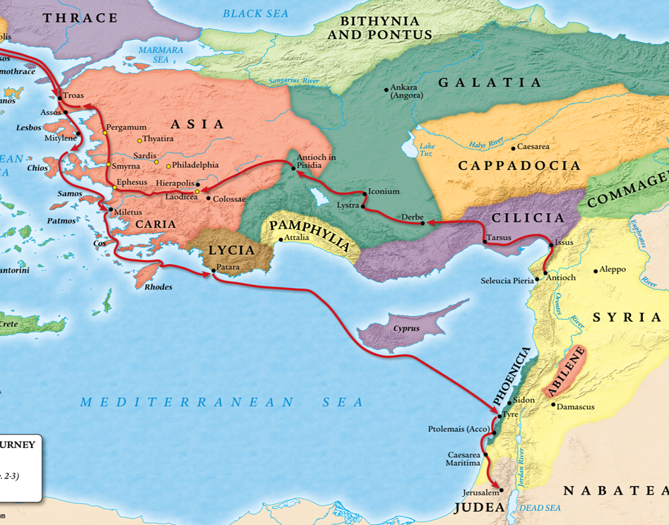
Setting: Circumstances
1 Peter is addressing a more general, widespread persecution encompassing the Roman world (1 Peter 5:9)

Slide 18
Setting: Circumstances
Until A.D. 64, Rome considered Christians to be a Jewish sect and therefore a permitted religion
Nero falsely blamed the burning of Rome on Christians to shift blame away from himself

Slide 19
Setting: Circumstances
Widespread rumors accused Christians of practicing cannibalism (Lord’s supper) & orgies of vice (love feasts)
Removal of legal status for Christianity allowed for both government approved persecution & mob violence

Slide 20
Setting: Circumstances
Persecution of Christians in Rome by Nero reached levels of extreme cruelty (Tacitus, Annals 15:44)

Slide 21
Setting: Date ~ A.D. 64-65
Peter is very familiar with Paul’s letters and commends them (2 Peter 3:15)
The suffering of Christians is widespread, but not yet extreme

Slide 22
Setting: Location
Babylon is a veiled reference to Rome (Papais, Clement)
No evidence Peter ever went to Babylon in either Mesopotamia or Egypt

Slide 23
Theme
1 Peter 1:2b & 5:12 - May grace & peace be yours - this is the true grace of God, Stand firm in it!
1 Peter 1:3-5 - God’s grace grants living hope in Christ and an imperishable inheritance reserved in heaven

Slide 24
Theme
This hope enables perseverance in suffering resulting in maturity & praise, glory & honor at Jesus’ revelation
Christ is the model for responding to suffering, and God uses it in positive ways in the believer’s life

Slide 25
Theme
Peter, “a fellow elder,” gives pastoral encouragement regarding suffering to stand firm in God’s grace & hope
Preparation for Persecution or Hope in Suffering - Be Hopeful: How to make the best of times out of your worst of times

Slide 26
Outline
I) God’s Grace and Salvation (1:1-2:10)
Introduction (1:1-2)
Plan of Salvation (1:3-12)
Products of Salvation (1:13-25)
Purpose of Salvation (2:1-10)

Slide 27
Outline
II) God’s Grace & Submission (2:11-3:12)
Submission to Authorities (2:11-17)
Submission to Master’s (2:18-25)
Submission at Home (3:1-7)
Submission in All of Life (3:8-12)

Slide 28
Outline
III) God’s Grace and Suffering (3:13-4:19)
Make Christ Lord (3:13-22)
Have Christ’s Attitude (4:1-11)
Glorify Christ’s Name (4:12-19)

Slide 29
Outline
IV) God’s Grace and the Saints (5:1-14)
Elders - Shepherd the Flock (5:1-4)
Saints - be humble (5:5-9)
Benediction (5:10-14)

Slide 30
Conclusions
Peter’s message is important to us today - God’s grace gives hope in Christ in all circumstances

Slide 31
Grace Bible Church Glorifying God by Making Disciples of Jesus Christ

Slide 32
