Slide 1
Grace Bible Church Glorifying God by Making Disciples of Jesus Christ

Slide 2
The Failure of the Theocracy Judges
Social mores establish how people get along with each other in a society
What happens when people do what is right in their own eyes?
Proverbs 16:25

Slide 3
The Failure of the Theocracy Judges
The period between initial conquest in 1406 B.C. & Samson’s death in 1055 B.C.
Purpose: To give a defense of the establishment of the monarchy by showing the utter failure of the theocracy to obey the Lord through the judges

Slide 4
Judges - Outline
Causes for the Period of the Judges (1:1-3:6)
Cycles of Judges (3:7-16:31)
Consequences of Disobeying the Lord (17-21)
Sin leads to suffering; repentance leads to deliverance (as warned in Numb. 26; Deut. 27-28; Joshua 23-24)

Slide 5
The Causes for the Period of Judges
Incomplete obedience
Pagan nations to be utterly destroyed because of their iniquity & abominations (Gen. 15:16; Exod. 23:23f; Leviticus 18:24-27 Deuteronomy 20:17-18)
Instead of utterly destroying them as commanded, several tribes put them to forced labor

Slide 6
The Causes for the Period of Judges
Failure to Teach the next Generation
They served Yahweh all the days of Joshua & the elders who survived him, but a new generation arose that did not know Yahweh or remember His work (2:7-10)
They did not teach them their history or to love God (Deut. 6)

Slide 7
The Causes for the Period of Judges
Idolatry
Not knowing Yahweh, what He had done or His commands, they fell into idolatry
The Lord would no longer drive out the nations, but they would become a test of Israel’s faithfulness (vs. 20-23)

Slide 8
The Causes for the Period of Judges
Intermarriage (See Deut. 7:3)
Intermarriage compounded the incomplete obedience and idolatry

Slide 9
The Cycles of Judges Judges 3:7-16:31
The cycle of judges went from disobedience to idolatry to oppression to repentance to deliverance

Slide 10
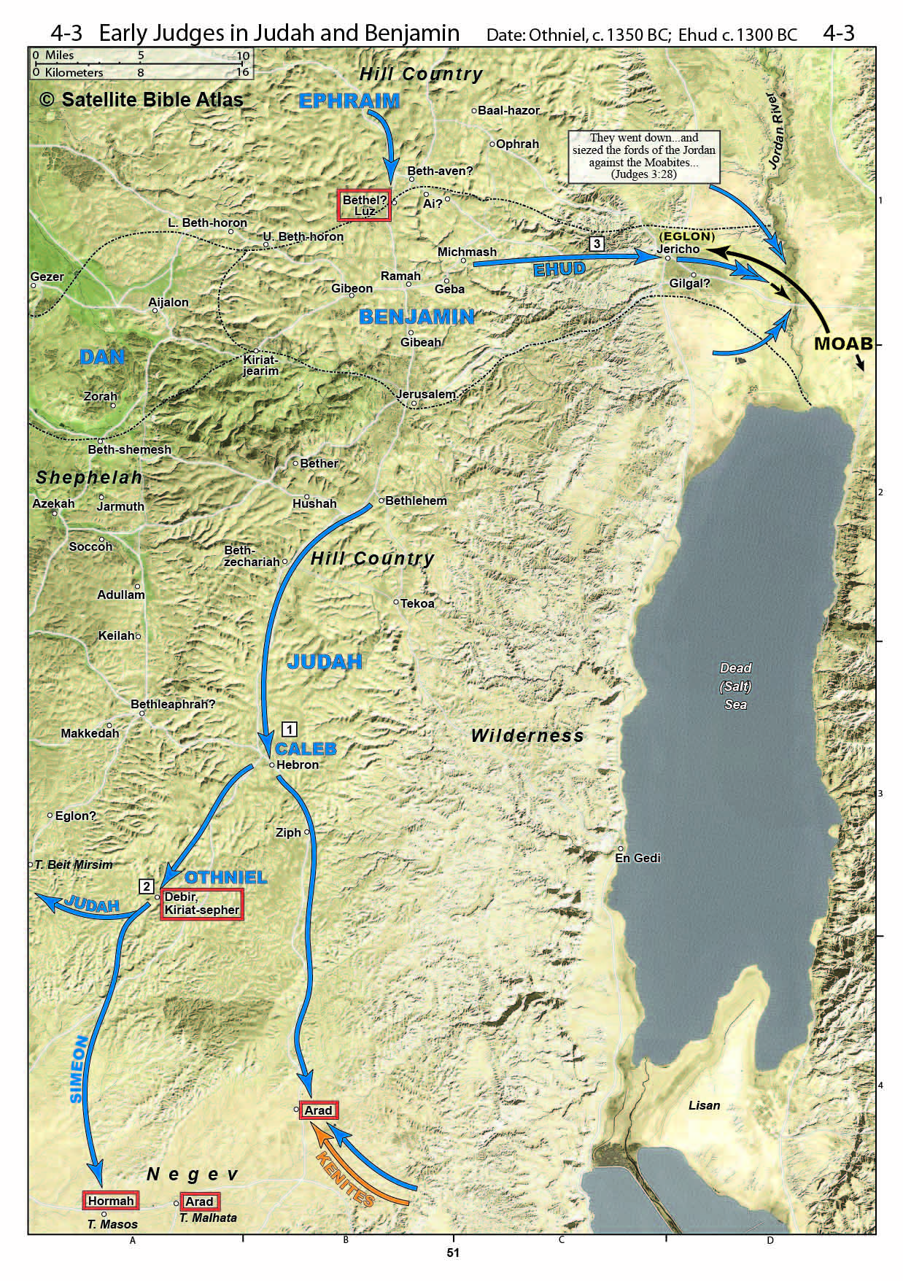
The Cycles of Judges - Othniel (Judges 3:7-11)
They forgot the Lord & served Baal
Oppressed for 8 years
Othniel was from Judah.
He defeated the king of Mesopotamia .
He judged for 40 years
To Mesopotamia

Slide 11
The Cycles of Judges - Ehud Judges 3:12-30
They did evil again & were oppressed for 18 years
Ehud was from Benjamin. He killed Eglon & defeated Moab, then judged for 8 years.
Notes:
Eglon had set himself up in Jericho. John Garstang found the “middle palace” in his dig with pottery that matches this time period

Slide 12
The Cycles of Judges - Shamgar Judges 3:31
He defeated the Philistines.
It is not known where he was from.
He judged for an unknown time

Slide 13
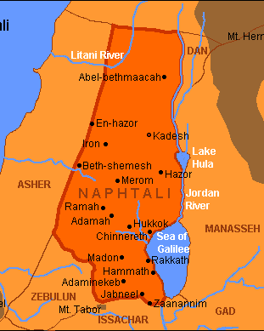
The Cycles of Judges - Deborah & Barack Judges 4 & 5
They did evil again
Oppressed for 20 years
They repented & cried out to the Lord
Deborah, a prophetess from Ephraim.
Balak was from Naphtali.

Slide 14
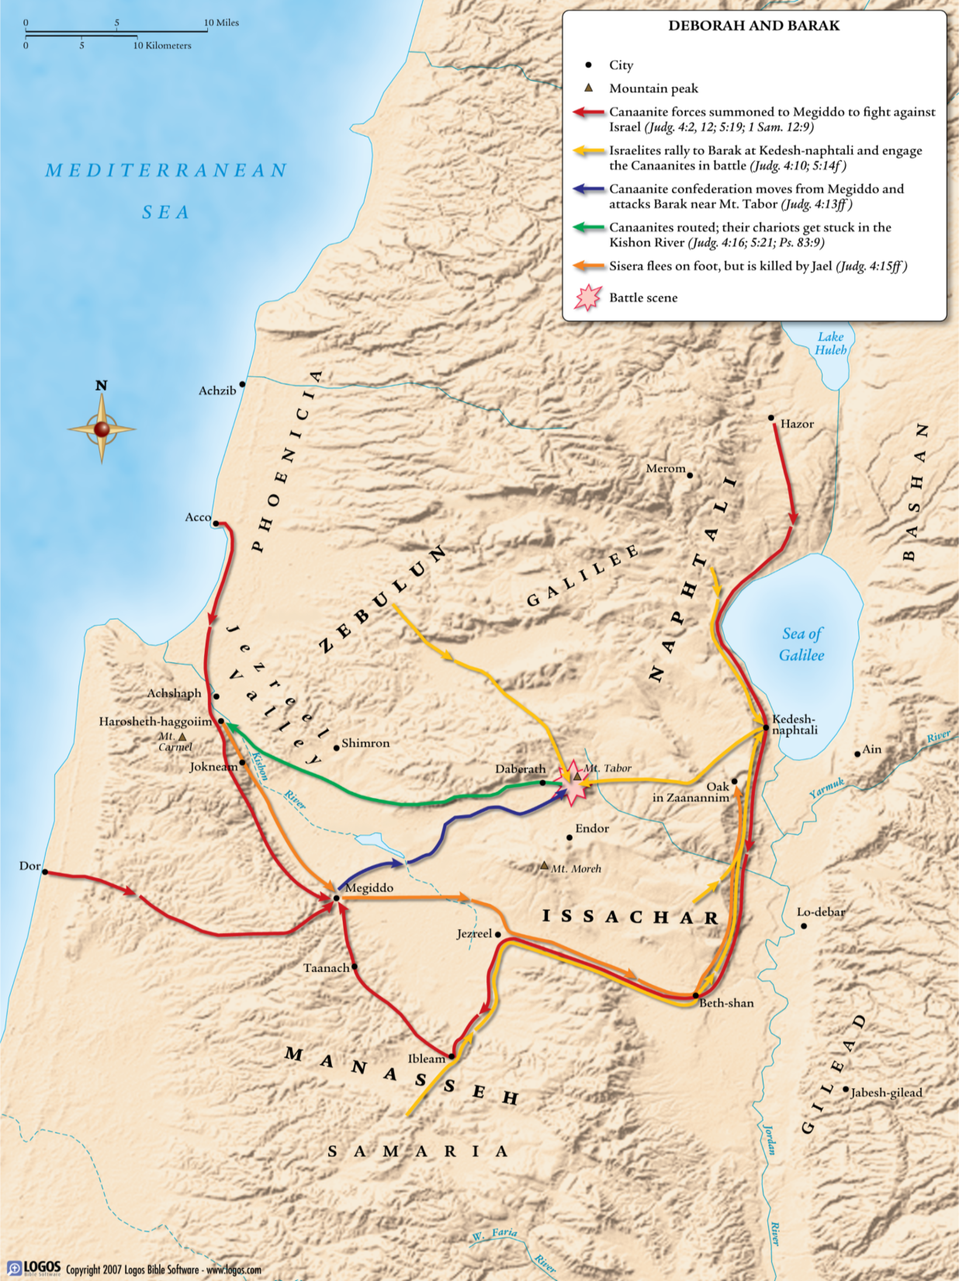
Mobilized at Mt Tabor
They defeated the Canaanites.
Jael received the honor
Victory Song of Deborah & Barak
There was peace for 40 years
Notes:
Canaanites had 900 iron chariots, but defeated at Mt Tabor and across plains of Meggido as they fled. Chariots mired and army swept away at river Kishon.
General Sisera fled by foot to east and north to tent of Jael, who killed him with a tent peg. She received the honor instead of Barak just as Deborah had predicted.
There was peace for 40 years

Slide 15
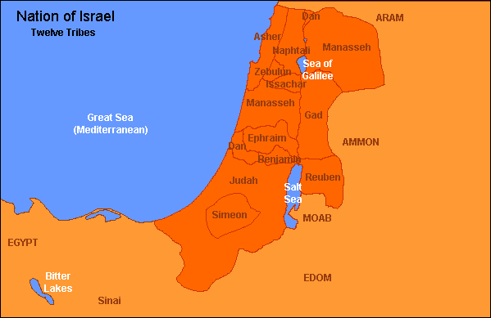
Cycles of Judges - Gideon Judges 6-8:32
They turned from the Lord again
Oppressed by Midian for 7 years
They repented & cried out
Gideon was from Manasseh.
To Midian

Slide 16
Cycles of Judges - Gideon Judges 6-8:32
The angel of the Lord visits Gideon at Ophrah & calls him to defeat Midian
Gideon’s fear overcome by miracle of fire from rock consuming the meat & bread
Gideon tears down altar of Baal & the Asherah, offers sacrifice to God
Notes:
Gideon was from Manasseh
Threshing wheat in a wine press because of fear of Midianites
Miracles:

Slide 17
Midianites mobilize & camp in valley of Jezreel prompting Gideon to mobilize (33-35)
Gideon’s fear calmed by 2 miracles with fleece & dew (36-40)
God has Gideon’s reduced his army from 22,000 to 10,000 to 300 (7:1-8)
Report of dream gives Gideon confidence (9-15)

Slide 18
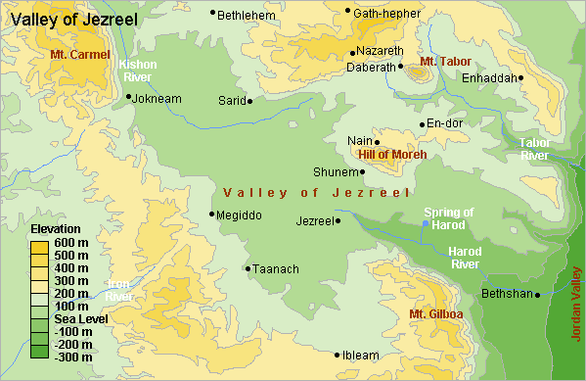
Gideon’s 300 surrounded the enemy camp of 135,000 (16-20)
Midianites fight each other & then flee (21-23)
Midian

Slide 19
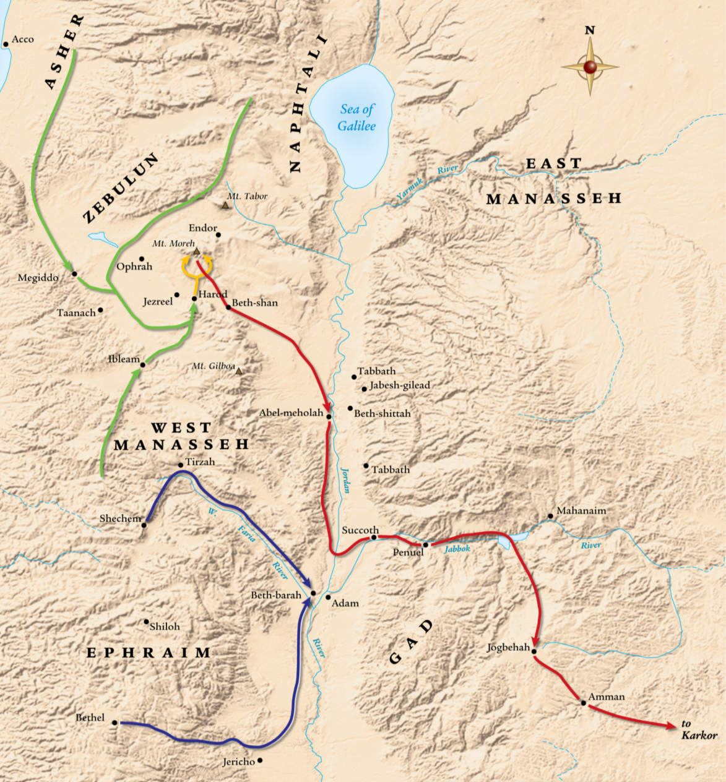
Ephraim called to block escape routes at Jordan river (24-25)
Gideon & 300 pursue & defeat 15,000 men of kings Zebah & Zalmunna, & chastens Succoth Penuel for not helping him
The land was undisturbed for 40 yrs

Slide 20
Abimelech Judges 8:33-9:57
They did evil again
He was one of Gideon’s seventy sons.
He was a usurper that murdered his brothers
He caused turmoil and civil war in Ephraim

Slide 21
Cycles of Judges - Tola Judges 10:1,2
He was from Issachar, but lived in Ephraim
He judged for 23 years

Slide 22
Cycles of Judges - Jair Judges 10:3-5
He was from Gilead (Gad).
He judged for 22 years

Slide 23
Cycles of Judges - Jephthah Judges 10:6-12:7
They did evil again
Oppressed for 18 years

Slide 24
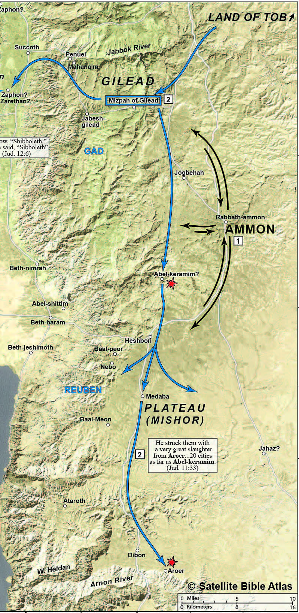
Cycles of Judges - Jephthah Judges 10:6-11:40
Jephthah of questionable character, but brought from Tob to lead Gilead (11:1-11)
He rebuked the Ammonites for their wrong history (11:12-28), Made a rash vow, Then defeated Ammon (11:29-33), and carried out his vow (11:34-40)
Notes:
Jephthah was son of harlot, so driven away from rest of family
He agreed to come fight on condition he would be made chief in family
He knew history of Israel and Ammon & rebuked them
He vowed to sacrifice 1st thing from his house if he won war
He won, then carried out sacrifice of his daughter who came out of house first
(Animals lived in homes & were usually first things out the door)

Slide 25
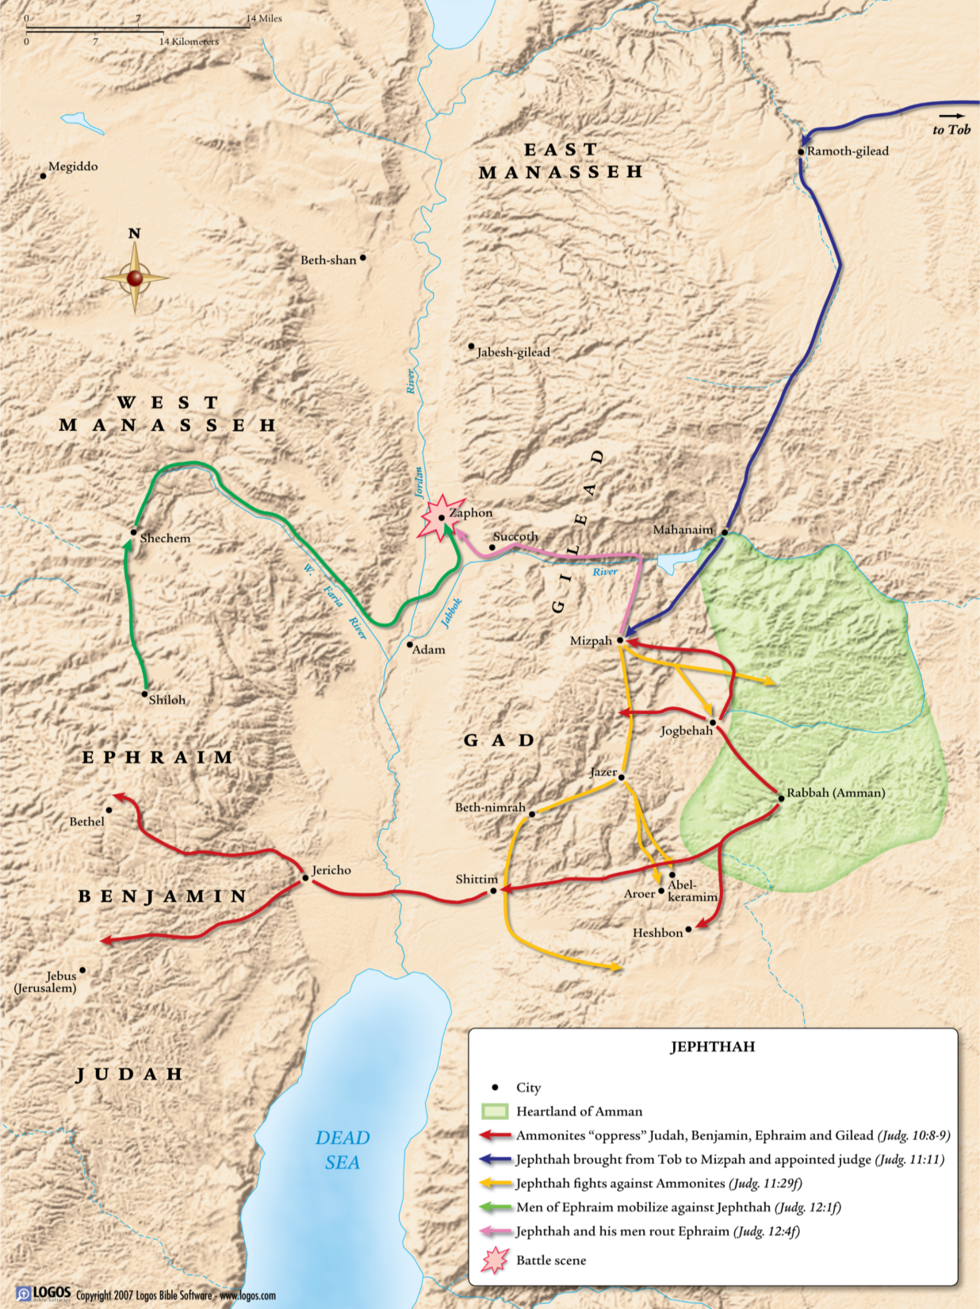
Cycles of Judges - Jephthah Judges 12:1-7
Ephraim was jealous and fought Jephthah and lost, resulting in 42,000 needless deaths
He judged for 6 years
Notes:
Jephthah was son of harlot, so driven away from rest of family
He agreed to come fight on condition he would be made chief in family
He knew history of Israel and Ammon & rebuked them

Slide 26
Cycles of Judges - Ibzan Judges 12:8-10
He was from Bethlehem.
He judged for 7 yrs

Slide 27
Cycles of Judges - Elon Judges 12:11-12
He was from Zebulun.
He judged for 10 years

Slide 28
Cycles of Judges - Abdon Judges 12:13-15
He was from Ephraim.
He judged for 8 years

Slide 29
Cycles of Judges – Birth of Samson Judges 13
Oppressed by Philistines for 40 years (13:1)
The Angel of the Lord visits Manoah & his wife - they will have a son who is to be a Nazrite. Samson is born in Zoar (Dan) (13:2-24)

Slide 30
Cycles of Judges – Samson’s Marriage Judges 14
God used Samson despite his lustful passion to do what was right in his own eyes.
Acts of Strength
Killed the lion (6)
Killed 30 men of Ashkelon (19)

Slide 31
Cycles of Judges – Samson’s Vengeance Judges 15
He caught 300 foxes & burns their fields for giving his wife to another man (1-5)
He slaughtered those who murdered his wife (6-8)
He broke his bonds & killed 1,000 with the jawbone of a donkey (9-19)
He carried the gate of Gaza 40+ miles to Hebron
He judged for 20 years (20)

Slide 32
Cycles of Judges - Samson Judges 13-16
Samson’s downfall was his lust for Delilah
He avenged his eyes & killed more in his death than while alive
God is able to accomplish His purpose even through people like Samson

Slide 33
Consequences of Disobedience Judges 17-21
The final two stories serve as examples of what happens when people do what is right in their own eyes
Christians are restrained by the Holy Spirit, religious people by fear of God, government is to restrain everyone

Slide 34
Consequences of Disobedience Judges 17-21
Judges is a warning to all nations of the idolatry, immorality & anarchy that results from pursuing paths of sin
God is merciful and gracious to both forgive and bless those who repent and follow Him
Revival begins with Christians becoming serious in their pursuit of holiness and service to God

Slide 35
Grace Bible Church Glorifying God by Making Disciples of Jesus Christ

