Slide 1
Grace Bible Church Glorifying God by Making Disciples of Jesus Christ

Slide 2
Conquest & Establishing the Theocracy The Book of Joshua
The Most High is ruler over the realm of mankind (Daniel 4)
God has chosen a people for Himself and prepared them to be a holy nation

Slide 3
Conquest & Establishing the Theocracy The Book of Joshua
Genesis 15:13-16 – prophecy
Yahweh remembered His covenant with Abraham & sent Moses to Egypt to free His poeple
1st generation wandered 40 years & died
2nd generation conquered land on the east side of Jordan

Slide 4
Overview The Book of Joshua
1-12: Preparation & Conquest
13-21: Division of the Land
22-24: Appendix
The Altar of Witness
Joshua’s Farewell Address & Charge

Slide 5
Overview The Book of Joshua
Theme: The fulfillment of the Lord’s promise to plant Israel in the land of Canaan through their obedience

Slide 6
Joshua Assumes Command Joshua 1
He was to be strong & courageous for Yahweh would be with him (vs. 1-7)
Prosperity & Success were dependent upon obedience to God
Jordan valley – from West: Jericho to plains of Moab
Pictorial Library of Bible Lands

Slide 7
The Spies & Rahab Joshua 2
Two spies sent out, they lodged with Rahab
Rahab hid and protected them
James 2:25 – placed herself in peril because of her beliefs about God
Yahweh is God of heaven & Earth

Slide 8
The Spies & Rahab Joshua 2
Those in her house would be protected, it would be marked by a scarlet thread
Verse 9-11, 24 – the people were afraid because of what Yahweh had done

Slide 9
The Jordan is Crossed Joshua 3
A miracle would build confidence that the Lord was with Joshua
The Levites with the Ark of the Covenant would go first
Spiritual, not military preparation would take priority.

Slide 10
Crossing the Jordan Joshua 3
The waters of the Jordan were cut off at Adam when the feet of the priest entered the Jordan river
They all crossed on dry ground (vs. 17)

Slide 11
The Memorial stones Joshua 4
A stone for each tribe was picked up from the Jordan & then stacked
This would be a memorial to what God had done (vs. 21-24)
Memorials are still important
The Jordan flowed again when the priests left its river bed

Slide 12
Keeping the Covenant Rites Joshua 5
They were vulnerable to attack
But the kings were afraid
Circumcision had not been practiced during the wilderness wanderings
It disabled the army before the enemy
Obedience to God was essential for victory

Slide 13
Keeping the Covenant Rites Joshua 5
They celebrated Passover & ate some of the produce of the land
The manna ceased the next day
Joshua met the Captain of the Host of Yahweh

Slide 14
The Conquest of Jericho Joshua 6
They would not conquer it this strategic, walled city in the usual way
March around it once per day for 6 days
March around it 7 times the 7th day, then blow horns & shout the last time
City under the ban, only articles of worth saved for Lord’s treasury

Slide 15
The Conquest of Jericho Joshua 6
The walls fell down & the city conquered & burned with fire
Jericho Ruins – Ariel from West
Pictorial Library of Bible Lands

Slide 16
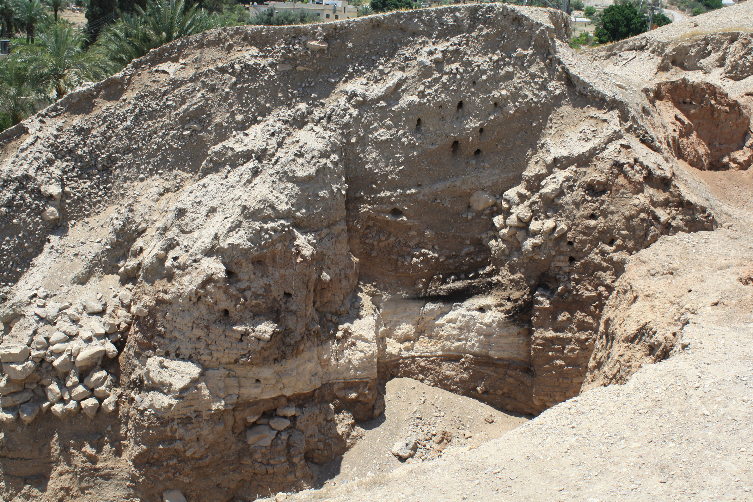
The Conquest of Jericho - Joshua 6
Archeological evidence confirms it
Jericho Excavation cut – South – with burn layer

Slide 17
The Conquest of Jericho Joshua 6
Rahab protected. She marries Salmon & gave birth to Boaz, the great-grandfather of king David
A curse would be on whoever rebuilt it

Slide 18
Defeat at Ai Joshua 7
Joshua only sent 3,000 to conquer Ai
They were defeated & 36 killed
They had not kept Yahweh’s covenant
Achan was found out, he gave glory to God by his confession (vs. 19-21)
Achan’s disobedience resulted in the defeat of the army & destruction of him, his family & all his belongings.

Slide 19
Conquest of Ai Joshua 8
They obeyed Yahweh’s instructions
They set an ambush, destroyed the city & then the men of war
Obedience to the Lord resulted in victory!

Slide 20
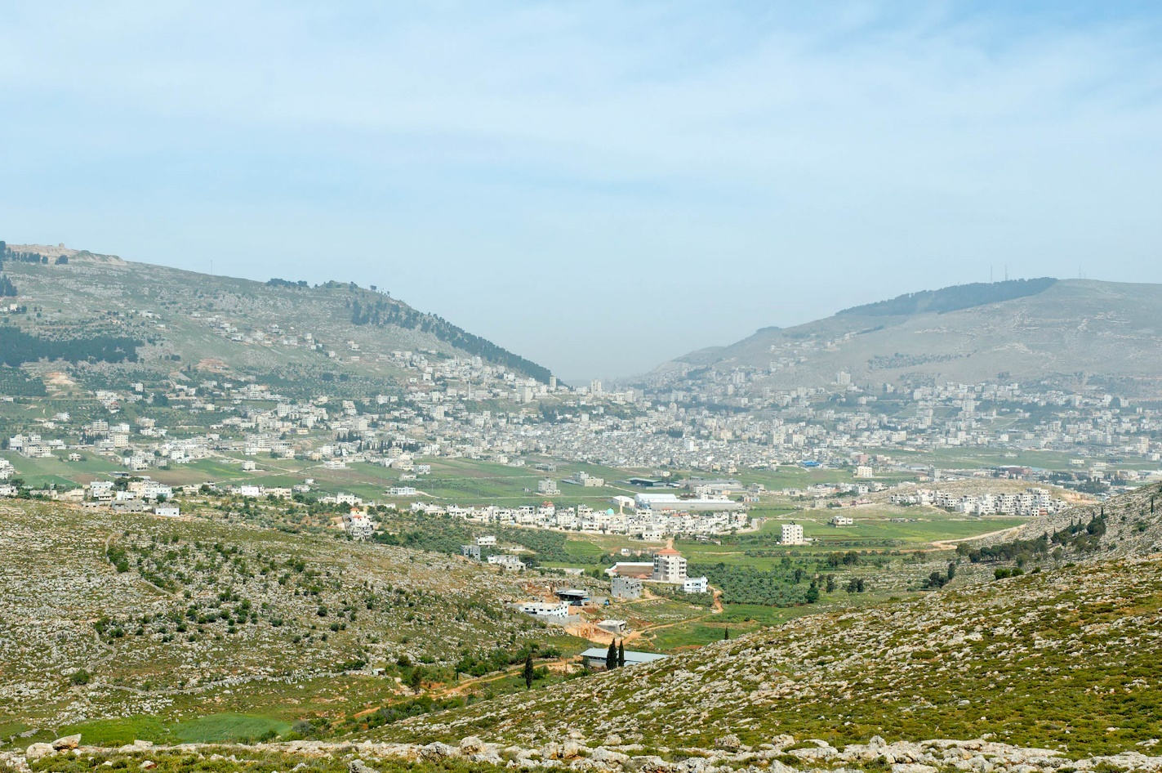
Conquest of Ai Joshua 8
Joshua fulfilled Deut. 27-28 – Built altar, read law, blessings & curses on Mt Ebal and Gerazim
Mt Gerizim
Mt Ebal
Shechem
Pictorial Library of Bible Lands

Slide 21
A Hasty Covenant Joshua 9
Gibeonites wisely planned to deceive Israel in order to spare their own lives
Joshua did not seek the Lord first & was deceived by them
The Gibeonites became servants – hewers of wood, haulers of water

Slide 22
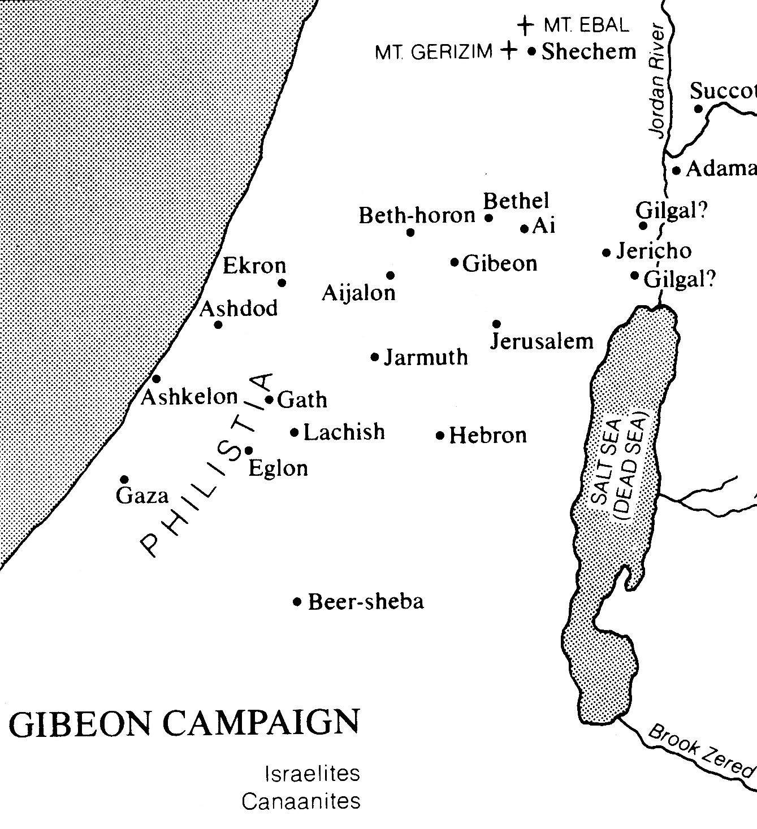
Conquest of the South - Joshua 10
Five Amorite kings attack Gibeon
Israel mobilized & attacks suddenly

Slide 23
Conquest of the South - Joshua 10
More died by hailstones than by sword
The sun & moon stood still – no day like it before or after (vs. 12-14)

Slide 24
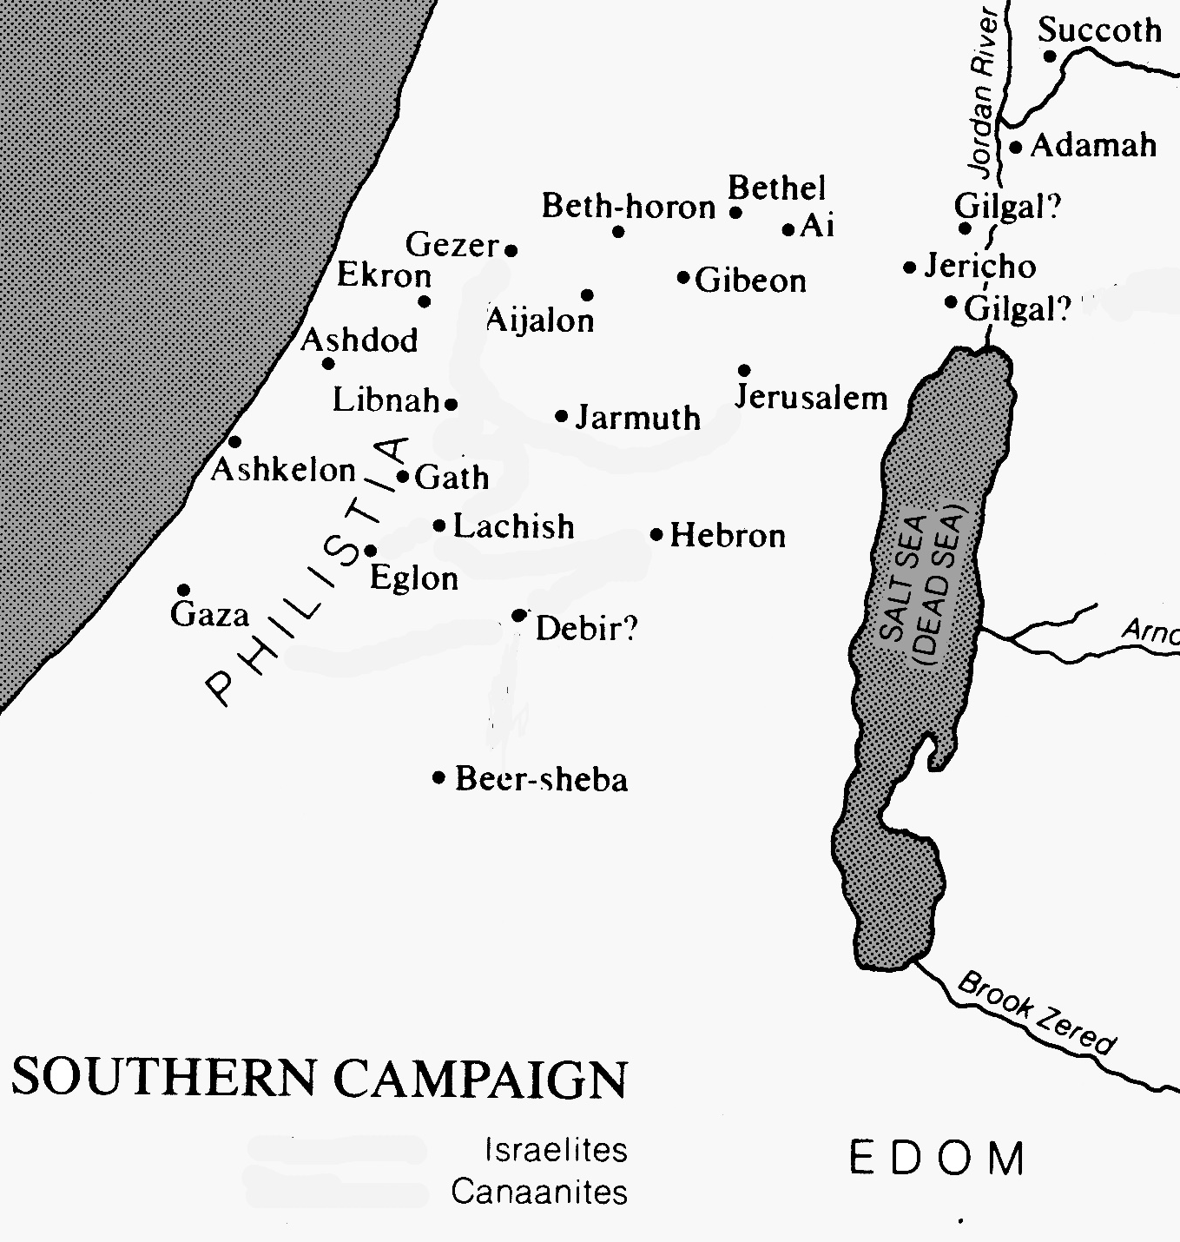
Conquest of the South - Joshua 10
Conquered southern areas in succession:

Slide 25
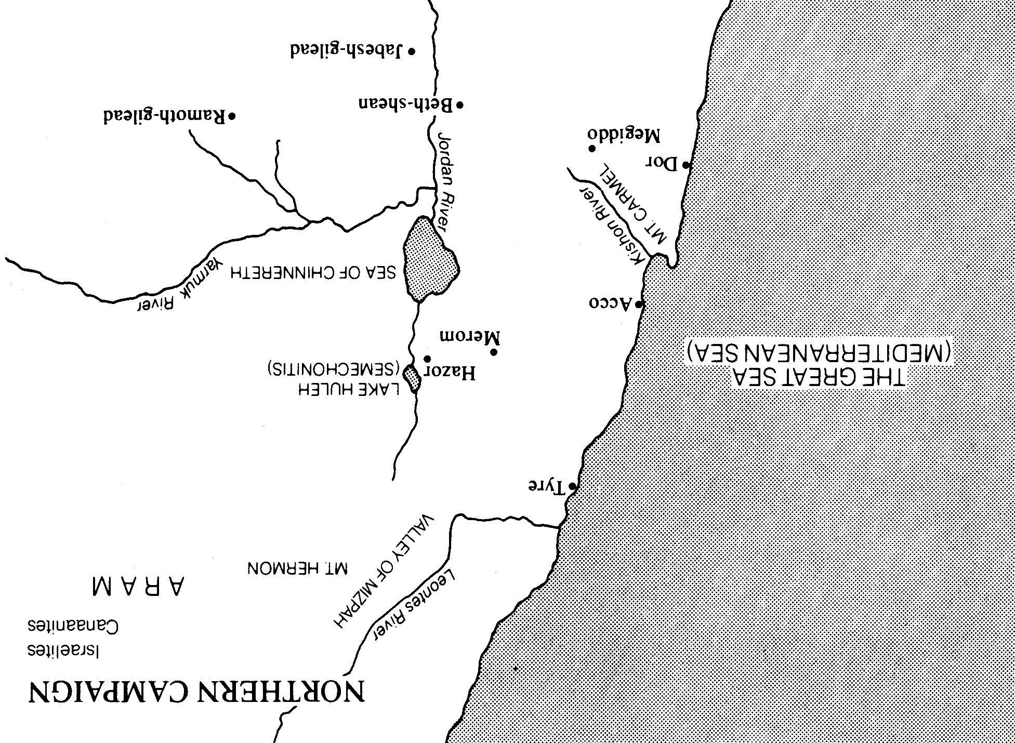
Conquest of the North - Joshua 11
Northern alliance defeated at Merom
Northern cities systematically destroyed

Slide 26
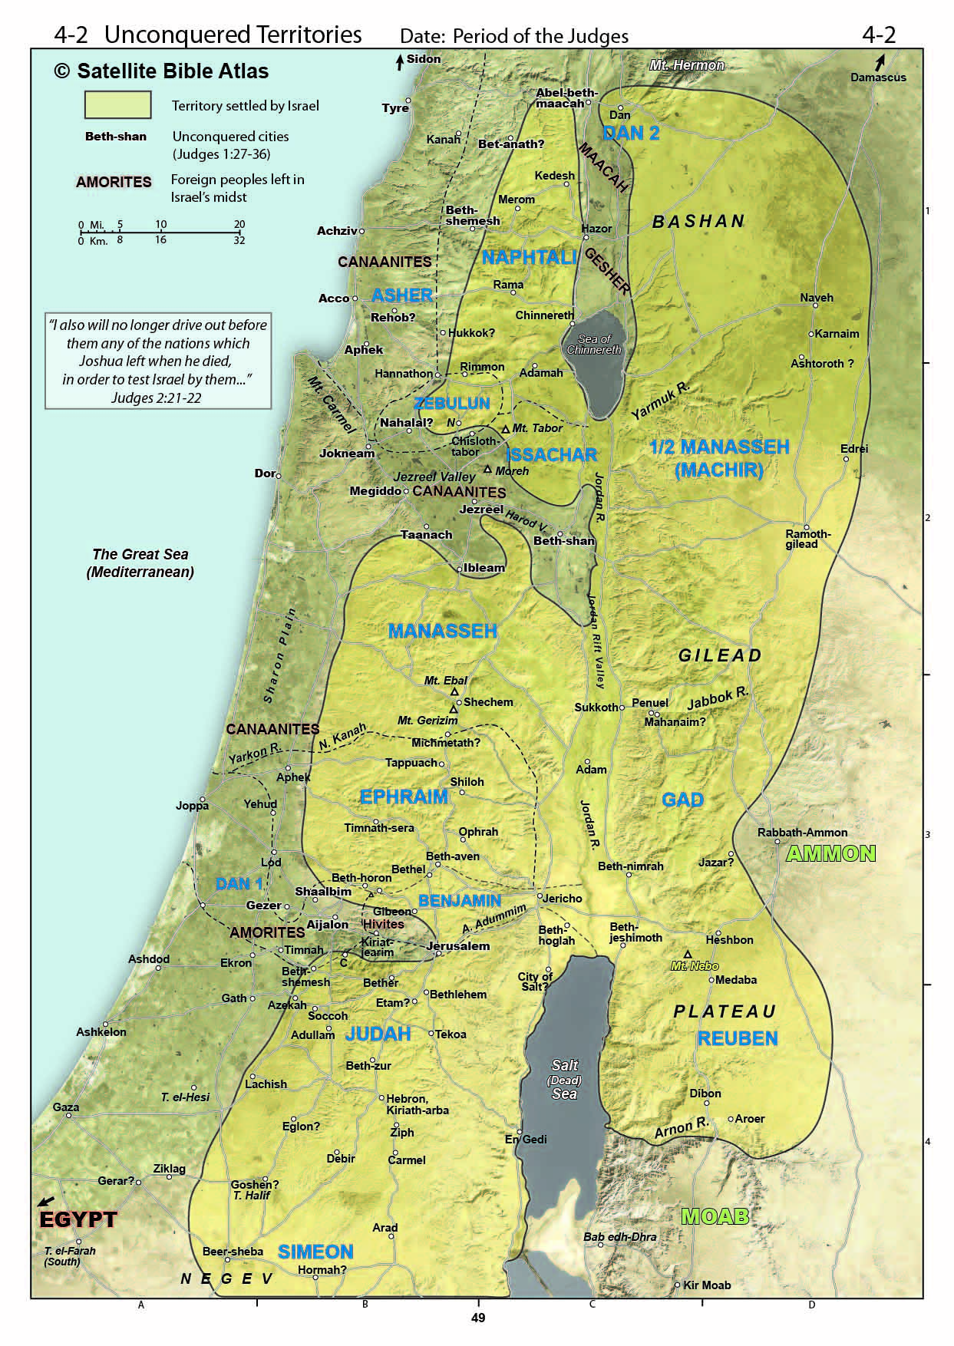
Conquest
Joshua 13:1-7
All the land conquered as Yahweh had spoken to Moses
After initial conquest, they would be driven out (13:6) little by little (Exod. 23:30; Deut. 7:22)

Slide 27
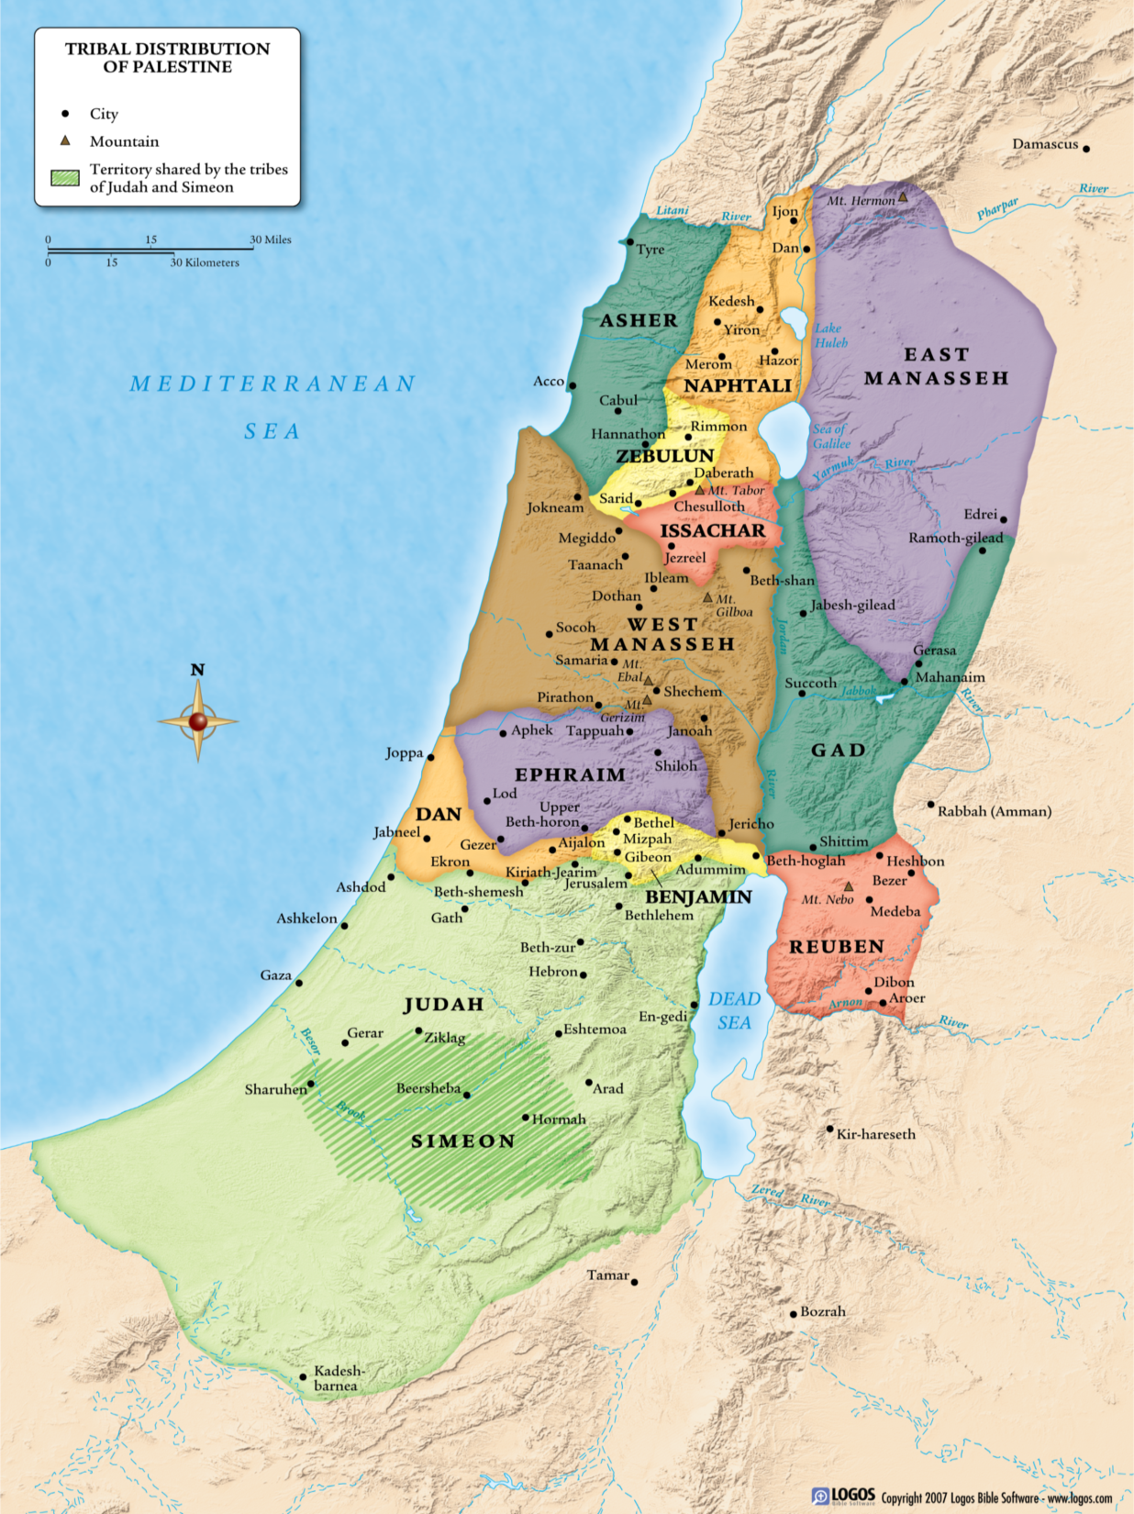
They were obedient & the Lord fought for them
If they remained obedient the rest of the lands would be conquered
●
Hebron

Slide 28
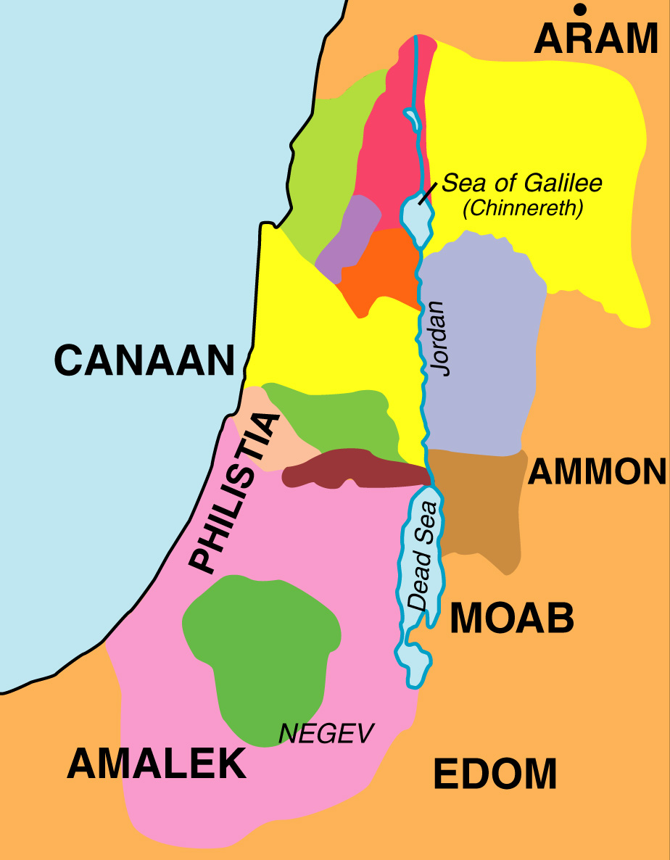
l Cities of Refuge
Manasseh
n Levitical Cities
Naphtali
n
Asher
n
n
n
n
Zeb
n
l
n
l
n
n
n
n
n
n
Iss.
n
Gad
n
Manasseh
l
n
n
l
n
n
Ephraim
n
n
Dan
n
n
n
n
Ben,
l
n
n
Reuben
Judah
n
n
n
n
l
Simeon
Hebron
n
n
n
n
n
n
n

Slide 29
The Altar of Witness Joshua 22
The eastern tribes returned home
They built an altar - almost causing a civil war
Its purpose was to be a witness to future generation that they were also a part of Israel

Slide 30
Joshua’ Farewell Address & Charge Joshua 23-34
Keep the law of the Lord, cling to Him only
Choose whom you will serve
They chose to serve the Lord
They were the example of the Lord’s blessing on those who obey Him

Slide 31
You must chose. Whom will you serve?
Your choice will affect you & your nation

Slide 32
Grace Bible Church Glorifying God by Making Disciples of Jesus Christ

