Slide 1
Grace Bible Church Glorifying God by Making Disciples of Jesus Christ

Slide 2
A reminder to consider others Please:
Turn off your cell phone or set to vibrate only
Turn off sound to all electronic devices
Use the nursery or cry room if your child is fussy
Get up during the preaching only if absolutely necessary (please sit in back if you must leave early)
Notes:
2

Slide 3
Developing a Heart of Thanksgiving
Thanksgivings in Biblical Cultures
Feast of First Fruits, Feast of Booths
1541 Coronado in Palo Duro Canyon
1564 French Huguenots at Parris Is
1607 English – Cape Henry, VA
1619 English – Berkley Plantation, VA

Slide 4
Developing a Heart of Thanksgiving
Our Thanksgiving Holiday traces back to the 1621 celebration by the Pilgrims
Christians are not normal people –
Indwelling Holy Spirit, Promises of God, Purpose of life
We can respond differently even to life’s hardships & tragedies

Slide 5
A Brief Pilgrim History
Pilgrim history is important:
Establish a colony in Massachusetts

Slide 6
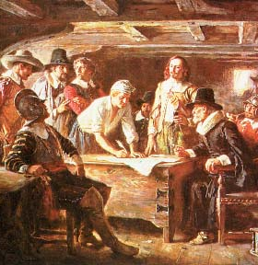
Mayflower Compact:
“In the Name of God… For the Glory of God and the advancement of the Christian faith…”

Slide 7
A Brief Pilgrim History
Pilgrim history is important:
Establish a colony in Massachusetts
The Mayflower Compact
Descendants

Slide 8
Scrooby, England
Church of England – 1536
Queen “bloody” Mary – 1547-1558
Queen Elizabeth - 1558-1603
Puritans – reforms in the church
Separatists – churches independent of government & ecclesiastical interference

Slide 9
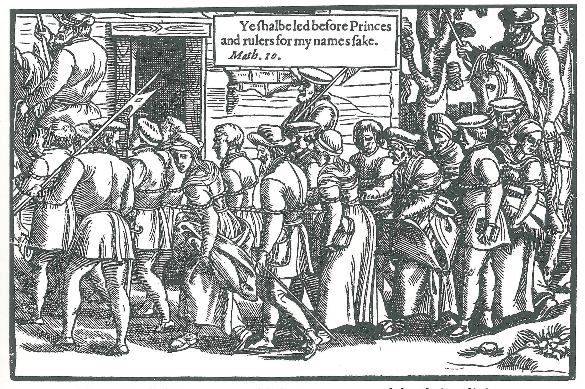
Scrooby, England
Persecution of separatists increased under King James (1603-1625)

Slide 10
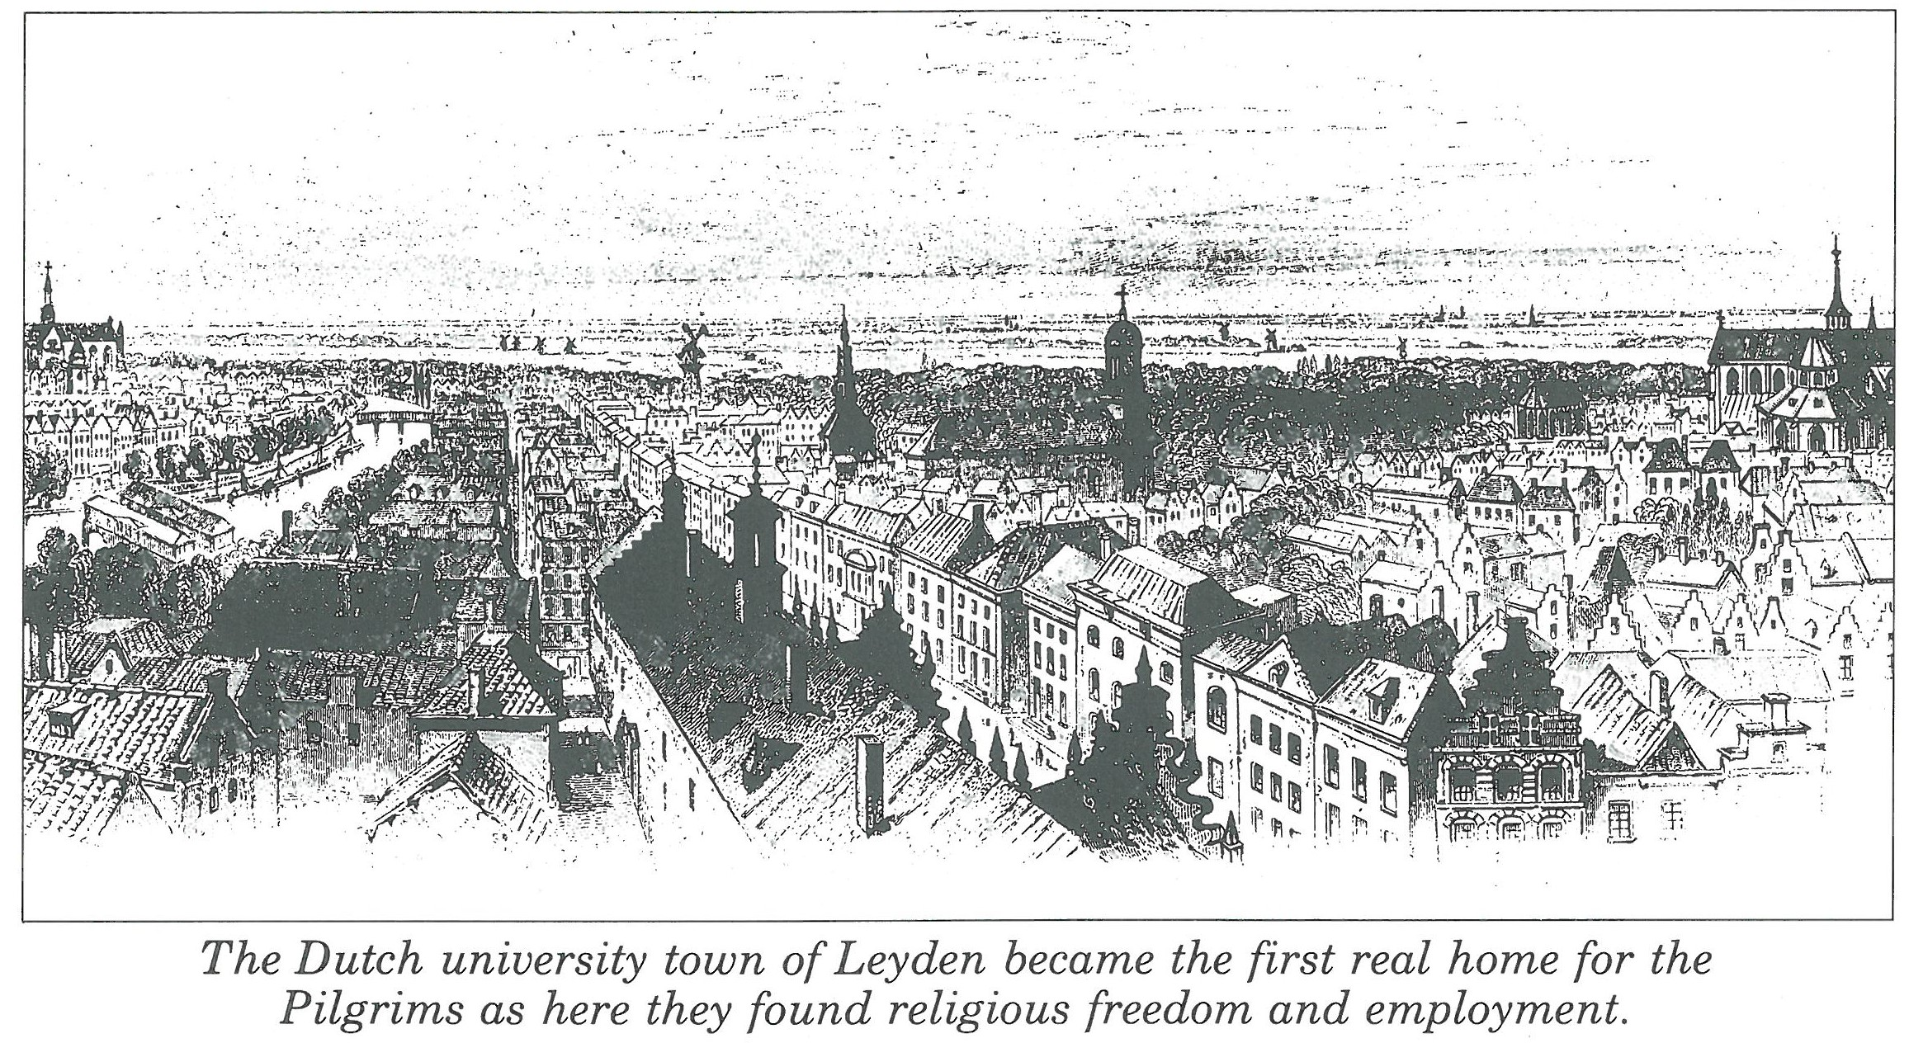
Leyden, Holland
Life was hard for the immigrants

Slide 11
Leyden, Holland
Life was hard for the immigrants
Restricted growth
Wore out the physical boy
Temptations
Missionary desire
Concern about war with Spain
It was thought wise to establish a colony in America

Slide 12
Voyages
July 22, 1620 – the Speedwell left Holland for Southhampton, England
They were swindled
Supplies sold to pay port fees
Departure delayed to August 5

Slide 13
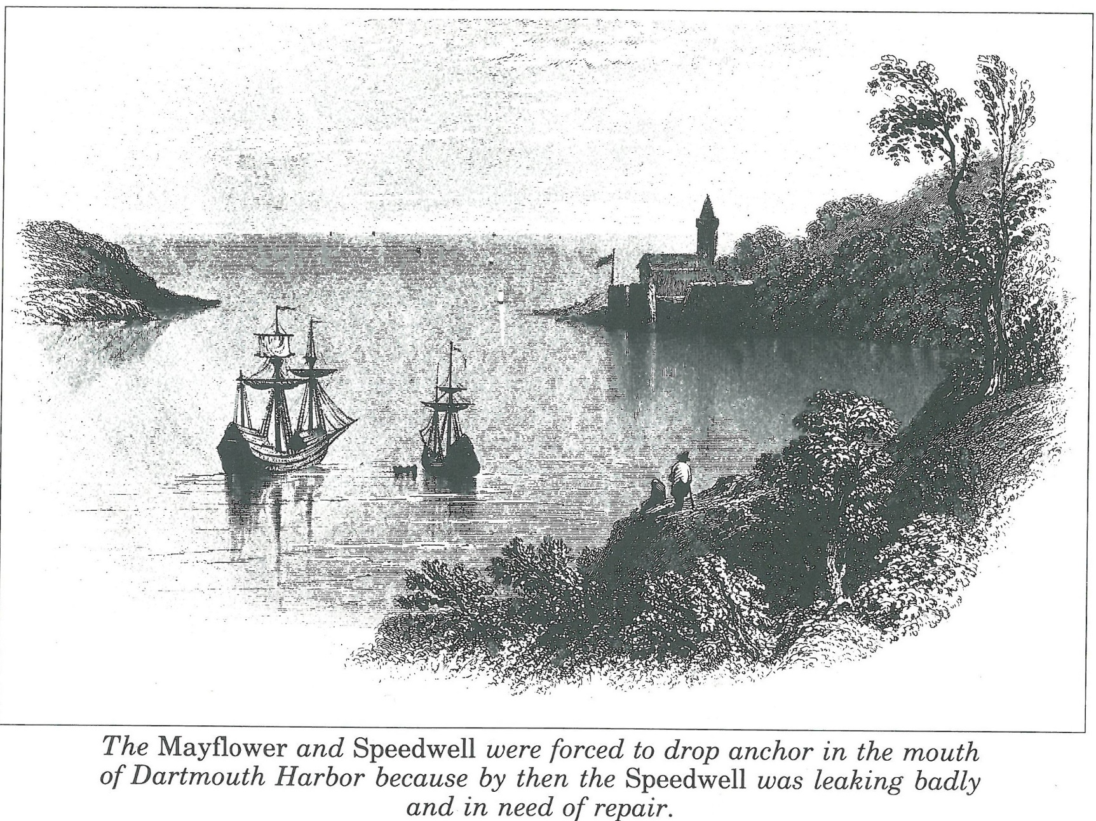
Voyages
Aug. 8 – Speedwell leaking

Slide 14
Voyages
Aug. 25 – Speedwell leaking again

Slide 15
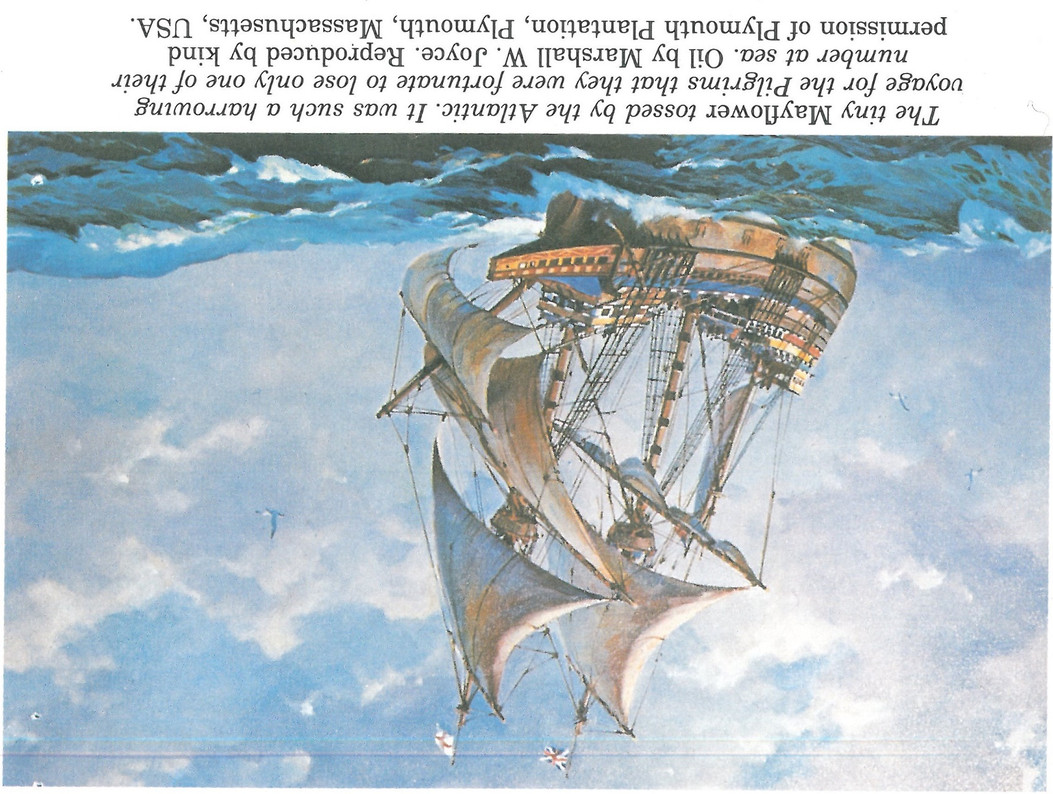
Voyages
Sept. 6 – Mayflower sets out alone

Slide 16
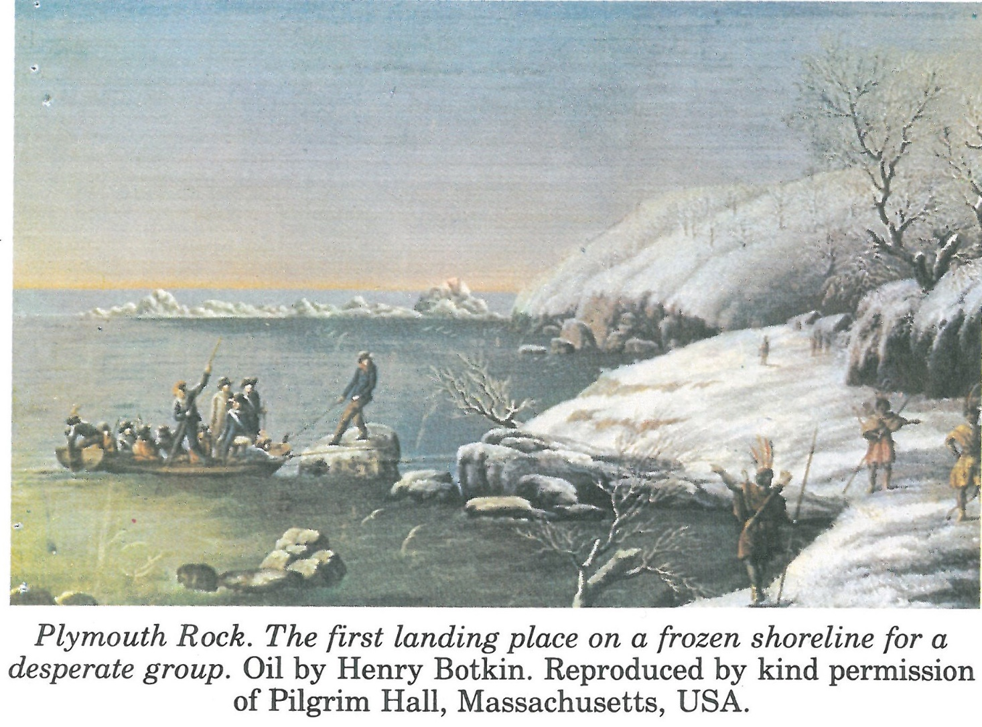
Cape Cod
Land sighted Nov. 6.
Settlement site chosen Dec. 11

Slide 17
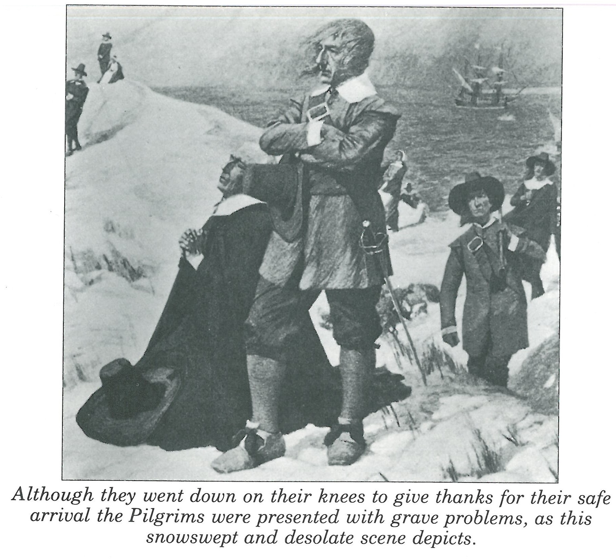
Cape Cod
A harsh winter, scarce food, sickness, death.

Slide 18
102 arrived at Cape Cod

Slide 19
Providence & Miracles
Persecution & Hardship narrowed Colony to the more mature
Some exploited them, others helped
Very gifted leaders
Innovative in finding solutions to problems
Survival of John Howland

Slide 20
Providence & Miracles
Sudden sickness of blasphemous sailor
Storms pushed them north to form an independent colony
Plymouth - former site of Patuxet tribe that had died off. Only safe spot, and stored corn provided needed food

Slide 21
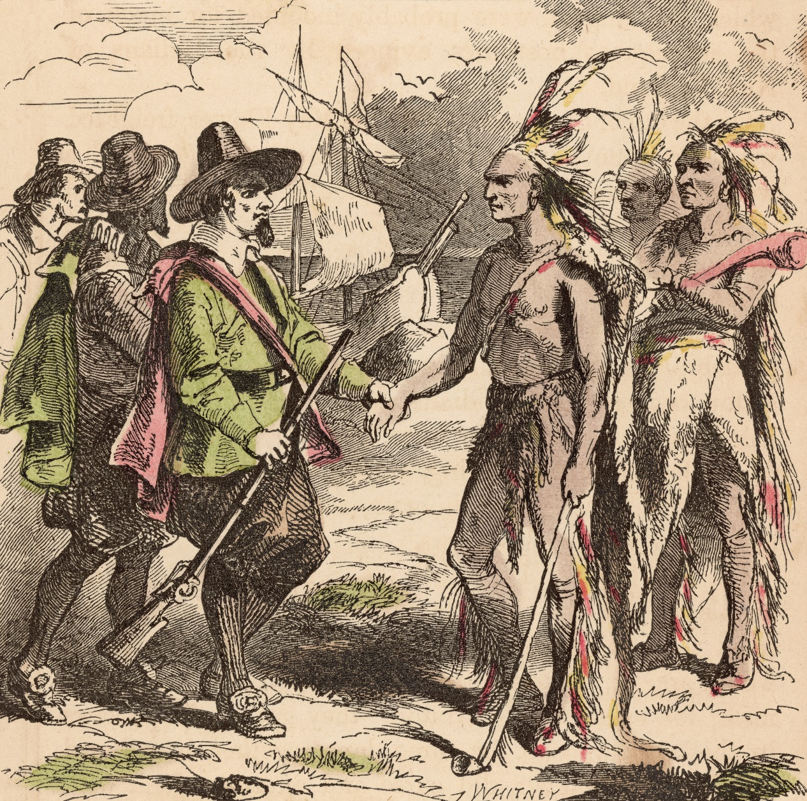
Samoset & Squanto

Slide 22
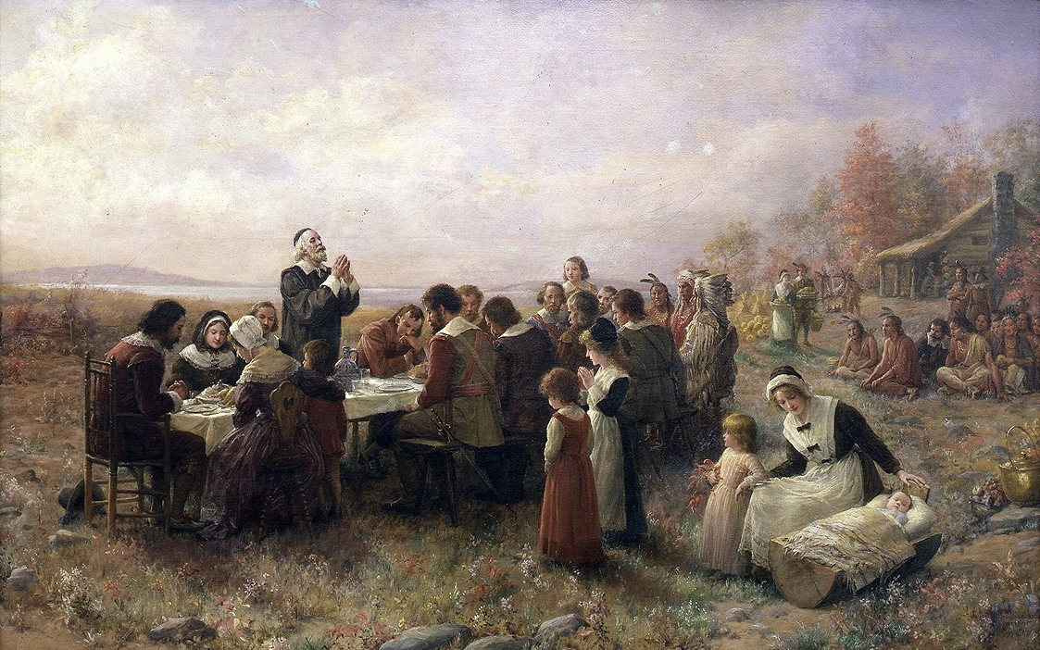
Elder William Brewster would have led them in a Thanksgiving prayer to God

Slide 23
Thanksgiving
Food from harvest would be shared with 36 inadequately provisioned & equipped additions from the Fortune
The real proof of their hearts of thanksgiving was their worship Sunday after Sunday throughout their suffering

Slide 24
Developing a Thankful Heart
1) Recognize your true condition – Luke 7:36-50; Romans 3:10-18
2) God is good and good things come from Him – Genesis 3; James 1:14-15; James 1:13, 17
3) God wants to change you – Rom. 2:4; Luke 13:1-5; Rom. 8:29, Eph. 1:4

Slide 25
Developing a Thankful Heart
4) God uses the troubles and trials of life for your good – James 1:2-4; Romans 5:1-8
5) Count your blessings – Psalm 57

Slide 26
Conclusions
The Pilgrims are an example of the godly who have hearts of thanksgiving
Don’t be like the rest of our society, follow the example of the Pilgrims

Slide 27
Grace Bible Church Glorifying God by Making Disciples of Jesus Christ

