Slide 1
Grace Bible Church Glorifying God by Making Disciples of Jesus Christ

Slide 2
A reminder to consider others Please:
Turn off your cell phone or set to vibrate only
Turn off sound to all electronic devices
Use the nursery or cry room if your child is fussy
Get up during the preaching only if absolutely necessary (please sit in back if you must leave early)
Notes:
2

Slide 3
The Purpose of Man Selected Scriptures
Psalm 11:3, “If the foundations are destroyed, What can the righteous do?
If you are well grounded in your faith, your feet will not stumble (Ps. 17:5) & you can help others (Eph. 4)
All things have been created by God and for God (Col. 1:16)

Slide 4
The Purpose of Man Selected Scriptures
All of creation glorifies God - whether man is aware of it or not - Psalm 148:3-4
The proper response to consideration of creation is awe / worship of God - Ps. 33:8

Slide 5
The Creation of Man Genesis 1:26-27; 2:7; Psalm 100:3; Isaiah 64:8
Jesus cites Genesis declaring that God created mankind from the beginning male and female
There are only two genders & they are not fluid - to claim otherwise is rebellion against God & depravity

Slide 6
The Creation of Man Genesis 1:26-27; 2:7; Psalm 100:3; Isaiah 64:8
Genesis 2:7 - God made Adam from dirt - not any previous life form
Claims of apes evolving to men are fictional tales of imagination

Slide 7
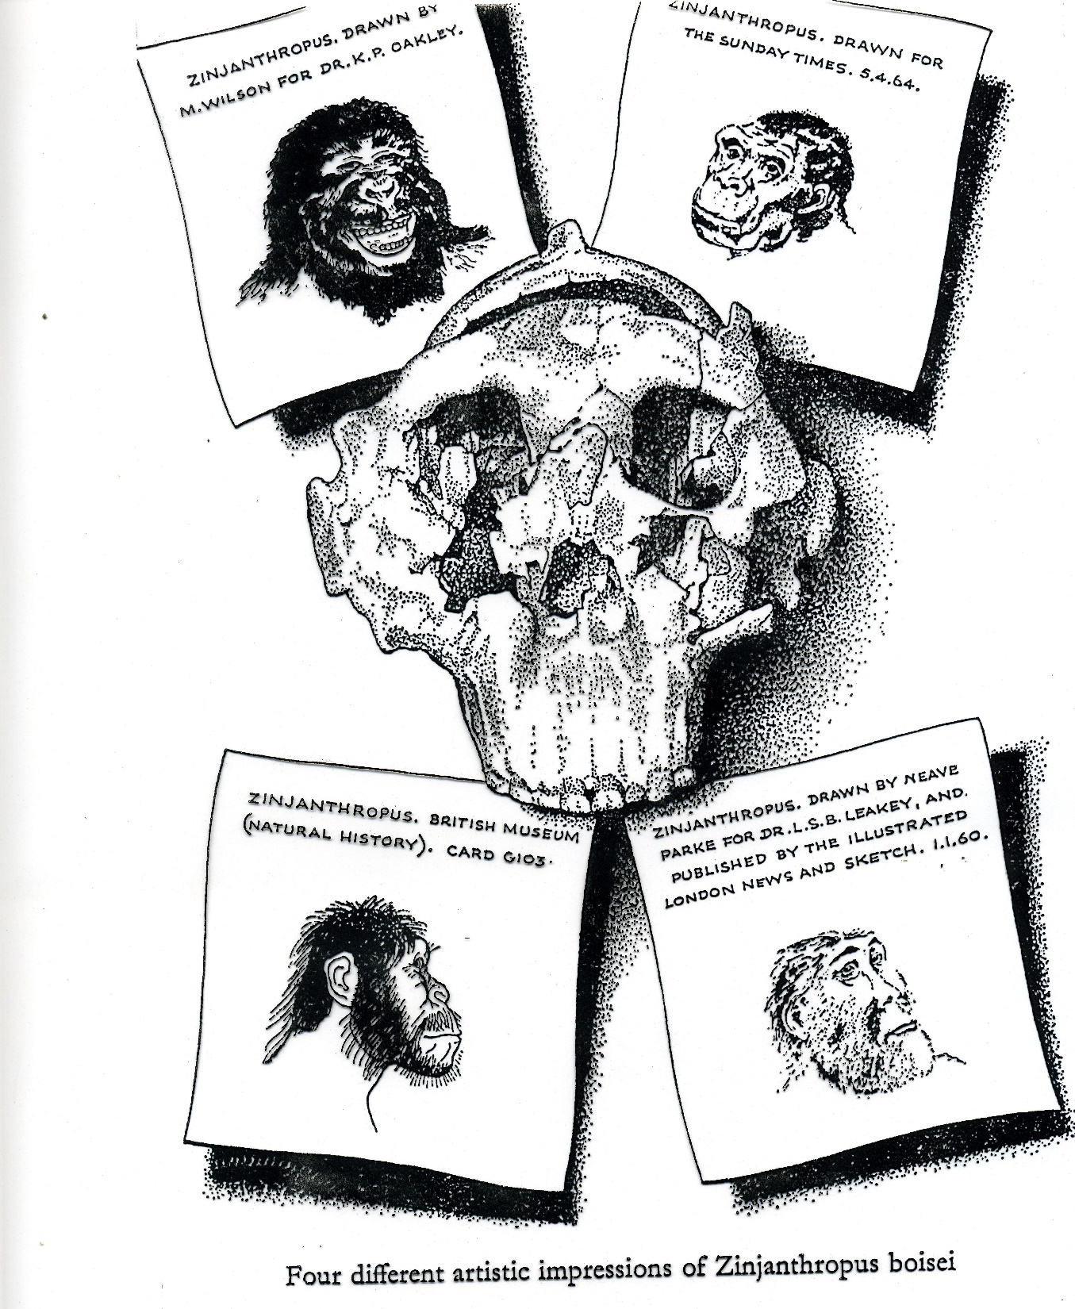

Slide 8
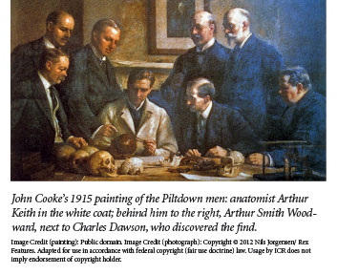
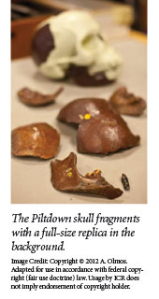

Slide 9
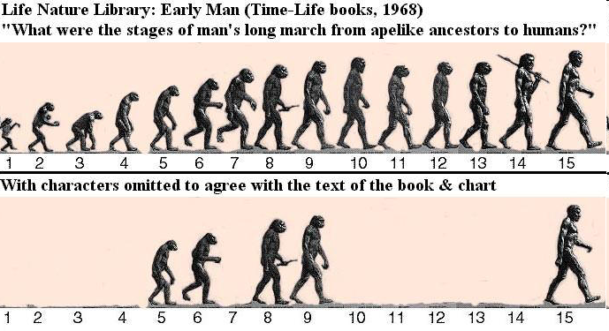

Slide 10
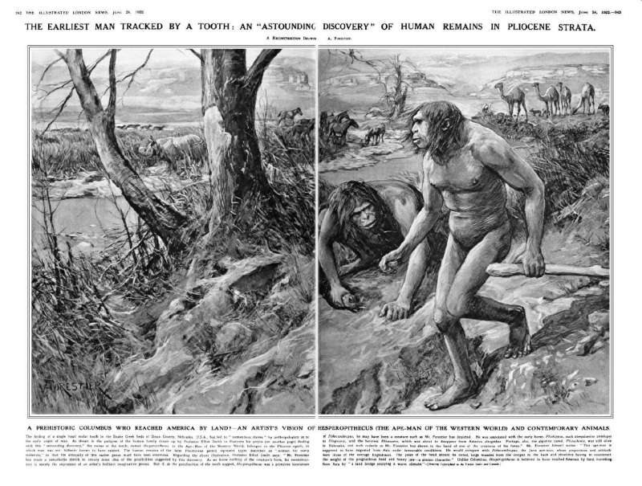

Slide 11
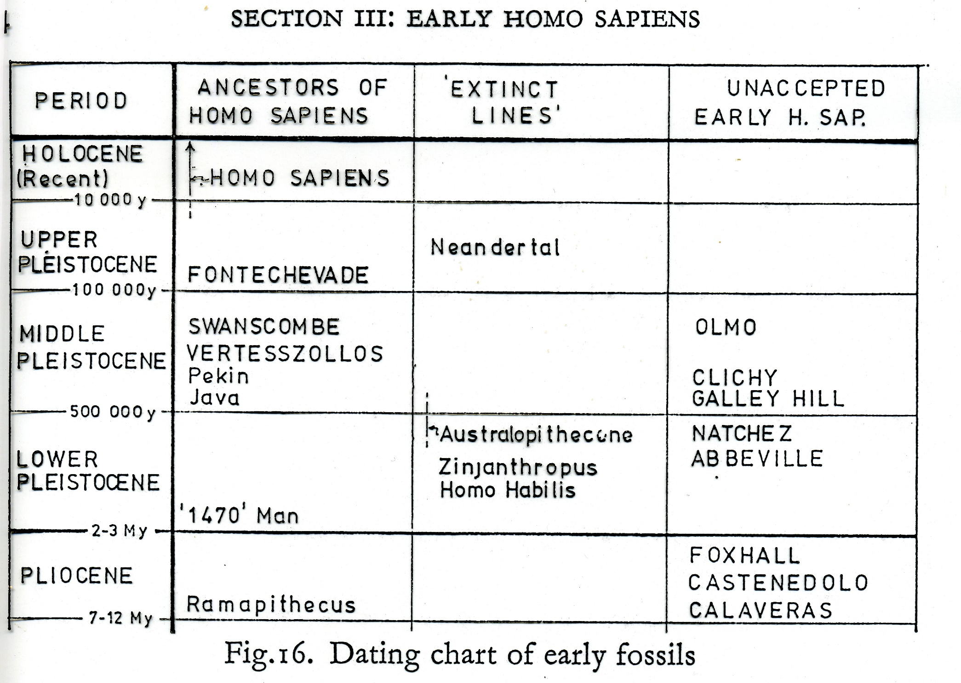

Slide 12
The Creation of Man Genesis 1:26-27; 2:7; Psalm 100:3; Isaiah 64:8
God formed (yatsar) Adam’s physical from the dust of the ground.
God breathed life into him – life comes from life
Man became a living nephesh – being / soul – the immaterial part of man

Slide 13
The Fashioning of Eve Genesis 2:18-23
Genesis 2 expands the summary of Genesis 1:24-31
God instigates & fashions Eve who is built / fashioned (banah) from Adam’s rib
God’s surgery on Adam to get the rib from his side to form the woman was painless and quick

Slide 14
The Fashioning of Eve Genesis 2:18-23
Adam recognizes her origin naming her woman (ishshah) - female man
Genesis 3:20 – Eve, the mother of all the living. A fact backed up by mitochondrial DNA

Slide 15
Man - Made in the Image & Likeness of God - Genesis 1:27
Does not refer to physical likeness or resemblance - God is a spirit, no idols can be made of Him
Image includes the qualities of personhood: ability to reason / think; experience emotions; make choices (rational, emotional, volitional)

Slide 16
Man - Made in the Image & Likeness of God - Genesis 1:27
These qualities are immaterial and separate man from the animals
Likeness includes reflection of God’s Communicable attributes

Slide 17
Man - Made in the Image & Likeness of God - Genesis 1:27
Non-communicable attributes are inherent qualities of God that make Him God
Eternal, Self-existent, Self-sufficient, Omniscient, Omnipresent, Omnipotent, Immutable, Creator, Sovereign

Slide 18
Man - Made in the Image & Likeness of God - Genesis 1:27
Communicable attributes include character qualities that exist in God and are to be in man even if tainted
Kindness, Care, Benevolence, Patience, Faithfulness, Goodness, Love, Mercy, Grace, Forgiveness, Holiness, Jealousy, Anger, Wrath, etc.

Slide 19
Man - Made in the Image & Likeness of God - Genesis 1:27
God is glorified when man reflects His attributes and when God displays them in dealing with man

Slide 20
Man - A Responsible Steward of the Earth Genesis 1:28; 2:15
God made man His regent over the earth and its creatures - Genesis 1:28
Man’s first stewardship was to cultivate and keep the garden of Eden - Genesis 2:15

Slide 21
Man - A Responsible Steward of the Earth Genesis 1:28; 2:15
This stewardship would require children & by God’s design it takes both a man & a woman to produce kids
Proper stewardship results in good parks & gardens. Poor stewardship results in wasted resources & disaster

Slide 22
Man - A Responsible Steward of the Earth Genesis 1:28; 2:15
God glorifies Himself in man being created in His image & likeness and in man’s stewardship over the earth

Slide 23
Man - In Rebellion Against God
Eve is deceived to disobey God and Adam joins her plummeting all mankind into sin - Gen. 3; Rom. 5:12
Sin corrupted man’s nature - he hides from God, yet God seeks him out - Gen. 3:7-10

Slide 24
Man - In Rebellion Against God
Sin has corrupted in image & likeness of God in man: depraved thinking, emotional turmoil, wrong choices
Sin causes the communicable attributes to become improper, faint or even missing

Slide 25
God’s Glorification in Sinners
Romans 9:19-26 - it is blasphemous slander to accuse God of being responsible for man’s sin
Rom. 9:20-21: The Creator can do whatever He desires with His creations, so they have no right to complain

Slide 26
God’s Glorification in Sinners
Rom. 9:22-23: God glorifies Himself in vessels of wrath by demonstrating His own character

Slide 27
The Example of Pharaoh Exodus 3 - 14
Exodus 3 - The miracles would compel Pharaoh to let God’s people go.
Exodus 4 - The miracles would affirm that Moses is God’s spokesman
Exodus 5 - Pharaoh increases the labor of Israel. Exodus 6 - God would redeem Israel with great judgments

Slide 28
The Example of Pharaoh Exodus 3 - 14
Exodus 7 - Pharaoh hardens his heart after the miracles of Moses’ staff and turning the water into blood
Exodus 8 - Pharaoh hardens his heart when plague of frogs was gone & it stays hardened in plague of gnats

Slide 29
The Example of Pharaoh Exodus 3 - 14
Exodus 9 - Pharaoh hardens his heart after plague of livestock death
The Lord hardens Pharaoh’s heart in the plague of boils in order to show His power and proclaim His name

Slide 30
The Example of Pharaoh Exodus 3 - 14
After Israel is freed, the Lord hardens Pharaoh’s heart to be honored in their destruction in the Red Sea
Rahab of Jericho believed in the Lord in part because of Pharaoh’s destruction in the Red Sea

Slide 31
God’s Glorification in Sinners
God glorifies Himself in vessels of wrath by the display of His attributes in dealing with them
God glorifies Himself in man as either vessels of wrath or vessels of mercy - which do you want to be?

Slide 32
God’s Invitations & Warnings
Hebrews 11:1, 6
Matthew 11:28-30
Isaiah 55:6-7
Isaiah 1:18-20
Psalm 145:17-20

Slide 33
Grace Bible Church Glorifying God by Making Disciples of Jesus Christ

