Slide 1
Grace Bible Church
Glorifying God by Making Disciples of Jesus Christ

Slide 2
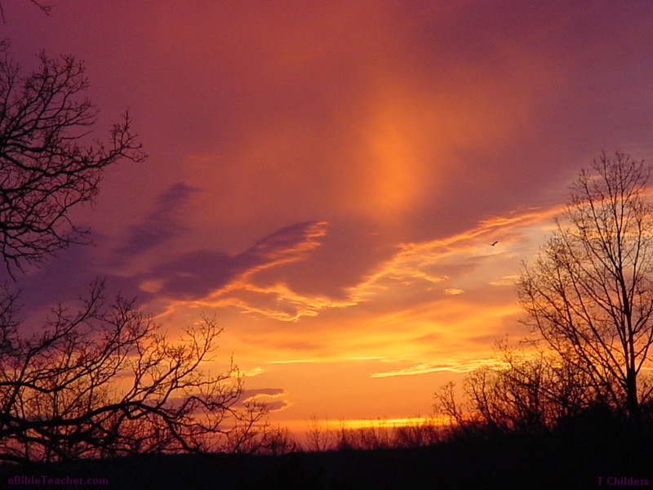
Holy, Holy, Holy # 3
Holy, holy, holy! Lord God Almighty!
Early in the morning
Our song shall rise to Thee;
Reginald Heber © 1997 Integrity’s Hosanna! Music and Word Music
ARR UBP – CCLI License No. 378119

Slide 3
Holy, holy, holy! Merciful and mighty!
God in three Persons,
Blessed Trinity!

Slide 4

Holy, holy, holy!
All the saints adore Thee,
Casting down their golden crowns
Around the glassy sea;

Slide 5
Cherubim and seraphim
Falling down before Thee,
Which wert and art
And evermore shalt be.

Slide 6
Holy, holy, holy!
Though the darkness hide Thee,
Though the eye of sinful man
Thy glory may not see;

Slide 7
Only Thou art holy -
There is none beside Thee,
Perfect in power, In love and purity.

Slide 8
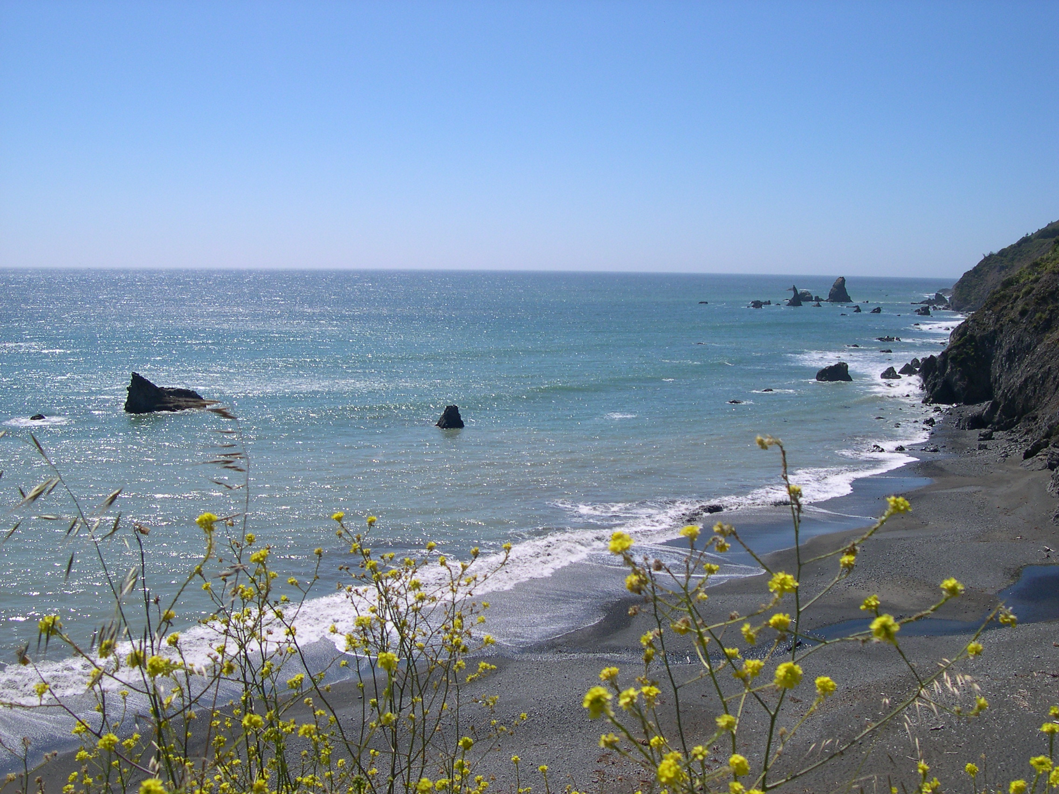
Holy, holy, holy! Lord God Almighty!
All Thy works shall praise Thy name
In earth and sky and sea;

Slide 9
Holy, holy, holy! Merciful and mighty!
God in three Persons,
Blessed Trinity!

Slide 10
Grace Bible Church
Glorifying God by Making Disciples of Jesus Christ

Slide 11
For The Beauty Of The Earth #182
For the beauty of the earth,
For the glory of the skies,
For the love which from our birth
Over and around us lies;
Pierpoint, Folliott Sanford, altered/ Kocher, Conrad © Public Domain
– CCLI License No. 378119

Slide 12
Lord of all,
To Thee we raise
This, our hymn
Of grateful praise.

Slide 13

For the wonder of each hour,
Of the day and of the night,
Hill and vale and tree and flower,
Sun and moon and stars of light:

Slide 14
Lord of all,
To Thee we raise
This, our hymn
Of grateful praise.

Slide 15
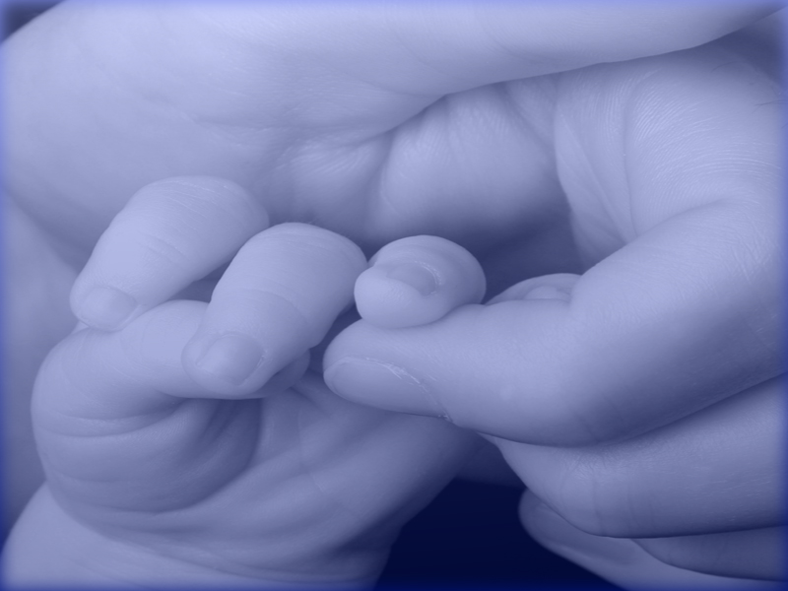
For the joy of human love,
Brother, sister, parent, child;
Friends on earth and friends above;
For all gentle thoughts and mild:

Slide 16
Lord of all,
To Thee we raise
This, our hymn
Of grateful praise.

Slide 17

For Thy Church that evermore
Lifteth holy hands above,
Offering up on every shore
Her pure sacrifice of love:

Slide 18
Lord of all,
To Thee we raise
This, our hymn
Of grateful praise.

Slide 19
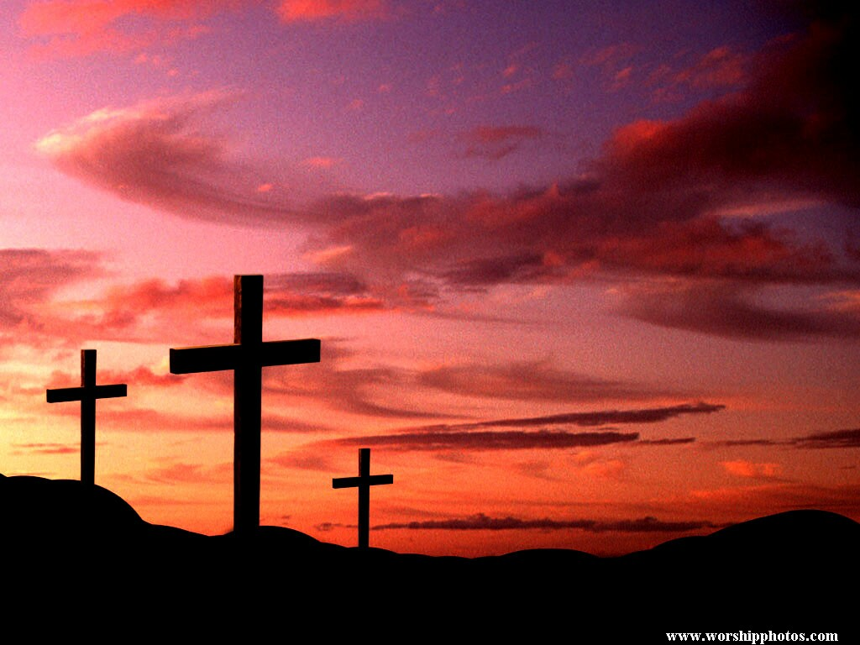
For Thyself, best gift divine,
To our race so freely given;
For that great, great love of Thine,
Peace on earth and joy in heaven:

Slide 20
Lord of all,
To Thee we raise
This, our hymn
Of grateful praise.

Slide 21
Living For Jesus # 605
Living for Jesus
a life that is true,
Striving to please Him
Chisholm, Thomas Obediah / Lowden, Carl Harold © Public Domain
ARR UBP – CCLI License No. 378119

Slide 22
in all that I do,
Yielding allegiance,
Glad-hearted and free,

Slide 23
This is the pathway
of blessing for me.

Slide 24
O Jesus, Lord and Savior,
I give myself to Thee;

Slide 25
For Thou, in Thy atonement,
Didst give Thyself for me.
I own no other master;

Slide 26
My heart shall be Thy throne.
My life I give,
hence forth to live,
O Christ, for Thee alone.

Slide 27
Living for Jesus,
who died in my place,

Slide 28
Bearing on Calvary
my sin and disgrace-
Such love constrains me

Slide 29
to answer His call
Follow His leading
and give Him my all.

Slide 30
O Jesus, Lord and Savior,
I give myself to Thee;

Slide 31
For Thou, in Thy atonement,
Didst give Thyself for me.
I own no other master;

Slide 32
My heart shall be Thy throne.
My life I give,
hence forth to live,
O Christ, for Thee alone.

Slide 33
Living for Jesus wherever I am,
Doing each duty
in His holy name,

Slide 34
Willing to suffer affliction or loss,
Deeming each trial
a part of my cross.

Slide 35
O Jesus, Lord and Savior,
I give myself to Thee;

Slide 36
For Thou, in Thy atonement,
Didst give Thyself for me.
I own no other master;

Slide 37
My heart shall be Thy throne.
My life I give,
hence forth to live,
O Christ, for Thee alone.

Slide 38
Living for Jesus through
Earth’s little while,

Slide 39
My dearest treasure,
The light of His smile,
Seeking the lost ones

Slide 40
He died to redeem,
Bringing the weary
To find rest in Him.

Slide 41
O Jesus, Lord and Savior,
I give myself to Thee;

Slide 42
For Thou, in Thy atonement,
Didst give Thyself for me.
I own no other master;

Slide 43
My heart shall be Thy throne.
My life I give,
hence forth to live,
O Christ, for Thee alone.

Slide 44
Grace Bible Church
Glorifying God by Making Disciples of Jesus Christ

Slide 45
Happy Our Home When God is There
Hymn # 453
Happy our home
when God is there,
Binding our hearts in love,
Ken Bible / John Dykes ©1997 Integrity / Hosanna / Word Music, ARR, ICS,UBP CCLI 378119

Slide 46
Blessings each day
with moments shared,
Drawing our tho’ts above.

Slide 47
Happy our home
when daily prayer
Bears every daily need;

Slide 48
When parents share
God’s Holy Word
And daily let Him lead.

Slide 49
Happy our home
when children praise,
Lifting our Savior’s name;

Slide 50
When parents speak
And show His love,
Faithful each day the same.

Slide 51
Father of all,
Our God of Peace,
We look to You alone;

Slide 52
Come with Your
precious gift of love
And make our house Your home

Slide 53
Grace Bible Church
Glorifying God by Making Disciples of Jesus Christ

Slide 54
Becoming a Godly Mother
What is a Mother?
  One who has given birth to a child.
  The female parent of a child
  A woman who exercises care and tenderness toward another, or gives parental advice

Slide 55
Becoming a Godly Mother
Motherhood changes, but does not end when the child becomes an adult
No woman is perfect nor becomes a godly mother automatically.
The goal is to continue to mature to become all Christ wants you to be as a person, a woman and a mother

Slide 56
Walking with God
This is the starting point in becoming a godly mother
The failure to be a good mother will always trace back to her understanding of God and walk with Him
Sin is the reason we are not good and until the problem of sin is resolved we cannot be good

Slide 57
Walking with God
The problem of sin is overcome with the gospel - salvation by faith in the person and work of Jesus Christ
We rest on Jesus’ promises to us John 1:12-13; 3:36; 5:24; 10:27-30, etc.
The new birth brings spiritual life
Christians are to walk in a manner worthy of their calling (Eph. 4:1)

Slide 58
Walking with God
Christians are to walk with a renewed mind, not a darkened one (Eph.. 4:17-24; Rom, 12:1-2)
We are to walk in the fruit of the Spirit, not the deeds of the flesh (Galatians 4; Eph. 4:25-5:14)
The godly mother must make walking with God the priority

Slide 59
Learning of God
Make reading the Bible a habit
Make reading the Bible a priority over other materials and entertainment
Listen to Bible audio recordings or sermons while doing chores or driving.
Encourage family devotions and lead young children in their devotions

Slide 60
Learning of God
Participate in opportunities at church to learn about God and His will
Keep a journal of what you are learning and observations of God’s attributes being displayed

Slide 61
Talking with God
Prayer becomes a way of life by practice
Pray throughout the day
Include prayer as part of both your family and private devotions
Give God thanks when you notice what He has done, and petition Him when you receive a request

Slide 62
Talking with God
Participate in corporate prayer
Keep a prayer journal
Strive to set aside a block of time in which you can concentrate on prayer

Slide 63
Serving God
Find at least one ministry to participate in and become committed to it.
Participate in other ministries as your time allows
Take advantage of those ministries in which multiple members of your family can participate
Be open to ministry opportunities that come to you individually

Slide 64
Walking with Her Husband
God has created all people with a purpose, and He has given specific but different roles for men & women
The purpose of the creation of women - Genesis 2:18-25; 1 Corinthians 11:8-9
The role of the wife to her husband - Ephesians 5:21-33; 1 Peter 3:1-6

Slide 65
Walking with Her Husband
A godly wife is an asset, a blessing to her husband - Proverbs 31:10-31
The Christian woman’s first allegiance & submission is to the Lord God and must obey all His commands
You cannot be a better mother than you are a wife - the modeling of godliness you set in daily life.

Slide 66
Walking With Her Husband
Keep your priorities in proper order. God first, your husband second, yourself third.
Develop your character and practice so that you are a blessing from God to your husband
Be your husband’s private prayer warrior

Slide 67
Walking With Her Husband
Be your husband’s greatest encourager
Remember that your marriage is to be a reflection of Christ and the church

Slide 68
Walking before Others
Your example in daily life will speak much louder than any instruction you give your children

Slide 69
Walking with Her Children
If you want to be a good mother, you must parent according to God’s instructions
The father will be held accountable, but the responsibility lies on both parents - Prov. 6:20-22; 10:1; 17:25
Teach your children about God and His will and loving Him in all the daily situations of life - Deut. 6:4-9

Slide 70
Walking with Her Children
Teach your children wisdom, the proper application of knowledge in life. It begins with the fear of God
Knowledge and skills are important, but always secondary to the development of a godly character

Slide 71
Walking With Her Children
Your first priority is loving God yourself
Your second priority is training the character of your children
Be a diligent prayer warrior on behalf of your children
Be actively involved in their lives, but do not allow them to become the center of your life

Slide 72
Walking With Her Children
Direct your children to do hard things that will improve their character, skills and dependence upon God
Your goal is to train your children to be independent adults that will be a blessing to others
Cut the apron strings. Be a resource, but show respect and don’t let them become dependent on you

Slide 73
Influencing the World
You will have a major influence upon your children and those you care for and nurture
1 & 2 Kings notes the name of each king’s mother, marking her influence on them being good or evil
You have more influence than you may realize, your legacy will be in the lives you have touched

Slide 74
Grace Bible Church
Glorifying God by Making Disciples of Jesus Christ

Slide 75
I Am a Woman Hymn # 452
I am a woman
Called to be a servant;
Bound by the grace
that Your love imparts.
Claire Cloninger ©1997 Integrity/Hosanna/Word Music, ARR, ICS,UBP CCLI 378119

Slide 76
Lord, make me humble,
Teach me to follow;
Make me a woman
of Your heart.

Slide 77
I am a woman
Called to speak with wisdom;
Shining a light
that will lead to You

Slide 78
Lord, give me courage
To be your witness;
Make me a woman
Of Your truth.

Slide 79
I am a woman
Purchased by Your mercy;
Bought by the love
that would spare no cost.

Slide 80
Lord, make me holy,
Loving You only;
Make me a woman
Of Your cross.

Slide 81
Grace Bible Church
Glorifying God by Making Disciples of Jesus Christ

