Slide 1
Grace Bible Church Glorifying God by Making Disciples of Jesus Christ

Slide 2
A reminder to consider others Please:
Turn off your cell phone or set to vibrate only
Turn off sound to all electronic devices
Use the nursery or cry room if your child is fussy
Get up during the preaching only if absolutely necessary (please sit in back if you must leave early)
Notes:
2

Slide 3
Salutation & Thanksgiving 2 Thessalonians 1:1-5
Our world has radically changed in the last year, and we need to be prepared for the future
Even loosely defined, Christians are a minority in the United States
Christians are concerned about truth
society blocks truth and embraces lying and deception

Slide 4
Salutation & Thanksgiving 2 Thessalonians 1:1-5
Christians are concerned about life
Society embraces death of the most vulnerable (abortion / euthanasia)
Christians are concerned about morality
Society embraces sexual deviancy and depravity

Slide 5
Salutation & Thanksgiving 2 Thessalonians 1:1-5
Christians are concerned about the welfare of others
Society embraces a fantasy world & science fiction
Christians are concerned about racial harmony
Society embraces blatant racism under marxist euphemisms

Slide 6
Salutation & Thanksgiving 2 Thessalonians 1:1-5
Christians are concerned about worship of God –
Governments are using PST to restrict & oppress churches
You may not have experienced blatant persecution yet, but others have, how long until you do is unknown

Slide 7
Salutation & Thanksgiving 2 Thessalonians 1:1-5
Habakkuk is an example of firm faith in God even while expecting devastation to come
The Thessalonian church was born in the midst of adversity and matured rapidly to become a model

Slide 8
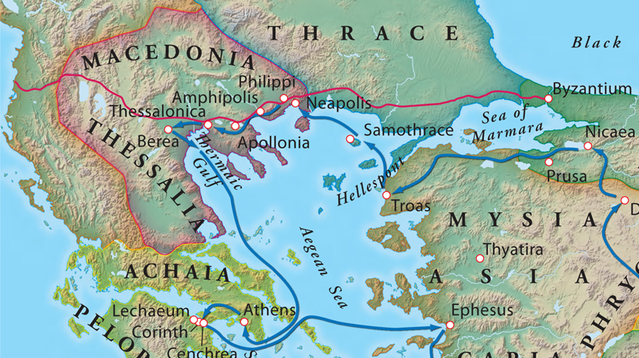
A Church Planted in Thessalonica
Persecution arose quickly forcing Paul to go to Berea, then to Athens.

Slide 9
Salutation 2 Thessalonians 1:1-2
Timothy’s report on the them prompted the writing of 1 Thessalonians
A few months later, another report on the Thessalonians prompted the writing of 2 Thessalonians

Slide 10
Salutation 2 Thessalonians 1:1-2
Similar themes in both letters:
Encouragement in persecution.
The day of the Lord.
Exhortations to be ready

Slide 11
Salutation 2 Thessalonians 1:1-2
The letter is to the church of the Thessalonians in God our Father and the Lord Jesus Christ
“Our Father” stresses the common personal relationship they have with God

Slide 12
Salutation 2 Thessalonians 1:1-2
The blessing wished is double source coming from both God the Father and the Lord Jesus Christ
Grace is a blessing you do not deserve - you are saved by grace, are to stand firm in grace, extend it to others

Slide 13
Salutation 2 Thessalonians 1:1-2
Peace is the tranquility of harmony - it comes from God the Father through the Lord Jesus Christ
Prayer grants us peace in any circumstance as our anxieties are cast on the Lord.

Slide 14
Salutation 2 Thessalonians 1:1-2
Christianity grants peace between all believers because we become one family
God is good & because He is good His grace & peace give hope that can be extended to others in the gospel

Slide 15
Commending their Faith and Love 2 Thessalonians 1:3
The commendation arises from an obligation to give God thanks for His work in the Thessalonians
God was doing the work Paul & companions had gone there to do, and He was answering their prayers

Slide 16
Commending their Faith and Love 2 Thessalonians 1:3
There is no room for jealousy in the body of Christ because our lives are about His glory, not our own
The Thessalonians were growing beyond expectation - faith that increased exceedingly - love super abounded

Slide 17
Boasting of their Steadfastness 2 Thessalonians 1:4
Paul had warned them about coming persecution even as they were already experiencing it -1 Thess. 2:14-16
They were handling persecution & tribulation so well that Paul was boasting about them to other churches

Slide 18
Boasting of their Steadfastness 2 Thessalonians 1:4
Persecution, diwvkw / diōkō, is organized oppression and harassment.
Affliction, qli:yiV / thlipsis, is to “press” or “squash” and so means trouble that involves direct suffering
Suffering includes physical pain

Slide 19
Boasting of their Steadfastness 2 Thessalonians 1:4
Perseverance, upomevnhv / huomenā, to stand still, remain firm, continue to bear up in difficult circumstances
Faith: They believed God and trusted Him even in the midst of the persecution and affliction

Slide 20
Boasting of their Steadfastness 2 Thessalonians 1:4
Endured, ajnevcomai / anechomai: “to receive, take up, bear & endure, ” respond with patient godliness

Slide 21
Proof of their Worthiness 2 Thessalonians 1:5
Judgment, krivsiV / krisis, refers to a decision by a judge whether for or against - the verdict
Judgment in John 3:19-21 is the Light coming into the world dividing it between evil & those of truth

Slide 22
Proof of their Worthiness 2 Thessalonians 1:5
Their endurance in affliction & suffering is the evidence of their godliness & God reckoning them worthy
We forget that suffering is and has been normal for Christians throughout history and in other lands

Slide 23
Proof of their Worthiness 2 Thessalonians 1:5
2 Timothy 3:12; John 16:33; Matthew 5:10–12
Expect tribulation, but you will be blessed by God for it
God’s righteous judgment of the Thessalonians - “Well done . . . enter the joy of your master”

Slide 24
Grace Bible Church Glorifying God by Making Disciples of Jesus Christ

