Slide 1
Grace Bible Church Glorifying God by Making Disciples of Jesus Christ

Slide 2
A reminder to consider others Please:
Turn off your cell phone or set to vibrate only
Turn off sound to all electronic devices
Use the nursery or cry room if your child is fussy
Get up during the preaching only if absolutely necessary (please sit in back if you must leave early)
Notes:
2

Slide 3
Hope that Transcends Despair Habakkuk 3:1-19
Habakkuk was grieved about the rise of wickedness during the early years of the reign of Jehoiakim
We have pleaded with God over the increasing evil of our own nation
God’s answer that He would send the even more wicked Chadeans perplexed Habakkuk even more

Slide 4
Hope that Transcends Despair Habakkuk 3:1-19
We are perplexed in God allowing those of depraved minds to gain the key positions of authority
Media fueled riots over false accusations of racism destroyed business, maimed & murdered people
Murder rate up 30% in 2020

Slide 5
Hope that Transcends Despair Habakkuk 3:1-19
Civil liberties lost over COVID-19 fear
FICTION

Slide 6
Hope that Transcends Despair Habakkuk 3:1-19
Habakkuk was honest and humble in his questions, seeking God for answers, and accepting them

Slide 7
Hope that Transcends Despair Habakkuk 3:1-19
God’s twofold answer is that the righteous will live by faith, and He is holy & will punish evil nations
History is a record of God’s judgment upon nations as they became evil

Slide 8
Structure Habakkuk 3:1
Habakkuk 3 is a poetic prayer set to music to be used for worship in the temple.
It presents his petition (2), the majesty of God (3-7), the power of God (8-15), his trust in God (16-19)

Slide 9
Habakkuk’s Petition Habakkuk 3:2
God’s answers caused him fear - but fear of the Lord is the beginning of wisdom (Prov. 9:10)
He wants God to do such work again in his own time that God’s work would be made known

Slide 10
Habakkuk’s Petition Habakkuk 3:2
He wants God to remember to be merciful in the midst of the wrath that was to come (Deut. 4:31)
Promises made to Israel do not belong to our nation, but promises made to the church belong to believers

Slide 11
Habakkuk’s Petition Habakkuk 3:2
We have tribulation in this world & believers suffer for many reasons, but not directly from God’s wrath
Walking with God avoids the sins and depravity that bring God’s wrath (Romans 1:18-32)

Slide 12
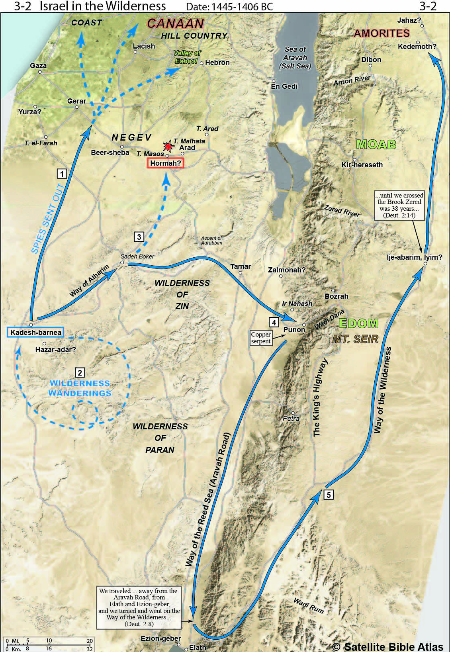
God’s Majesty Declared Habakkuk 3:3-7
These are references to God’s actions in coming with His people from the south (Deut. 33:2; Judges 5:4-5)

Slide 13
God’s Majesty Declared Habakkuk 3:3-7
Exodus 19-20: The Lord manifested Himself on Mt. Sinai in fire, smoke, thunder, lightning & earthquakes

Slide 14
God’s Majesty Declared Habakkuk 3:3-7
The heavens and earth declare God’s glory - Psalm 8; 19
God is associated with light - Exod. 34:29; Matt. 17:2; 1 John 1:5; Psalm 18:14; 97:4; 104:2, 1 Tim. 6:16

Slide 15
God’s Majesty Declared Habakkuk 3:3-7
God sent pestilence and plagues upon Egypt (Exodus 4-12) and other evil nations (Deut. 28:59f)
The mountains were destroyed in the flood & will be again in the future (Rev. 16). Only God is eternal

Slide 16
Habakkuk’s Questions Habakkuk 3:8
Rhetorical questions - God was not angry against rivers or the sea when He brought salvation to Israel

Slide 17
God’s Power Remembered Habakkuk 3:9-15
vs. 9 - God is a warrior ready for action which He takes by His word (Psalm 33:6,9).
vs. 9c-10 - a vivid description of a massive rain storm & an earthquake - the great flood or ?

Slide 18
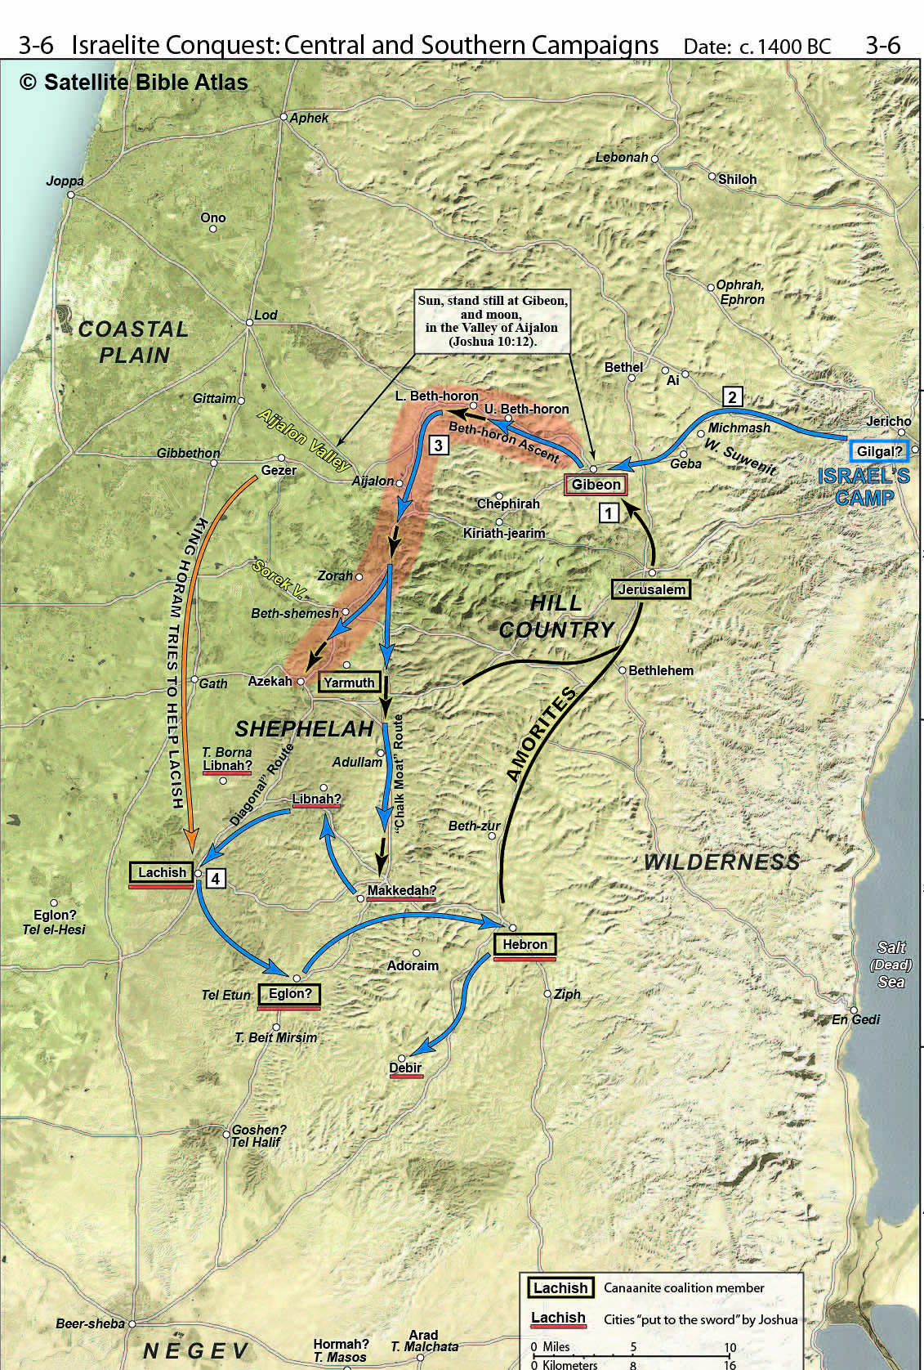
Habakkuk 3:11-13
Joshua 10 – Conquest of central & southern Canaan

Slide 19
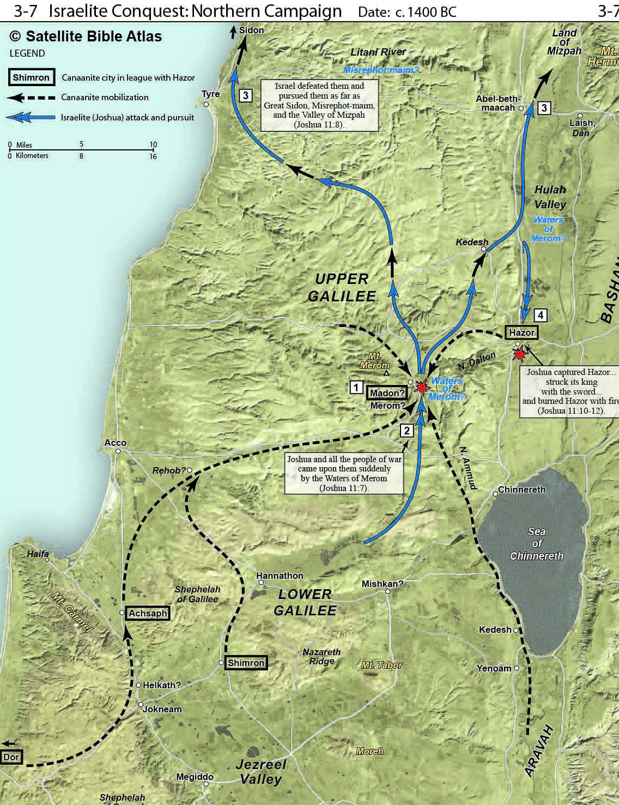
Habakkuk 3:11-13
Joshua 11 – Conquest of Northern Canaan

Slide 20
God’s Power Remembered Habakkuk 3:9-15
vs. 14 - The defeat of Midian (Judges 7) or Ammon, Moab & Edom destroying each other (2 Chron. 20)
vs. 15 - the Red Sea crossing? See the Song of Moses in Exodus 15

Slide 21
The Response Habakkuk 3:16-19
vs. 16
Knowing what God was going to do makes Habakkuk very afraid
vs. 17
Hyperbole of a worst case scenario for plants bloom & fruit, but they can be destroyed & fruit stolen

Slide 22
The Response Habakkuk 3:16-19
vs. 18
God keeps His promises, so Habakkuk can be encouraged by God’s past actions to save & leave a remnant
Instead of despair, he can rejoice in the God who saves the righteous

Slide 23
The Response Habakkuk 3:16-19
vs. 19 - The Lord strengthens making him as surefooted as an ibex in rocky crags - safe in precarious places

Slide 24
Conclusions
We have pleaded with God about evil in our land, and He is now judging us
The nations’ length of days is unknown, but current regime polices is quickly destroying it
Whether God grants revival or not, we are to pray for mercy & stand up for righteousness regardless of cost

Slide 25
Conclusions
God strengthens those who wait on Him (Isaiah 40:31).
He guides those who trust Him (Proverbs. 3:5-6)
He provides what is needed for those who seek first His kingdom & righteousness (Matthew 6:33)

Slide 26
Conclusions
He makes those who walk with Him secure even in precarious situations (Habakkuk)
The righteous walk by their faith in God because they know & trust Him even when they don’t understand

Slide 27
Conclusions
Our hope is in God Himself who changes us to become His children through faith in Jesus Christ
A Christian’s hope transcends the circumstances of the world because it is based in Jesus & His promises

Slide 28
Grace Bible Church Glorifying God by Making Disciples of Jesus Christ

