Slide 1
Grace Bible Church Glorifying God by Making Disciples of Jesus Christ
Download notes at:
GraceBibleNY.org/hermeneutics

Slide 2
Verse Analysis Four basic parts of Bible Study
Observation - What is in the passage?
Interpretation - What did the passage mean to those to whom it was written?
Correlation - What insights do other Scriptures give to this passage and its meaning?
Application - How does God want me to apply the principles in the passage to my own life?

Slide 3
Verse Analysis - Review
Step One – Set the Context
Textual
Genre
Historical
Step Two – Observations
Who, What, When, Where, Why & How
Lexical: Words to define
Grammatical: Verb parsing, Noun declination, conjunctions, adjectives, adverbs, comparisons, etc

Slide 4
Verse Analysis - Review
Step Three – Rewrite the verse in your own words
I do this after Correlation (Step 4 – Cross references)
Step Four – Cross references
Step Five – Applications to work on
I do this throughout the process and at the conclusion of the study

Slide 5
Verse Analysis - Advanced.
Step Six – The Pivotal Idea
What is the principle point of the passage?
If an action, concentrate on the verbs
If a doctrine, concentrate on the nouns
Step Seven – The Theme
In one sentence, write out the theme of the passage
Chart the Passage (see Chapter 10)
A table or graphic that helps you the relationships of the parts of the passage
Step Nine – Give a title to the passage

Slide 6
Romans 12:1-2 1 Therefore I urge you, brethren, by the mercies of God, to present your bodies a living and holy sacrifice, acceptable to God, which is your spiritual service of worship. 2 And do not be conformed to this world, but be transformed by the renewing of your mind, so that you may prove what the will of God is, that which is good and acceptable and perfect.
Immediate Context
Near Context
Notes:
Immediate Context: 12:1-2 serve as a transition from chapters 9-11 to the rest of 12
Near Context. Chapters 9-11 concern the Righteousness of God revealed in His dealings with His chosen people of Israel - especially in His continued faithfulness to His promises to them. Chapter 12:3-8 describes the transformed life in being part of the Body of Christ and serving God in the church, and the rest of the chapter in living among others.

Slide 7
Romans 12:1-2 1 Therefore I urge you, brethren, by the mercies of God, to present your bodies a living and holy sacrifice, acceptable to God, which is your spiritual service of worship. 2 And do not be conformed to this world, but be transformed by the renewing of your mind, so that you may prove what the will of God is, that which is good and acceptable and perfect.
Immediate Context
Near Context
Context in the book
Historical Context
Notes:
Context in the book. The Book of Romans prior to 12:1-2 describes God’s mercy to sinners in providing a way of salvation by His grace through being justified in Christ by faith in Him. Chapters 9-11 illustrate this same truth in His dealings with the nation of Israel. The rest of the book following describe the practical results of having faith in Christ - a transformed life.
Historical Context. Written by Apostle Paul during 3rd missionary journey ~ A.D. 55-56 from either Corinth or another Grecian city. Paul had not yet been to Rome, but wanted to go.

Slide 8
Romans 12: 1-2 Observations
Who
What
When
Where
Why
How
Notes:
*Who - Paul writing to the saints in Rome
*What - Paul transitions from telling them what God has done for them to telling them how they ought to then live.
*When - Paul is writing about the middle of his ministry - approx. 56 AD during his third Missionary Journey
*Where - It is unknown exactly where Paul is writing from, but somewhere in Greece - Corinth, Philippi, etc.
*Why - Paul wants them to clearly understand the gospel of Jesus Christ and to live in its transforming power.
*How- Paul points out the logical conclusion that a life lived by faith in Jesus is also a life transformed into a living sacrifice for Christ.

Slide 9
Observations – Key Words & Definitions
Urge - parakalevw parakaleō (verb PAI1S)
Present - paristhmi paristêmi (PAInf)
Sacrifice - qusia, thusia
Acceptable –eujavrestoV, euarestos
Spiritual Service of worship – logikhvn latreivan, logikên latreian
Notes:
parakalevw parakaleō to ask for something earnestly and with propriety—‘to ask for (earnestly), to request, to plead for, to appeal to, earnest request, appeal.
Present: παρίστημι d: to make something available to someone without necessarily involving actual change of ownership
Sacrifice: θυσία, that which is offered as a sacrifice
Acceptable: εὐάρεστος, pertaining to that which causes someone to be pleased
Spiritual / reasonable: λογικός pertaining to being genuine, in the sense of being true to the real and essential nature of something—‘rational, genuine, true.
Service of worship: λατρεία to perform religious rites as a part of worship

Slide 10
Observations – Key Words & Definitions
Conformed – suschmativzw, suschêmatizô (verb – PMImp2Pl)
Transformed – metamorfovw, metamorphoô (verb – PPImp2Pl)
Renewing - ajnakaivnwsiV / anakainôsis;
Prove - dokimavzw, dokimazô (PAInf)
Good – ajgaqovV, agathos
Perfect – tevleioV, teleios
Notes:
Conformed: συσχηματίζομαι to form or mold one’s behavior in accordance with a particular pattern or set of standards
Transformed: μεταμορφόομαι to change the essential form or nature of something
Renewing: ἀνακαίνωσις, to cause something to become new and different, with the implication of becoming superior
Prove: δ
οκιμάζω to try to learn the genuineness of something by examination and testing, often through actual use
Good: ἀγαθός : positive moral qualities of the most general nature
Perfect: τέλειος pertaining to being perfect in the sense of not lacking any moral quality

Slide 11
Observations: Questions
Therefore – a link - what is the conclusion of?
Brethren – Who is he referring to?
By the mercies of God – Which mercies is he referring to?
Present bodies a living and holy sacrifice – a sacrifice is killed – how is your body to living and dead at the same time?
Conformed to this world – how does the world pressure us to conform

Slide 12
Observations: Questions
Transformed – how radical is this change?
Renewing of your mind - the means of being transformed. How is the mind renewed?
Prove the will of God - how does being transformed prove the will of God?
Good, acceptable and perfect - refers to the will of God - how is the will of God known?

Slide 13
Additional Observations
Grammatical Insights
Cause & Effect statements
Linking words
Notes:
Grammatical ” Urge is an PAI - present is a PAInf becoming a living sacrificed is urged. It is the right and logical thing to do.
Do not be conformed and be transformed are imperatives – commands. These are not option for the Christian.
Linking Words
But link of contrasts between conformed to the world and transformed by God
Therefore links to the theology presented in the previous 11 chapters which explains the mercies of God
And links verses 1 & 2 – a continuative result.
So that – links action with the result

Slide 14
Additional Observations
Grammatical Insights
Cause & Effect statements
Linking words
Questions
Notes:
Other: Questions for applicaton
*If I am to resist the pressure of the world to mold me into its image then my mind must be radically changed. What will radically change my mind?
*It is only logical that I should serve the Lord - How can I serve Him to demonstrate His will?
*A sacrifice dies when it is offered. I am to be a living sacrifice. I must die to myself and live for Him
*I must living for God in a way that is acceptable to God. What is there in my life that may not be holy? What may not be acceptable to Him?

Slide 15
Interpretive: Rewrite Verse in own words
See after Step Seven - Theme
Notes:
In view of all that God has done in providing salvation to you, you are to live your life in holiness completely for Him with nothing held back. This is the only logical response you can have in worship of Him.
Do not let the world pressure you into its mold, but have your mind completely changed into new patterns of thinking so that you may prove God’s will in your life by following His will instead of your own. His will is good and acceptable and perfect.

Slide 16
Cross References – Romans 12:1
TSK – Rom. 12:1 beseech. ch. 15:30. 1 Co. 1:10. 2 Co. 5:20; 6:1; 10:1. Ep. 4:1. 1 Th. 4:1, 10; 5:12. He. 13:22. by the. ch. 2:4; 9:23; 11:30, 31. Ps. 116:12. Lu. 7:47. 2 Co. 4:1; 5:14, 15. Ep. 2:4–10. Phi. 2:1–5. Tit. 3:4–8. 1 Pe. 2:10–12. that ye. ch. 6:13, 16, 19. Ps. 50:13, 14. 1 Co. 6:13–20. Phi. 1:20. He. 10:22. a living. Ps. 69:30, 31. Ho. 14:2. 1 Co. 5:7, 8. 2 Co. 4:16. Phi. 2:17. He. 10:20–22; 13:15, 16. 1 Pe. 2:5. acceptable ver. 2; ch. 15:16. Ps. 19:14. Is. 56:7. Je. 6:20. Ep. 5:10. Phi. 4:18. 1 Ti. 2:3; 5:4. 1 Pe. 2:5, 20.

Slide 17
Cross References – Romans 12:2
TSK Rom 12:2 be not. Ex. 23:2. Le. 18:29, 30. De. 18:9–14. Jn. 7:7; 14:30; 15:19, 17:14. 1 Co. 3:19. 2 Co. 4:4; 6:14–17. Ga. 1:4. Ep. 2:2; 4:17–20. Ja. 1:27; 4:4. 1 Pe. 1:14, 18; 4:2. 2 Pe. 1:4; 2:20. 1 Jn. 2:15–17; 3:13; 4:4-5; 5:19. Re. 12:9; 13:8. be ye. ch. 13:14. Ps. 51:10. Eze. 18:31; 36:26. 2 Co. 5:17. Ep. 1:18; 4:22–24. Col. 1:21, 22; 3:10. Tit. 3:5. prove. ver. 1. Ps. 34:8. Ep. 5:10, 17. 1 Pe. 2:3. good. ver. 1; ch. 7:12, 14, 22. Ps. 19:7–11; 119:47, 48, 72, 97, 103, 128 174. Pr. 3:1–4, 13–18. Ga. 5:22-23. Ep. 5:9. Col. 4:12. 1 Th. 4:3. 2 Ti. 3:16, 17.

Slide 18
Step Five – Applications to work on
See after Interpretive Paraphrase

Slide 19
Interpretive Paraphrase
Notes:
In view of all that God has done in providing salvation to you, you are to live your life in holiness completely for Him with nothing held back. This is the only logical response you can have in worship of Him.
Do not let the world pressure you into its mold, but have your mind completely changed into new patterns of thinking so that you may prove God’s will in your life by following His will instead of your own. His will is good and acceptable and perfect.

Slide 20
Interpretation – Romans 12:1-2 Key Thoughts
Vs. 1 -
Vs. 2 -
Pivotal Idea
Theme
Notes:
Vs. 1 – Because God in mercy has saved believers, they should sacrificially live for Him in worship
Vs. 2 – Christians are to resist the world and instead be transformed in mind resulting in a life that demonstrates God’s will in it.
Pivotal Idea: Be a living sacrifice who is not conformed to this world but is transformed by a renewed mind.
Theme: In view of the salvation God has provided in Christ we ought to live our lives completely for Him in holiness by resisting the pressure of the world to conform us into its image and instead be radically changed by a transformed mind that does God will.

Slide 21
Possible Applications
Command to fulfill?
Sin to avoid?
Promise to Claim?
Example to follow?
Problem to solve?
What will I do to obey what God is teaching in this passage?
Notes:
Command: Yes – 1. Be a living sacrifice for God – it is only reasonable in view of His mercies in salvation
2. Don’t be conformed to the world, be transformed by the renewing of the mind and living accordingly in the will of God
Sin to avoid: being conformed to the world, not being transformed to be like Christ
Promise:
Example: Yes – Paul
Problem: Overcoming the pressures of the world. Yielding to God’s commands & will
How to obey: Continued resistance to the world and transformation of my life through a mind renewed by the Holy Spirit through His word to be a living sacrifice for God’s glory.

Slide 22
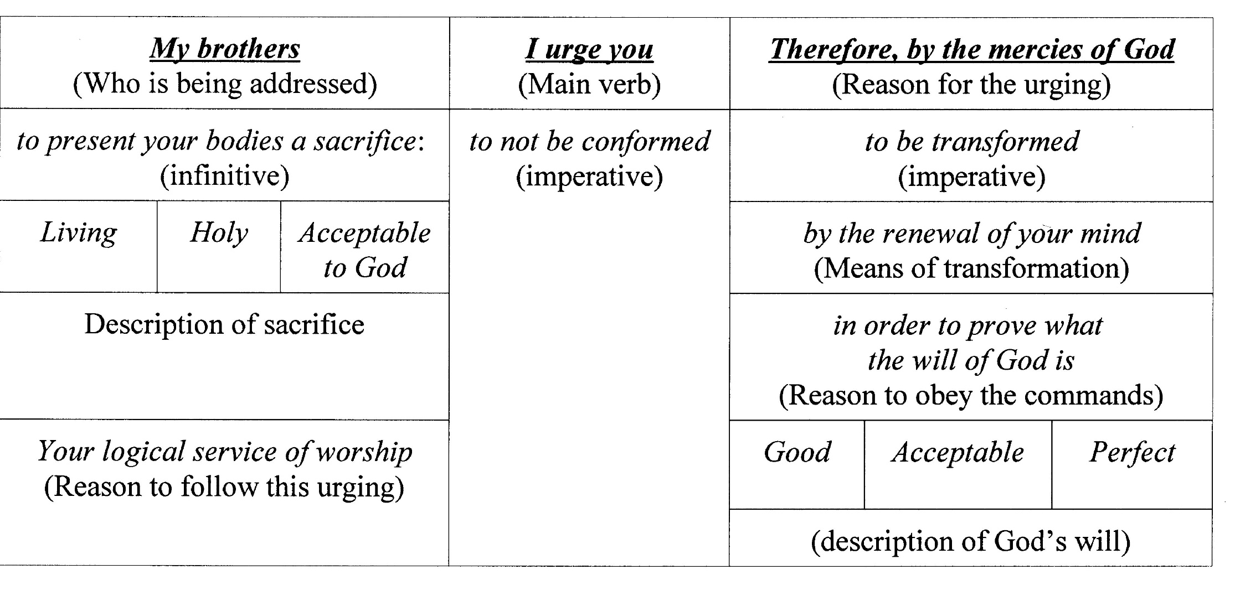
Chart
Notes:
Keep in mind that charting is flexible and optional. It’s purpose is to help you solidify in your own mind the relationship between the various parts of the verse / passage.
It could be an outline, a table, a graphic drawing of some sort. Much of that will depend on the individual.

Slide 23
Grace Bible Church Glorifying God by Making Disciples of Jesus Christ

