Slide 1
Grace Bible Church Glorifying God by Making Disciples of Jesus Christ

Slide 2
A reminder to consider others Please:
Turn off your cell phone or set to vibrate only
Turn off sound to all electronic devices
Use the nursery or cry room if your child is fussy
Get up during the preaching only if absolutely necessary (please sit in back if you must leave early)
Notes:
2

Slide 3
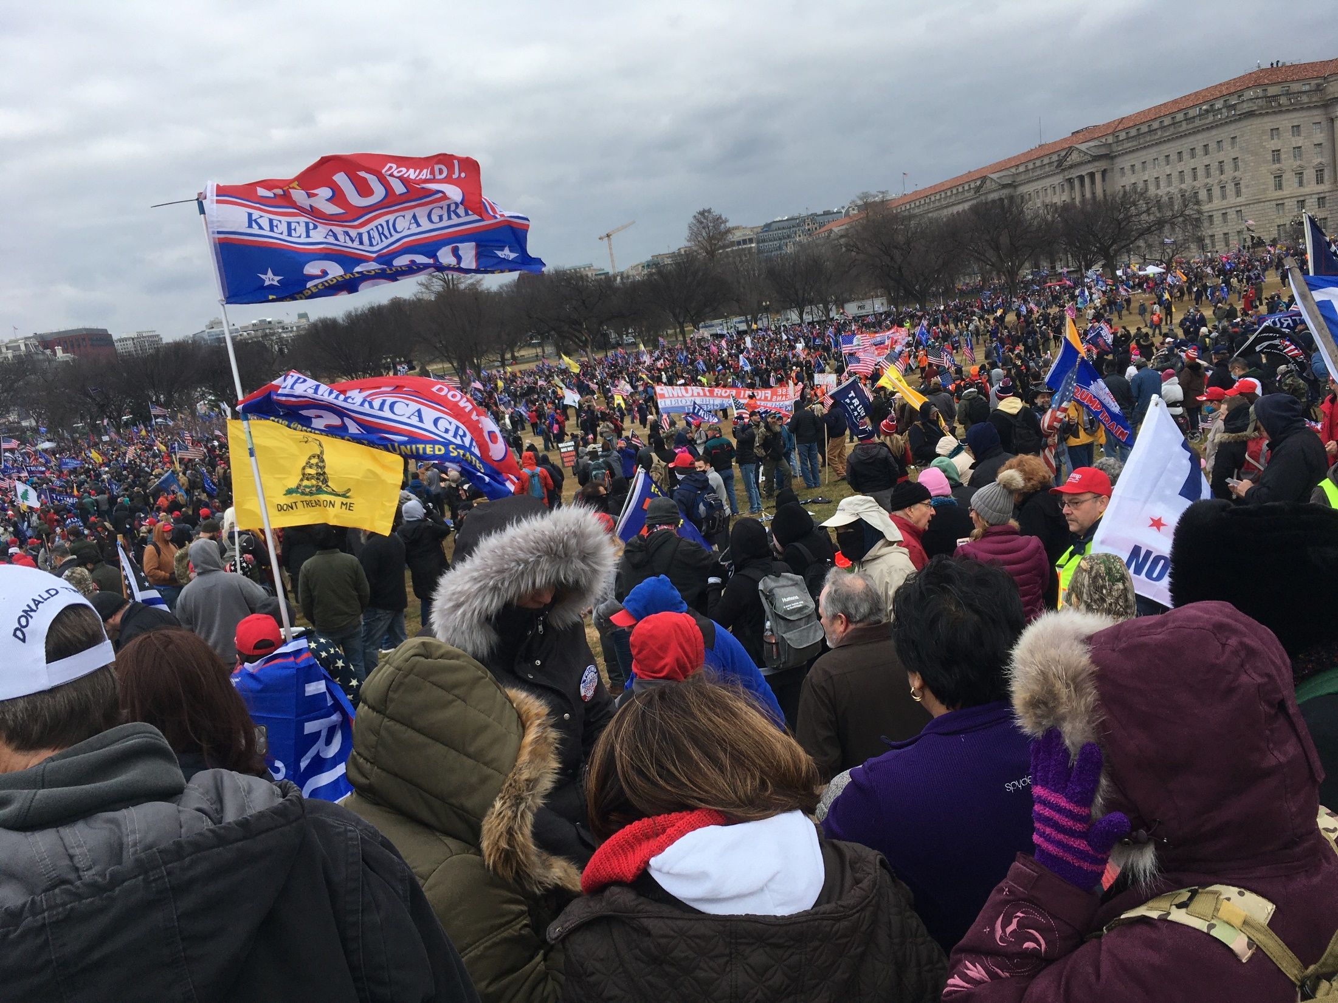
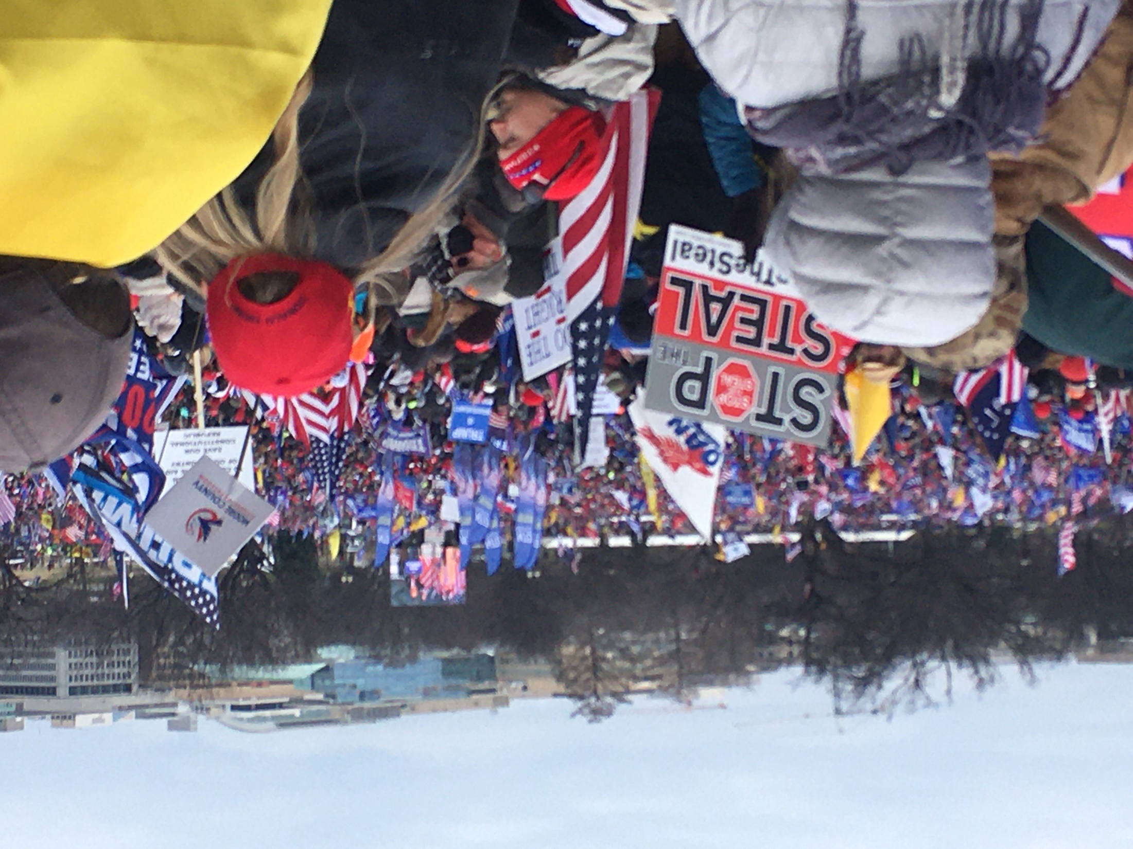
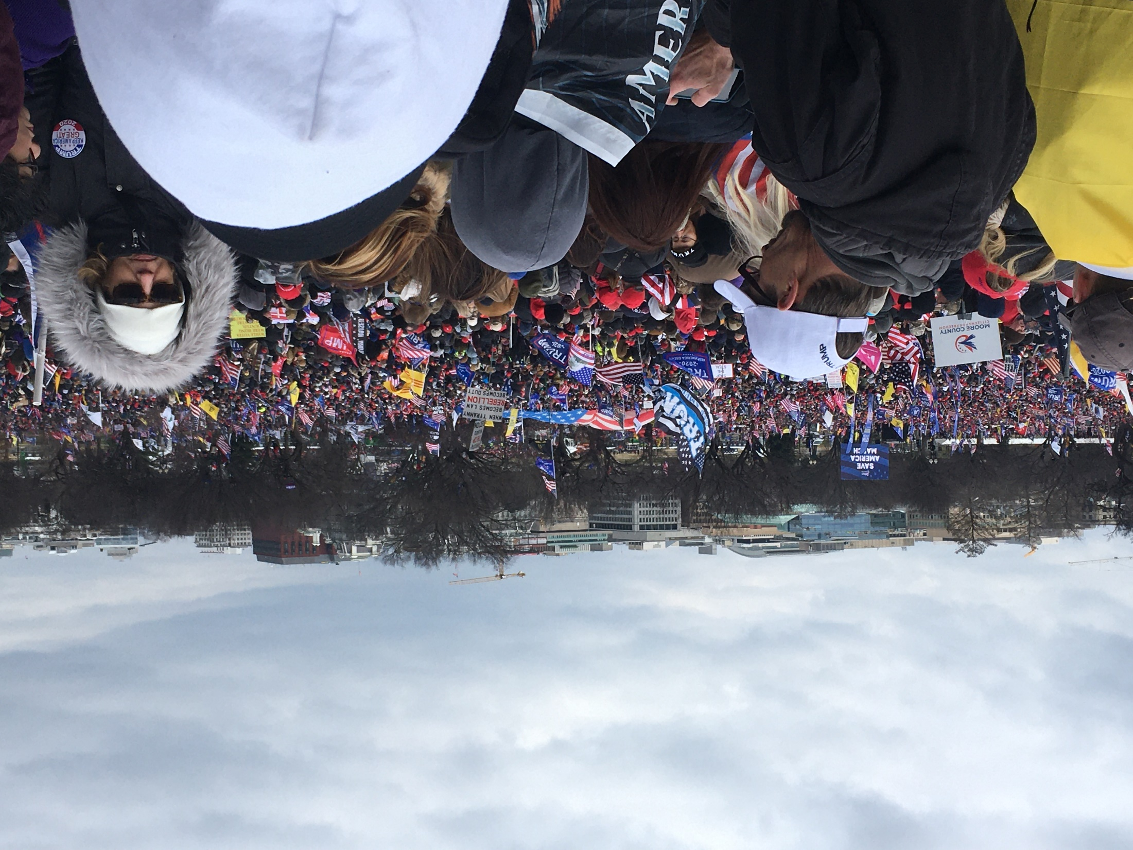
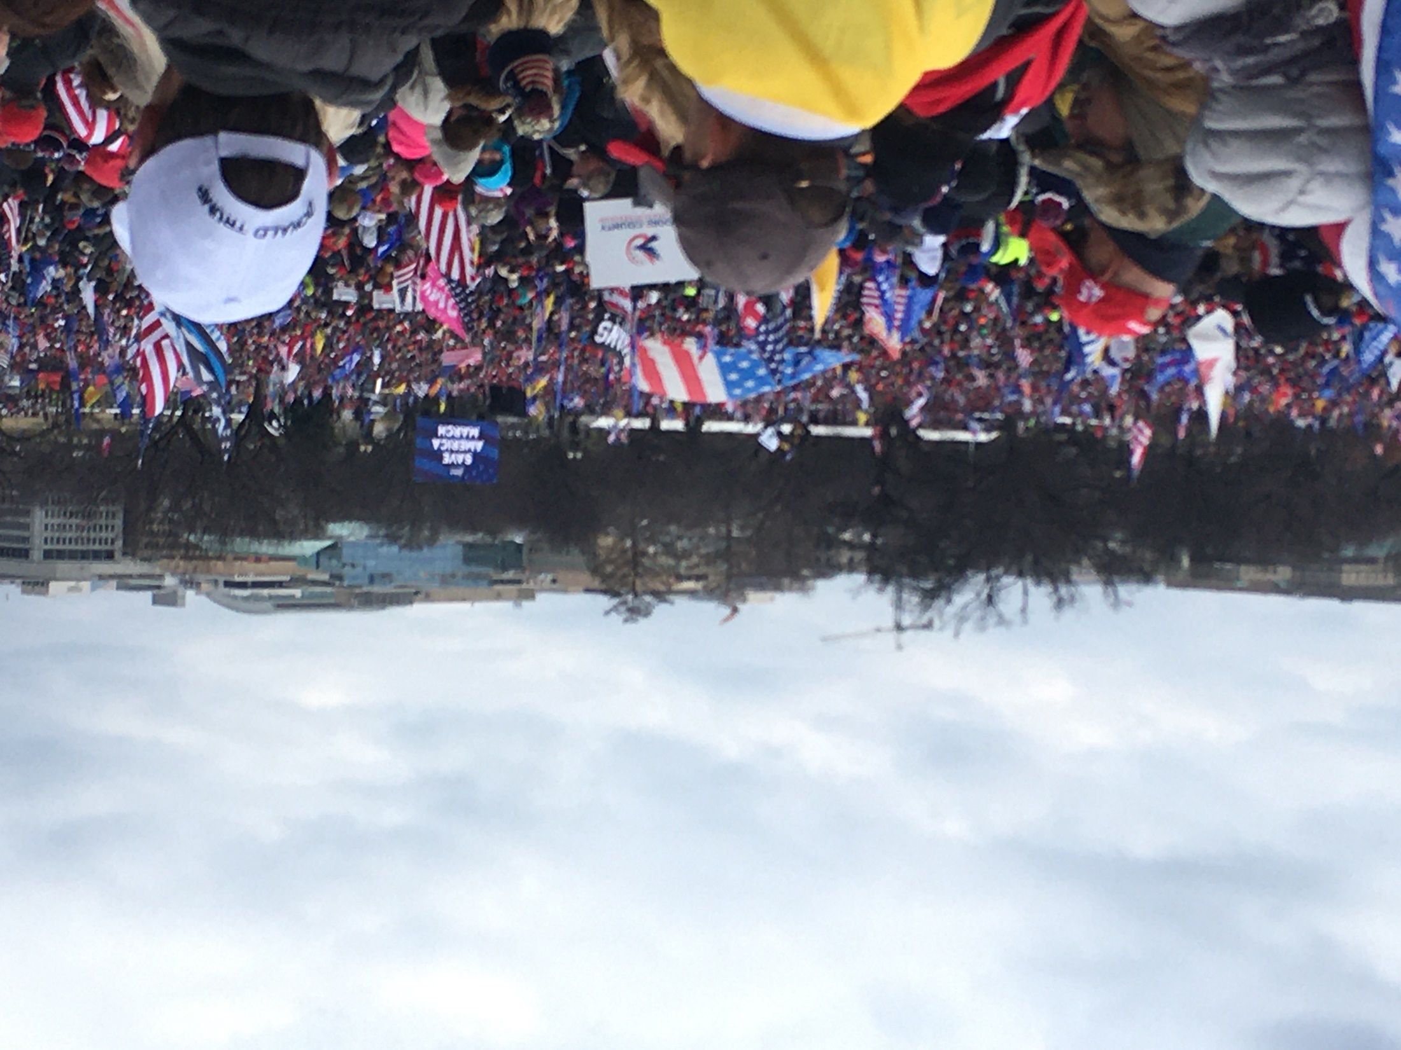
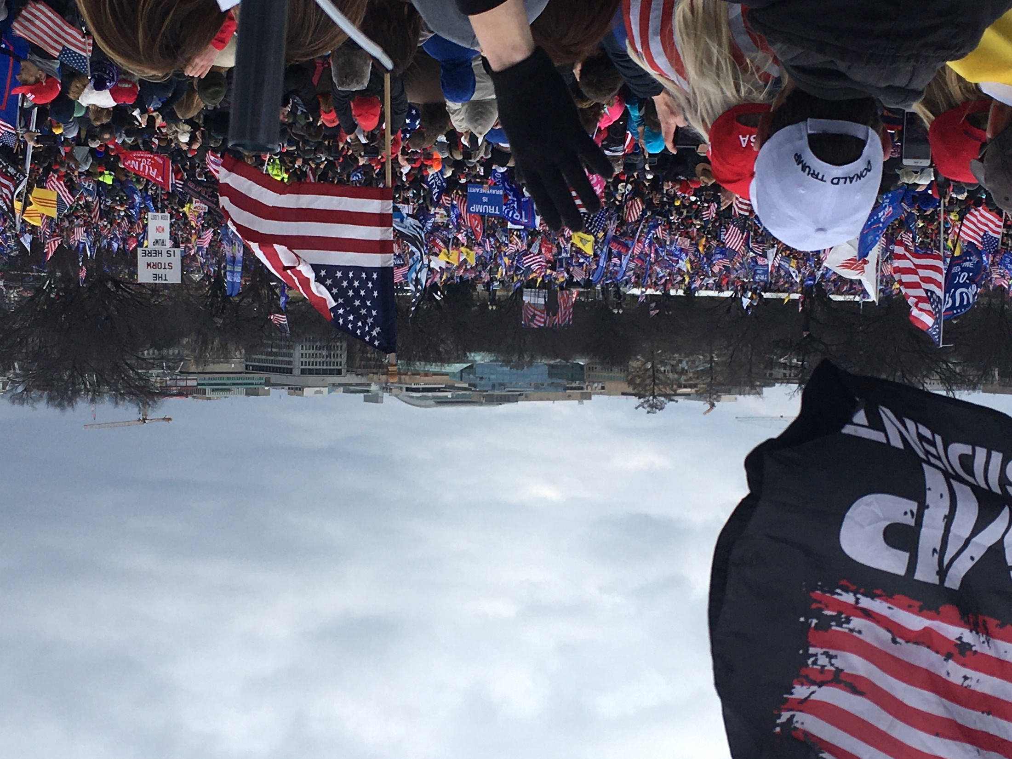
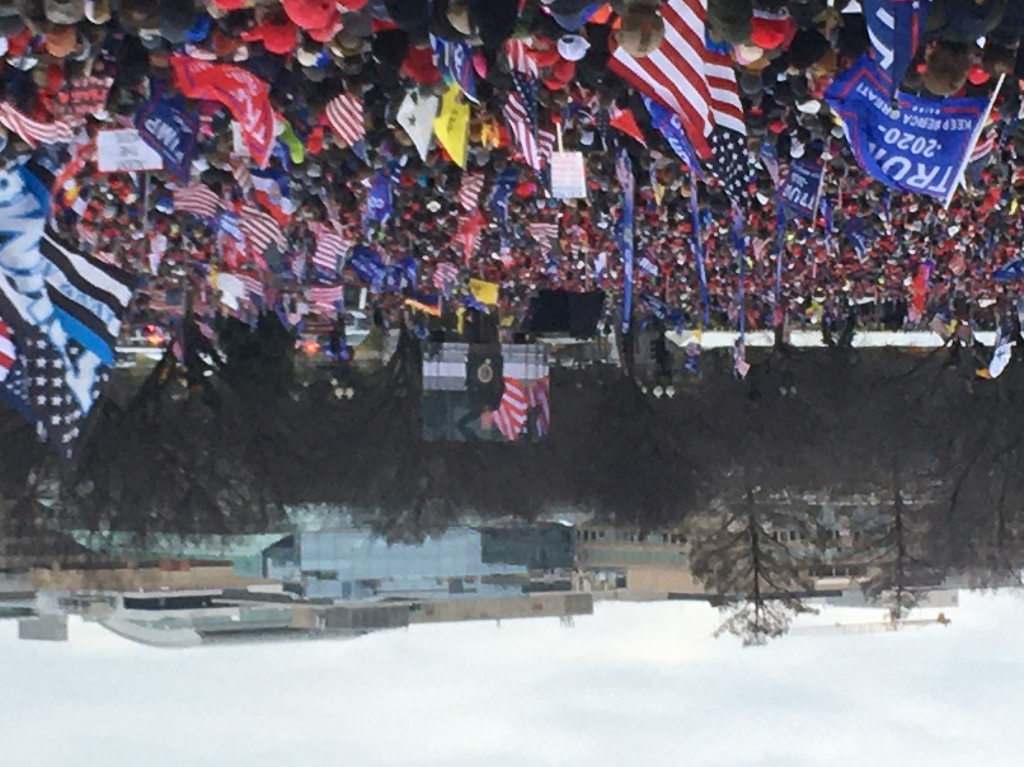
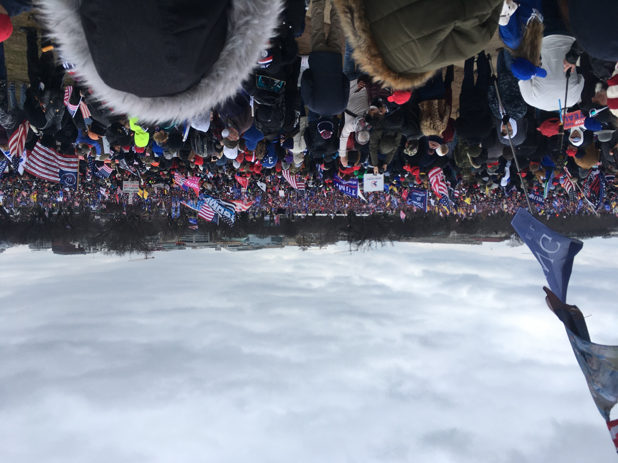
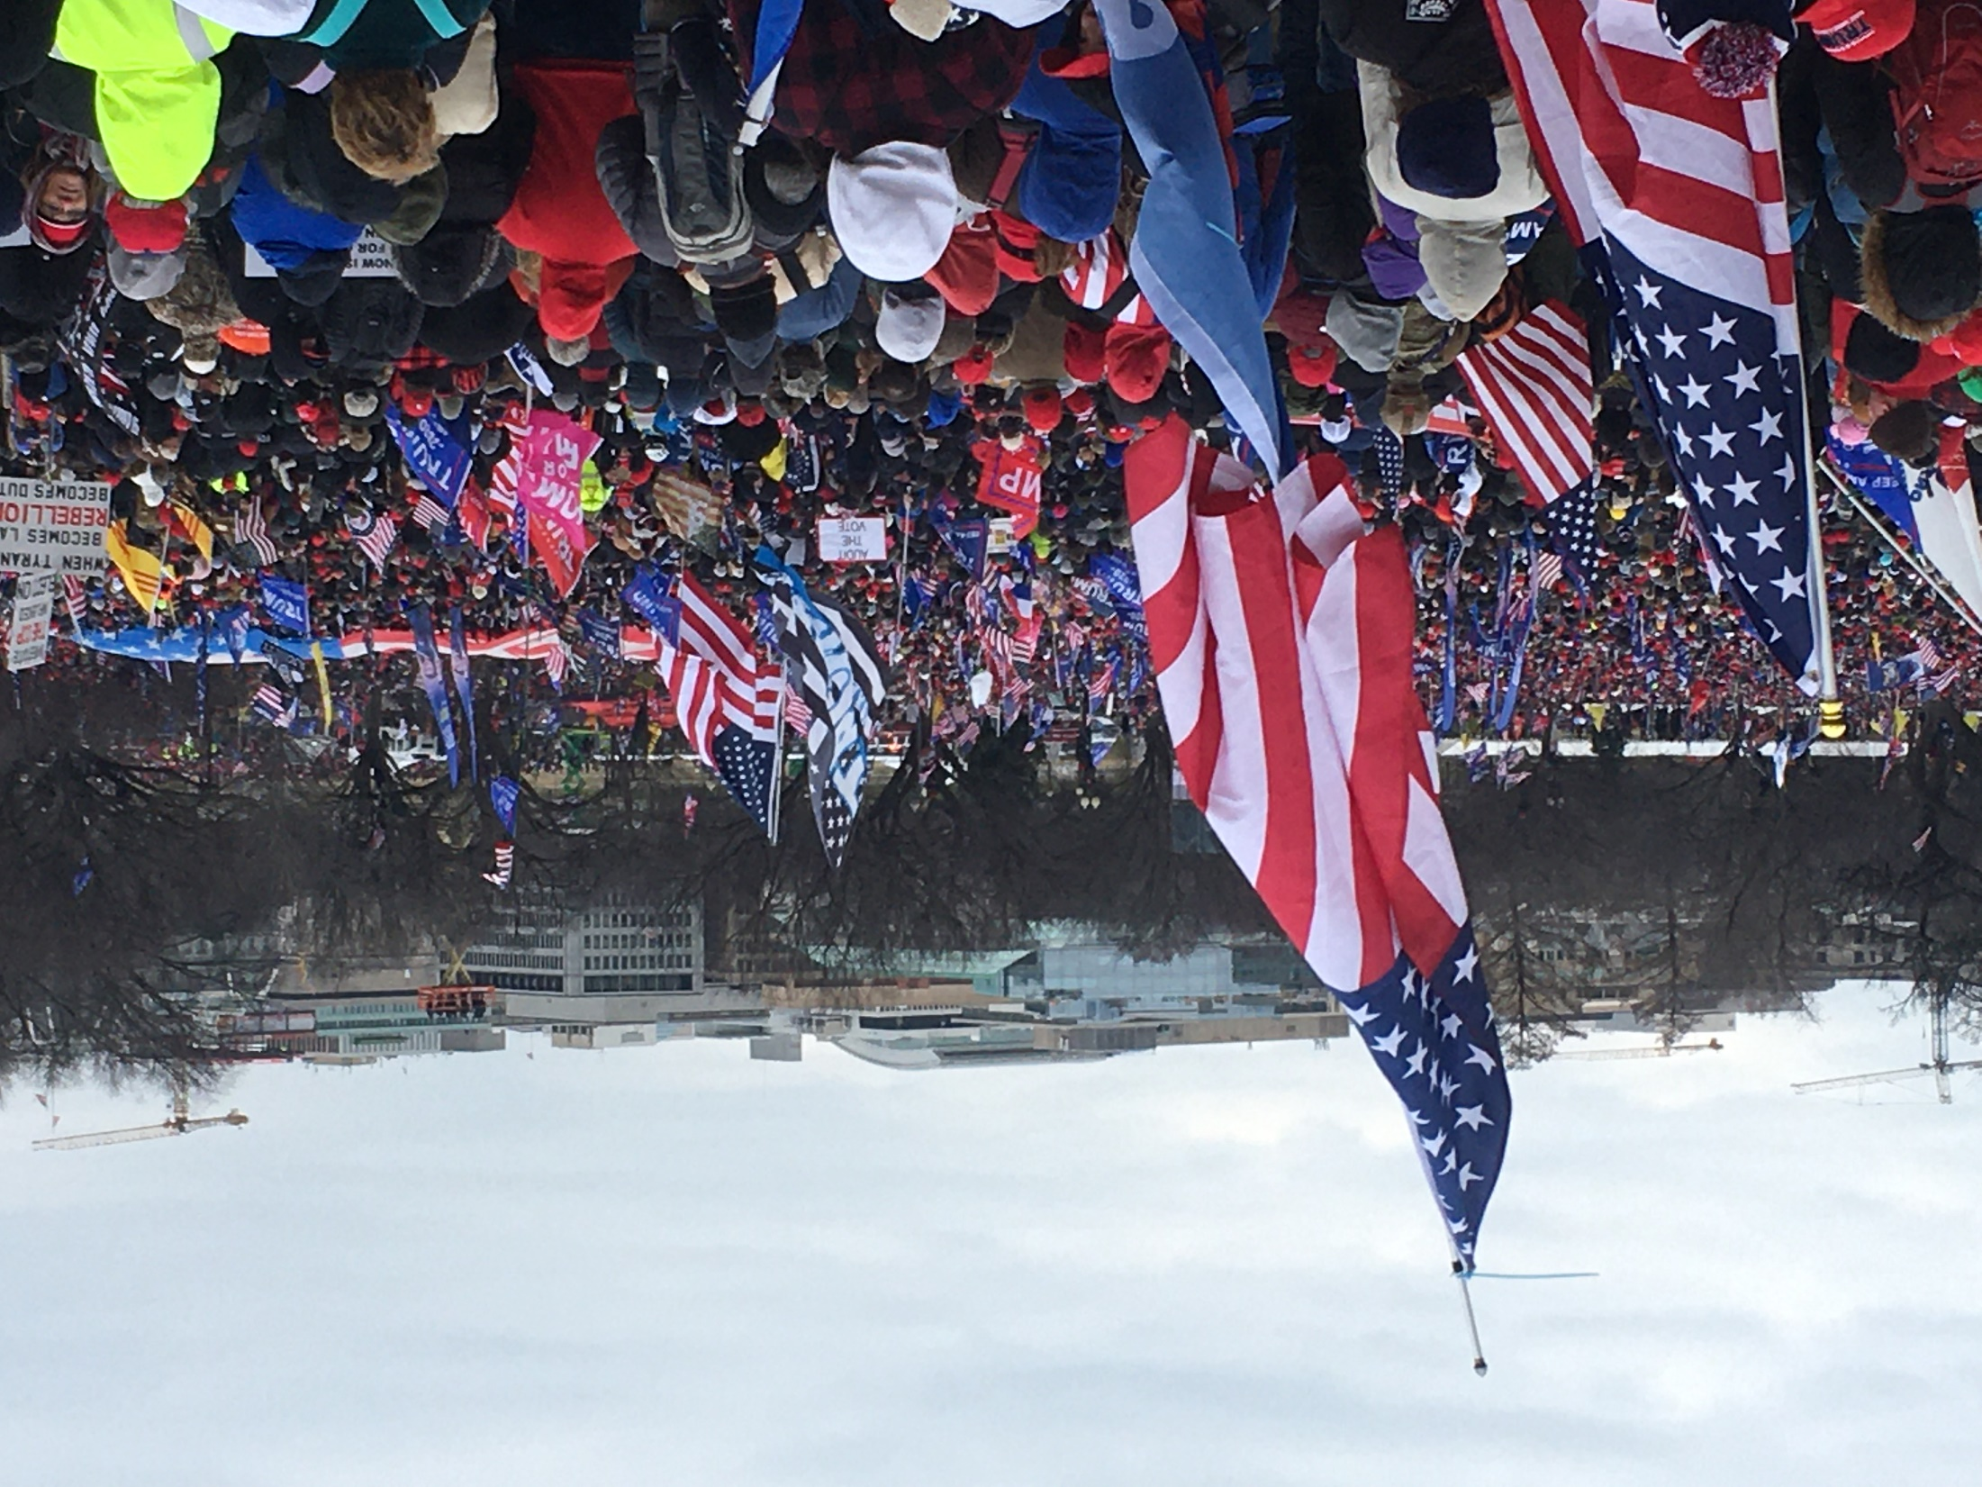
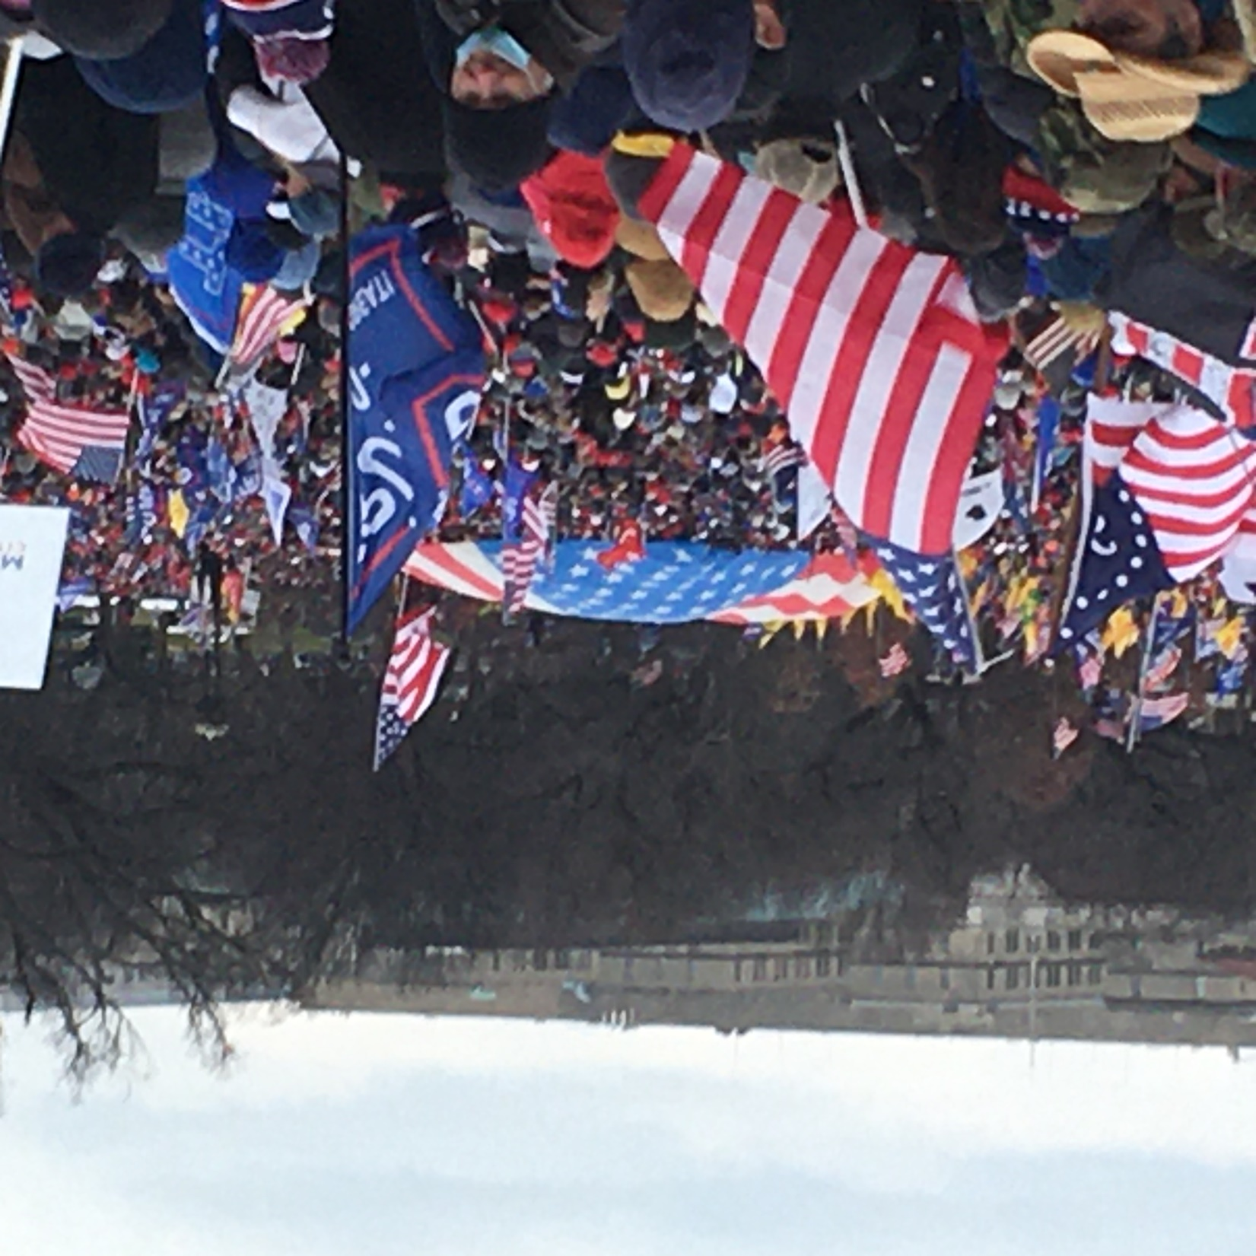

Slide 4
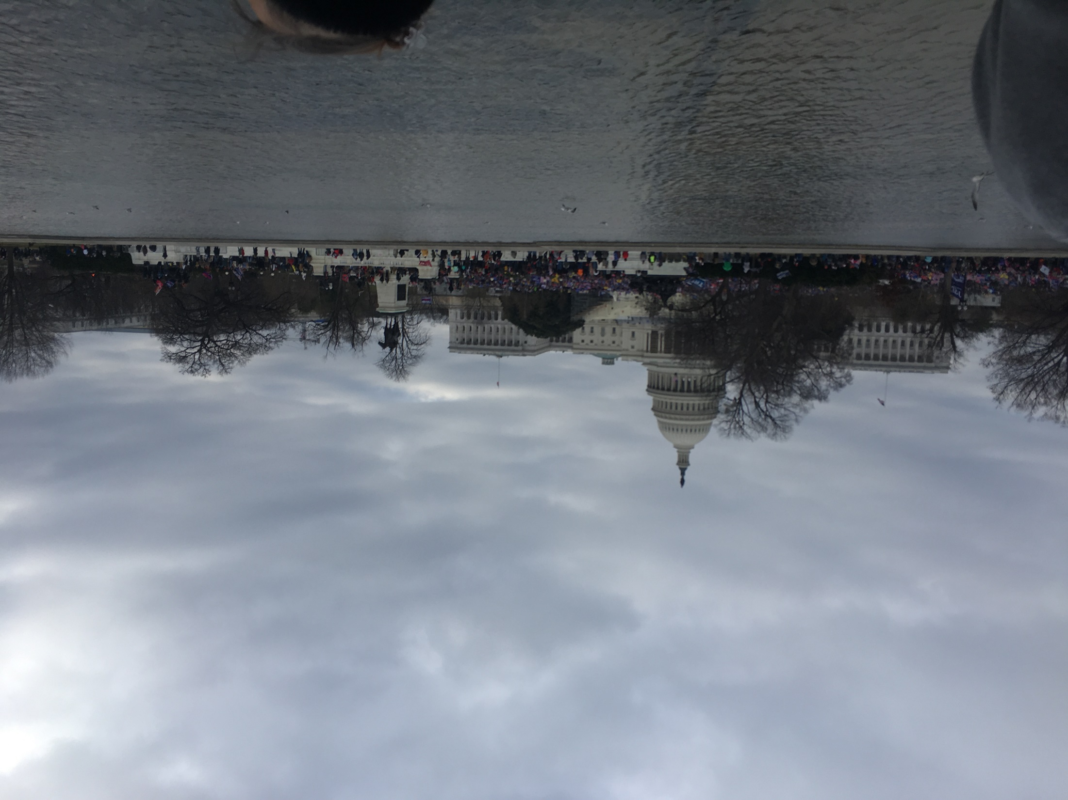

Slide 5
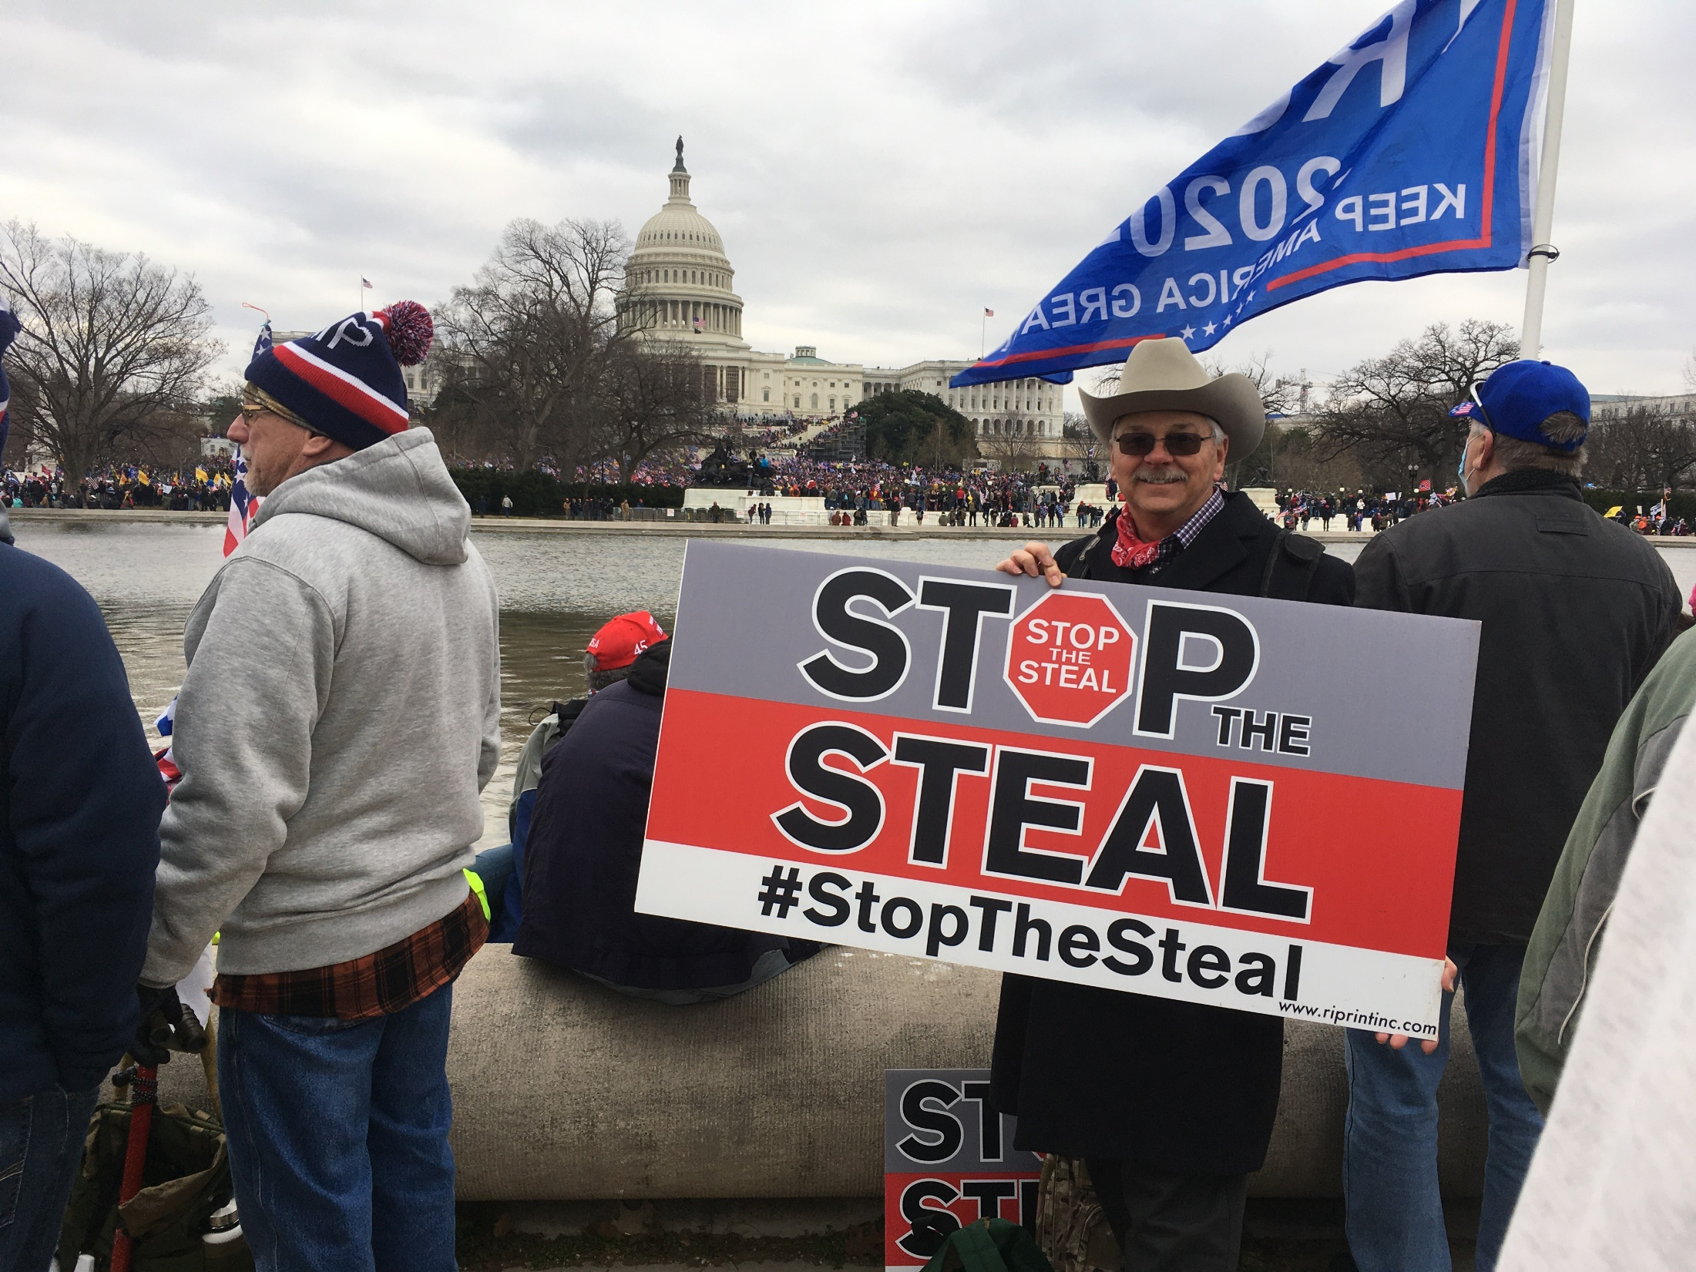

Slide 6
The Judgment
Daniel 9
Romans 1:18-32

Slide 7
The Plan
Finish 1 Thessalonians
Habakkuk – Hope though in Despair
2 Thessalonians – Persecution, The Day of the Lord, Being Ready
1 Peter – Preparation for Persecution
Revelation – The Future End

Slide 8
Preparing for the Future
Persecution is not to be feared
We determine in advance how to respond as did the Apostles – Acts 5:41 – rejoicing to be considered worthy to suffer for the shame of Jesus’ name
1 Thessalonians 4:13-18

Slide 9
Review 1 Thessalonians 4:1-12
Pleas and exhortation to walk to please God - excel still more
God’s will: Your Sanctification - abstain from sexual immorality, walk in sexual purity
Love the brethren - excel still more / abound

Slide 10
Review 1 Thessalonians 4:1-12
Live in a quiet fashion,
Mind your business,
Work with your hands so that you
Will behave properly to outsiders
Not be in need

Slide 11
The Concern 1 Thessalonians 4:13
Asleep / euphemism for died: koimwmevnwn / koimōmenōn
False doctrine of “Soul sleep” - souls have mental awareness after death (2 Cor. 5:6-8; Phil. 1:2; Luke 16)
Grief: the deep pain of sorrow within the soul

Slide 12
The Concern 1 Thessalonians 4:13
Hope moderates grief, it does not eliminate it
Christians are to properly grieve which includes showing empathy to one another
Secular theories of grief vary and people do not have to go through their “stages of grief” to be healthy

Slide 13
The Belief 1 Thessalonians 4:14
The death, burial & Resurrection of Jesus Christ are the foundations of our faith (1 Cor. 15:3-4, 17-20)
God would bring the souls of those who had already fallen asleep in Jesus with Him

Slide 14
The Promise 1 Thessalonians 4:15
This doctrine comes from God via Paul (See 2 Peter 1:20-21; 3:15-16)
The “coming,” parousiva / parousia: general meaning of either “to be present” or “to have come” (arrival)

Slide 15
The Promise 1 Thessalonians 4:15
Paul includes himself among those that could be “alive and remaining” at the presence of the Lord’s coming
Imminence: The Lord could come at any time - we are to be ready & eagerly anticipating the Lord’s return

Slide 16
The Future Fulfillment 1 Thessalonians 4:16-17
Sequence of events:
Descent from Heaven,
Shout,
Voice of Archangel
Trumpet of God,
Dead rise,
Alive raptured,
Meet in air,
Eternity with Christ

Slide 17
The Future Fulfillment 1 Thessalonians 4:16-17
Jesus return is not hidden, it is will be visible to all (Rev. 1:7)
Dead in Christ precede those alive & remaining - both received imperishable & immortal bodies (1 Cor 15)
Rapture, from Latin “rapers” translates aJrpavzw / harpadzo = caught up / snatched up

Slide 18
The Future Fulfillment 1 Thessalonians 4:16-17
Occurs at / near beginning of Daniel's 70th week, the Tribulation period fits imminence
Pre-Tribulational view fits “no wrath” passages (1 Thess. 1:10; 5:9; Revelation 3:10)

Slide 19
The Future Fulfillment 1 Thessalonians 4:16-17
Various Mid-Tribulational and Post-Tribulational views not as strong in Biblical support
All believers meet the Lord in the air and will be with Him forever more

Slide 20
The Comfort 1 Thessalonians 4:18
In this context, parakalevw / parakaleō, (call alongside) is to comfort
These promises give us hope in the present and the future dealing with death of others or facing our own
Promises of future in eternity give hope transcending current tribulation & giving purpose to life

Slide 21
Final Thoughts
It is hard to see the demise of a nation that you love
We grieve, but we still have hope in Jesus Christ and we are citizens of heaven
The rapture should motivate us to live boldly for Christ in the here and now since I know my future

Slide 22
Grace Bible Church Glorifying God by Making Disciples of Jesus Christ

