Slide 1
The Threat of Social Justice and a Christian Response

Slide 2
John 10:10
Jesus taught, “The thief comes only to steal and kill and destroy; I came that they may have life, and have it abundantly.”

Slide 3
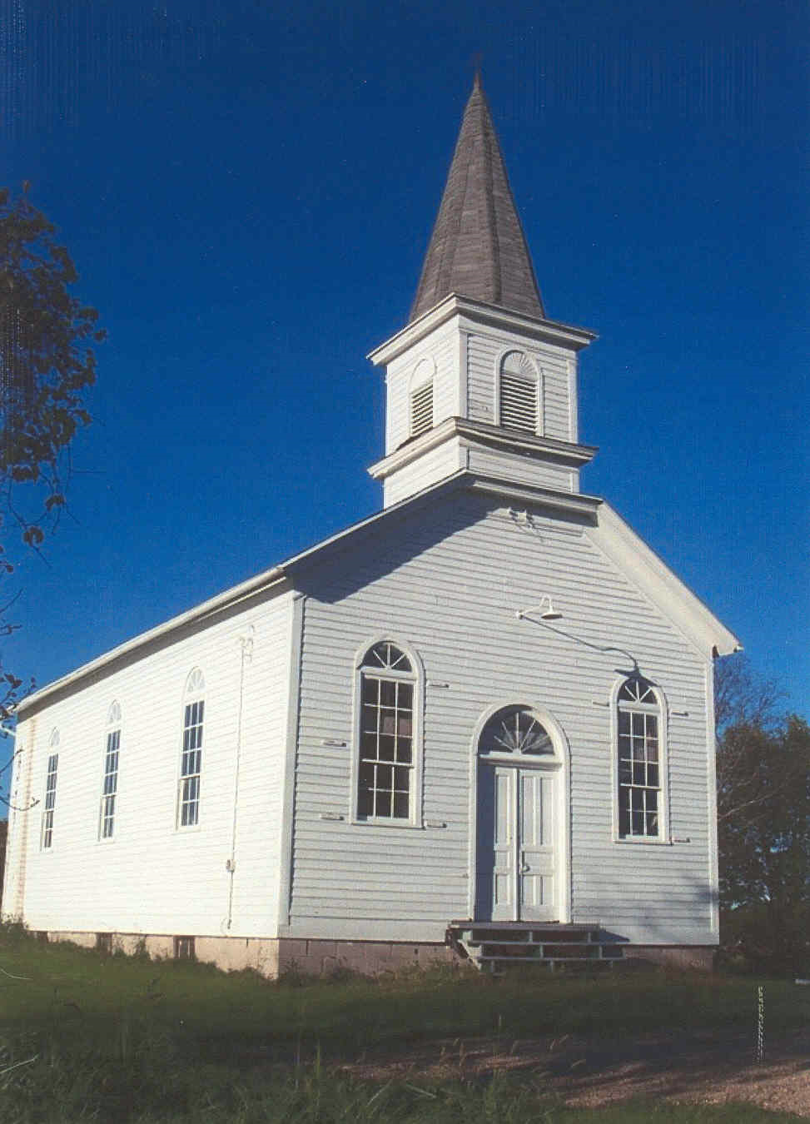
The Social Justice Religion: Soteriology and Ecclesiology
The Church of Social Justice
Victims = Saints
Sociologists = Apostles/Prophets
Community Organizers= Clergy
Social Justice Warriors = Missionaries
Oppressed Perspectives = Revelation Sociology = Canon
Universities = Seminary
Activism = Church
How Social Justice Parallels the Gospel
The Bad News:
How Social Justice Contradicts the Gospel
Focus: External Behaviors instead of Heart Condition
Group: Oppressor Classes instead of Individuals
Order: Sanctification precedes Justification
Power: Perpetual Repentance instead of Justification
White/Male/Straight Privilege = Original Sin
Systemic Oppression = Providence
Political Correctness = The Law
The Good News:
Woke = Born Again
Liberal Politics = Sacraments
Cancelled = Judgement
Equity = Heaven

Slide 4
Steps
Get
Get Woke (Salvation Experience)
Come to an understanding of “systemic oppression.”
Realize you are complicit in the system as the result of “privilege.”
Repent
Repent (Own Your Privilege)
Stop supporting “whiteness.” (Put Off)
Participate in “lamenting” and “raising awareness.” (New Ordinances) (Put On)
Find forgiveness from “oppressed people/media elites” (New Priests)
Shame
Shame Others (Evangelism)
Promote “Oppressed Perspectives” (New Holy Books)
Make Ultimatums (New Catechism)

Slide 5
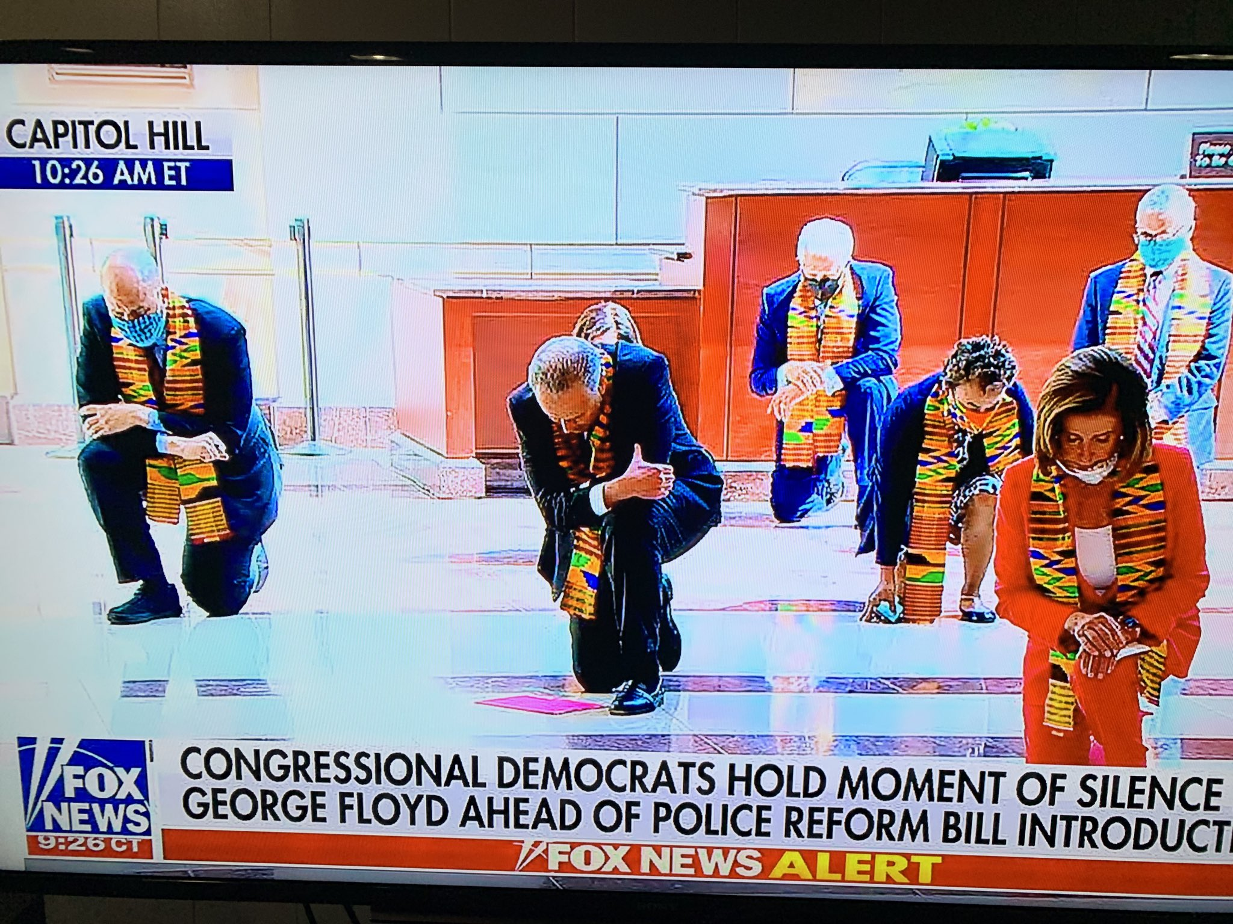
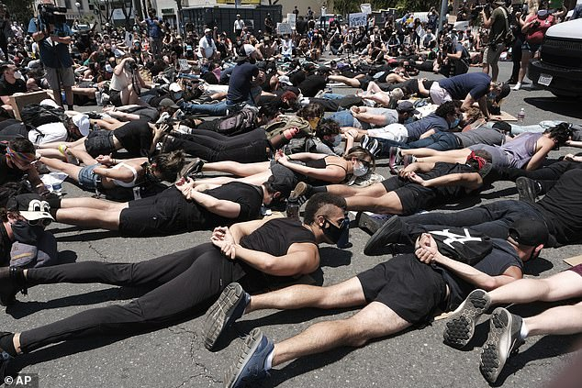
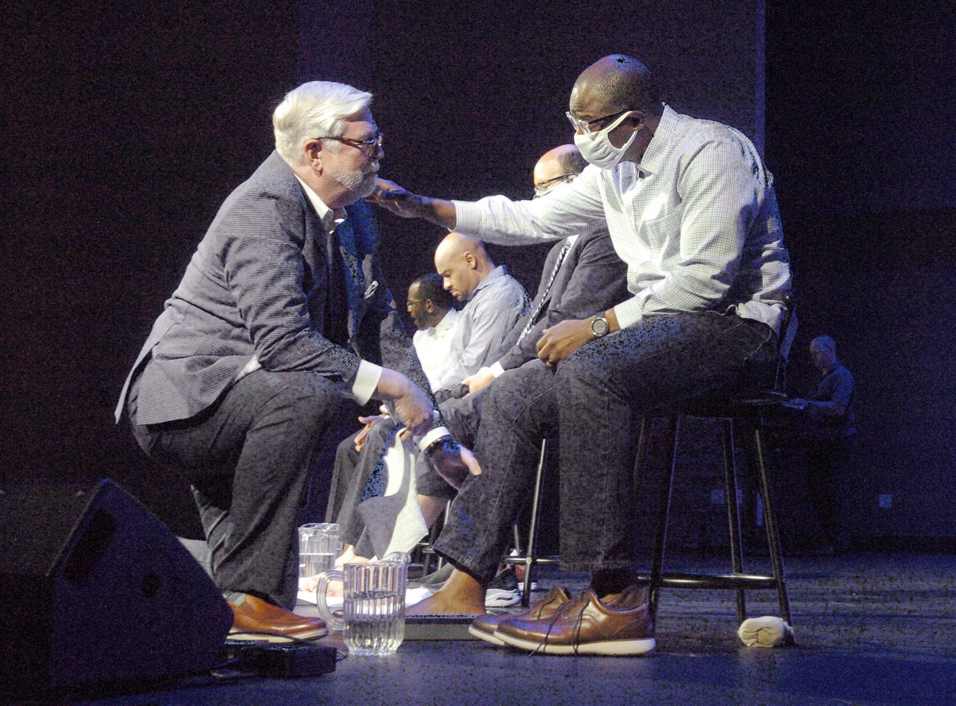
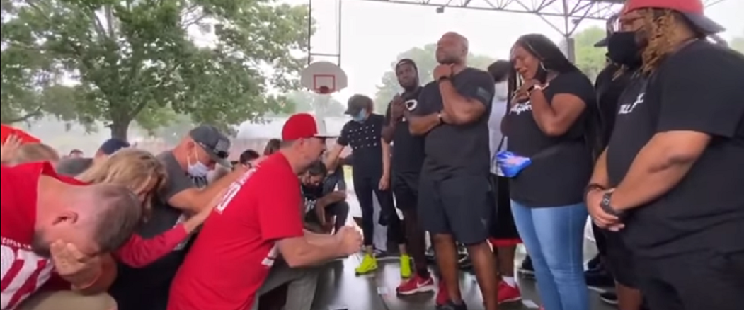

Slide 6
Damage CRT does
Caters to Low Expectations
Overlooks Destruction
Platforms Criminals as Virtuous
Blames The System for Individual Transgressions
Perpetuates Racism by Promoting the Myth that Whites have Special Power
Disparages Law and Order
Disparages Cohesive Identity

Slide 7
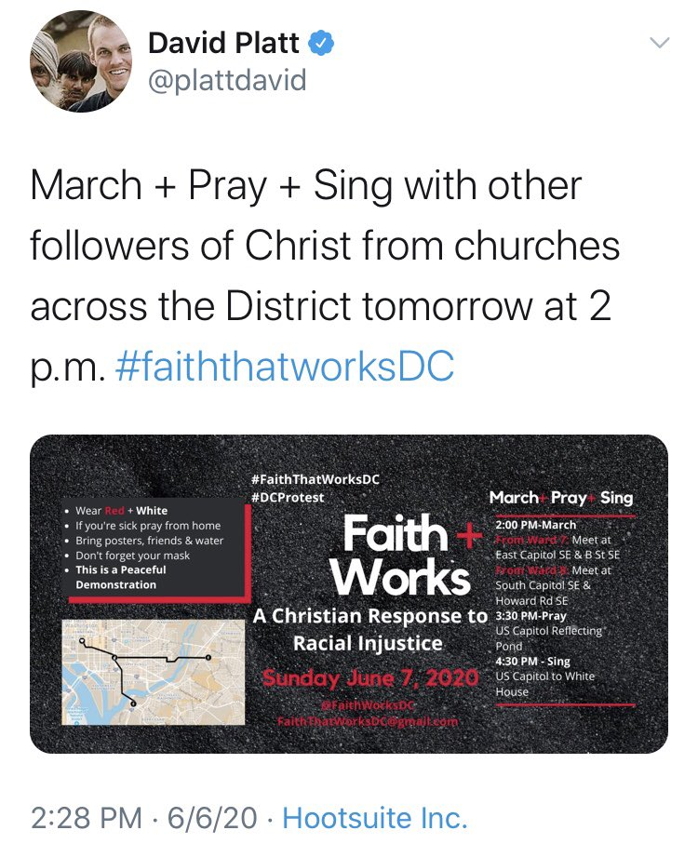
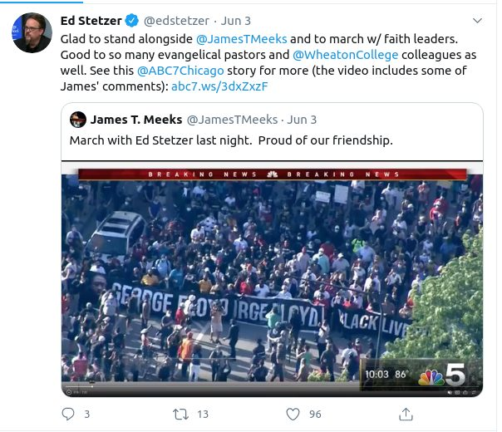
Evangelicals Join #BLM Movement

Slide 8
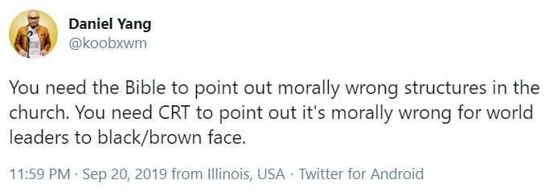
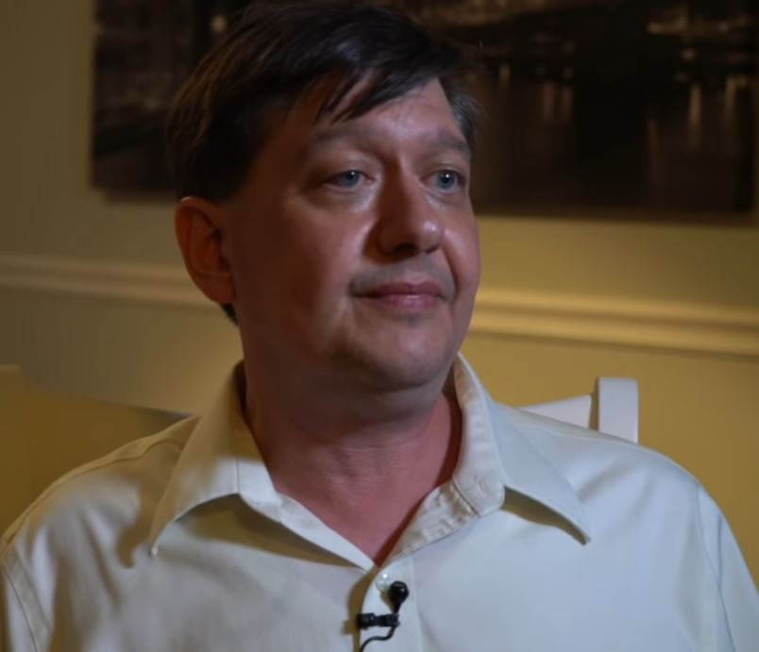
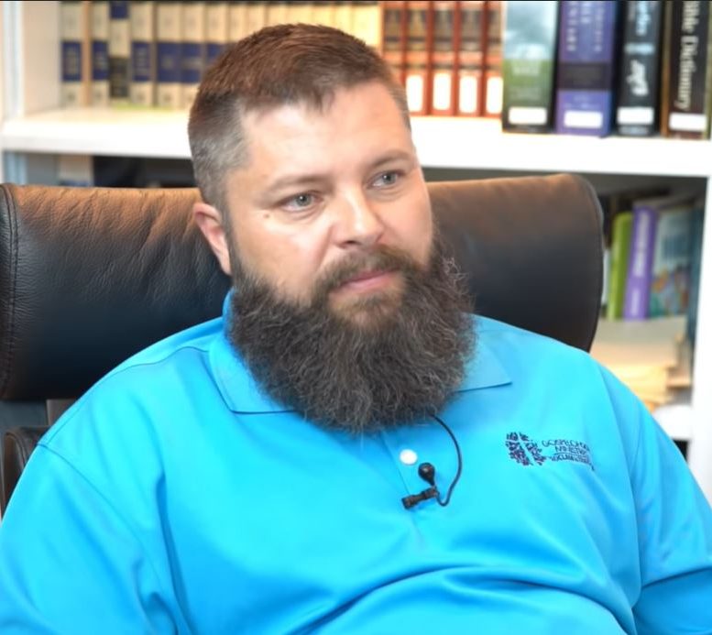
Damage to the Church?
Undermines Sufficiency of Scripture
Destroys Body Fellowship
Changes Leadership Qualifications
Reorientates the Church’s Mission

Slide 9
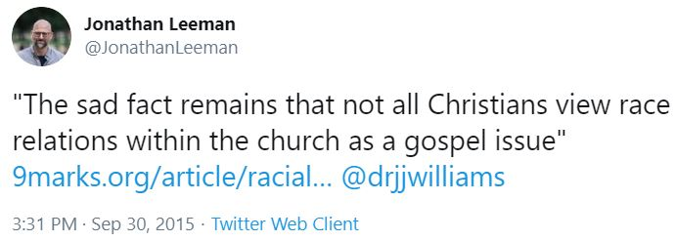
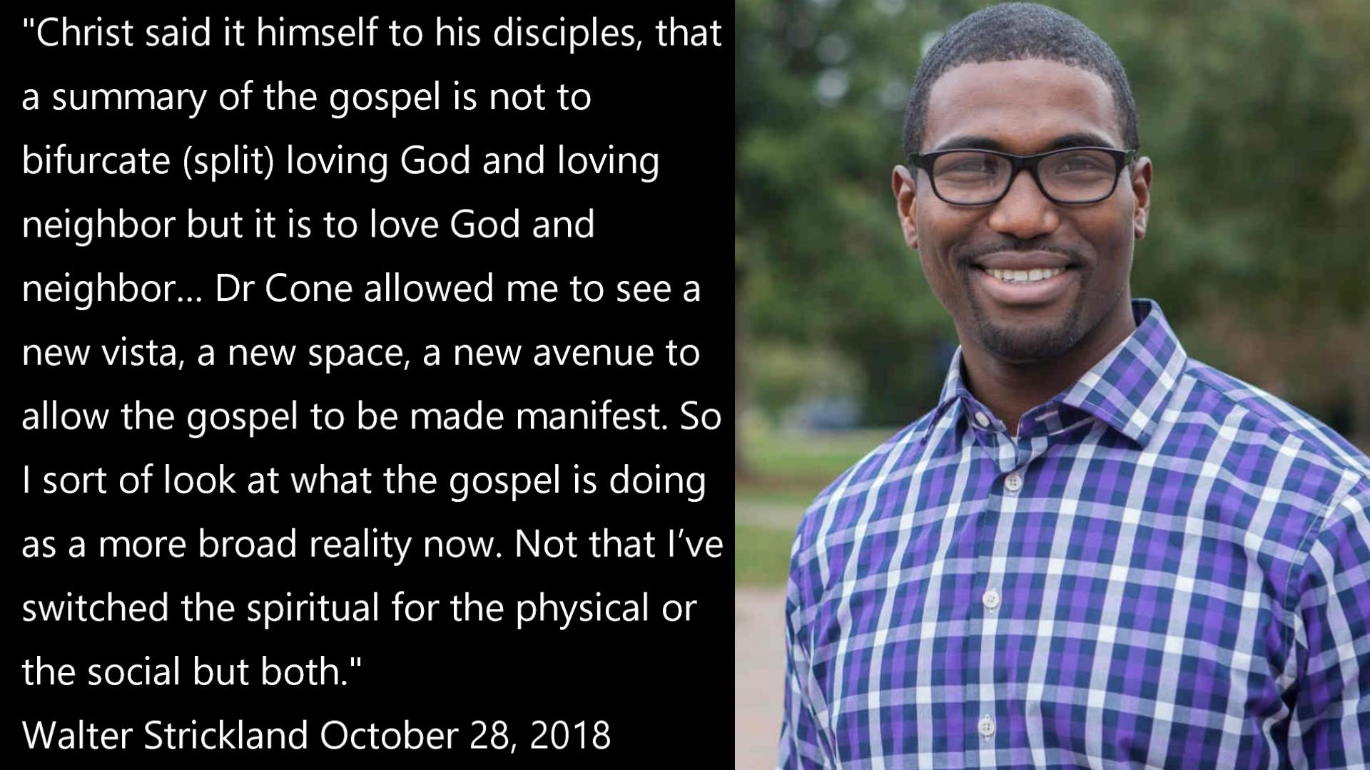
Damage to the Gospel
The goal of this book is to shine a spotlight on one of the aspects of the gospel that has been neglected and dismissed as inappropriate for discourse. – Eric Mason “Woke Church”
For all of my passion for the gospel of Jesus Christ, which has been accurate and faithful to the best of my ability, the gospel that I have held so dear has been, in reality, a truncated and incomplete gospel. – Paul Tripp, after MLK50 conference

Slide 10
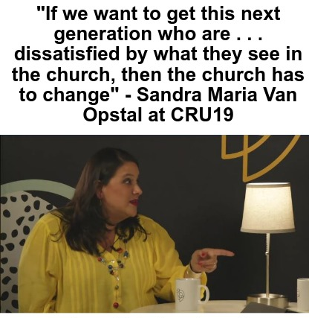
Pragmatic or Ideological?
Those who desire to make a good showing in the flesh try to compel you to be circumcised, simply so that they will not be persecuted for the cross of Christ.” Gal 6:12
John Calvin observed Christians “who ought to have remained fixed in Christ” but instead became insatiably curious for the erroneous “new and strange inventions of men.” They lacked a sufficient “dread or guard against so many false teachers.”

Slide 11
Marxist Syncretism
Replace
Social Gospel: Fabian Socialism Imported into Mainline Christianity
Liberation Theology: Communism Imported into Catholicism
Combine
Progressive Evangelicalism: New Left Ideology added to Evangelical Christianity
Woke Church: Social Justice Theory added to Evangelical Christianity

Slide 12
The Social Justice Philosophy
Philosophical Branch | Social Justice Concept | False Teaching
Epistemological | Standpoint Epistemology | Gnosticism
Metaphysical | Egalitarianism (Equity, Diversity, and Inclusion) | Pelagianism Marcionism
Ethical | Marxism | Phariseaism Galatian Heresy

Slide 13
What You Need To Fight The Social Justice Gospel in the Church
A Basic Knowledge of the Gospel
A Basic Knowledge of the errors of Marxism and Postmodernism

Slide 14
Truth
"God is spirit, and those who worship Him must worship in spirit and truth.” John 4:24
“You will know the truth, and the truth will make you free.“ John 8:32
Jesus said to him, "I am the way, and the truth, and the life.” John 14:6
“[The Spirit] will guide you into all the truth.” John 16:14
"Your word is truth.” John 17:17
All Scripture is inspired by God and profitable for teaching, for reproof, for correction, for training in righteousness; so that the man of God may be adequate, equipped for every good work. 2 Tim 3:15-16

Slide 15
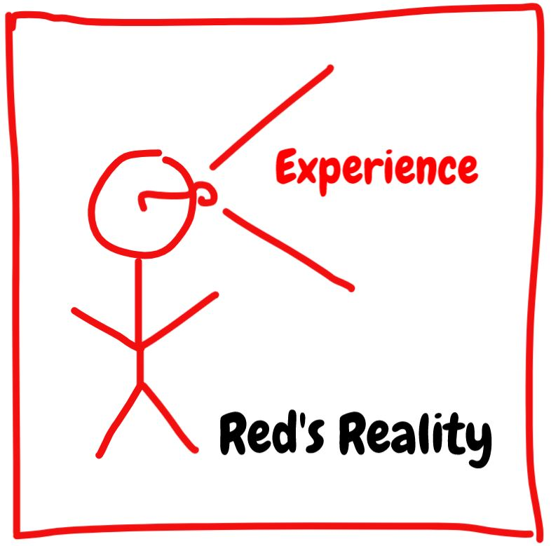
Standpoint Epistemology

Slide 16
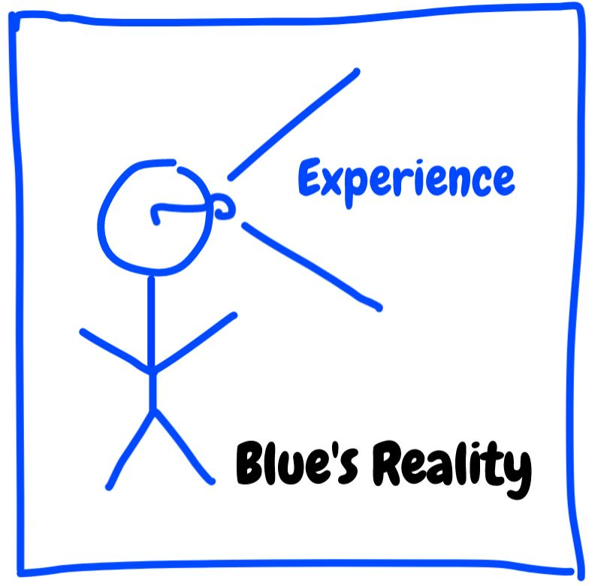
Standpoint Epistemology

Slide 17
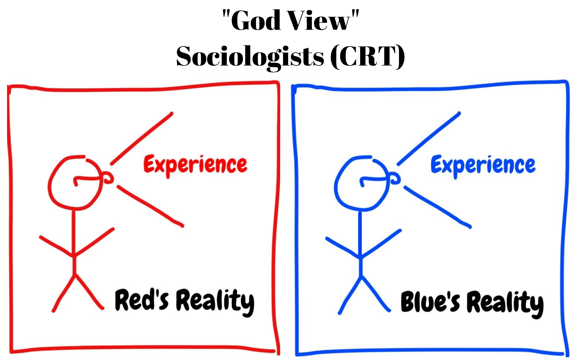
Standpoint Epistemology

Slide 18
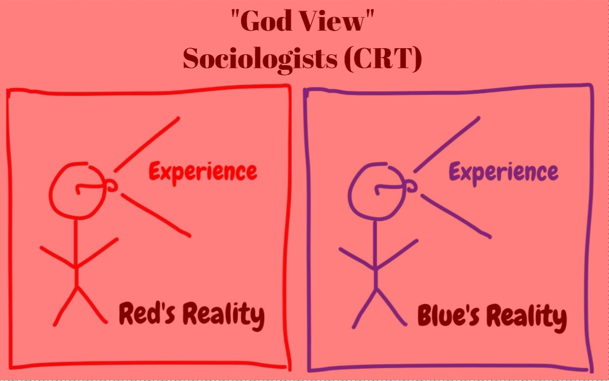
Standpoint Epistemology

Slide 19
Standpoint Epistemology

Slide 20
Christianity

Slide 21
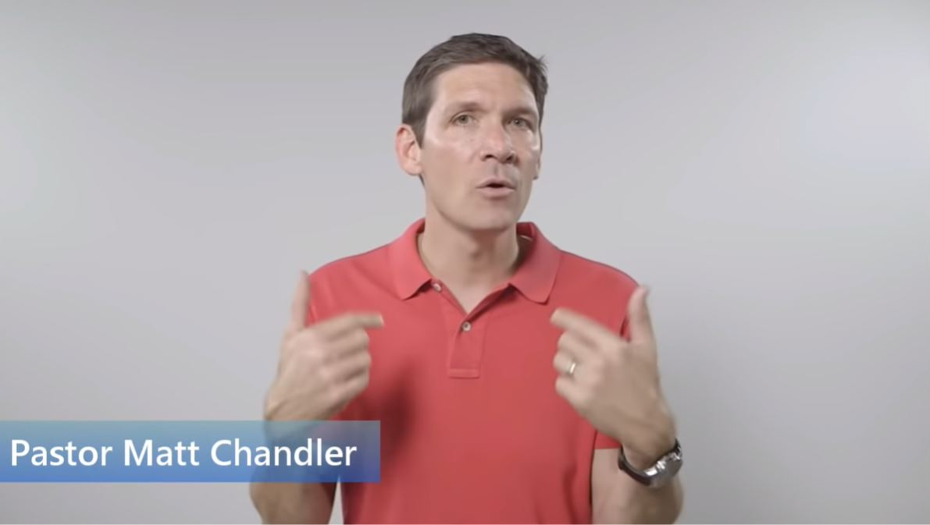
Intersectionality
There was some lenses put over
my eyes in which I saw the world
through those lenses not knowing
what those lenses are. So if I can
kind of be straight about what I’m
talking about. I grew up with this
invisible bag of privilege. – Matt
Chandler

Slide 22
Soft Intersectionality

Slide 23
Caring Well Initiative

Slide 24
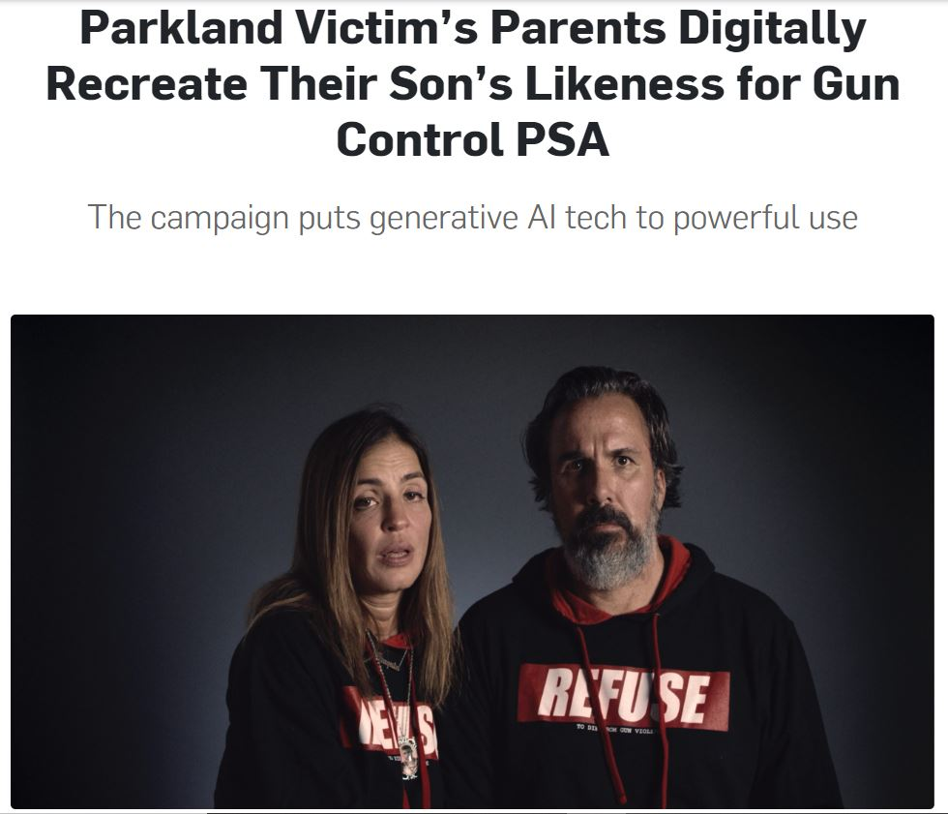
Other Examples

Slide 25
Impact of Standpoint Epistemology
Erodes Biblical Sufficiency
Downplays Christian Identity
LGTBQI+ Orientations
Subversion of Due Process
Revisionist History (Memory Studies)
Generational Guilt

Slide 26
Generational Guilt
The person who sins will die. The son will not bear the punishment for the father’s iniquity, nor will the father bear the punishment for the son’s iniquity; the righteousness of the righteous will be upon himself, and the wickedness of the wicked will be upon himself. Ezek 18:20

Slide 27
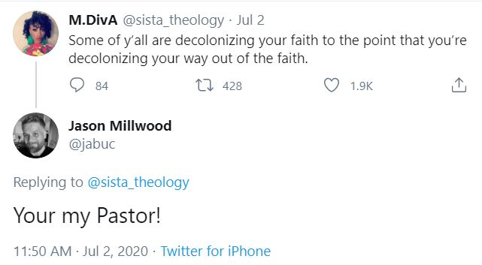
Deconstruction

Slide 28
Response to Standpoint Epistemology
Being part of a minority group does not necessarily mean one experiences oppression or disadvantage.
Experiencing oppression or disadvantage does not mean one is more qualified to speak about injustice.
God gave an objective standard for adjudicating justice from His perspective.

Slide 29
Being part of a minority group does not necessarily mean one experiences oppression or disadvantage.
Biblical Examples: Moses, Esther, Daniel, Ruth, etc.
Modern Examples: Barack Obama, Ruth Bader Ginsburg, Ted Cruz, Mark Cuban, etc.

Slide 30
Experiencing oppression or disadvantage does not mean one is more qualified to speak about injustice.
God’s justice is universally accessible.
The righteous is concerned for the rights of the poor, The wicked does not understand such concern. Prov 29:7
You, Ezra, according to the wisdom of your God which is in your hand, appoint magistrates and judges that they may judge all the people who are in the province beyond the River, even all those who know the laws of your God; and you may teach anyone who is ignorant of them. Ezra 7:25
Furthermore, you shall select out of all the people able men who fear God, men of truth, those who hate dishonest gain; and you shall place these over them as leaders of thousands, of hundreds, of fifties and of tens. Exodus 18:21
God’s justice is known by the righteous.
"The same law shall apply to the native as to the stranger who sojourns among you.“ Ex 12:49
Many nations will come and say, "Come and let us go up to the mountain of the LORD And to the house of the God of Jacob, That He may teach us about His ways And that we may walk in His paths." For from Zion will go forth the law, Even the word of the LORD from Jerusalem. Micah 4:2
For the wrath of God is revealed from heaven against all ungodliness and unrighteousness of men who suppress the truth in unrighteousness, because that which is known about God is evident within them; for God made it evident to them. Rom 1:18-19

Slide 31
God gave an objective standard for adjudicating justice from His perspective.
All Scripture is inspired by God and profitable for teaching, for reproof, for correction, for training in righteousness; so that the man of God may be adequate, equipped for every good work.
2 Tim 3:16

Slide 32
Questions to Ask
Why should a person’s external identity factors or personal experience alone qualify them more than someone else to speak authoritatively on law, justice, history, etc.? Would we assume someone is qualified to write instruction manuals for surgeons simply because they underwent an operation?

Slide 33
Equality
Ways in which we are different:
Gender: Have you not read that He who created them from the beginning made them male and female. Matt 19:4
Culture/Geography (Organic): And He made from one man every nation of mankind to live on all the face of the earth, having determined their appointed times and the boundaries of their habitation. Acts 17:26
Abilities: The Lord said to him, “Who has made man’s mouth? Or who makes him mute or deaf, or seeing or blind? Is it not I, the Lord? Ex 4:11
Spiritual Gifts: Now there are varieties of gifts, but the same Spirit. And there are varieties of ministries, and the same Lord. There are varieties of effects, but the same God who works all things in all persons. 1 Cor 12:4-6
Hierarchal Positions: Eph 5:21-6:9, Rom 13:1 (Wives/Husbands, Children/Parents, Masters/Slaves, Rulers/Subjects)

Slide 34
Equality
Ways in which we are the same:
Made in the Image of God: “God created man in His own image, in the image of God He created him; male and female He created them.” Gen 1:27
Accountable to God: “Therefore having overlooked the times of ignorance, God is now declaring to men that all people everywhere should repent.” Acts 17:30
Subject to the Law: "The same law shall apply to the native as to the stranger who sojourns among you.” Exodus 12:49
Sinful: “For all have sinned and fall short of the glory of God.” Rom 3:23
In Need of Salvation: “For God so loved the world, that He gave His only begotten Son, that whoever believes in Him shall not perish, but have eternal life.” John 3:16
If Redeemed, Part of the Body of Christ: “There is neither Jew nor Greek, there is neither slave nor free man, there is neither male nor female; for you are all one in Christ Jesus.” Gal 3:28

Slide 35
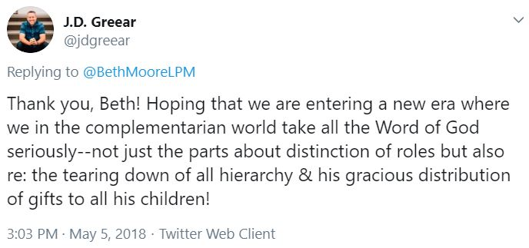
Egalitarianism (Equity, Diversity, and Inclusion)
Victim Categories
Income
Gender
Race
Sexual Minorities
Disability
Etc.
Restructuring Hierarchies
Corporate Apologies
Positive Rights/Holistic Pro-Life
Affirmative Action/Multi-Ethnic Church Model
Hate Speech Laws

Slide 36
Consequences
Mission Drift
New Order of Sin
Subverting Leadership Qualifications
Implementing Unbiblical Hierarchies
Political Consequences
Reparations

Slide 37
Anti-Capitalism
But now this taco soup is an anonymous commodity. It arrives on my table seemingly by magic. With this anonymity comes ingratitude—I do not recall those farmers and harvesters to whom I owe a debt of thanks. I do not think of God’s mercy in providing a harvest. And with anonymity and ingratitude comes injustice. Like so much of what we consume in our complicated world of global capitalism and multinational corporations, purchasing this corn and these beans involves me, however unwittingly, in webs of systemic injustice, exploitation, and environmental degradation that I am ignorant about and would likely not consent to. I do not know where the onions in my soup came from or how the workers who harvested them were treated. My leftovers may have been provided by a man whose kids can’t afford lunch today. Tish Harrison Warren, Liturgy of the Ordinary, 70.

Slide 38
With Justice for All: A Strategy for Community Development By: John Perkins
Communism, then, came along as an attempt to distribute the earth’s resources more equitably. Communism sprang into being because apostate religion could not challenge man’s greed. But atheistic Communism has not brought justice either. Neither capitalism nor Communism can bring justice to the poor.
We as Christians must champion an alternative. We must create a system that is based not on greed, not even on greed tempered by honesty (the ideal of free enterprise), but on justice and love. We must create a system that distributes wealth more equitably in response to human needs. This Christian economic system will by its very existence be a prophetic voice to the world system.
And we have charted a strategy for achieving that vision—a strategy of relocation, reconciliation and redistribution.
A depressed community striving to become self-sufficient needs outside technology and funds to get started. Government and other outside groups can provide these.

Slide 39
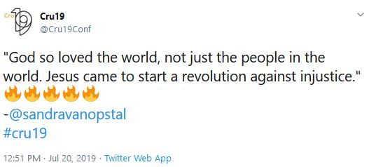
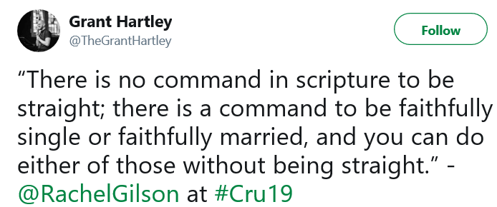
Cru

Slide 40
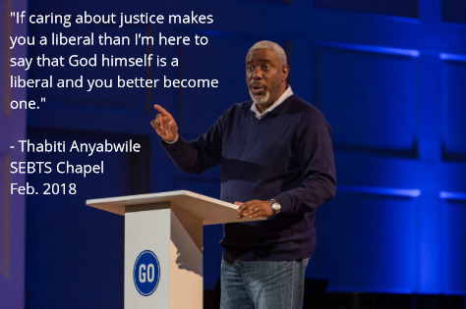
Political Consequences

Slide 41
Three Kinds of Justice According to “Woke Church”
Intervening Justice (Charity)
01
Preventative Justice - (Curtailing)
02
Systemic Justice (Changing): "developing programmatic approaches to address systems that have historically worked against the principles of justice.” (35)
03

Slide 42
Tim Keller’s Social Justice
Redeemer Presbyterian Church’s mission is “to help build a great city for all people through a movement of the gospel that brings personal conversion, community formation, social justice, and cultural renewal to New York City and, through it, the world.”
The “substitutionary atonement” involved Jesus losing His “power” which, in turn, inspired Christians to be “radical agent[s] for social change” by giving up theirs. (2007)
“It’s biblical that we owe the poor as much of our money as we can possibly give away.” (2010)

Slide 43
Problems | TGC- Justin Lonas (2019) | Rich Christians – Ronald Sider (1977)
Disparity in Wealth Distribution | “ . . . an increasingly large portion of wealth in the United States belongs to a small number of people.” | “. . . the rich too often benefit much more than the poor when a country experiences economic growth.” (11)
Structural Injustice | “It’s the clear-eyed pictures of racial injustice that still pervade America—and the ways its evil seeps into and drives other class and culture issues.” | [In] the United States, the connections between racist, religious, and ethnic hostility on the one hand and poverty, hunger, and even starvation on the other are painfully clear. (170)
Unmerited Privilege | “Americans’ chances for financial stability depend more and more on being born and raised in a certain set of circumstances.” | “God wants every person and family to have equality of economic opportunity . . . (land, money, education) . . .” (xiv)
Evil “haves” | “ . . . people in the front row can be poor in other ways (lack of humility, meaningful relationships, generosity, and so on).” | “The rich often neglect or oppose justice because it demands that they end their oppression and share with the poor.” (67)
Segregated Church | “The increasing educational and economic segregation of American life is mirrored in the church.” | “We have failed to comprehend the concept that the church worldwide is one body . . . The division between the haves and the have nots in the body of Christ is a major hindrance to world evangelism.” (94)

Slide 44
Exodus 23
1 “You shall not bear a false report; do not join your hand with a wicked man to be a malicious witness.
2 You shall not follow the masses in doing evil, nor shall you testify in a dispute so as to turn aside after a multitude in order to pervert justice;
3 nor shall you be partial to a poor man in his dispute.
4 “If you meet your enemy’s ox or his donkey wandering away, you shall surely return it to him.
5 If you see the donkey of one who hates you lying helpless under its load, you shall refrain from leaving it to him, you shall surely release it with him.
6 “You shall not pervert the justice due to your needy brother in his dispute.
7 Keep far from a false charge, and do not kill the innocent or the righteous, for I will not acquit the guilty.
8 “You shall not take a bribe, for a bribe blinds the clear-sighted and subverts the cause of the just.
9 “You shall not oppress a stranger, since you yourselves know the feelings of a stranger, for you also were strangers in the land of Egypt.

Slide 45
Exodus 23
Partiality to oneself by joining with a wicked man—perhaps for personal reward.
Partiality to oneself by following a multitude—peer pressure and concern for reputation.
Partiality to the poor—letting compassion for someone keep justice from taking its course.
Partiality to oneself by failing to help someone because they are an enemy—taking revenge.
Partiality to a needy brother—perhaps lying to protect someone who is personally close.
Partiality to oneself by taking a bribe.
Partiality to oneself by oppressing a stranger—perhaps taking advantage of someone who is vulnerable because they have no connection or means of recourse in society.

Slide 46
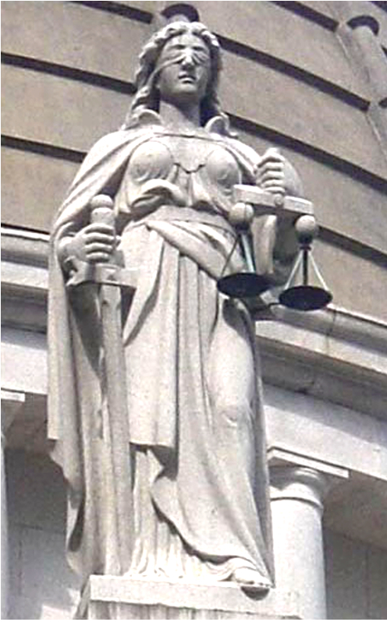
Justice is not Egalitarian
Justice, from God’s perspective, is the faithful application of his law irrespective of who the person its being applied to is, or what group they belong to. It doesn’t matter if they’re poor, or foreign, or a family member, they deserve what’s called “equality before the law.” This biblical thinking is what influenced our culture to include things like due process, trial by jury, and the idea that justice is blind.
While biblical justice is retributive, meaning criminals are punished for their actual crime, today’s social justice is redistributive, meaning it seeks to reallocate influence, privilege, and resources to create a world with a more equitable outcome. It destroys biblical understandings of personal responsibility, private property, and objective truth.

Slide 47
Questions to Ask
Why assume that intrinsic worth equals egalitarianism?
Christ submitted to His Father’s will and the Holy Spirit glorifies Christ.
The created order included hierarchies.
Is God’s law fair?
Is diversity, equity, and inclusion in the church part of the church’s mission or a result of being in Christ?
On what basis are humans entitled to social privileges?

Slide 48
A Different Gospel
“I am amazed that you are so quickly deserting Him who called you by the grace of Christ, for a different gospel; which is really not another; only there are some who are disturbing you and want to distort the gospel of Christ. But even if we, or an angel from heaven, should preach to you a gospel contrary to what we have preached to you, he is to be accursed! As we have said before, so I say again now, if any man is preaching to you a gospel contrary to what you received, he is to be accursed!” Gal 1:6-9

Slide 49
A Different Gospel
ἕτερος (Different)
“Another of the disciples said to Him, ‘Lord, permit me first to go and bury my father.’” Matt 8:21
“Or what king, when he sets out to meet another king in battle . . .” Luke 14:31
“And he proceeded to send another slave . . .” Luke 20:11
ἄλλος (Similar)
“Then He said to the man, “Stretch out your hand!” He stretched it out, and it was restored to normal, like the other.” Matt 12:13
“And Mary Magdalene was there, and the other Mary, sitting opposite the grave.” Matt 27:61
“Leaving the crowd, they took Him along with them in the boat, just as He was; and other boats were with Him.” Mark 4:36
“not that there is another one” - ESV
Μεταστρέφω (change, alter, distort)
“The sun will be turned into darkness And the moon into blood” Acts 2:20
“But even if we, or an angel from heaven, preach any other gospel to you than what we have preached to you, let him be accursed.” – KJV

Slide 50
What “Different” Gospel?
“But not even Titus, who was with me, though he was a Greek, was compelled to be circumcised. But it was because of the false brethren secretly brought in, who had sneaked in to spy out our liberty which we have in Christ Jesus, in order to bring us into bondage. But we did not yield in subjection to them for even an hour, so that the truth of the gospel would remain with you.” Gal 2:3-5
False Brethren (ψευδάδελφος): “The term's usage in Koine Greek commonly designated traitors within a city who allowed the enemy to sneak into the city and survey its defenses.” – Dr. Bob Utley
“Paul wanted this man to go with him; and he took him and circumcised him because of the Jews who were in those parts, for they all knew that his father was a Greek.” Acts 16:3
Q: Why circumcise Timothy and not Titus? A: Because in Titus’s case, circumcision was compelled as a gospel issue.

Slide 51
Mixing Law and Grace
But when Cephas came to Antioch, I opposed him to his face, because he stood condemned. For prior to the coming of certain men from James, he used to eat with the Gentiles; but when they came, he began to withdraw and hold himself aloof, fearing the party of the circumcision. The rest of the Jews joined him in hypocrisy, with the result that even Barnabas was carried away by their hypocrisy. But when I saw that they were not straightforward about the truth of the gospel, I said to Cephas in the presence of all, “If you, being a Jew, live like the Gentiles and not like the Jews, how is it that you compel the Gentiles to live like Jews? Gal 2:11-14
Καταγινώσκω (guilty) vs. ἀνάθεμα (cursed) (1:8)
Theological difference between someone who is temporarily inconsistent, and someone whose life pattern affirms error related to the gospel. “For many walk, of whom I often told you, and now tell you even weeping, that they are enemies of the cross of Christ.” (Phil 3:18)

Slide 52
What is the Gospel?
“nevertheless knowing that a man is not justified by the works of the Law but through faith in Christ Jesus, even we have believed in Christ Jesus, so that we may be justified by faith in Christ and not by the works of the Law; since by the works of the Law no flesh will be justified.” Gal 2:16
“For I am not ashamed of the gospel, for it is the power of God for salvation to everyone who believes, to the Jew first and also to the Greek. For in it the righteousness of God is revealed from faith to faith; as it is written, ‘BUT THE RIGHTEOUS man SHALL LIVE BY FAITH.’” Rom 1:16
“Now I make known to you, brethren, the gospel which I preached to you, which also you received, in which also you stand, by which also you are saved, if you hold fast the word which I preached to you, unless you believed in vain. For I delivered to you as of first importance what I also received, that Christ died for our sins according to the Scriptures, and that He was buried, and that He was raised on the third day according to the Scriptures.” I Cor 15:1-4

Slide 53
Changes the Gospel Case Study: Jarvis Williams

Slide 54
CRT Applied to Christianity
Racism is normative (systemic)
“I applaud the many white Southern Baptists who responded with outcries for justice after the controversial deaths of black men at the hands of predominately white police officers in Ferguson, Staten Island, Baltimore, and elsewhere.”
White privilege maintains white dominance
“the most significant instances of racial disparity in Southern Baptist life is intellectual racism” because black scholarship is “dismissed” and there are “few” black leaders.
Whites will promote racial advances for blacks only when they also promote white self-interest (Interest Convergence)
“certain predominately white churches” want a “multiethnic church” but “they don’t want to leverage privilege and power with vetted qualified black and brown people.”
Color blindness subordinates minorities
Southern Baptists should not claim they view all people in a color-blind fashion.
Race is socially constructed for the purpose of racism
“Race, in our experience, is a construct that people created for the advancing a racist agenda flowing out of Europe into America.”
Voices of color are needed to help whites understand minority oppression (Standpoint Epistemology)
“white Southern Baptists with privilege and without personal experience of the challenges associated with being a black or brown person in the US, should spend more time listening to their black and brown brothers and sisters instead of trying to speak to, at, about, or for them.”
History should be interpreted through minority experience (revisionism/memory studies)
Peter’s problem in Gal 2 was not a misunderstanding of “justification by faith” but a “gentile-exclusive gospel.”

Slide 55
CRT Infused “Racial Reconciliation” Mixes Law and Grace
“Be willing to die for [racial reconciliation] as you would for penal substitution.”
“According to Paul, racial reconciliation is NOT an implication of the gospel and certainly not a social issue instead of a gospel issue! But it is a GOSPEL ISSUE!!!!!!!!”
“Certain Southern Baptists view racial reconciliation as a social issue instead of a gospel issue because of an incomplete understanding of both the gospel and race.”
“I want to argue that the category of gospel should NOT be narrowly defined as entry language (i.e. justification by faith) but should be broadly defined to include maintenance language (i.e. walking in the Spirit)”
“[The Gospel’s] maintenance language tells one how to live in the power of the Spirit the reality of what God has done for him in Christ (Gal 5:16-6:10; Eph 2:11-6:20).”
“This unification of all things in Christ includes our receiving the blessings of all of the spiritual blessings in the heavenly places in Christ (1:3), which at least includes election (1:4), predestination (1:5), adoption into God’s family (1 :5) hearing and believing the gospel (1 :13), and racial reconciliation (2:11-3:8).”
“I offer a few biblical reasons Southern Baptists from every racial stripe should continue to work toward removing the stain of racism from their churches, from their homes, and from every aspect of SBC life.” (Removing the Stain of Racism, 74)
“All sinners experience justification before God by faith in Jesus Christ apart from works of the law (Rom 3:20-4:25; 5:8-10), but without personal holiness, we will not experience final justification because our works will prove whether we trust in Jesus and our works will either vindicate us or condemn us in the judgment (Matt 12:33-37; James 2:14-26).”

Slide 56
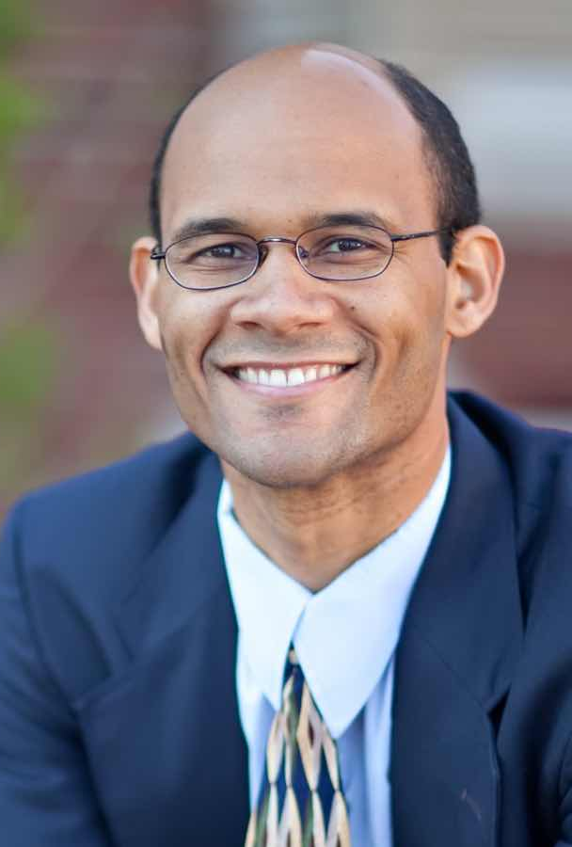
CRT Infused “Racial Reconciliation” Mixes Law and Grace
Racial Reconciliation Includes Dos and Don’ts like:
DO get rid of art: “Southern Baptist churches need to erase, take down, or paint over all images of a white Jesus, white disciples, and all-white children learning at the feet of Jesus. These images perpetuate white supremacy and suggest the kingdom of God revolves around whiteness.”
DON’T be colorblind: “Southern Baptists should not claim they view all people in a color-blind fashion.’
DO diversify your church: “Southern Baptists need to enlarge their ethnic circles to include more black and brown believers. If Southern Baptists live monoethnic lives, then they will have a limited monoethnic perspective of the complexity of Southern Baptist life.”
Do support other multi-ethnic churches: “Southern Baptists must pray for and support multiethnic church plants in their cities and communities if their churches are not going to pursue reconciliation.”
DO listen to experiences: “white Southern Baptists with privilege and without personal experience of the challenges associated with being a black or brown person in the US, should spend more time listening to their black and brown brothers and sisters instead of trying to speak to, at, about, or for them.”
DO implement quotas: “If the stain of racism is going to become less apparent within the SBC, white leaders responsible for organizing conferences must intentionally include black and brown people at the center of their conferences. And the SBC needs to have conferences that are predominately led by black and brown individuals.”
Question: Did Christ’s death really accomplish racial reconciliation?

Slide 57
Emotional Barriers
Sympathy
It’s loving your neighbor to “just listen.”
Shouldn’t we care about the oppressed?
But, we’re all equal in the eyes of God.
Fear:
The Church has been wrong before, we don’t want to be wrong again.
What will my friends and family think of me?
Opposing this will make me lose ministry and job opportunities.

Slide 58
Resources
Christian:
Social Justice vs Biblical Justice: How Good Intentions Undermine Justice and Gospel – E. Calvin Beisner
Why Social Justice Is Not Biblical Justice – Scott Allen
Social Justice and the Christian Church – Ronald Nash
Social Justice Goes to Church: The New Left in Modern American Evangelicalism – Jon Harris
Non-Christian
Cynical Theories: How Activist Scholarship Made Everything about Race, Gender, and Identity—and Why This Harms Everybody – Helen Pluckrose and James Lindsay
The Quest for Cosmic Justice – Thomas Sowell

Slide 59
What Christianity Offers
Forgiveness of Sin (Including Injustice)
Unity in Christ (Gender/Class/Age/Tribe/Tongue/Nation)
Fulfilling Identity (More Than Power Relationships)
Roles and Responsibilities: Social and Political (A Purpose)
A Basis for Rights (Responsibilities)
Theology of Culture (A Sense of Belonging)

