Slide 2
June 1, 2019: Adoption of Resolution 9 on Critical Race Theory and Intersectionality

Slide 3
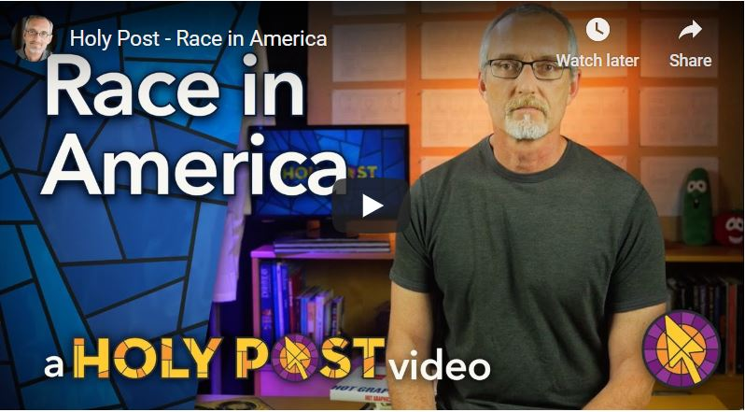
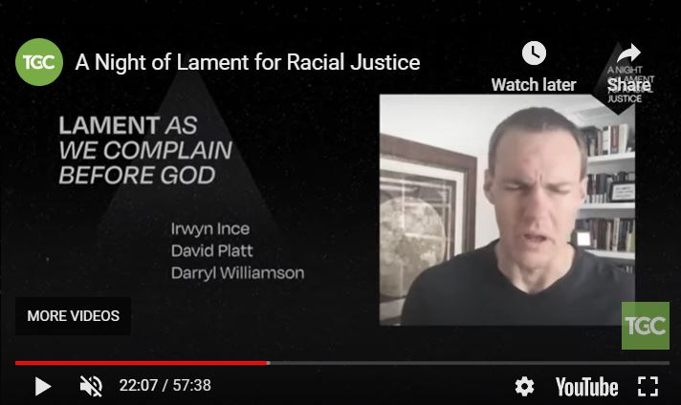

Slide 5
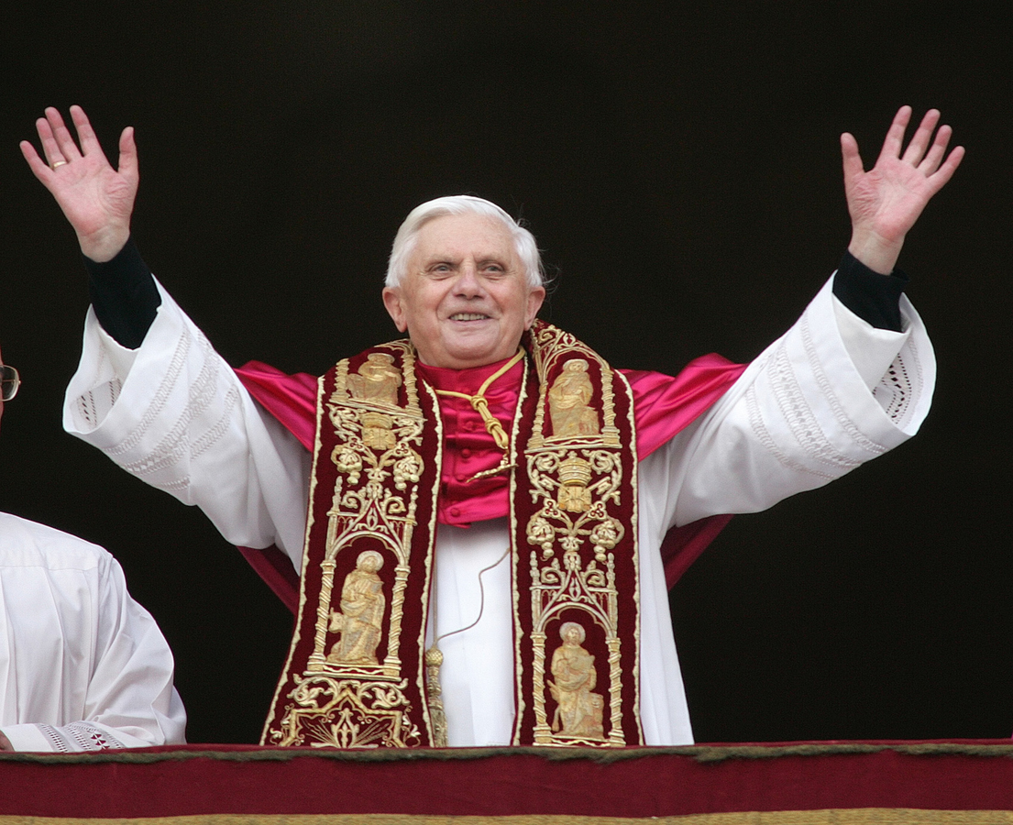
“The social doctrine of the Church has unceasingly highlighted the importance of distributive justice and social justice for the market economy.”

Slide 6
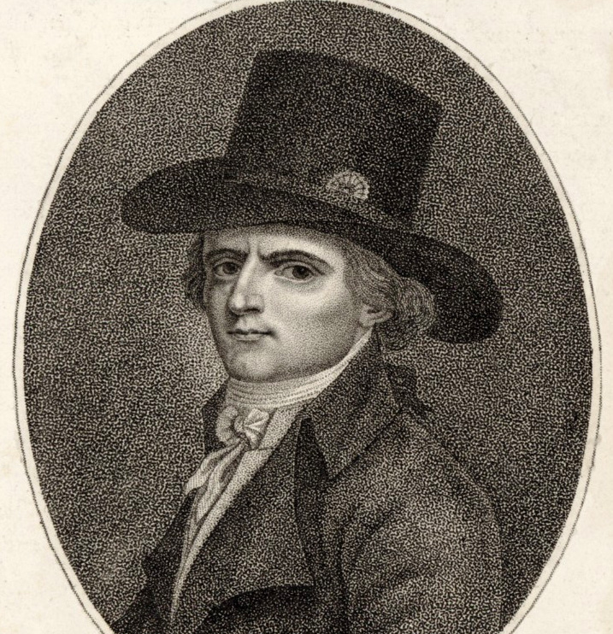
Rousseau
Babeuf

Slide 7
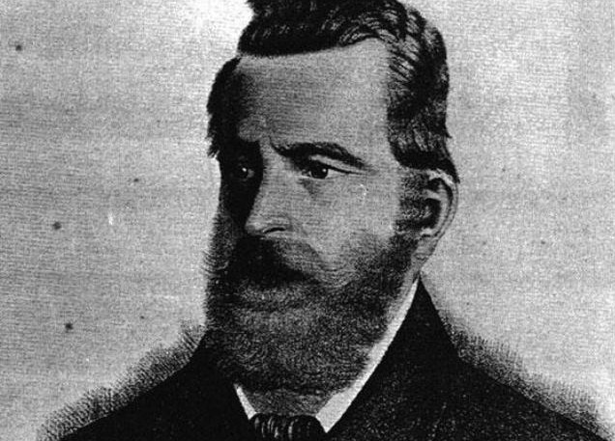
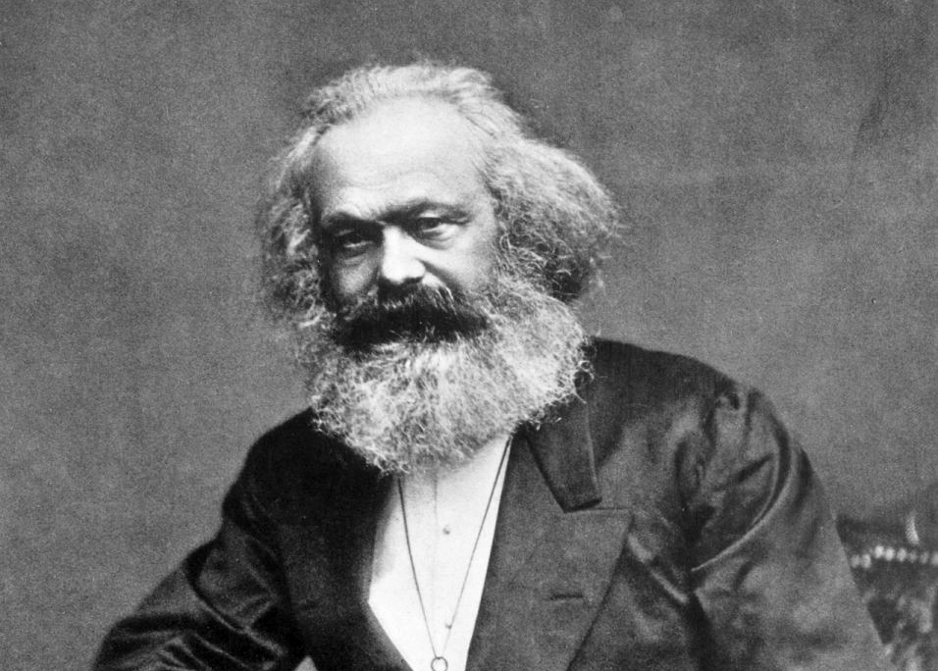
August Becker
Karl Marx

Slide 8
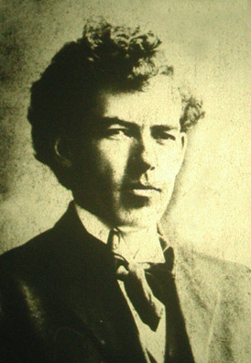
J. Stitt Wilson
Sprague’s “Socialism”

Slide 9
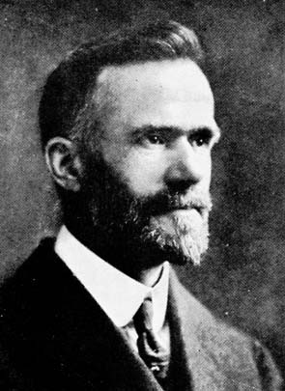
Walter Rauschenbusch and Charles Erdman

Slide 10
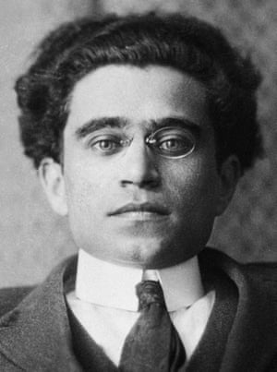
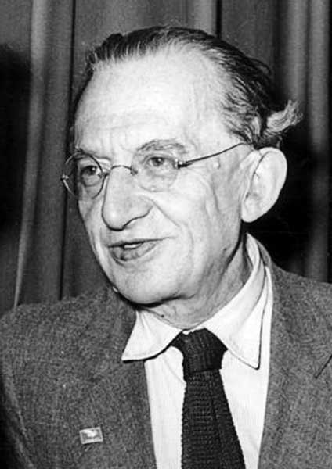
Gramsci and Lukacs

Slide 11
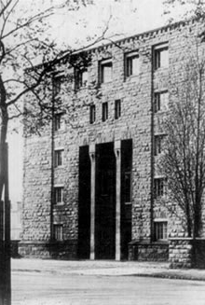
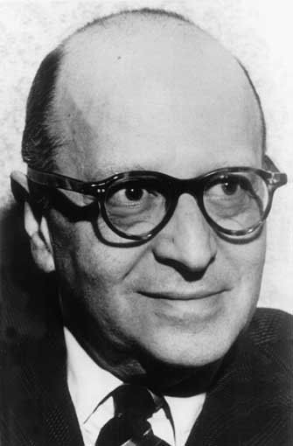
The Frankfurt School and Horkheimer

Slide 12
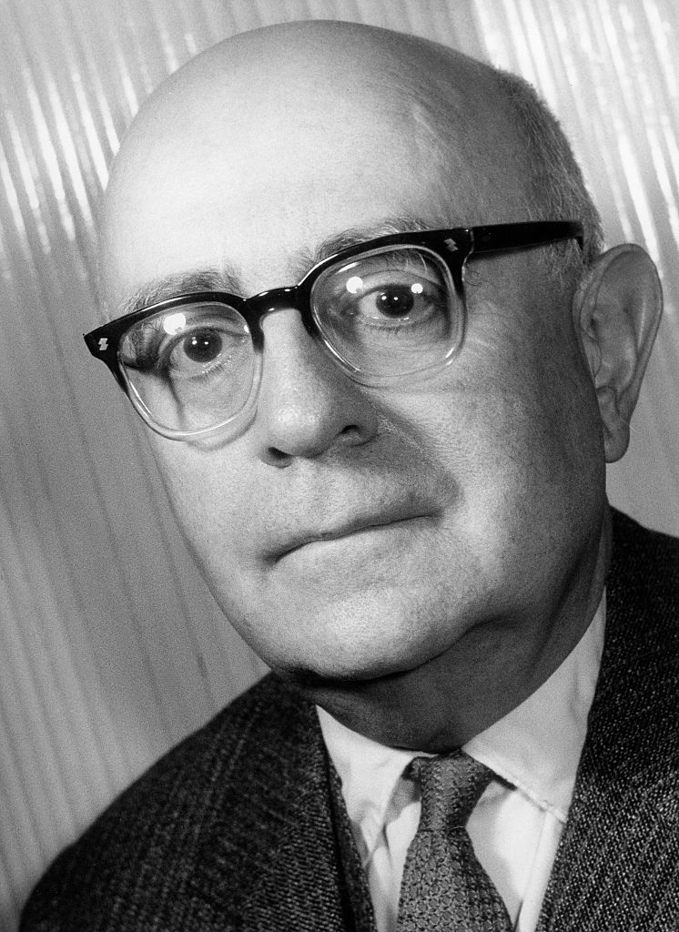
Marcuse and Adorno

Slide 13
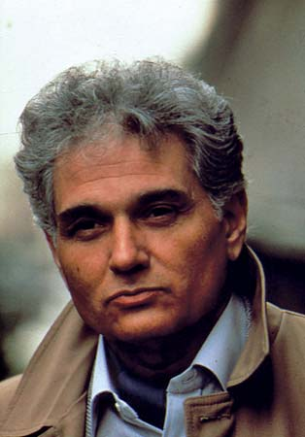
Derrida and Foucault

Slide 15
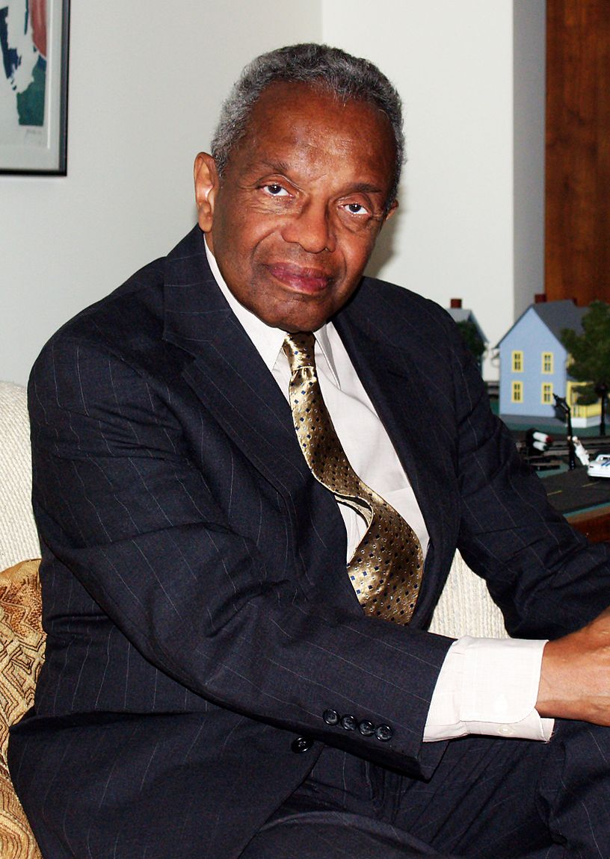
Derrick Bell and Kimberle Williams Crenshaw

