Slide 1
Grace Bible Church Glorifying God by Making Disciples of Jesus Christ

Slide 2
A reminder to consider others Please:
Turn off your cell phone or set to vibrate only
Turn off sound to all electronic devices
Use the nursery or cry room if your child is fussy
Get up during the preaching only if absolutely necessary (please sit in back if you must leave early)
Notes:
2

Slide 3
Introduction to Thessalonians 1 Thessalonians 1:1
Causes of turmoil and fear
Control by fear (terrorism)
The Thessalonian Church born in adversity

Slide 4
Thessalonica
Founding of the city
Casander in 315 B.C.
Named after his wife (1/2 sister of Alexander the Great)

Slide 5
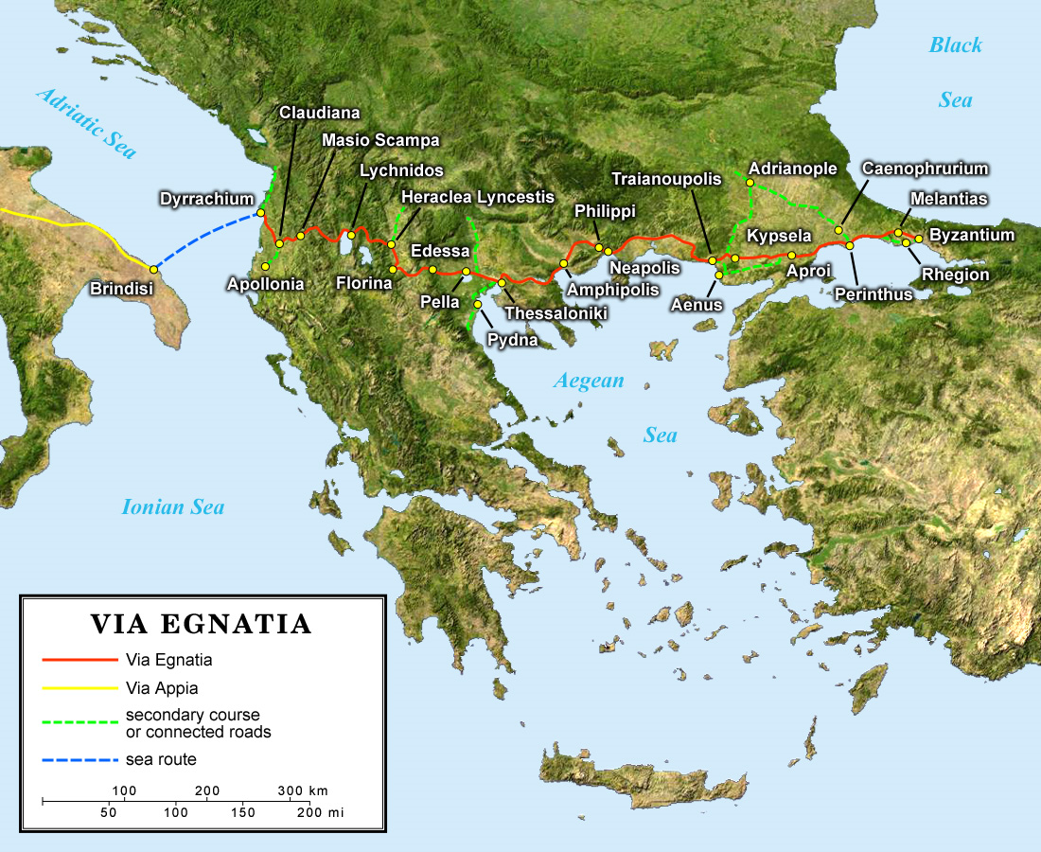

Slide 6
The Second Missionary Journey Acts 16
Macedonian Call

Slide 7
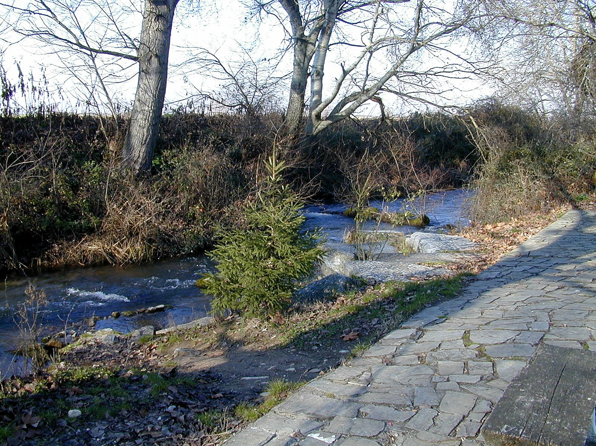
The Second Missionary Journey Acts 16
Planting a church in Philippi

Slide 8
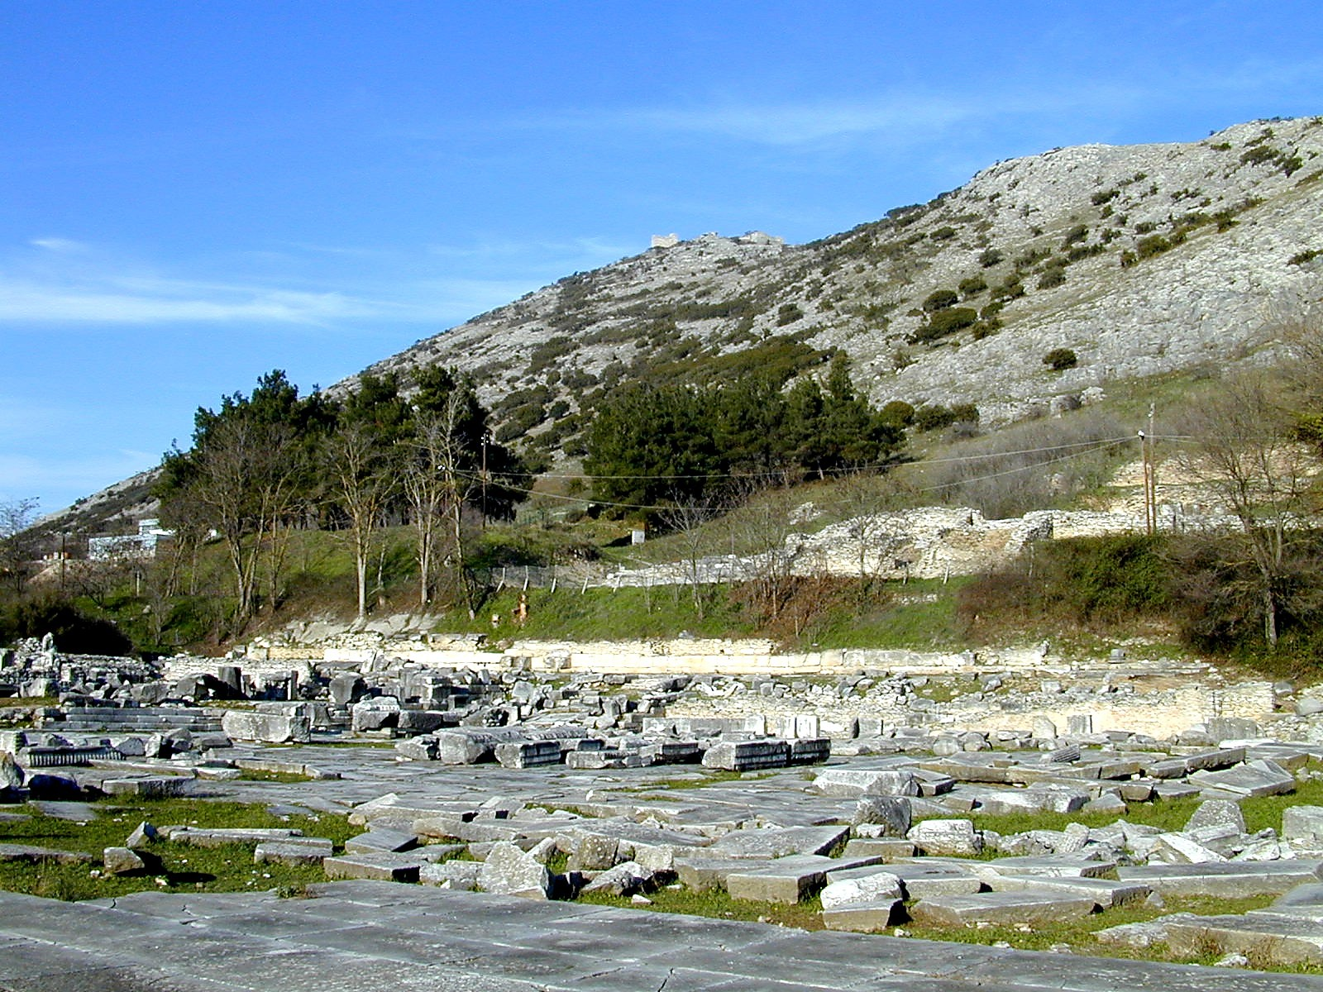
The Second Missionary Journey Acts 16
Paul & Silas in prison

Slide 9
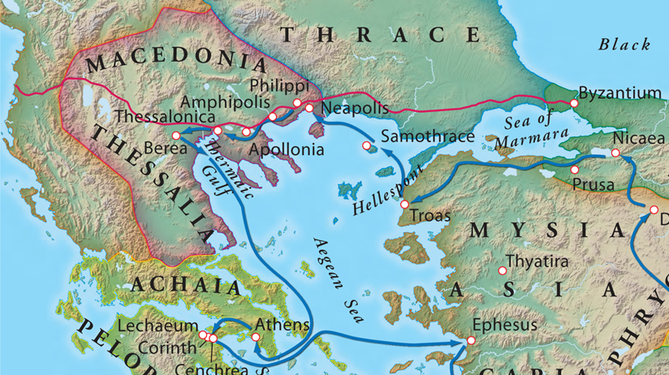
A Church Planted in Thessalonica Acts 17:1-4
Strategic importance of Thessalonica

Slide 10
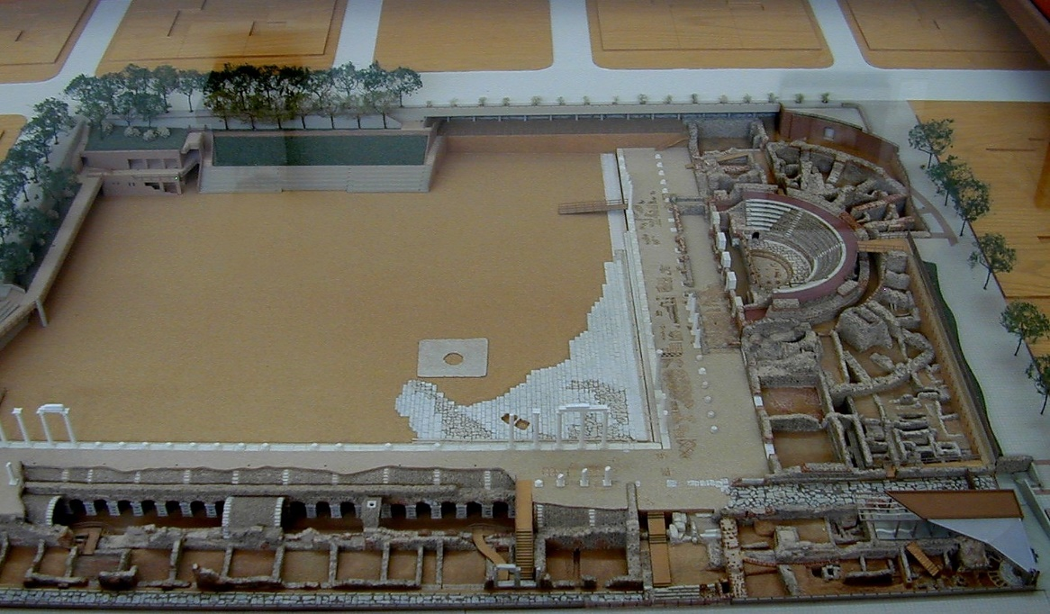
A Church Planted in Thessalonica Acts 17:1-4
Proclaiming the Messiah
Salvation of Jews & God-fearing Greeks
Model of Ruins
at Thessaloniki

Slide 11
Persecution Arises Acts 17:5-15
Attempt to start a riot (Acts 17:5-9)
Charges before the Magistrate (Acts 17:6-7)
Men who have upset the world
Jason has welcomed them
They act contrary to Caesar’s decrees
There is another king, Jesus

Slide 12
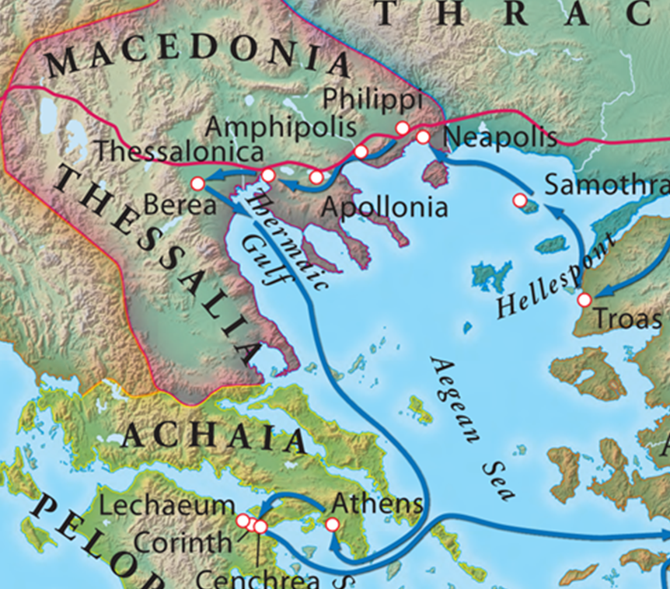
Persecution Arises Acts 17:5-15
Sent to Berea (Acts 17:10)
Pursued Paul to Persecute (Acts 17:13-15)

Slide 13
Author, Date & Occasion of Writing
Paul
Purpose
Place & Time

Slide 14
Major Themes in Thessalonians
Joy & Thankfulness (1 Thess. 1:2; 2:13; 2:19-20; 3:9)
Remember our Ministry & Teaching (1:5; 2:1-2; 2:5; 2:11; 2:3-4; 4:2; 5:2)
The Return of Christ & Implications 1:9-10; 2:19; 3:11-13; 4:13-18; 5:1-11)

Slide 15
Outline of 1 Thessalonians
I. Personal Reflections (Chapters 1-3)
Paul’s Commendation for Their Growth (1:1-10)
Paul’s Founding of the Church (2:1-16)
Timothy’s Strengthening of the Church (2:17-3:13)

Slide 16
Outline of 1 Thessalonians
II. Practical Exhortation (4-5)
Concerning Christian Conduct (4:1-12)
Concerning the Coming of the Lord (4:13-5:11)
Concerning Holy Living (5:12-22)
Conclusion (15:23-28)

Slide 17
Salutation 1 Thessalonians 1:1
Paul, Silvanus & Timothy - unified co-laborers
The Church at Thessalonica in God the Father and the Lord Jesus Christ
Grace
Peace

Slide 18
Grace & Peace are still a good greeting and wish in our own time
God is good, and the Thessalonians are a model church to follow in our own time

Slide 19
Grace Bible Church Glorifying God by Making Disciples of Jesus Christ

