Slide 1
Grace Bible Church Glorifying God by Making Disciples of Jesus Christ GraceBibleNY.Org/ New-Testament-Survey

Slide 2
NT Survey - MARK
Author: Mark
John Mark (Acts 12:12); Cousin of Barnabas – (Colossians 4:10); Mother had a large house in Jerusalem (Acts 12); Led to the Lord by Peter? (1 Peter 5:13); On first missionary journey (Acts 13:5,13); Cause of division between Paul & Barnabas (Acts 15); Became useful to Paul (2 Timothy 4:11)
Affirmed as author by early church - Papias, Irenaeus, Clement of Alexandria, etc.

Slide 3
NT Survey - MARK
Theme: Jesus, The Son of God as a Servant
Pastoral, the nature of being a disciple
Written to a Roman audience – omitting material not important to Gentiles while explaining the unfamiliar.
A theme of “Jesus: the victor in conflict” is contrasted with Roman emphasis on power
Written: ~ A.D. 60 – other gospels NOT dependent on Mark

Slide 4
NT Survey - MARK
Key Verse: 10:45 - “For even the Son of Man did not come to be served but to serve, and to give His life a ransom for many.”

Slide 5
NT Survey - MARK
I. Sent to Serve (1-10)
A. The Presentation of the Servant. 1:1-2:12
B. The Opposition to the Servant. 2:13-8:26
C. The Instruction from the Servant. 8:27-10:52
II. Sent to Sacrifice / Save (11-14)
A. The Rejection of the Servant. 11-15
B. The Resurrection of the Servant. 16

Slide 6
NT Survey - LUKE
Author: Luke – a co-laborer with Paul from the 2nd Missionary Journey on.
Written: ~A.D. 58-60
Theme: Jesus as the Son of Man
A historical, chronological account of Jesus as the perfect Son of Man who came to seek and save sinful men.
Key Verse: 19:10 – “For the Son of Man has come to seek and to save what which is lost”

Slide 7
NT Survey - LUKE
Misc: Luke places a stress that Christ is also Savior of the Gentiles.
He is writing to Theophilus, a Greek man, engaging in a Greek way of thinking by providing a history of Jesus based on eyewitness accounts.
He frequently notes timing and location of events.

Slide 8
LUKE - Outline
I. Seeking the Lost. 1:1-19:27
A. The ministry of Christ introduced 1:1-4:13
B. The ministry of Christ in Galilee 4:14-9:50
C. The ministry of Christ amid growing rejection 9:51-19:27
II. Saving the Lost. 19:28 -ch.24
A. The ministry of Christ during the week of crucifixion 19:28-23:56
B. The ministry of Christ in His resurrection 24:1-53

Slide 9
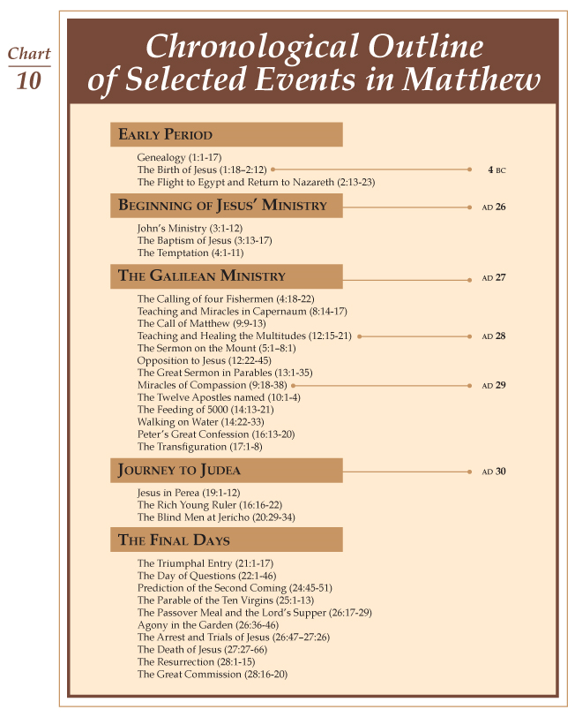

Slide 10
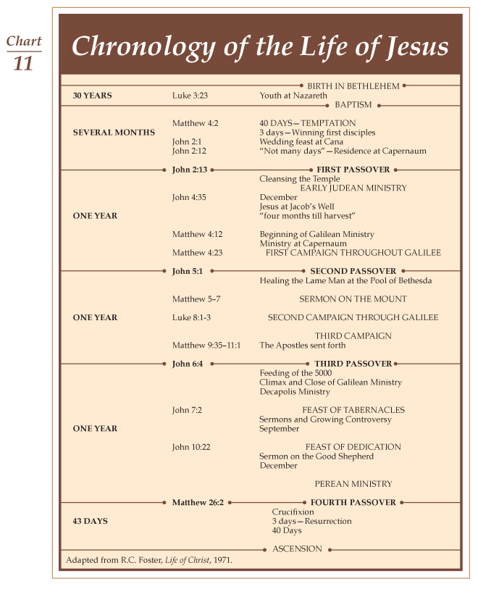

Slide 11
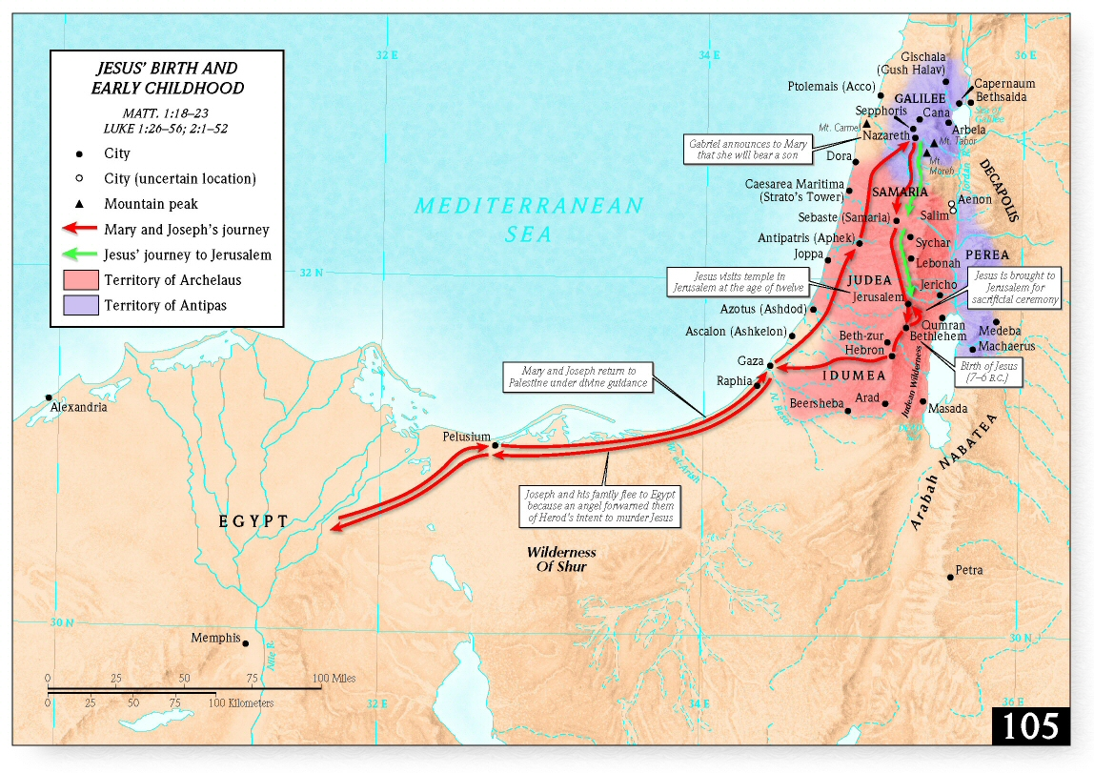

Slide 12
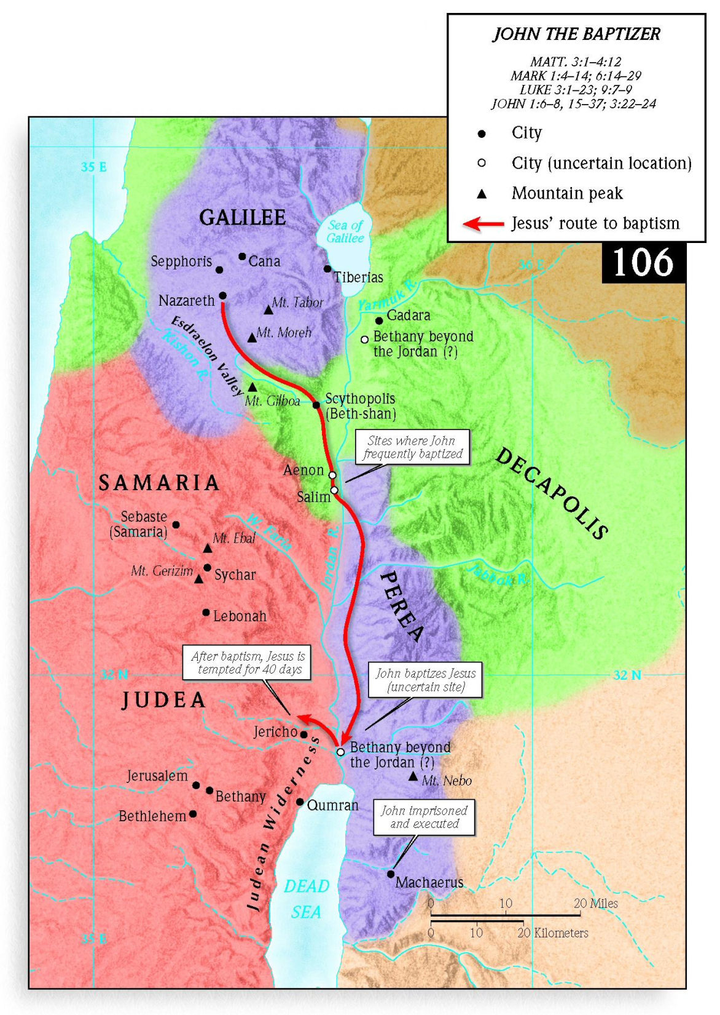

Slide 13
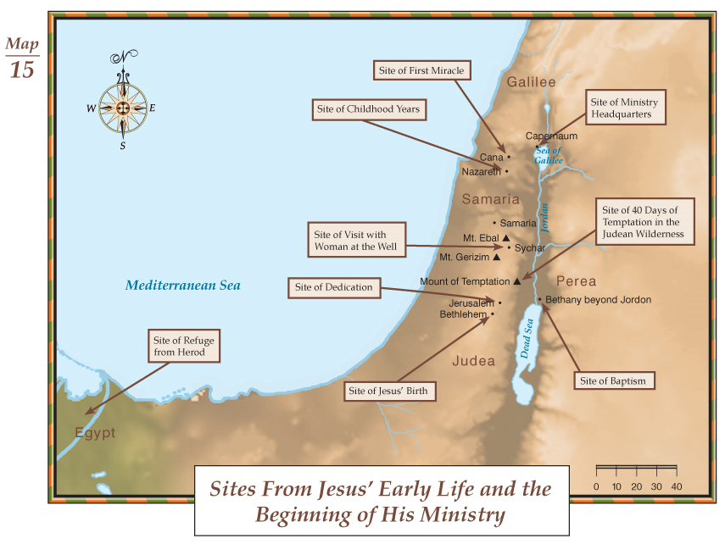

Slide 14
Judean Wilderness – Ascent of Adummim

Slide 16
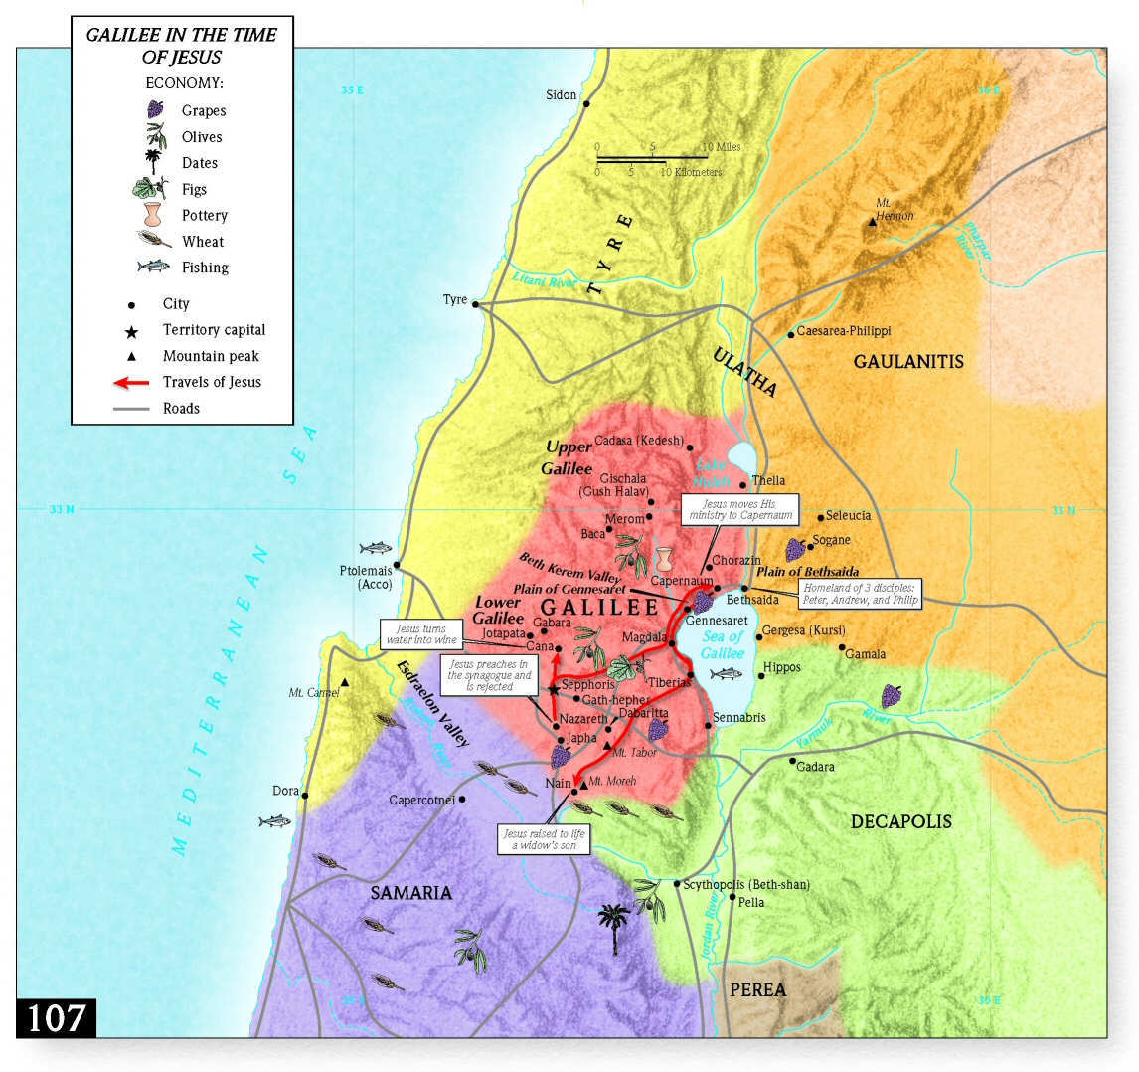

Slide 17
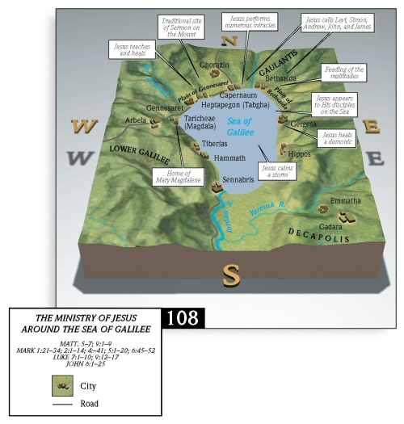

Slide 18
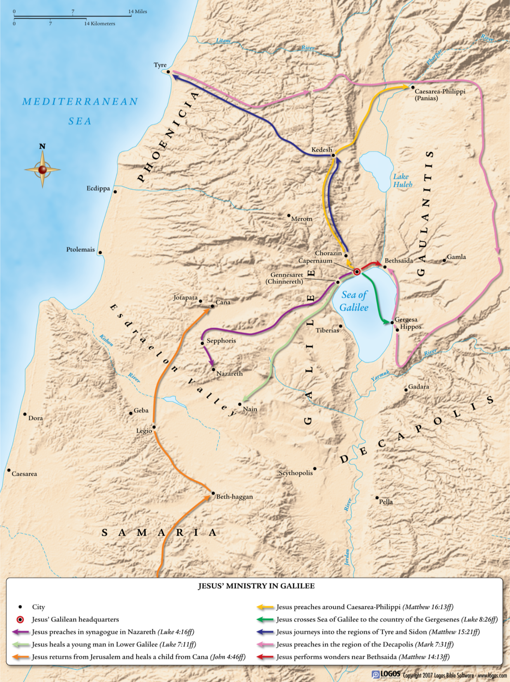

Slide 19
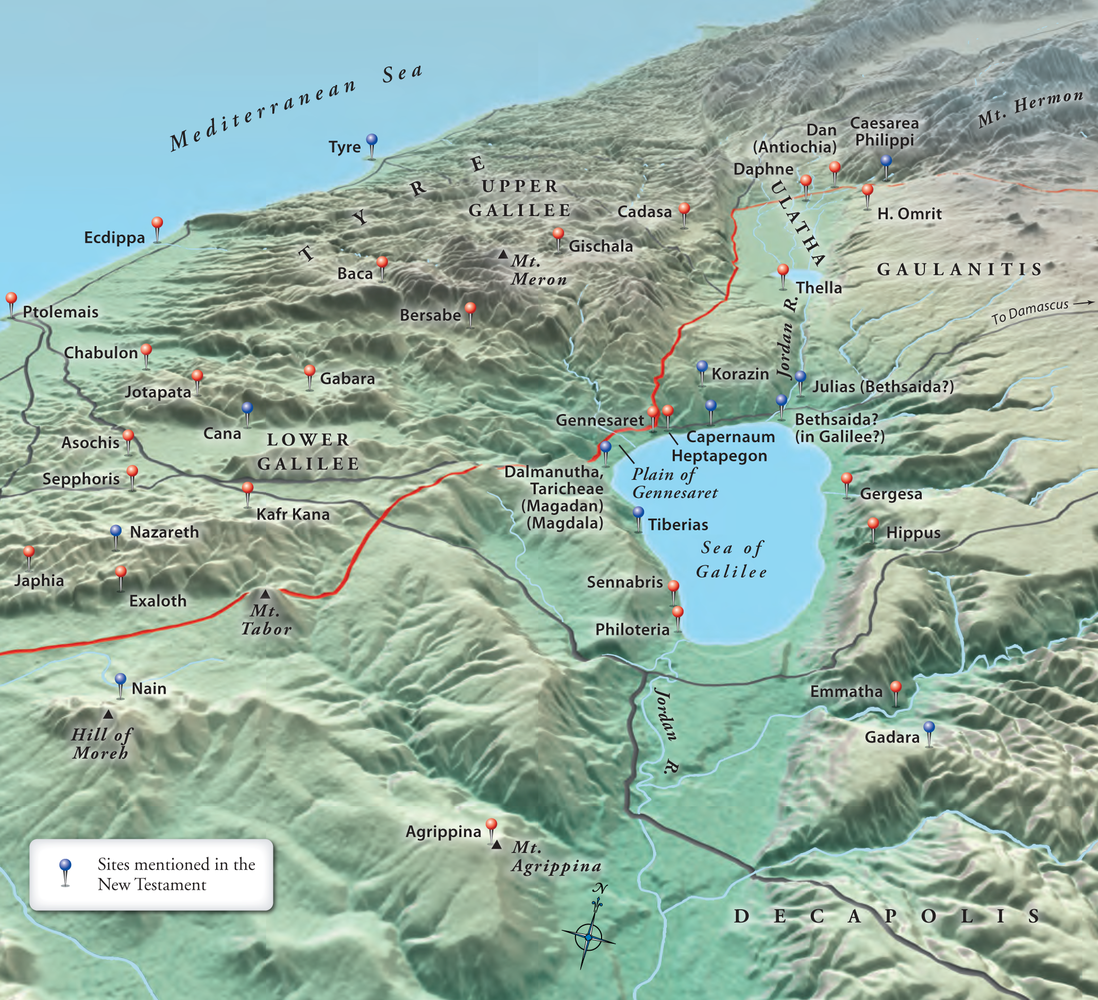

Slide 20
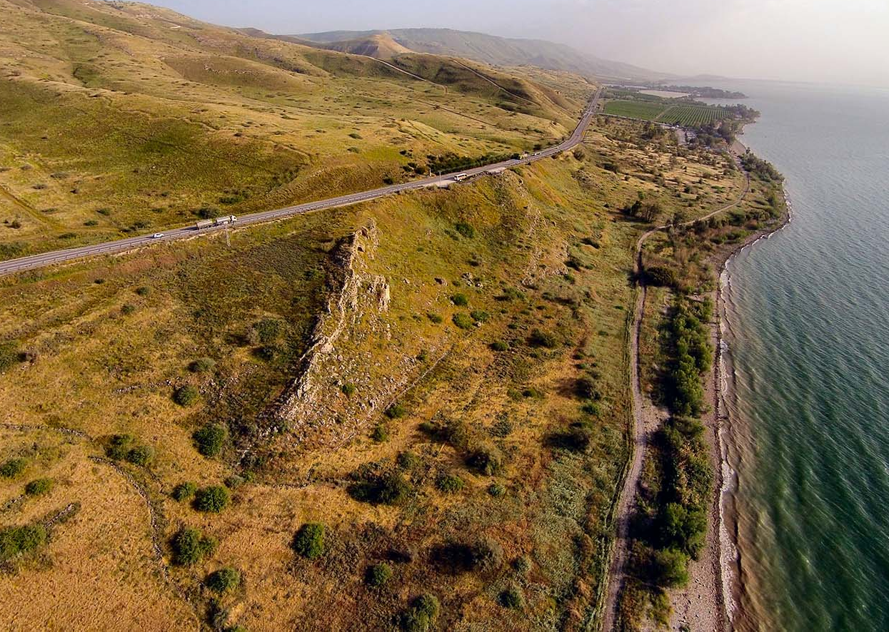
Gersa
Kursi cliff
Steep hill at Gadera

Slide 21
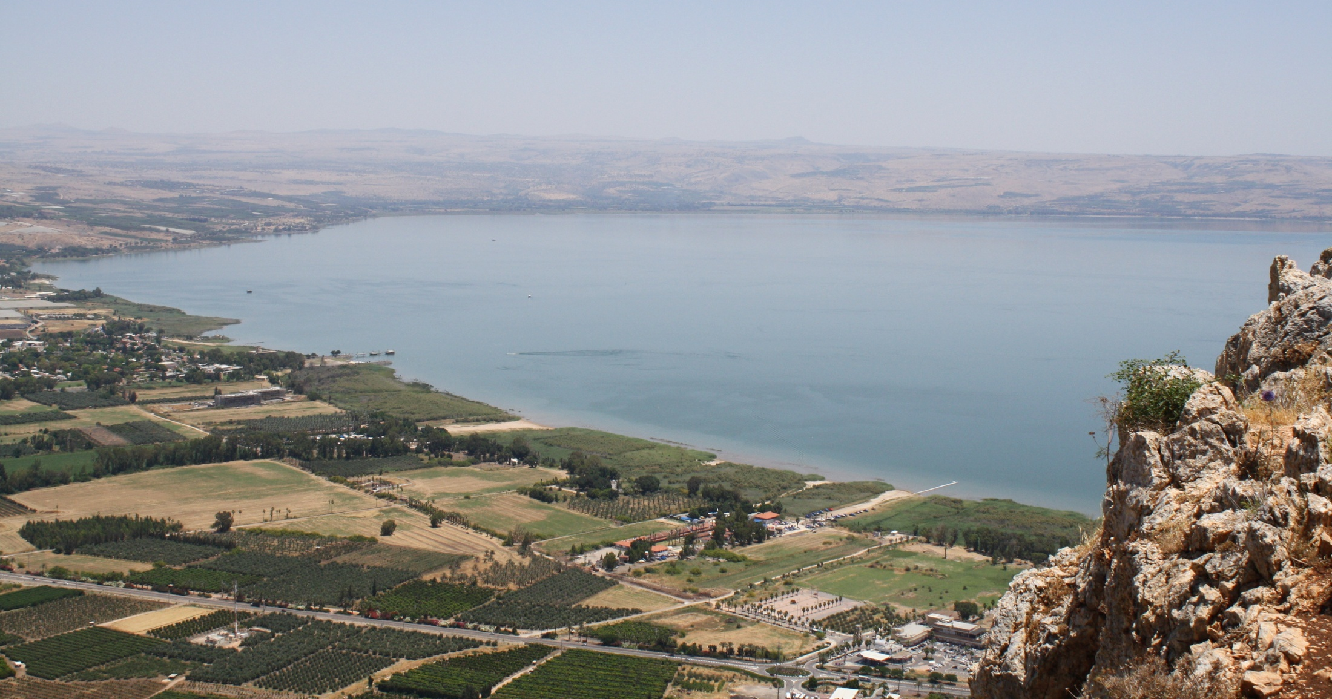
North End – Sea of Galilee
Chorazin
Gersa
Bethsaida
Capernaum
Plain of Gennesaret

Slide 23
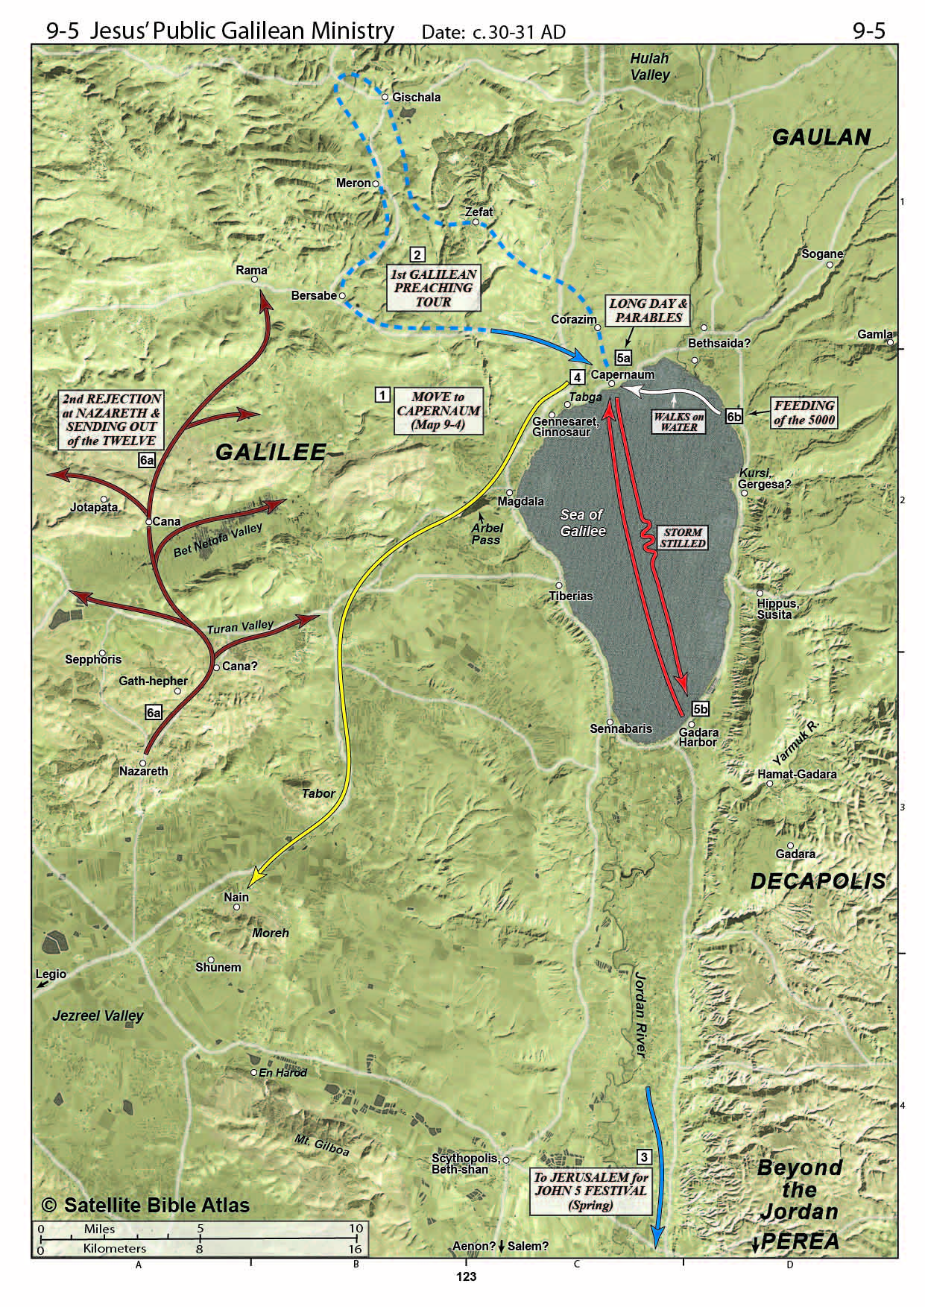

Slide 24
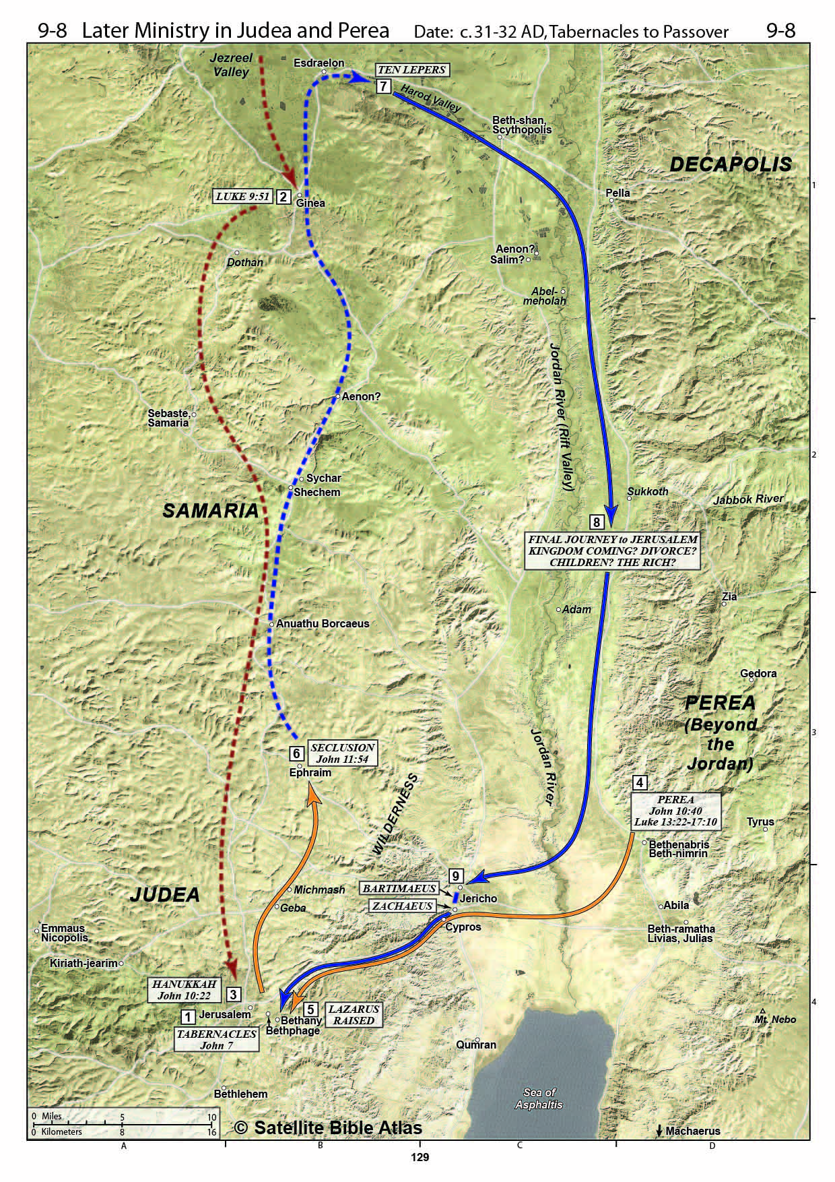

Slide 25
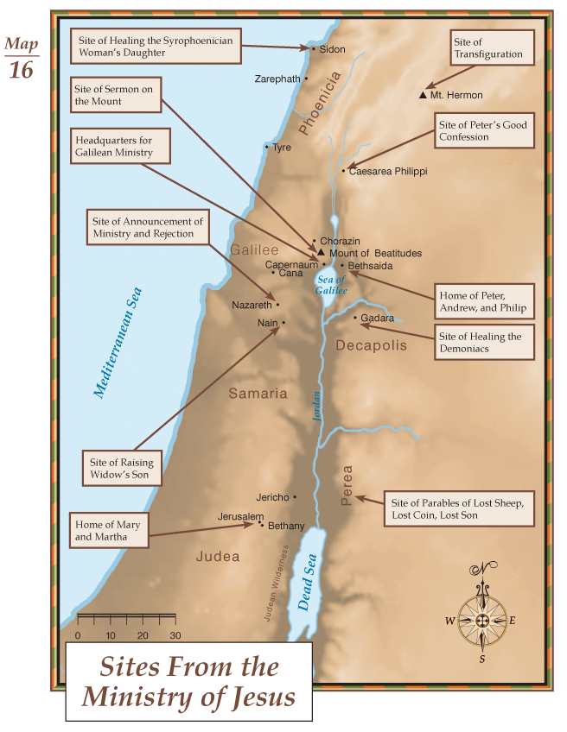

Slide 26
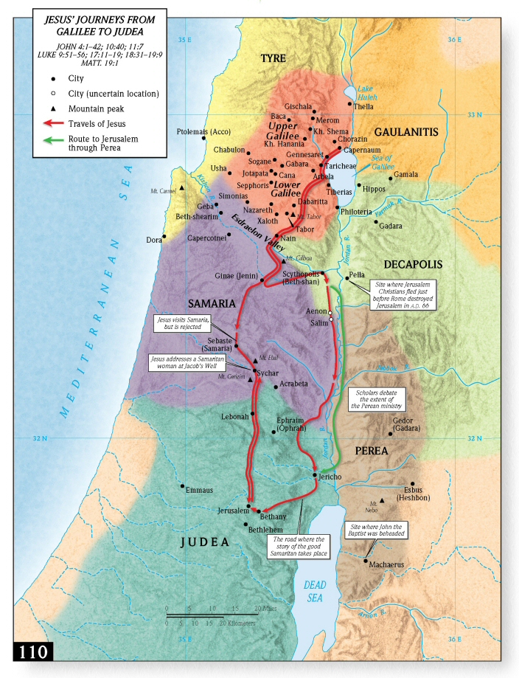

Slide 27
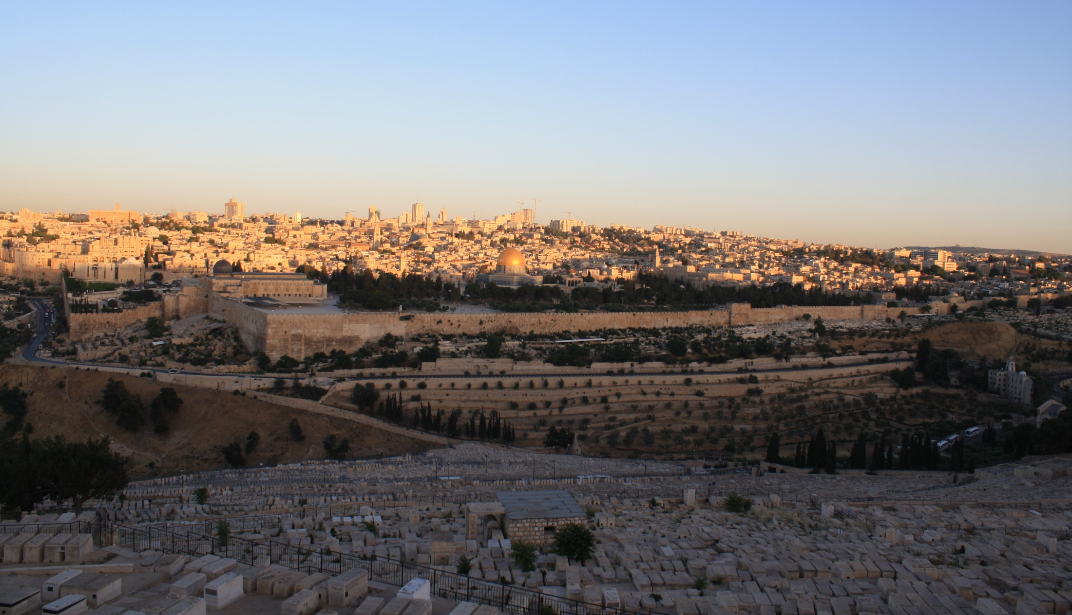
Jerusalem from Mt. of Olives

Slide 28
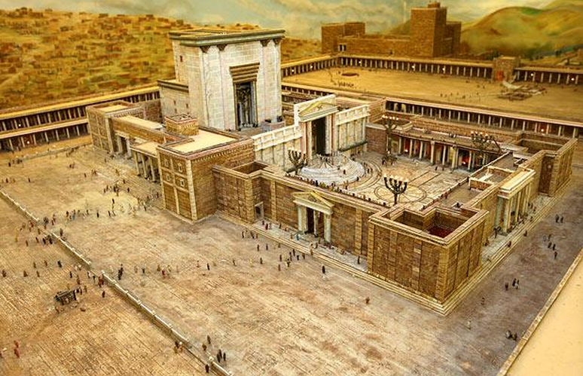
Second Temple – Herod’s Improvements

Slide 29
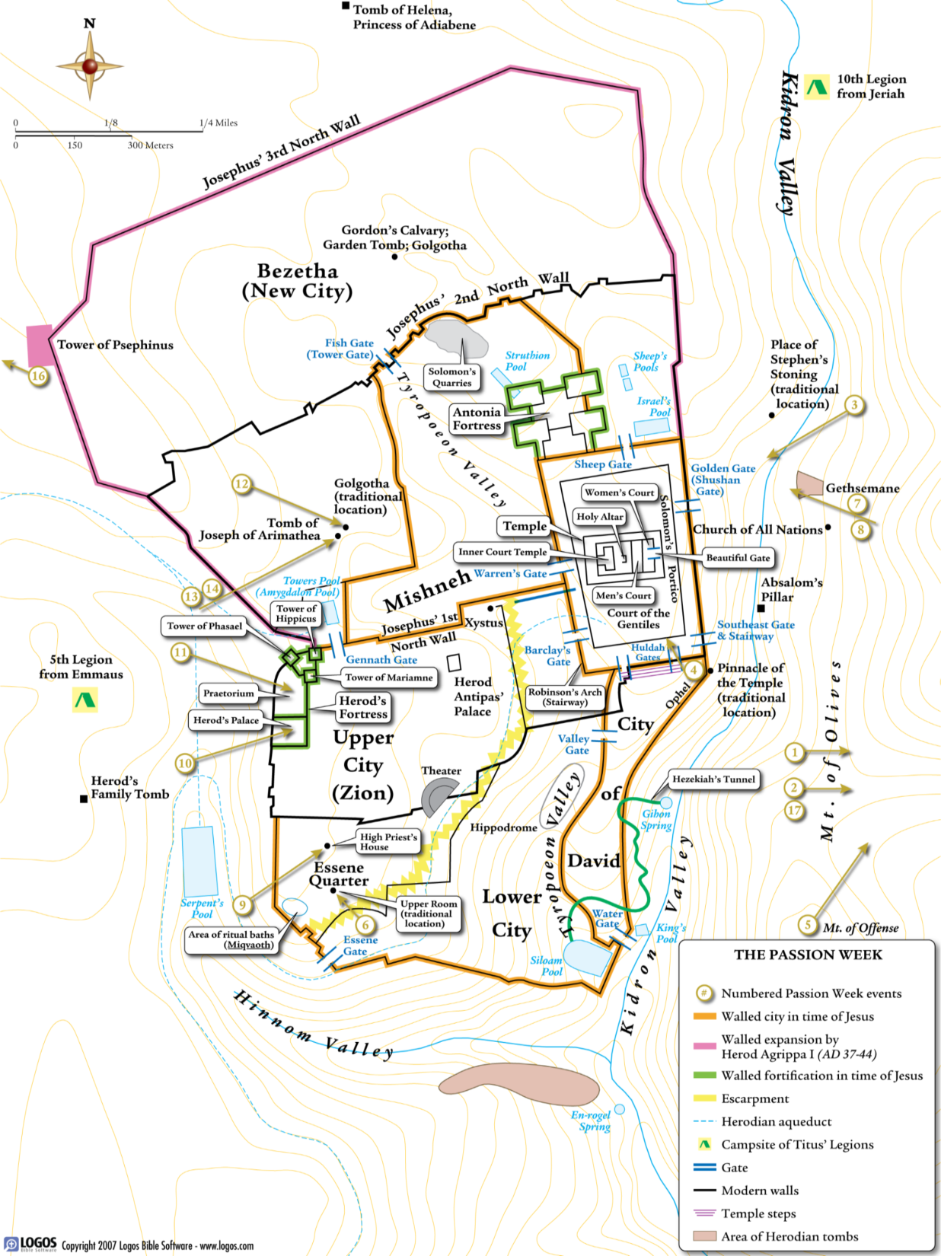

Slide 30
