Slide 1
Grace Bible Church Glorifying God by Making Disciples of Jesus Christ
For PDF class notes, go to
https://gracebibleny.org/old-testament-survey

Slide 2
2 Kings 13-15
Jeroboam II (Israel) Hosea
793-753 (41 yr)
Evil – restores border of Israel & extends NW
Uzziah (Judah)
790-740 (52 yrs),
Good, then proud, then humbled. Extended Judah West & South
Notes:
V. Azariah’s (Uzziah) Reign in Judah (15:1-7) (Uzziah - 52 years. Mother: Jecoliah of Jerusalem. Good as his father, Amaziah. High places remained. Struck with leprosy when proud. Jotham his son co-reigned

Slide 3
Kings of Israel Prophet
Zechariah 783-752 (6 mo) Hosea
Inherited, Evil like Jeroboam
Shallum 752 (1 month) Hosea
Usurper, Evil like Jeroboam
Menahem 752-742 (10 yrs) Hosea
Usurper, Evil like Jeroboam
Pekahiah 742-740 (2 yrs) Hosea
Inherited, Evil like Jeroboam
Notes:
W. Zechariah (15:8-12) evil like fathers. Murdered by Shallum - fulfilling prophecy against Jehu - sons to 4th generation on throne
X. Shallum’(15:13-16) 1 month. Evil. Murdered by Menahem
Y. Menahem (15:16-22) 10 years. Evil. Murdered Shallum, struck Tiphash and “ripped up” the pregnant women. Paid off Pul, king of Assyria, with 1,000 talents of silver to go away
Z. Pekahiah (15:23-26) 2 years. Inherited kingdom. Evil. Murdered by Pekah

Slide 4
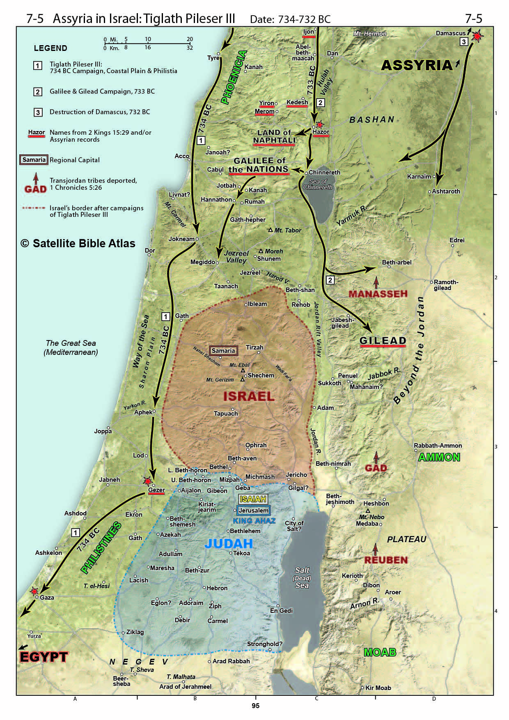
Pekah (Israel) Hosea
752-732 (20 yrs)
Usurper, Evil like Jeroboam
Jotham (Judah) Isaiah & Micah
750-731 (16 yrs)
Good, like Uzziah, but high places remained
Territory lost to Tiglath-Pilesar
Notes:
AA. Pekah (15:27-31) 20 years. Evil. Tiglath-pileser (Assyria) conquered northern areas of Israel and deported the inhabitants. Murdered by Hoshea
BB. Jotham (15:32-38) 16 years. Mother - Jerusha, daughter of Zadok. Good like father, Uzziah - but high places remained. Built upper gate of the House of the Lord
Toward end of their reigns, Assyria conquered Levant, coastlands and Israel – Pekah became a vassal of Assyria

Slide 5
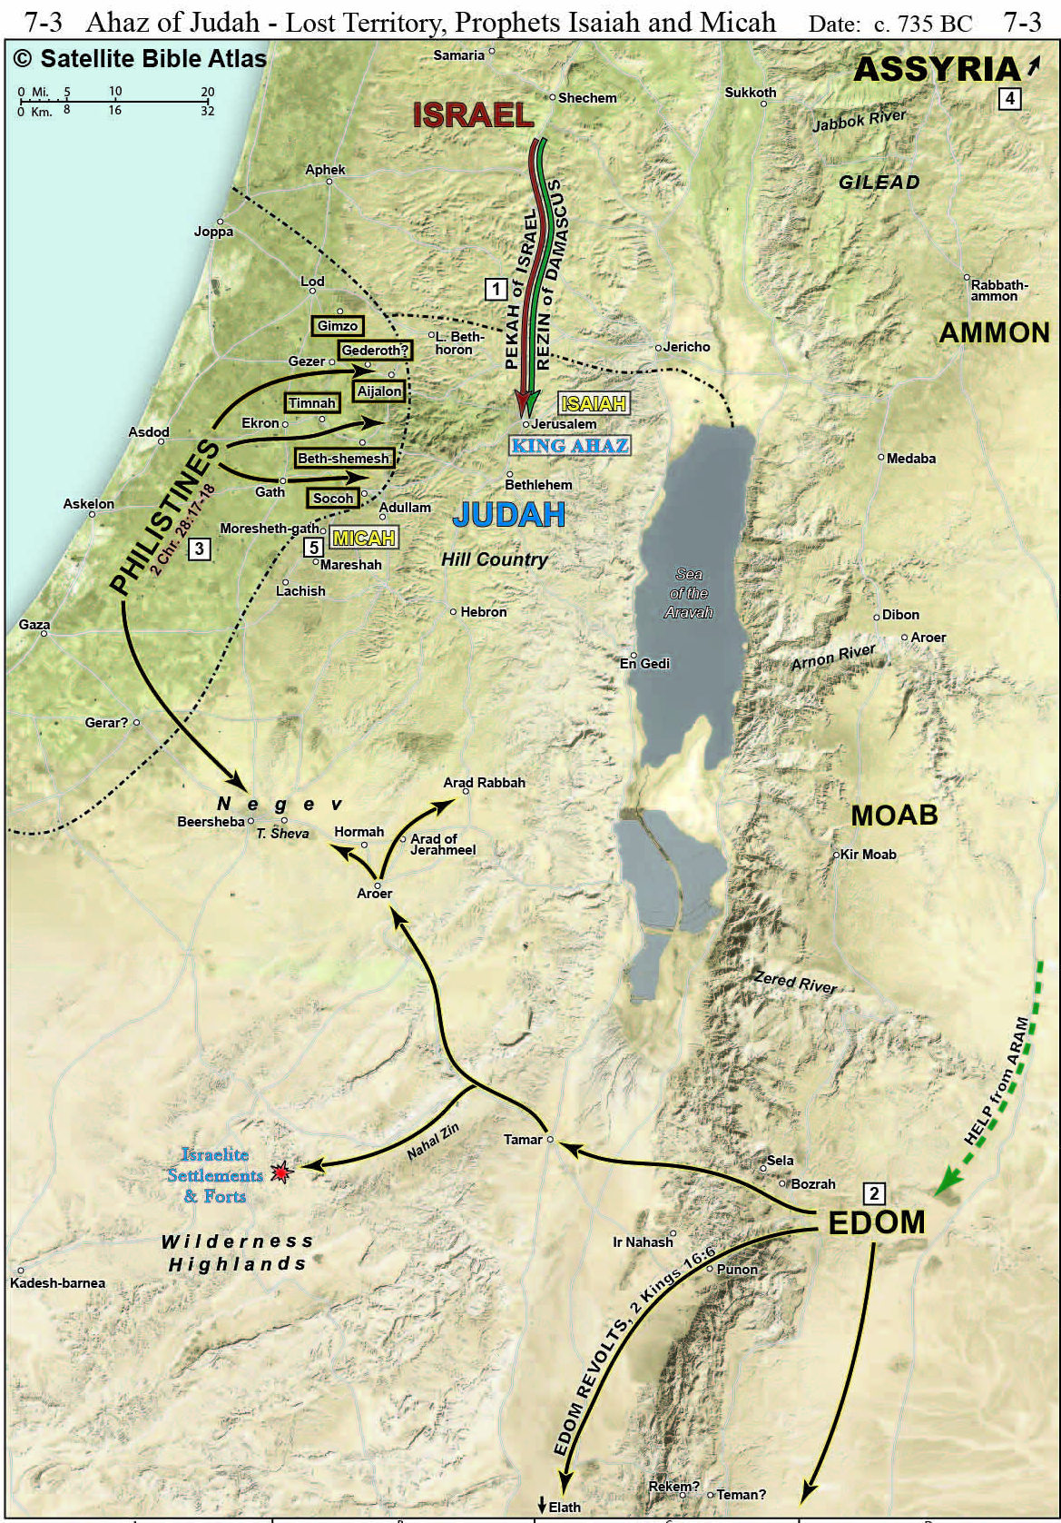
Ahaz (Judah)
735-715 (16 yrs) Isaiah & Micah
Evil like kings of Israel
Lost territory on all sides.
Made alliance with Assyria – copied their idolatry
Notes:
CC. Ahaz’s Reign in Judah (16) 16 years. Evil. Walked in ways of the kings of Israel - including having sons pass through the fire (Molech worship?). Besieged by Pekah and Rezin (Aram), he made himself a vassal of Tiglath-pileser who then captured Damascus, killed Rezin and deported the people. Ahaz visited Tiglath-pileser and make a copy of the atar at Damascus and installed it in Jerusalem, moving the brazen alter to the Lord to the side, removed the sides of the laver, and removed the oxen base of the bronze and set it on the paving. He also removed the covered way and outer entry in the house of the Lord “because of the king of Assyria.” He was trying to both emulate and please the Assyrians.

Slide 6
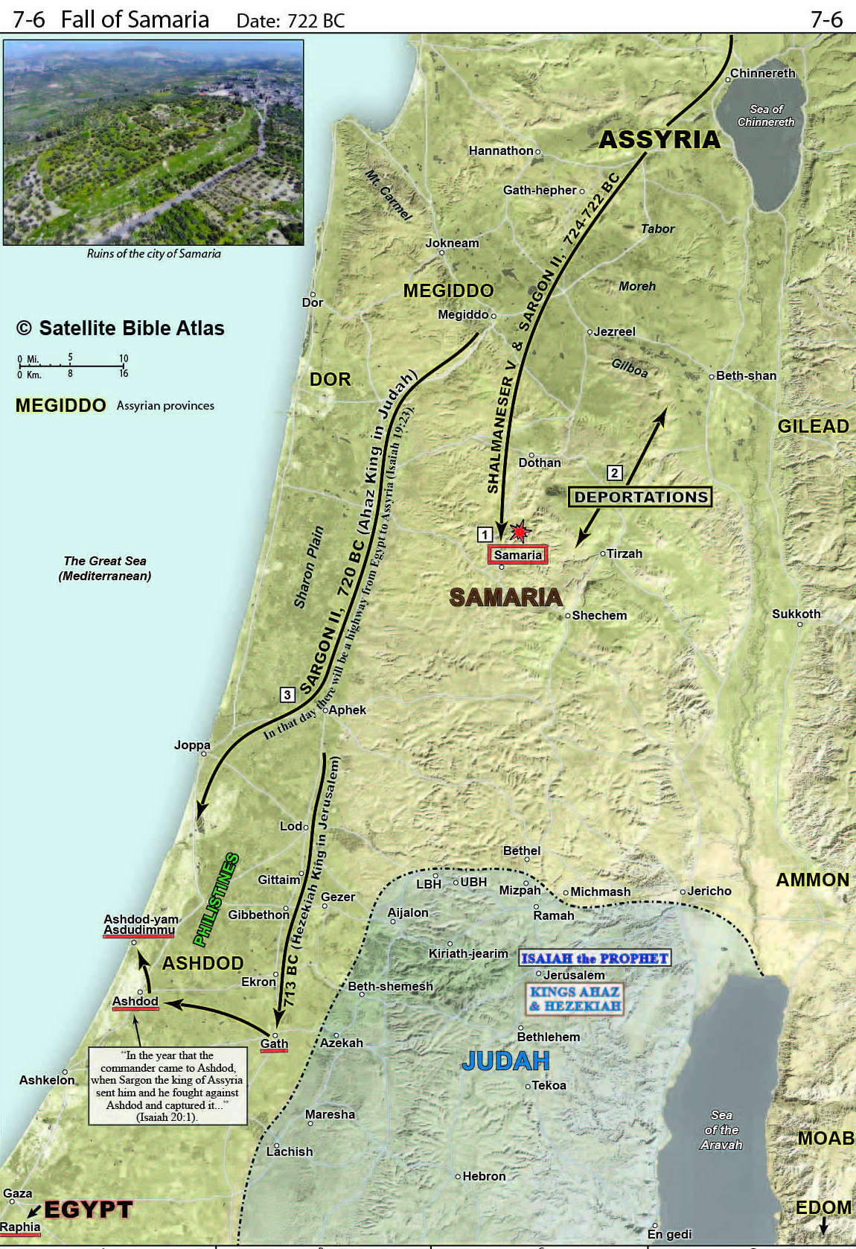
Hoshea (Israel)
732-722 (9 yrs) Hosea
Usurper, Evil like Jeroboam
Began as vassal of Assyria – rebelled and was destroyed after 3 year siege – last of Israel deported
Notes:
DD. Hoshea’s Reign in Israel (17)
1. Hoshea’s Reign (17:1-5) 9 years. Evil - “but not as the kings of Israel who were before him.” Became a vassal to Shalmaneser (Assyria), but then rebelled aligning himself with Egypt. Assyria invaded and besieged Samaria for 3 years.

Slide 7
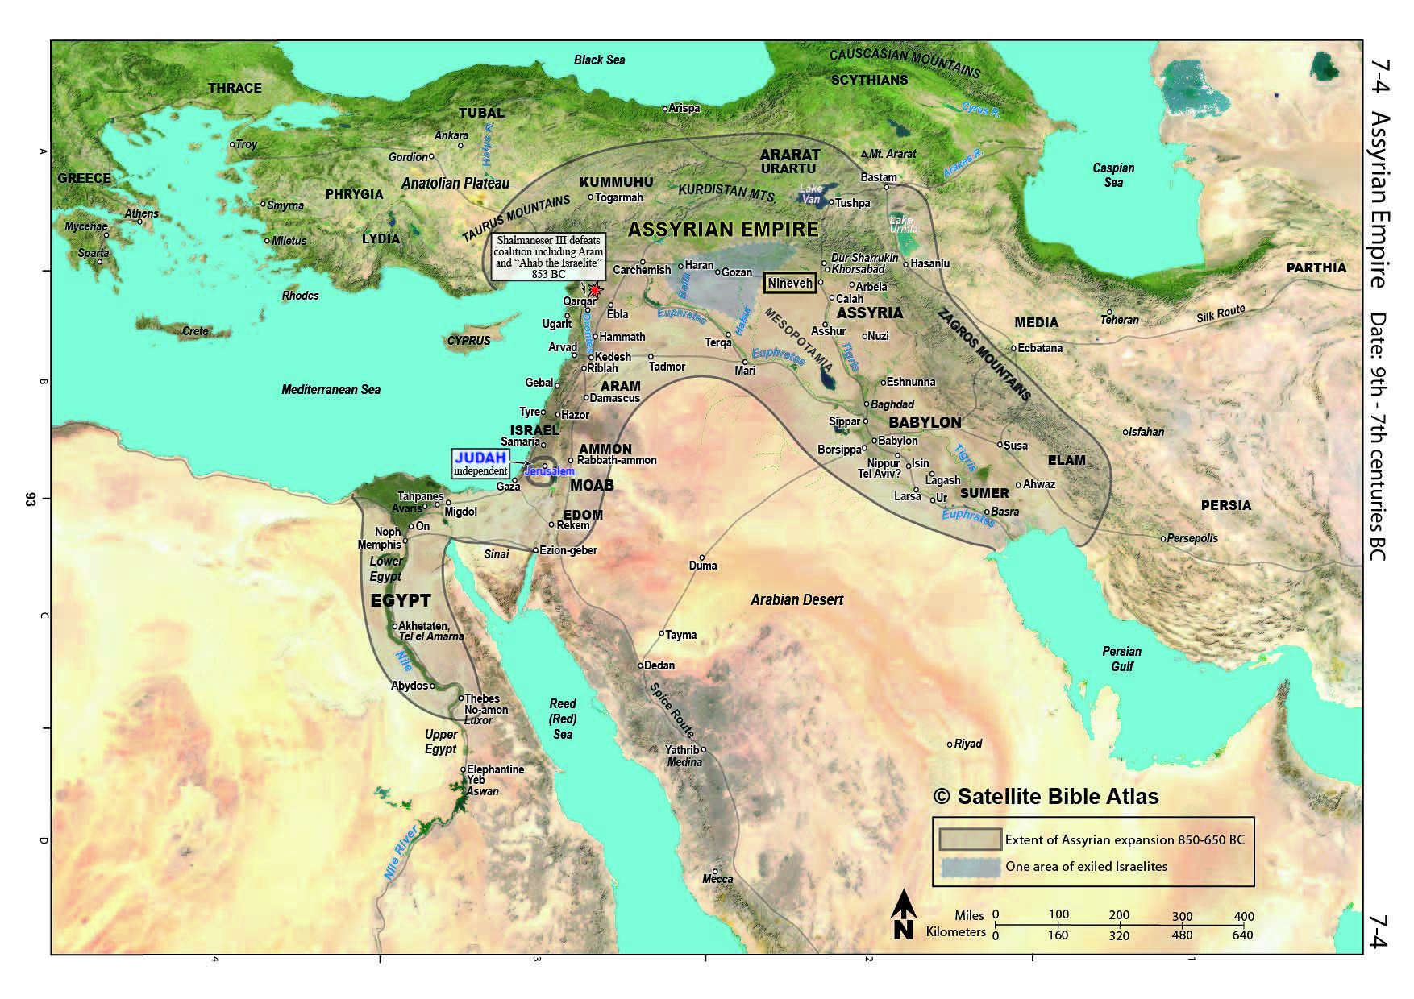
Notes:
Peak of Assyrian Empire – would expand and contract – peak under Asherbenapal

Slide 8
Fall of Israel 2 Kings 17:6-41
Israel Captured by Assyria – 722 BC (6)
Why Israel Fell (7-23)
Idolatry
Forsook the Lord’s Commands
Importation of Foreigners to Israel (24-41)
Assyria imports people from other lands
Lions killing them – priest of Israel sent to Bethel to teach them “the custom of the God of the land” – they continued to serve their gods
Notes:
3. Why Israel Fell (17:7-23) IDOLATRY * They feared and walked in the customs of the nations whom the Lord had driven out before the sons of Israel (7-8). *They built high places and sacred pillars and Asherim. (9-11) * They served idols (12). *they would not listen to the prophets the Lord sent (12-14). *They forsook the Lord’s commands (15-16). *The made their children pass through the fire, practicing divination (17). *They introduced their evil to Judah (19-20). *They walked in the ways of Jeroboam.

Slide 9
The Book of Hosea
Author: Hosea Date: 760-715 BC
Theme: “Loyal Love: God’s loyal love toward an unfaithful people ”
Biblical Context: 2 Kings 14:23-18:12
Contemporaries: Kings Uzziah, Jotham, Ahaz, & Hezikiah in Judah, and Jeroboam II in Israel. Prophets: Amos, Jonah, Micah, Isaiah
Notes:
“Hosea” means “salvation” it is similar to Joshua. He was probably from the North in the area around Samaria. He speaks as a native of the land. He notes some of the smaller incidents in that land. In 7:5 he notes the King of Israel as “our King.”
Politically, the final demise of Israel in imminent (though Israel was currently in a resurgence of power under Jeroboam II).
Spiritually, idolatry was rampant throughout the land.

Slide 10
The Book of Hosea
Outline:
I. Adulterous wife (Gomer) & faithful husband (Hosea) 1-3
II. Adulterous Israel & faithful LORD. 4-14
Key Chapters & Verses
6:6 Loyalty vs. sacrifice
11-14 Restoration of Israel to God
11:1 Out of Egypt God called His Son whom He loved. (cf. Matt. 2:15)
4:6 Israel rejected as a priest; they forgot the law
Notes:
Some take it as allegorical, but Literal view is stronger being written in a narrative style. – see notes
Hosea does not mention Fall of Samaria – not important to the book.

Slide 11
THE BOOK OF HOSEA
I. The Adulterous Wife & Faithful Husband 1-3
A. Introduction 1:1
B. Prophetic Marriage of Hosea to Gomer 1:2-2:1
Hosea’s Marriage to Gomer 1:2
The Children of Hosea & Gomer 1:3-9
The Application of Future Restoration 1:10-2:1
Notes:
Was Gomer a harlot before marriage? - It would appear to be so - See notes
Children – appear to be Hosea’s – each named with prophetic meaning
National restoration: there would be National increase, conversion, reunion, leadership and restoration
vs. 2 “Contend with your mother.” A courtroom picture. The physical adultery of Gomer pictures the spiritual adultery of Israel
vs. 5 “I will go after my lovers” cohorative - emphatic I will go

Slide 12
The Book of Hosea
C. The Application of the Adultery of Gomer 2:2-23
Israel’s Sin of Spiritual Adultery 2:2-5
Judgment of God 2:6-13
Restoration of Israel 2:14-23
D. The Restoration of Gomer to Hosea 3:1-5
Notes:
(God’s retribution against Israel for her harlotries - Idolotry. Israel was prosperous at the time and attributed that prosperity to the pagan gods, not the Lord God (see also Jeremiah. 44:15-23). Rain & productivity withheld to show that Baal - the pagan deity of rain and fertility was not a god. It is designed to turn Israel back to the true God. The extent of the retribution is seen in the description of her being naked, desolate, a waste and death by thirst ).
Achor was the place that Achan & his family was stoned to death after he had stolen
booty from Ai and caused the troubling of Israel. Achor means “trouble.” - Joshua 7
v.16 close relationship to God (“Ishi” = “My husband”. Not Baali= “My master.”
v.17 Removal of idolatry
v.18 unity of nature (ref. to Isa. 11?), Safety in the land.
(This is a millennial scene. Unity of nature, safety in the land, national conversion)
v.19-20 National Conversion – a wedding scene, but Israel brings nothing to the marriage
Purchase of Gomer – see notes

Slide 13
II. The Adulterous Israel and the Faithful Lord Hosea 4-14
A. The Spiritual Adultery of Israel 4:1-6:3
The Sins of Israel 4:1-19
Rejection of the knowledge of God 4:1-11
Idolatry of Israel 4:12-19
Judgment on Israel 5:1-14
Eventual Restoration of Israel 5:15-6:3
Notes:
God’s charge against Israel - they have broken every aspect of the decalogue, cf Ex. 20
The results of their harlotry with idols - polluted lives
They turned to the same abominations & practices that caused God to destroy the Cannanites
The heaviest punishment will be on the men who create prostitution by their idolatry
4:17 - The greatest tragedy is for God to withdraw – see Romans 1:18f
Israel’s cup of iniquity is full. 5:1-14
They sought help from men instead of God

Slide 14
II. The Adulterous Israel and the Faithful Lord Hosea 4-14
B. The Refusal of Israel to Repent of her Adultery 6:4-8:14
Willful Transgression of the Covenant 6:4-11
Willful Refusal to Return to the Lord 7:1-16
Willful Idolatry 8:1-14
Notes:
7:1-4 The fire is so hot it no longer needs to be stirred. No one has to entice them.
They keep their immorality down until the opportune time for it to be express it fully
The last 6 kings of Israel were murdered.
Cake not turned - Looks good on the outside, but raw on the inside. Outward facade, but no inward reality
Israel had 9 bloody coups from its breaking away from Rehoboam to the Assyrian Captivity.
They could never be trusted to do right now matter how carefully aimed - “deceitful bow.”
They would not return to God
The charges are as follows; 1) broken God’s covenant & rebelled (vs.1),
2)set up kings apart from God’s direction (vs. 4), 3) They have made idols to worship (vs. 4-6),
4) They sought help from Assyria and not the Lord (vs 9), 5) Sinful altars, (vs 11)

Slide 15
II. The Adulterous Israel and the Faithful Lord Hosea 4-14
C. The Judgment of Israel by God 9:1-10:15
Judgment of Dispersion 9:1-9
Judgment of Bareness 9:10-17
Judgment of Destruction 10:1-15
Notes:
They had forgotten God and so were reaping the consequences
The elements of divine Judgment: 1) departure of joy (1,2); 2) exile from the land (3-6);
3) loss of spiritual discernment (7-9); 4) declining birth rate (10-16); 5) casting out (17)
Israel was very prosperous under Jehoash & Jeroboam II, but their prosperity only led them farther away from the Lord
Shalman is Assyrian Shalmanezer. This barbaric practice was widespread and practiced by the Syrians (2 Ki 8:12; Medes (Isa 13:16) & Babylonians (Ps. 137:8-9)

Slide 16
II. The Adulterous Israel and the Faithful Lord Hosea 4-14
D. The Restoration of Israel to the Lord 11:1-14:9
God’s Love for Israel 11:1-2
Israel’s Continuing Sin 12:1-13:16
God’s Promise to Restore Israel 14:1-9
Notes:
Their rejection of God would result in Assyria conquering them - & Egypt would not be able to help
They tried to play Assyria & Egypt against each other for their own gain - it did not work
Hosea will use Jacob as a figure for Judah/Israel and demonstrate the difference between that founding father of the nation and his descendents
Merchant = lit. a “canaanite” They thought God
was pleased with them because they were prosperous - prosperity gained through wickedness. Such was not true
The contrast again: Jacob came closer to the Lord through his trials, but Israel, brought out from Egypt by many miracles actually turned away from the Lord

Slide 17
The Book of Micah
Author: Micah Date: 739-686 BC
Theme: “Judgment on Samaria & Judah”
Biblical Context: 2 Kings 15:32-19:37, 2 Chronicles 27:1-32:23, Jeremiah 8
Contemporaries: Kings Jotham, Ahaz, & Hezikiah in Judah, and Jeroboam II in Israel. Prophets: Hosea, Isaiah
Notes:
Micah - His name means “Who is like Yaweh
Moresheth-Gath (1:14) was about 20 miles southwest of Jerusalem on the coastal plains near Gath. His family and occupation are unknown. Moresheth was an agricultural area
About 1/3 of the book indicts Israel and Judah for specific sins
Another 1/3 predicts the judgment that will come as a result of those sins
1/3 is a message of hope and consolation that God’s justice will triumph and the divine Deliverer will come

Slide 18
Micah - Outline
I. Prediction of Judgment (1-3)
A. Judgment on People 1:2 - 2:13
1. Judgment on Samaria 1:2-8
2. Judgment on Judah 1:9-16
3. Cause of Judgment 2:1-11
4. Promise of Future Restoration 2:12-13
Notes:
Word plays on names – see Notes
2:1-5 covetous and oppressive rulers. They coveted fields and houses and steal them and the inheritance. It would be taken away from them too (4).
2:6-11 - False prophets and rejection of true prophets.
6-9 - the claim against the false prophets
10,11 - Micah's response. They wanted their ears tickled (vs. 11)

Slide 19
Micah - Outline
B. Judgment on Leadership 3:1-12
1. Judgment on Princes 3:1-4
2. Judgment on Prophets 3:5-8
3. Promise of Future Judgment 3:9-12
Notes:
3:2-3 The rulers act like wild beasts "eat the flesh of my people" by unfair legal actions and bribery - vs. 11 & 7:3, theft (2:8), oppression (3:9), bloodshed (vs. 10; 7:2)
3:4 they would cry out themselves, but it would be too late
3:5 - they were supposed to be shepherds, but they acted as wolves
3:6-7 - night = doom. The "seers" would not be able to "see"
3:8 - Micah, a true prophet is contrasted with the false prophets.
3:9-11 Rulers judged for reward & bribe
3:11-12 Priests taught for hire, prophets divined for money. All deceived that the Lord would protect, but the Lord would punish.

Slide 20
Micah - Outline
II. Prediction of Restoration (4-5)
A. Promise of Coming Kingdom 4:1-8
B. Promise of Coming Captivities 4:9-5:1
C. Promise of Coming King 5:2-15
1. Birth of the Messiah 5:2
2. Rejection of the Messiah 5:3
3. Work of the Messiah 5:4-15
Notes:
See Notes
4:1 Time: in last days. A reversal of 3:12. The millennial kingdom
4:2 Nations would come to learn and follow God
4:3-4 God will judge and nations will be at peace. No threat of war "sitting under fig tree, etc. used in 1 King. 4:25; Zech. 3:10 to describe peace)
4:5 Israel will no longer pursue false gods, but only the LORD. (Not all nations will follow God - note vs. 2 "many nations").
4:6-8 God treats Israel as His flock and restores them. Note it is God that states "I will assemble... I will make the lame...
4:7 "for now and forever" word "forever ' does not mean a time without end, but a long period of time which is determined by context - cf Jer. 18:16. see Ebenezer Henderson - word study in minor prophets.

Slide 21
Micah - Outline
III. Plea for Repentance (6-7)
A. First Plea of God 6:1-9
B. Second Plea of God 6:9-7:6
C. Promise of Final Salvation 7:7-20
Notes:
See notes

Slide 22
Grace Bible Church Glorifying God by Making Disciples of Jesus Christ

