Slide 1
Grace Bible Church Glorifying God by Making Disciples of Jesus Christ
For PDF class notes, go to
https://gracebibleny.org/old-testament-survey

Slide 2
Jonah
Authors: Jonah (“Dove”) from Gath Hepher
Date: 780-753 B.C.
Time Period: Jeroboam II (2 Kings 14:25)\
Context: 2 Kings 13:10-25, 14:23.29. Contemporary with Amos & Hosea
Theme: God's fathomless mercy extends to all those who repent and turn

Slide 3
Jonah
Setting: Israel is prosperous under Jeroboam II with Assyria in mild decline after being dominate. Assyrian cruelty was already legendary.
Outline
I. God's Mercy upon Jonah. 1-2
A. Jonah and the Sea (1) (I won't go)
B. Jonah and the Fish (2) (I will go)
II. God's Mercy upon Nineveh. 3-4
A. Jonah in the City (3) (Here I am)
B. Jonah under the gourd (4) (I shouldn't have come)

Slide 4
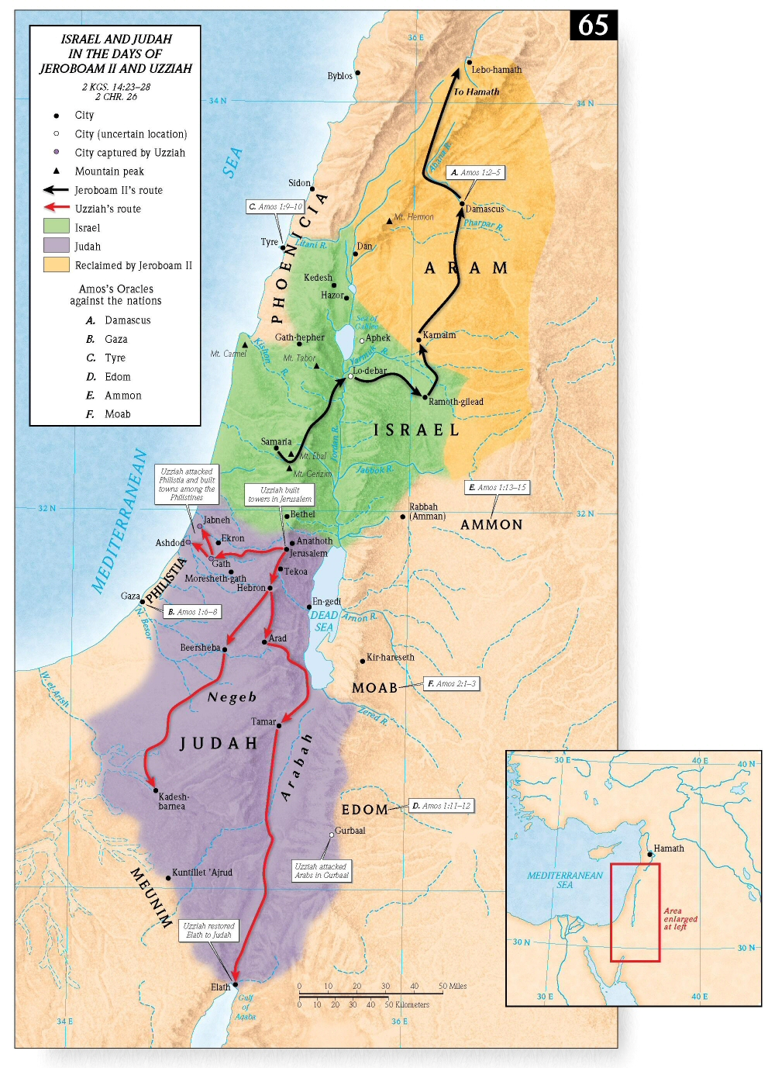

Slide 5
Jonah & the Sea (I Won’t Go) Jonah 1
Jonah is disobedient to first call (vs. 1-3)
2. Jonah is judged (vs. 4-17)
a. The Great Storm (vs. 4-16)
b. The Great Fish (vs. 17)

Slide 6
Jonah & the Fish (I Will Go) Jonah 2
1. Jonah’s prayer (vs. 1-9)
2. Jonah's Deliverance (vs. 10)

Slide 7
Jonah in the City (Here I Am) Jonah 3
1. Jonah is Obedient to Second Call (vs. 1-4)
2. Judgment of Ninevah Averted (vs. 5-10)
a. Their Repentance (vs. 5-9)
b. God’s Mercy (vs. 10)

Slide 8
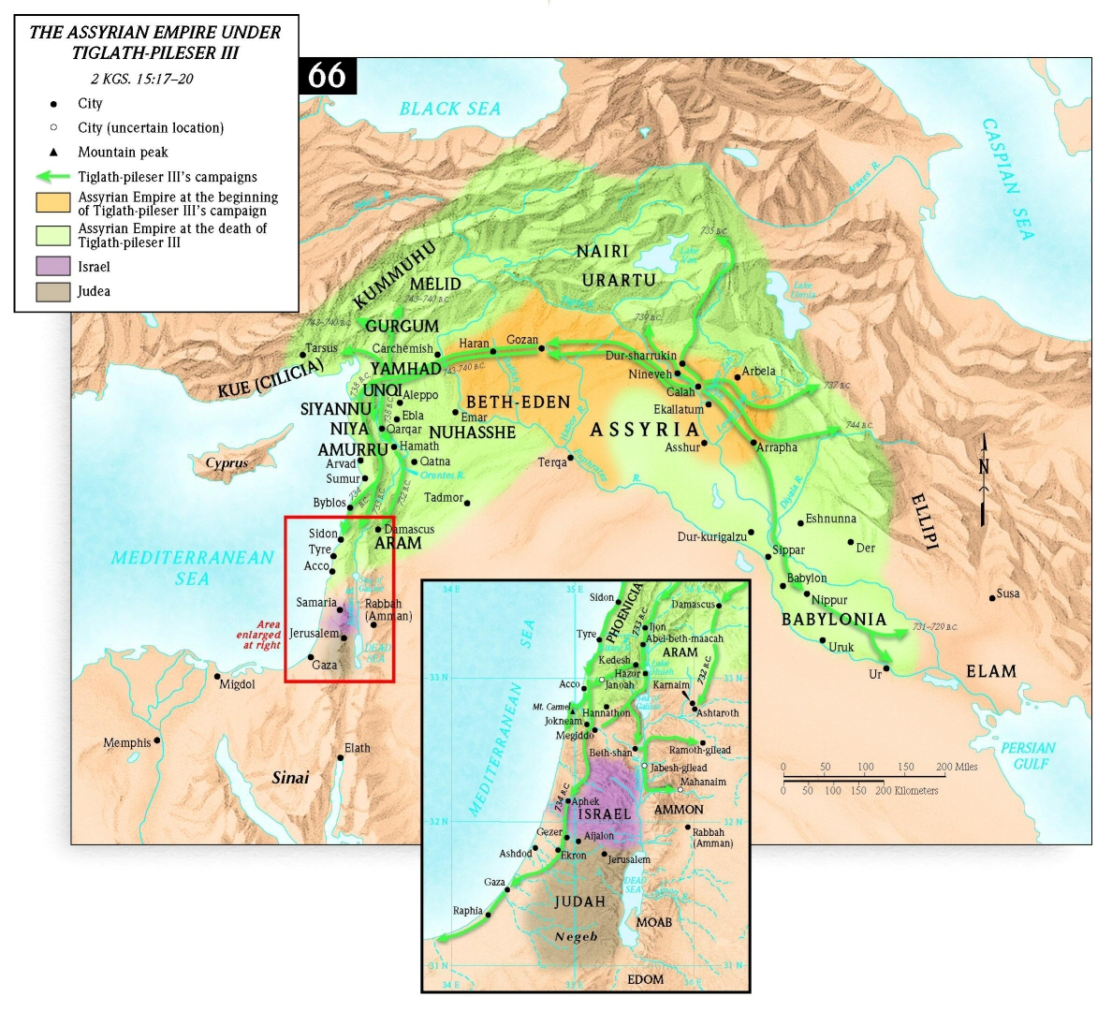

Slide 9
Jonah Under the Gourd (I Shouldn’t have Come) Jonah 4
1. Jonah’s Displeasure (vs. 1-3)
2. Jonah is Rebuked (vs. 4-11)

Slide 10
Grace Bible Church Glorifying God by Making Disciples of Jesus Christ
For PDF class notes, go to
https://gracebibleny.org/old-testament-survey

Slide 11
Amos
Authors: Amos (“Burden-bearer”) from Tekoa – a shepherd & fig grower by trade
Date: 764-753 B.C.
Time Period: Overlap of reigns of Uzziah & Jeroboam (1:1). Earthquake – 760 BC. Solar Eclipse June 15, 763 B.C.
Context: 2 Kings 14:23-15:7. Contemporary with Hosea

Slide 12
Amos
Theme: “Judgment of Israel” - Religion and everyday life are inseparable; God holds His people accountable to His law both in letter and in spirit.
Key Chapters & Verses:
7 Amos warns through visions: locusts, fire, plumbline.
9:8 Destroy sinful kingdom, but not totally
9:13-15 Future hope of restoration of Israel

Slide 13
Amos - Outline
Eight prophecies against nations. 1-2
Three Sermons on Israel's sin. 3-6
Five Visions of judgment. 7-9:10
Five promises of restoration of Israel. 9:11-15

Slide 14
I. Eight prophecies against nations Amos 1 & 2
Introduction (1:1-2)
Judgment Against Syria (1:3-5)
Judgment Against Philistia (1:6-8)
Judgment Against Phoenicia (1:9-10)
Judgment Against Edom (1:11,12)
Judgment Against Ammon (1:13-15)
Judgment Against Moab (2:1-3)
Judgment Against Judah (2:4-5)
Judgment Against Israel (2:6-16)

Slide 15
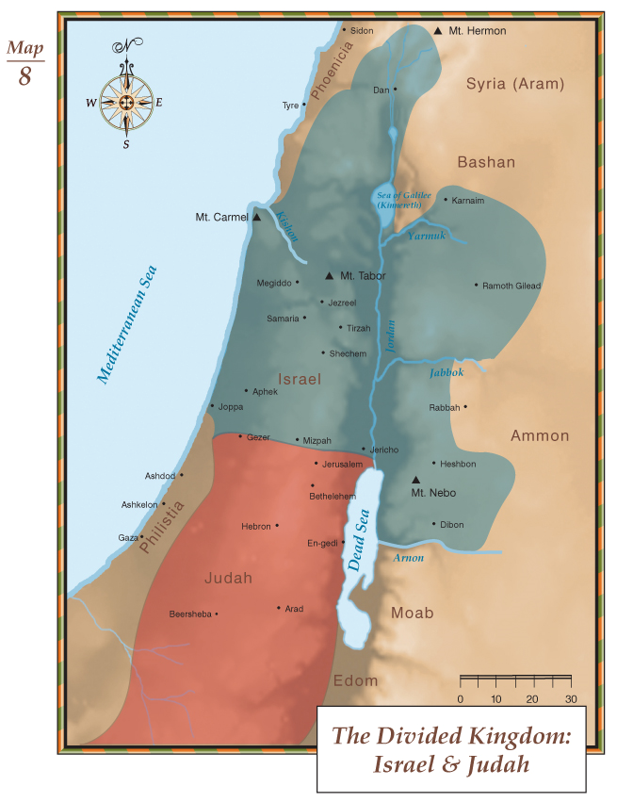
Phoenicia
Syria
Israel
Ammon
Philistia
Judah
Moab
Edom

Slide 16
II. Three Sermons on Israel's sin Amos 3-6
A. First Sermon: Israel’s Present (3)
1. Judgment is Deserved (3:1-10)
2. Judgment is Described (3:11-15)

Slide 17
II. Three Sermons on Israel's sin Amos 3-6
A. Second Sermon: Israel’s Past (4)
1. Judgment is Deserved (4:1-5)
2. Judgment is Demonstrated (4:6-11)
3. Judgment is Described (4:12-13)

Slide 18
II. Three Sermons on Israel's sin Amos 3-6
A. Third Sermon: Israel’s Future (5-6)
1. Judgment is Deserved (5:1-15)
2. Judgment is Described (5:16-6:14)
a. The First Woe of Judgment (5:16-27)
b. The Second Woe of Judgment (6)

Slide 19
IV. Five Visions of Judgment Amos 7:1-9:10
Vision of the Locusts (7:1-3)
Vision of the Fire (7:4-6)
Vision of the Plumb Line (7:7-9)
Historical Interlude - Opposition by Amaziah (7:10-17)
Vision of the Summer Fruit (8:1-14)
F. Vision of the Stricken Doorposts (9:1-10)

Slide 20
Five Promises of Restoration of Israel Amos 9:11-15
Restoration of the Land (11)
Restoration of the Borders (12)
Restoration of Abundant Prosperity (13)
Restoration of the Cities (14)
Restoration of Security (15)

Slide 21
Grace Bible Church Glorifying God by Making Disciples of Jesus Christ

