Slide 1
Grace Bible Church Glorifying God by Making Disciples of Jesus Christ
For PDF class notes, go to
https://gracebibleny.org/old-testament-survey

Slide 2
1 & 2 Kings
Authors: Jeremiah + (Talmud tradition) Written to those in exile.
Date: Written prior to 586 B.C.
Time Period: From David’s death to beginning of Ahaziah’s reign (971 - 851 B.C.)
Theme: “The historical development of the kingdom of God under the Davidic covenant - The welfare of the kingdom depends on covenant faithfulness of the king & the people.”

Slide 3
1 & 2 Kings - Outline
I The United Kingdom under Solomon
1 Kings 1-11
II The Divided kingdom
1 Kings 12 – 2 Kings 17
III The Kingdom of Judah, Hezekiah to its fall
2 Kings 18-25

Slide 4
Jehoshaphat 873-848 (25 yrs) Micaiah
Good, like Asa, Jehu, son of Hanani
but had son marry Jahaziel, son of Zechariah
Ahab’s daughter Eliezer, son of Dodavahu

Slide 5
Joel
Authors: Joel - His name means “Yahweh is God” From Puthuel (“open heartedness toward God”) Lived & prophesied in Jerusalem
Date: ~860-850 B.C. (uncertain)
Time Period: Invasion of Locusts
1 Kings 22:1-21, 2 Chron. 24:1-27. .
Theme: “The Day of the LORD; Historical & Eschatological” A call to repentance in light of the present locust plague & future judgment” ”
Notes:
The name occurs 19 times in the O.T. referring to 13 different people. This Obadiah may have been one of the officials sent out by Jehoshaphat to teach the law in the cities of Judah - 2 Chronicles 17:7
Early date is preferred: *No mention of the Chaldeans, the destruction of the city or temple, or the deportation of the all the people. *Those who are taken captive are taken to the Negev instead of east to Babylon (vs. 2). *Obadiah seems more parallel Amos, and Jeremiah quotes him in the same manner as he does Isaiah. *Finally, there are no Aramaic expressions

Slide 6
Obadiah - Joel
Historical Day of Yahweh (1) (Joel is speaking)
Impending Day of Yahweh (2:1-17) (Joel is speaking)
Eschatological Day of Yahweh (2:18-ch.3) (God is speaking)

Slide 7
I. Historical Day of Yahweh - Joel 1
Source of the Message (1:1)
Command to Contemplate the Devastation (1:2-4)
Completeness of the Devastation (1:5-12)
Call to Repent in Light of the Devastation (1:13-20)

Slide 8
II. Impending Day of Yahweh - Joel 2:1-17
Alarm Sounds (2:1)
Army Invades (2:2-11)
Admonition to Repent (2:12-17)

Slide 9
III. Eschatological Day of Yahweh - Joel 2:18 – 3:21
Introduction (2:19-20)
Material Restoration (2:21-27)
Spiritual Restoration (2:28-32)
National Restoration (3:1-21)

Slide 11
Ahaziah 853-852 (2 yrs), Elijah
Inherited, Evil like Ahab & Jeroboam
Jehoram 852-841(12 yr) Elijah
Inherited (brother?) Elisha
Evil like Jeroboam

Slide 12
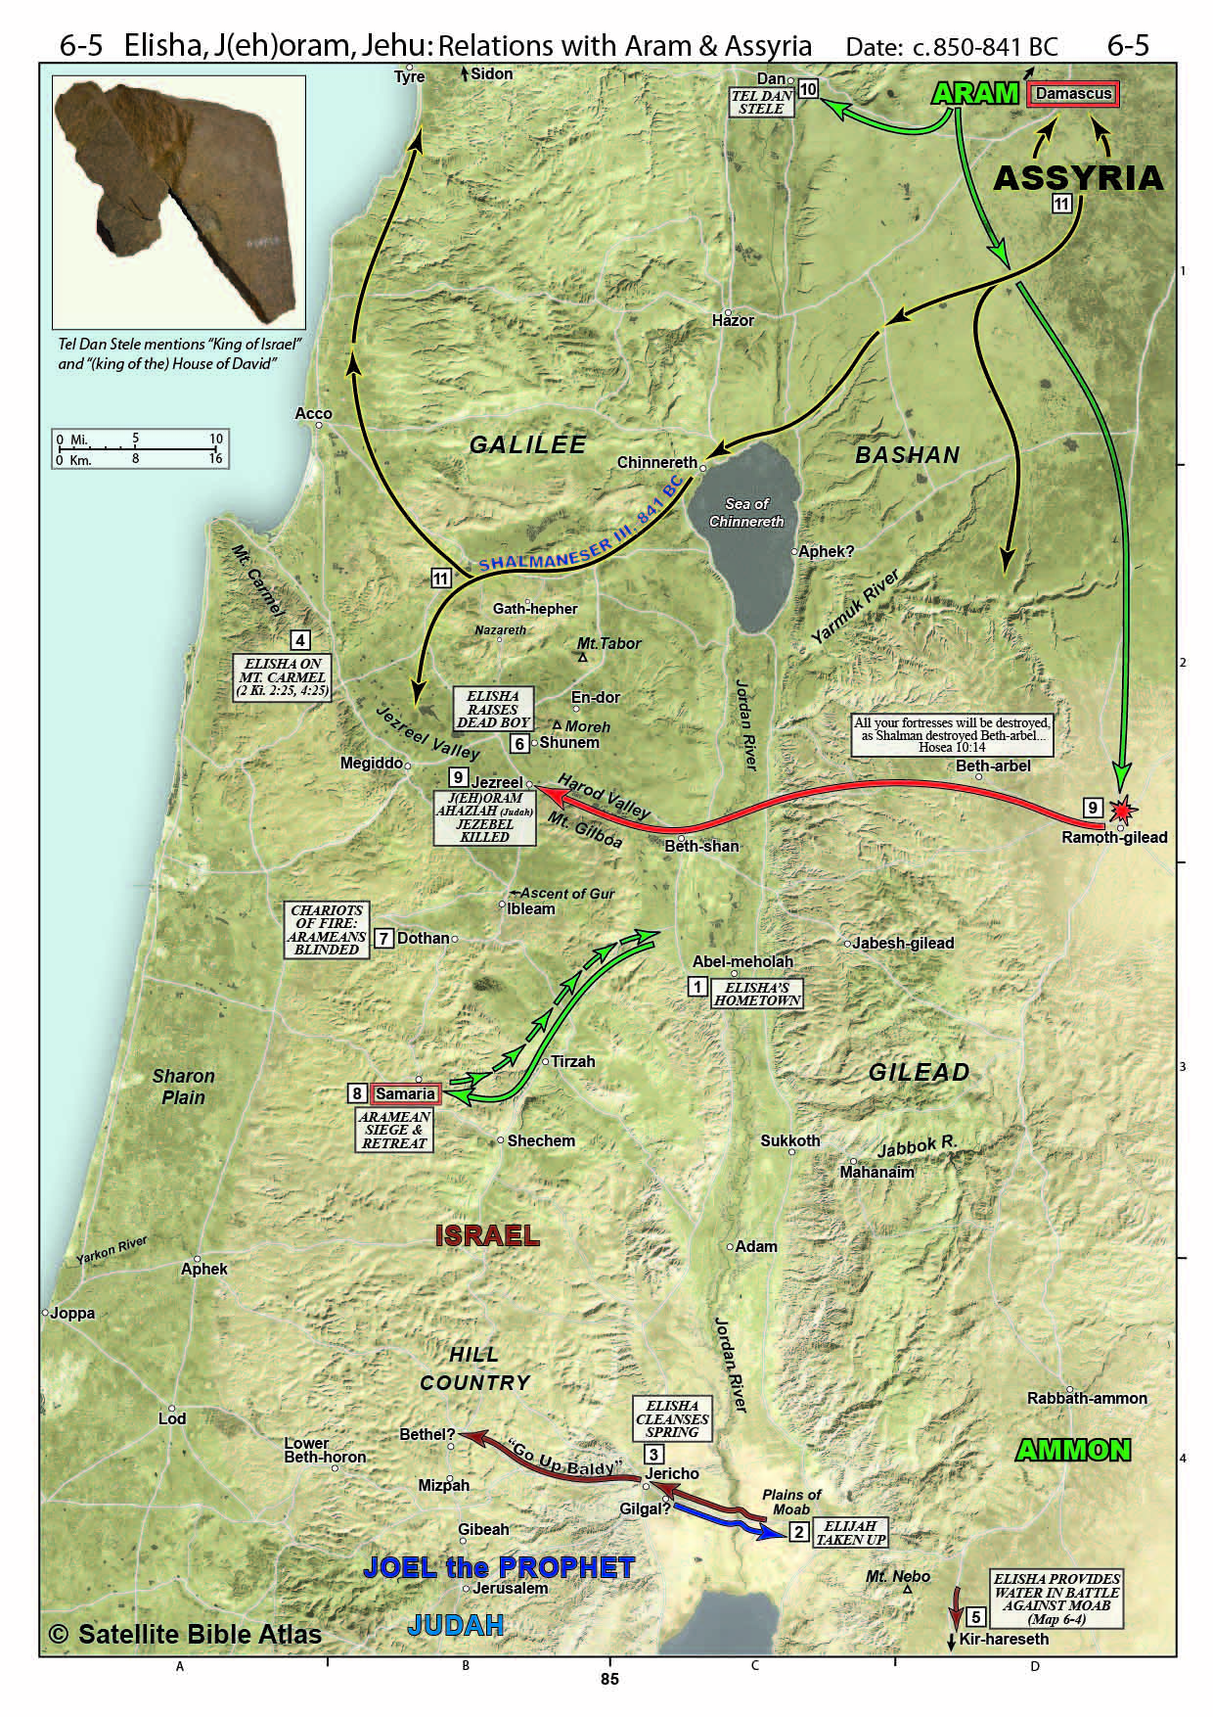
1. Transition 2 Kings 2:1-25
Elisha’s hometown
Elijah take to heaven – Elisha receives double portion of spirit
Purifies water in Jericho
Elisha curses 42 lads who are then torn up by two bears – on way to to Bethel
Mt Carmel

Slide 13
2. Jehoram’s Kingdom (3) 2 Kings 3:1-27
Evil like Jeroboam, but tore down pillar of Baal
Moab rebelled & he got Jehoshaphat & king of Edom to join him to attack Moab

Slide 14
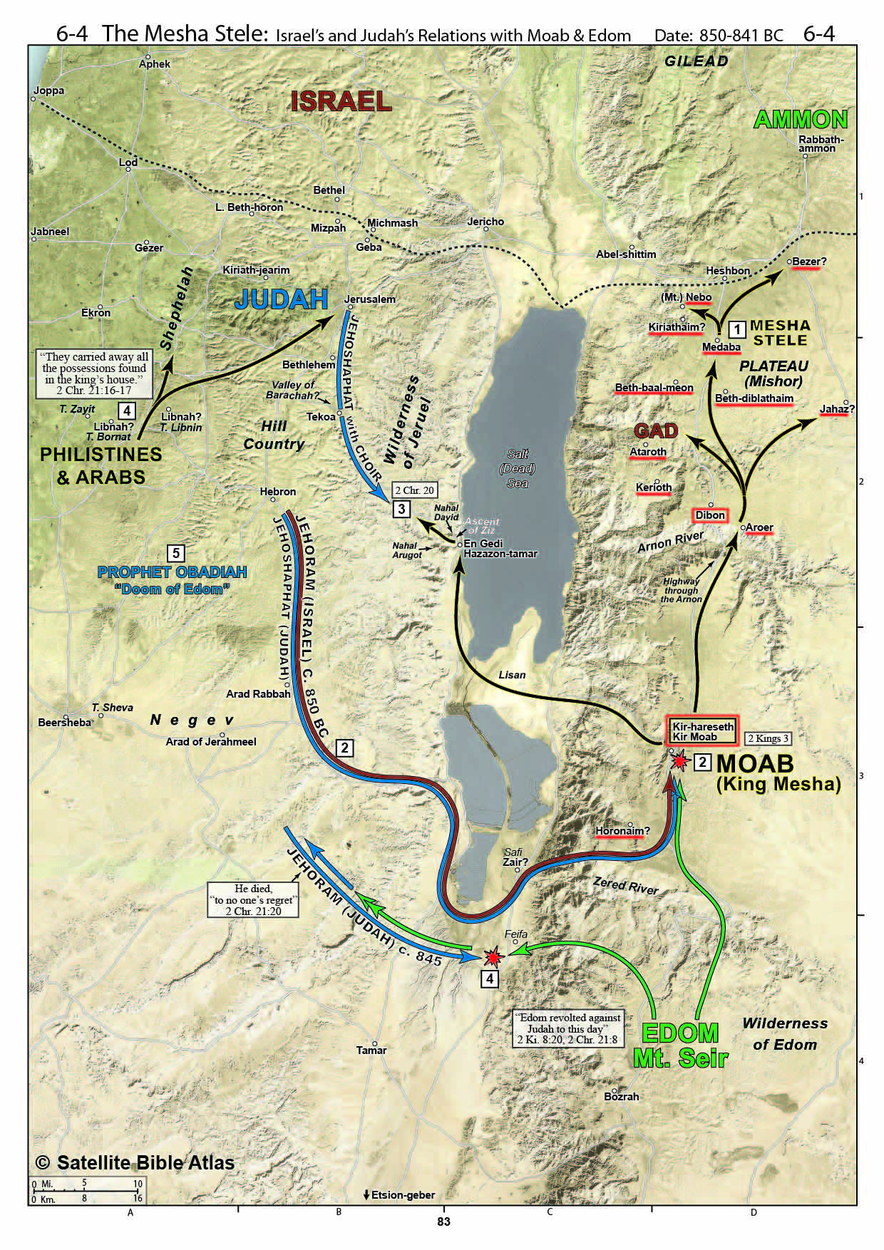
Moab expansion north
Israel, Judah & Edom alliance attack Moab
7 days in wilderness & run out of water
Elisha prophecies provision of water (upper Zered?) & destruction of Moab

Slide 15
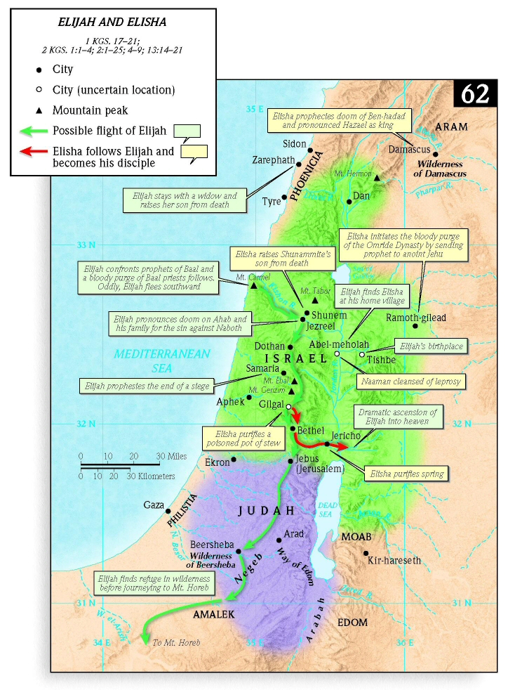
3. Miracles of Elisha 2 Kings 4 & 5
The Oil
The Shunammite’s Son
The Poisonous Stew (38-41)
The Bread (4:42-44)
Namaan’s Leprosy (5)

Slide 16
3. Miracles of Elisha 2 Kings 6 & 7
The Miracle of the Floating axe head
The Miracles of sight & blindness – (6:8-23)
The Miracle lifting the siege of Samaria (7)
Shunammite woman’s land restored (8:1-6)
Prophecy of Hazael’s future (8:7-15)

Slide 17
King of Judah Prophet
Jehoram 853-841 (8 yrs) Elishah
Evil - son-in-law to Ahab Obadiah
Edom revolts, he is unable to subjugate them
Ahaziah 841 (1 year), Elishah
Evil - grandson of Ahab Obadiah

Slide 18
Obadiah
Authors: Obadiah - His name means "Servant of Jehovah" .
Date: 850-841 B.C.
Time Period: Invasion (Revolt of Edom)
2 Kings 8:16-24, 2 Chronicles 21:1-20.
Contemporary: Elisha (reign of Jehoram)
Theme: “Doom upon Edom - The judgment of Edom and the restoration of Israel”
Notes:
The name occurs 19 times in the O.T. referring to 13 different people. This Obadiah may have been one of the officials sent out by Jehoshaphat to teach the law in the cities of Judah - 2 Chronicles 17:7
Early date is preferred: *No mention of the Chaldeans, the destruction of the city or temple, or the deportation of the all the people. *Those who are taken captive are taken to the Negev instead of east to Babylon (vs. 2). *Obadiah seems more parallel Amos, and Jeremiah quotes him in the same manner as he does Isaiah. *Finally, there are no Aramaic expressions

Slide 19
Obadiah - Outline
I The Coming Judgment of Edom 1:1-14
The Downfall (1-9)
The Cause (10-14)
II The Coming Day of the Lord 1:15-21
Judgment on Edom and the Heathen (15,16)
Future deliverance of Israel, 17-20
Ultimate Messianic kingdom, 21

Slide 20
I The Coming Judgment of Edom 1:1-14
The Downfall (1-9)
Nations called to destroy Edom (2)
Edom is arrogant & proud (3-4) (Petra)
A destruction that leaves nothing (5-6)
Allies will turn against her (7)
The Cause (10-14)
Violence against Jacob (10)
Gloated instead of helped (11-12)
Participated (13)
Persecuted (14)
Notes:
Vs. 10: Reason – Their violence
Result – “cut off forever” – near that under Maccabeans – completely fulfilled by 70 A.D.

Slide 21
II The Coming Day of the Lord 1:15-21
Judgment on Edom & Heathen (15-16)
It will be done to them as they have done
Future deliverance of Israel, 17-20
Some will escape – and the remnant will occupy their previous borders
Ultimate Messianic kingdom, 21
The theocratic kingdom will be restored
Notes:
Zaraepth is north near Tyre.
Sepharad is Spain

Slide 22
Usage of “The Day of the Lord”
The specific time of God’s judgment upon Israel and Judah.
God’s decisive judgment of Israel’s enemies
God’s universal judgment against all ungodly nations
The long time period from the Daniel’s 70th week to the eternal state.
Notes:
Zaraepth is north near Tyre.
Sepharad is Spain

Slide 23
Jehu’s Reign 2 Kings 9:30-10:36
Ahaziah joins Jehoram to take back territory – Jehoram wounded, goes to Jezreel
Jehu anointed king
Jehu kills Jezebell (dogs eat her),
Jehu destroys house of Ahab as prophesied
Jehu destroys priests, worshipers & house of Baal
Good to eliminate Baal worship, but walked in ways of Jeroboam

Slide 24
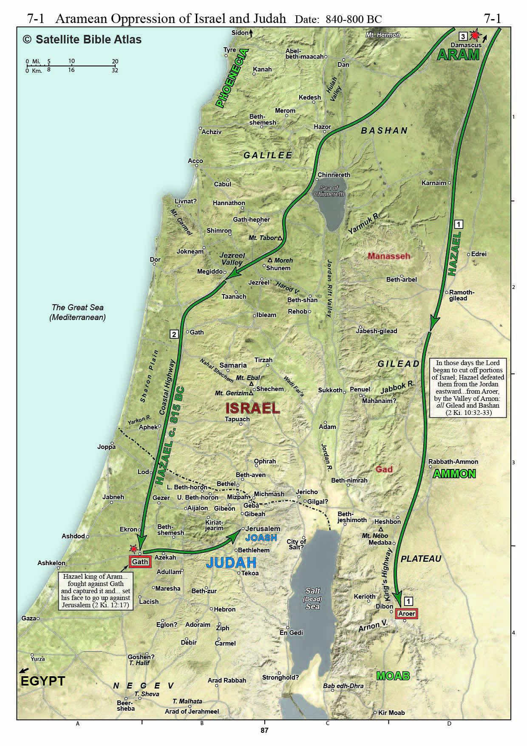
Hazael 2 Kings 10:28-32
After Jehu destroys Kings of Israel & Judah - Hazael conquers transjordan

Slide 25
Judah Prophet
Athaliah 841-835 (6 yrs) – Usurper Elishah
Evil, Daughter of Ahab, murderess Obadiah
Joash 835-796 (40 yrs) Joel
(son of Ahaziah) Jehoiada & son, Zechariah
Good, even repaired temple,
but evil after Jehoiada died

Slide 26
Hazael 2 Kings 11-13
After Joash turned from the Lord, Hazael conquered costal plain
Jehoahaz sought the Lord’s favor and was delivered – Assyria attacked Damascus (13:4-5)

Slide 27
King of Israel / Judah Prophet
Jehoahaz 814-798 (17 yr), Elisha
Inherited, Evil like Jeroboam
Sought God’s favor and the Lord delivered him
Jehoash 798-782 (16 yr) Elisha
Inherited, Evil like Jeroboam
Elisha dies – man thrown into his grave revives
Hazael dies, Israel regains territory
Amaziah 796-767 (29 yrs)
Good, but not like David, then evil

Slide 28
2 Kings 13-14
Before Elisha dies, he predicts Jehoash to defeat Aram 3 times
Amaziah defeats Edom
Amaiah provokes war with Israel & is defeated by Jehoash
Jeroboam II 793-753 (41 yr) Evil – restores border of Israel & extends NW

Slide 29
King of Israel Prophet
Jeroboam II 793-753 (41 yr) Jonah
Inherited, Amos
Evil like Jeroboam I Hosea
Zechariah 783-752 (6 mo) Hosea
Inherited, Evil like Jeroboam
Shallum 752 (1 mo) Hosea
Usurper, Evil like Jeroboam

Slide 30
King of Judah Prophet
Amaziah 796-767 (29 yrs)
Good, but not like David, then evil
Uzziah 790-740 (52 yrs), Azariah the priest
Good, then proud, then humbled
Jotham 750-731 (16 yrs) Isaiah
Good Micah
Ahaz 735-715 (16 yrs) Isaiah
Evil like kings of Israel Micah

Slide 31
Grace Bible Church Glorifying God by Making Disciples of Jesus Christ
For PDF class notes, go to
https://gracebibleny.org/old-testament-survey

