Slide 1
Grace Bible Church Glorifying God by Making Disciples of Jesus Christ
For PDF class notes, go to
https://gracebibleny.org/old-testament-survey

Slide 2
1 Kings
Authors: Jeremiah + (Talmud tradition) Written to those in exile.
Date: Written prior to 586 B.C.
Time Period: From David’s death to beginning of Ahaziah’s reign (971 - 851 B.C.)
Theme: “The historical development of the kingdom of God under the Davidic covenant - The welfare of the kingdom depends on covenant faithfulness of the king & the people.”

Slide 3
1 Kings - Outline
I The United Kingdom under Solomon
1 Kings 1-11
II The Divided kingdom
1 Kings 12 – 2 Kings 17
III The Kingdom of Judah, Hezekiah to its fall
2 Kings 18-25
Key People: Solomon, Jeroboam, Rehoboam, Jezebel, Ahab, Elijah

Slide 4
1 Kings Overview – Review of 1 & 2 Samuel
The people rejected the theocracy & cried out for a king to be like the other nations
A system of kings could at least force rudimentary obedience to the law
The main differences between Saul & David were repentance and humility
Good kings  godliness and blessings; Evil kings  to sin and curses

Slide 5
1 Kings Overview
1 & 2 Kings was one book in Hebrew text – “Kings” – divided in LXX (length of scroll?)
1 Kings begins with establishment and glorious reign of Solomon
It divides under Rehoboam and remains divided until captivity

Slide 6
Establishment of Solomon’s Reign 1 Kings 1-2
Solomon appointed king (1)
Adonijah attempts to become king (1-10)
Nathan & Bathsheba intervene (11-37)
David appoints Solomon as king (38-48)
Solomon spares Adonijah but warns him (49-53)
Notes:
Adonijah attempts to become king (1:1-10)
Nathan & Bathsheba intervene (1:11-37)
David appoints Solomon as king (1:38-48)
Solomon spares Adonijah but warns him (1:49-53)

Slide 7
Establishment of Solomon’s Reign 1 Kings 1-2
Solidification of Solomon’s Kingdom (2)
David’s Charge to Solomon (2:1-9)
David’s Death (2:10-11)
Solomon Begins Reign (2:12)
Solomon’s Enemies are Removed (2:13-36)
Notes:
Davd’s charge: 1) Walk with God, 2) Execute Joab, 3) Be kind to Barzillai, 4) Execute Shimei
David reigned for 40 years – 7 in Hebron, 33 in Jerusalem
Adonijah executed (13-25); Abiathar banished (26-27); Joab executed (28-35); Shimei executed (36-44)

Slide 8
The Growth of Solomon’s Kingdom 1 Kings 3-4
Solomon’s Request for Wisdom (3)
Solomon’s Dream & Prayer (3:1-9)
God’s Grant’s Solomon’s Prayer (3:10-15)
Solomon’s Wisdom (16-28)
Solomon’s Administration (4)
Solomon’s officials (4:1-19)
Solomon’s wealth, power & wisdom (4:20-34)
Notes:
Solomon prays for wisdom to lead the people. God grants him wisdom and riches and honor
Wisdom: discerning the true mother
Wealth: tribute from far and wide: Daily provision: 30 bushels of flower, 600 bushels of meal, 30 ox, 100 sheep + more 20-25
Power: 40,000 stalls for horses for chariots; 12,000 horsemen 26-28
Wisdom: wiser than all - 3,000 proverbs, 1, 005 songs, botany, zoology, world wide fame 29-34

Slide 9
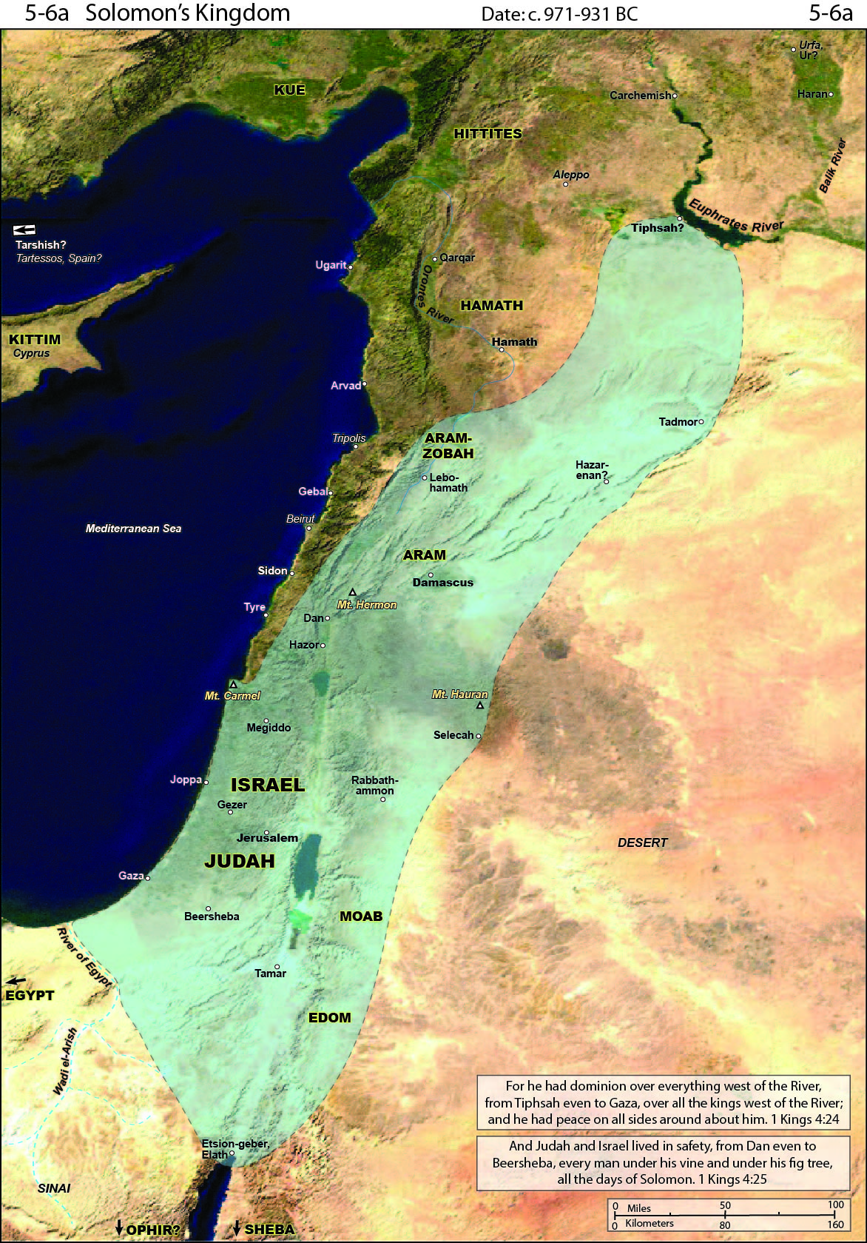

Slide 10
Construction of the Temple 1 Kings 5-8
Construction of the Temple (5-6)
Alliance with Hiram, king of Tyre (5:1-12)
Conscription of Laborers (5:13-18)
Temple Constructed (6:1-38)
Notes:
Sidonians brought timber: cedar & cypress
30,000 forced laborers, 70,000 transporters, 80,000 hewers of stone, 3,300 overseers

Slide 11
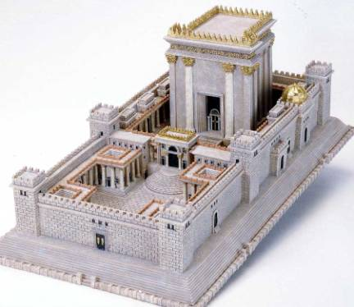

Slide 12
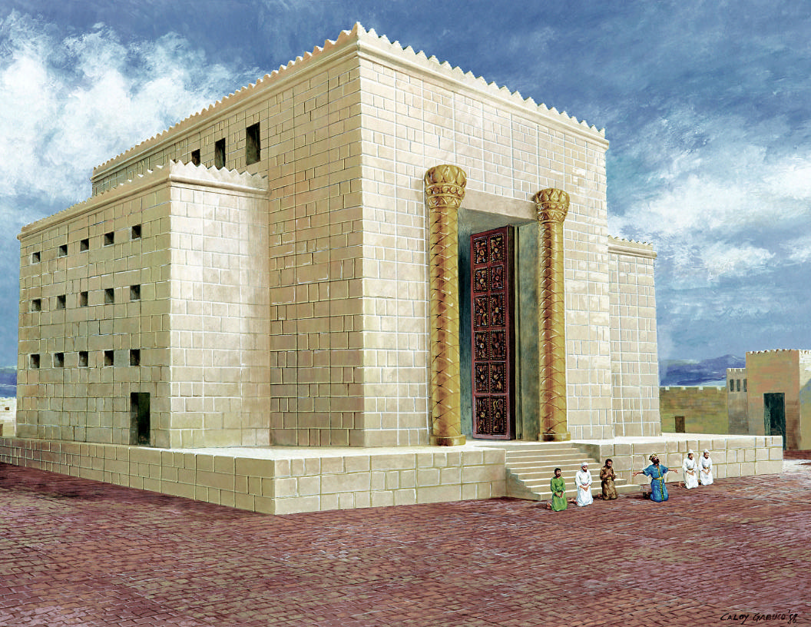

Slide 13
Construction of the Temple 1 Kings 5-8
Construction of Solomon’s Palace (7:1-12)
Furnishings of the Temple (7:13-51)
Dedication of the Temple (8)
Ark brought into the Temple (8:1-11)
Solomon address the people (8:12-21)
The Prayer of Dedication (8:22-53)
Charge to the people (8:54-61)
Dedicatory Sacrifices (8:62-66)
Notes:
Solomon’s palace – 30 X 50 cubits (45 X 75 ft ~ 3,375 sq ft / floor)
Hiram filled with wisdom & understanding to make all metal furnishings
Shekinah glory drove out priests once Ark brought in (8:10-11)
Petition – for God to hear and answer prayers prayed in and toward the Temple – 22-53
Charge – have hearts whole devoted to the Lord as witness to the world – 54-61
Sacrifice: 22,000 oxen, 120,000 sheep – feasting for 8 days – 62-66

Slide 17
The Decline of Solomon’s Kingdom 1 Kings 9-11
God Recounts the Covenant to Solomon (9:1-9)
Blessing if he keeps the covenant, curses if he does not
Notes:
God will bless if Solomon keeps the covenant, but will curse if he does not

Slide 18
The Decline of Solomon’s Kingdom 1 Kings 9-11
General Disobedience to the Covenant by Solomon (9:10-11:8)
a. Sale of Israelite Cities (9:10-14)
b. Enslavement of Canaanites (9:20-23)
c. Multiplication of Wealth (9:26- 10:25)
d. Multiplication of Horses (10:26-29)
e. Multiplication of Wives, Marriage with Foreign Wives (11:1-3)
f. Worship of Idols (11:4-8)
Notes:
Cities of Israel were not to be sold
Pharaoh captured Gezer and gave to Solomon as a wedding present (15-19)
Canaanites were to be destroyed, not enslaved
Multiplication of wealth, horses and wives against Deut. 17:14-17

Slide 19
The Decline of Solomon’s Kingdom 1 Kings 9-11
Chastening of Solomon (11:9-40)
The Lord would split the kingdom in the reign of Solomon’s Son (9-13)
The Lord sent adversaries against Solomon the rest of the days of his reign (14-40)
Notes:
Foreign wives turned Solomon to idolatry which resulted in chastening
Jeroboam appointed king of 10 tribes by prophet Ahijah (26-40)

Slide 20
The Kingdom Divides 1 Kings 12-14; 2 Chronicles 10-11
Rehoboam foolishly follows the counsel of his peers & is harsh to Israel, who then abandons him
The Lord made Jeroboam king – 1 Kings 11 & 12:15
Jeroboam was offered an enduring house if he obeyed the Lord (11:38), but he did not (12:25-33)

Slide 21
The Kingdom Divides 1 Kings 12-14; 2 Chronicles 10-11
Jeroboam set up altars at Bethel & Dan for false worship of the true God
A prophet predicted the destruction of the altar and that Josiah would desecrate it in the future (13:1-6)
About 300 years later, Josiah destroyed the altar just as had been prophesied (1 Kings 23)

Slide 22
Israel under Jeroboam

Slide 23
The Sacred Precinct at Dan

Slide 24
The Kingdom Divides 1 Kings 12-14; 2 Chronicles 10-11
The Lord would cut off Jeroboam and raise up another king.
All future kings of Israel would be compared to Jeroboam
Shishak (Egypt) conquers Judah & part of Israel (14:25-28)

Slide 26
The Kings of Israel
The Kingdom of Judah had both good kings and evil kings
All the kings of Israel were at least as evil as Jeroboam, some were much, much worse
The Lord sent prophets to warn the kings and the people about their sin and coming judgment

Slide 27
King of Judah Years of Reign, Prophet
King of Israel - Years of Reign,
(Total years) Moral nature
How he came to power
Rehoboam 931-913 (17 yrs), Evil
Jeroboam 931-910 (22 yrs) Ahijah
by the Lord; man of God
evil - set the standard
Nadab 910-909 (2 yr)
Inherited ; evil like Jeroboam
Abijam 913-911 (3 yrs), Evil

Slide 28
Baasha 909-886 (24 yr) Jehu
Usurper, evil like Jeroboam
Asa 911-870 (41 yrs) Hanani the seer
Good, like David, then proud

Slide 29
Elah 886-885 (2 yr)
Inherited, evil like Jeroboam
Zimri 885 (7 days), Usurper; Evil
Omri 885-874 (12 yr). Usurper,
More Evil than all before him
Ahab 874-853 (22 yr), Elijah
Inherited, Micaiah
More Evil than all before him The prophets

Slide 30
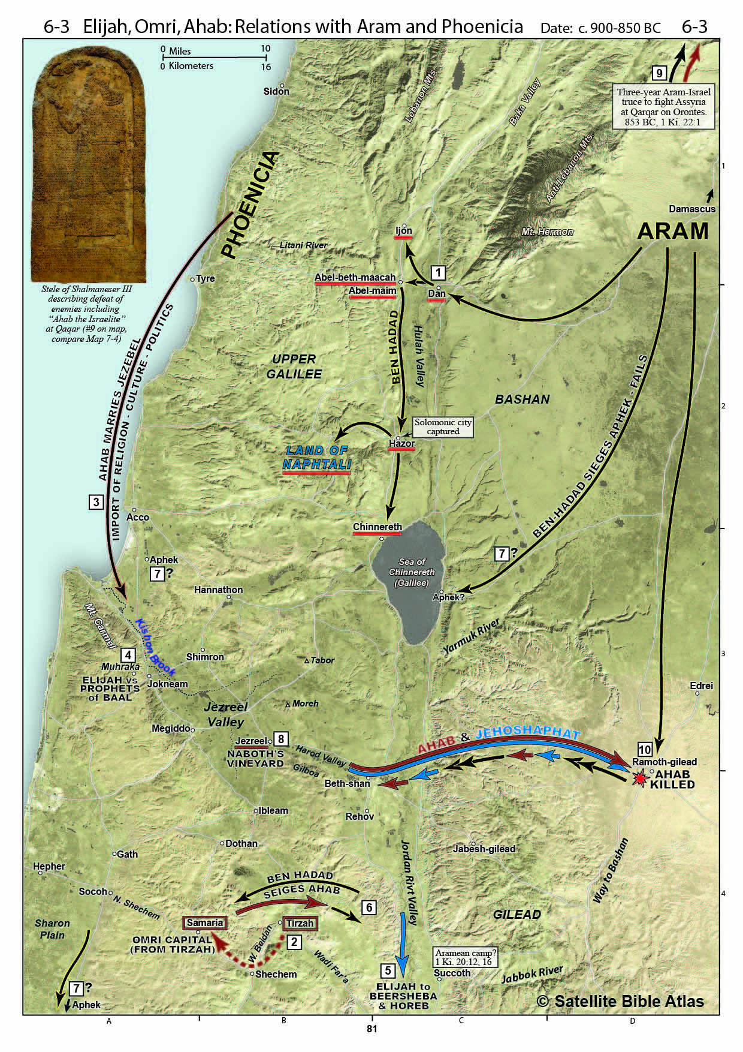
Miracles of Elijah
Drought – 17:1-7
Flour Bowl – 17:8-15
Resurrection of Widow’s Son – 17:16-24
Fire on Mt. Carmel – 18:1-40
Rain – 19:41-46

Slide 31
Failings of Elijah
– 1 Kings 19
Fled Jezebel – 19:1-8
Angels feed him, he goes to Horeb

Slide 32
Failings of Elijah – 1 Kings 19
Fled Jezebel – 19:1-8
Angels feed him, he goes to Horeb
Laments he alone is left– 19:9-14
Wind, earthquake, fire, gentle blowing
Instructions – 19:15-17
Anoint Hazael king of Aram;
Anoint Jehu king of Israel
7,000 left who have not bowed to Baal

Slide 33
Ahab – 1 Kings 20-22
Ahab’s wars with Aram – 20
Defeats Aram twice with small army to show that God is the LORD
Greed & Murder of Naboth – 21:1-16

Slide 34
Death of Ahab – 21:17-22:40
Judgment Predicted by Elijah (21:17-29)
Defeated by Syria (22:1-36)
Dies & is buried, dogs lick his blood in the chariot (22:37-40)

Slide 35
Jehoshaphat 873-848 (25 yrs) Micaiah
Good, like Asa, Jehu, son of Hanani
but had son marry Jahaziel, son of Zechariah
Ahab’s daughter Eliezer, son of Dodavahu
Ahaziah 853-852 (2 yr), Elijah
Inherited, Evil like Ahab & Jeroboam

Slide 36
Grace Bible Church Glorifying God by Making Disciples of Jesus Christ

