Slide 1
Grace Bible Church Glorifying God by Making Disciples of Jesus Christ

Slide 2
A reminder to consider others Please:
Turn off your cell phone or set to vibrate only
Turn off sound to all electronic devices
Use the nursery or cry room if your child is fussy
Get up during the preaching only if absolutely necessary (please sit in back if you must leave early)
Notes:
2

Slide 3
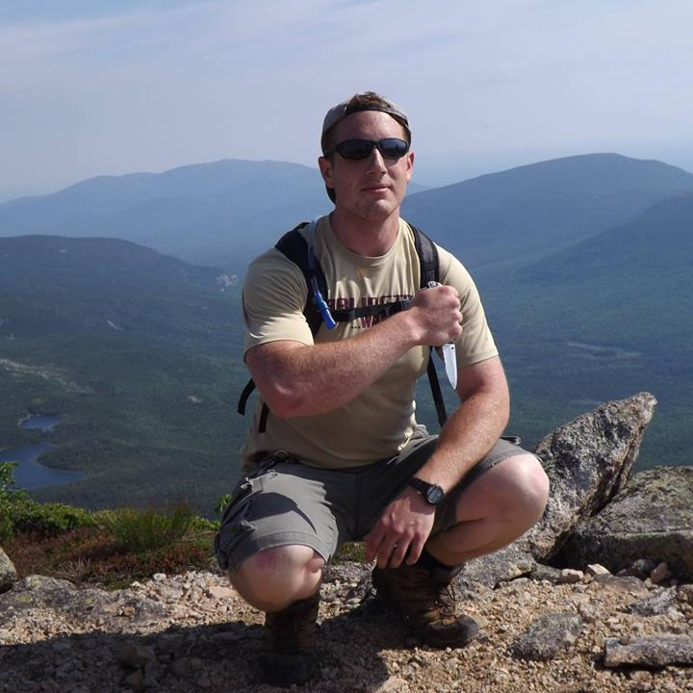
In Memory of Kenny Steier Son, Brother, Nephew, Friend, - A servant of the Lord Jesus Christ

Slide 4
The Opportunity of “Why?”
Asking why in the quest for truth begins a journey to understanding reality
It is permissible, even good, to ask questions of God – Habakkuk
The prophet did not understand how God’s plans fit with His character (1:13)

Slide 5
The Opportunity of “Why?”
He was striving to understand God, not challenging Him (2:1)
There is a huge difference between asking God questions & questioning God
It is blasphemous to accuse God of evil – Psalm 5:4

Slide 6
The Opportunity of “Why?”
We are gentle in correcting even those in opposition in hope God will grant them repentance – 2 Tim. 2:25-26
God welcomes those that will seek Him (Jeremiah 29:13)

Slide 7
The Patience of God
Romans 3:11
Psalm 86:15, 103:10
Acts 17:30-31
Humility & Repentance are the foundation for understanding the answer to the “why” questions.

Slide 8
The Patience of God
First, Be Thankful
Second, Be Humble

Slide 9
Why?
People are not as good as you think – Habakkuk 2
Romans 1:18
We must evaluate good and evil according to God’s standards, not our own

Slide 10
Why?
Tragedies occur because of the results of the activities and failures of individuals
We take God’s mercy for granted –
Do not presume on God’s merciful intervention and then blame Him if He chooses not to do so

Slide 11
Why?
People suffer because other people do sinful things – intentional or unintentional
God is not the author of evil – which is the antithesis of His very nature
We humbly consider if the tragedy is the result of someone else’s sin

Slide 12
Why?
We live in a fallen and sin cursed world
Many disasters occur because nature is taking its course in following the laws of physics
The Second Law of Thermodynamics – things corrode, rust and rot
We humble consider if it is due to the corruption of nature

Slide 13
Why?
Satan and demonic activity – the book of Job

Slide 14
Why?
God has judged people, nations, and even the entire world for their sins
We humble consider if it due to God’s hand of judgment

Slide 15
Why?
The Eternal Purposes of God
Seen in the life and death of Jesus
Exposed in the book of Job
Declared by Joseph – Genesis 50:20
Romans 8:28 – we humbly consider what good God may bring about

Slide 16
Faith Habakkuk 2:4; Romans 1:16
Because of God’s character, I can trust Him for what I do not know or understand
God’s perspective is vastly different from my own – Psalm 116:15, Matthew 5:11-12, John 16:33, etc.

Slide 17
Faith Habakkuk 2:4; Romans 1:16
I can ask God “why?”, but I also must request Him to reveal how He will glorify Himself that I might praise Him and draw closer to Him

Slide 18
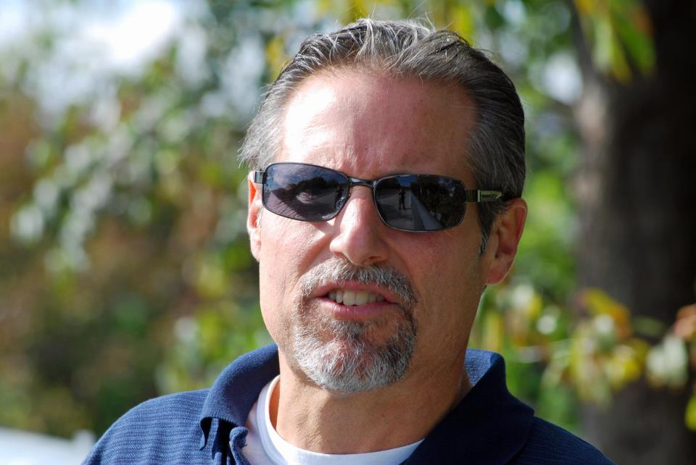
In Memory of Ray Marchetti Son, Husband, Father, Uncle, Friend A servant of the Lord Jesus Christ

Slide 19
In Memory of Kenny Steier Son, Brother, Nephew, Friend, - A servant of the Lord Jesus Christ

Slide 20
Grace Bible Church Glorifying God by Making Disciples of Jesus Christ

